Slide 1
ENGINEERING A PREVENTIVE MAINTENANCE PROGRAM

Slide 2
Elements
Selection of pavement sections
Design treatment
Preventive maintenance program
Quality control
Monitoring

Slide 3
Selection of Treatments
Pavement condition
  Environmental distress
  Roughness
  Skid resistance

Slide 4
Distresses in Asphalt Pavement

Slide 5
Types of Distresses
Fatigue cracking
Rutting
Thermal cracking
Block cracking
Roughness
Frost effect
Poor drainage effect
Water bleeding & pumping
Stripping
Raveling
Bleeding/flushing
Polished aggregate
Slickness
Shoving
Slippage Cracking
Depression
Reflection cracking
Etc.
Notes:
These are the common types of distresses. As we discussed before, distresses are not necessarily failure. When one or more distresses reaches an unacceptable condition, we call it failure.

Slide 6


Fatigue Cracking
Wheel load
HMA surface
Base
Subbase
Soil
Notes:
There are different types of cracking in flexible pavement. One of the common types of cracking is due to fatigue. When the load is applied the asphalt layer bends and tension is developed at the bottom of asphalt layer. When the load is removed the layer rebounds. When the bending and rebounding is repeated thousands of time cracks will start at the bottom of the layer and gradually propagate to the surface. It is like bending a paper clip several times. Eventually it will break.

Slide 7

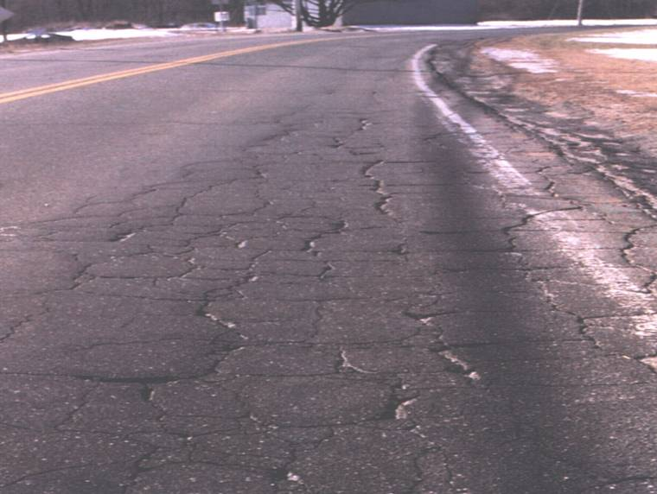
Early Stage of Fatigue Cracking
Advanced Stage of Fatigue Cracking
Notes:
Fatigue cracking starts with small cracks in the wheel paths. Later, alligator cracks are developed as shown here. This is a structural type distress.

Slide 8
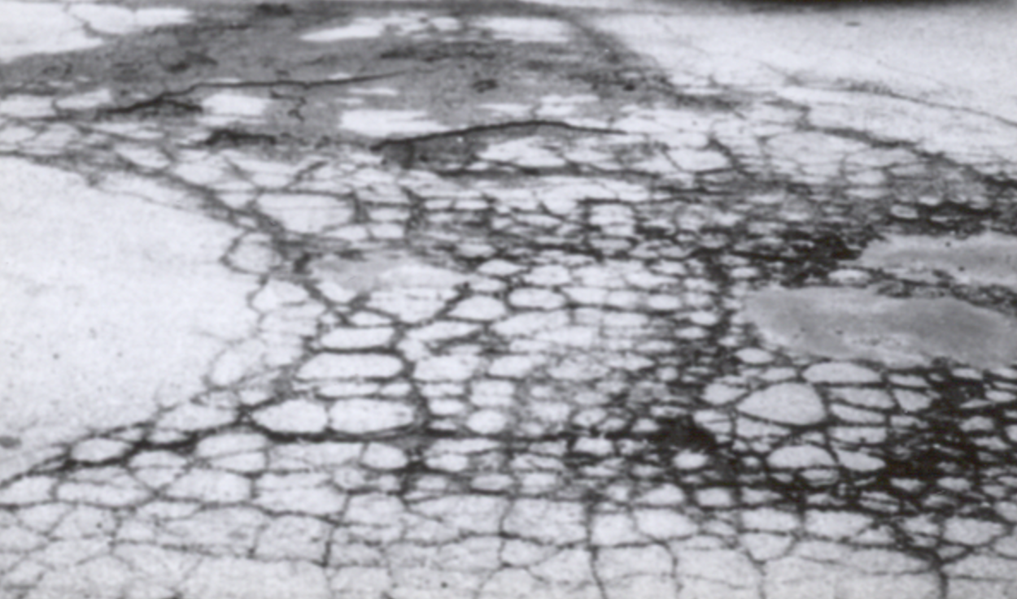
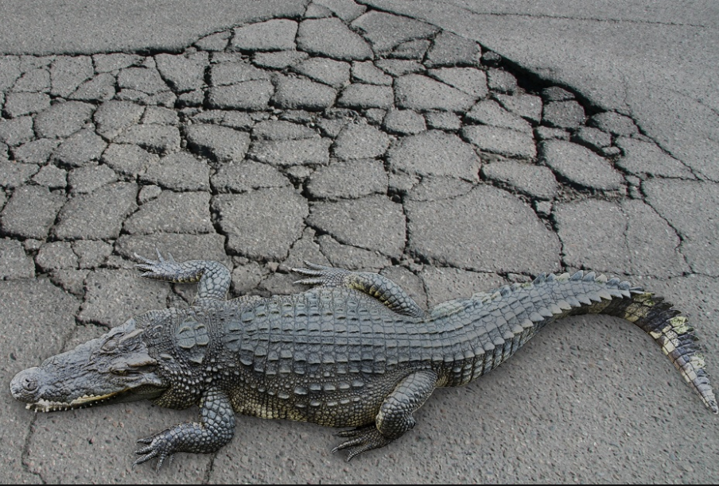
Fatigue
Cracking

Slide 9
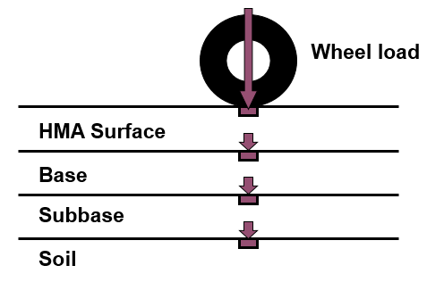
Rutting (Permanent Deformation)
Notes:
When the wheel load is applied deformation occurs in all layers. When the load is removed most of the deformation is rebound. However, a small deformation remains permanently. This permanent deformation accumulates with the continuous load repetitions. This means that rutting that appears at the pavement surface could be developed from any layer of the pavement.

Slide 10
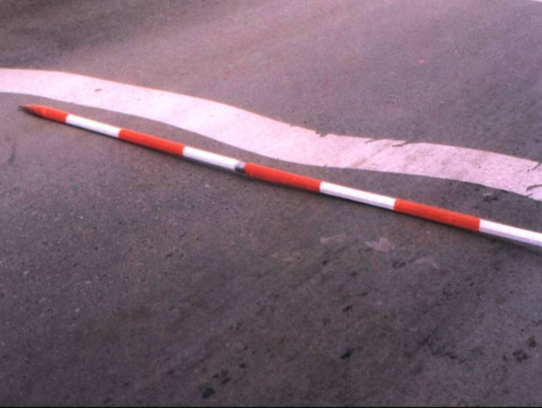

Rutting
Notes:
Permanent deformation (rutting) occurs in the wheel path.

Slide 11
Rutting Reasons
Unstable HMA
Poor Compaction During Construction
Poor Subgrade
Notes:
This slide shows the surface layer for three types of rutting. The first case shows rutting in the wheel path and shoving outside of the wheel path, which indicates that the surface layer is unstable. Instability of HMA could be due to too much asphalt in the mix, too soft asphalt for that region, rounded aggregate, and/or too many fines. The second case shows rutting at the surface, but no deformation at the bottom of the layer. This means that the compaction during construction was not enough and the traffic produced further compaction. The third case shows that the HMA layer thickness is essentially the same and permanent deformation occurred in the subgrade.

Slide 12
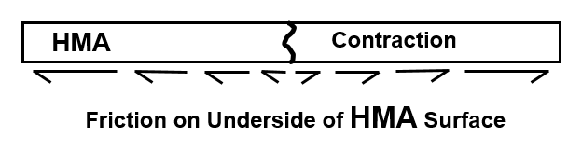
Thermal Cracking
Notes:
Thermal (low temperature) cracking is always in the lateral direction. When the temperature decreases in the winter while the layer is not free to move because of friction, tension develops in the HMA layer. When the tensile stress exceeds the tensile strength, the material will crack.

Slide 13
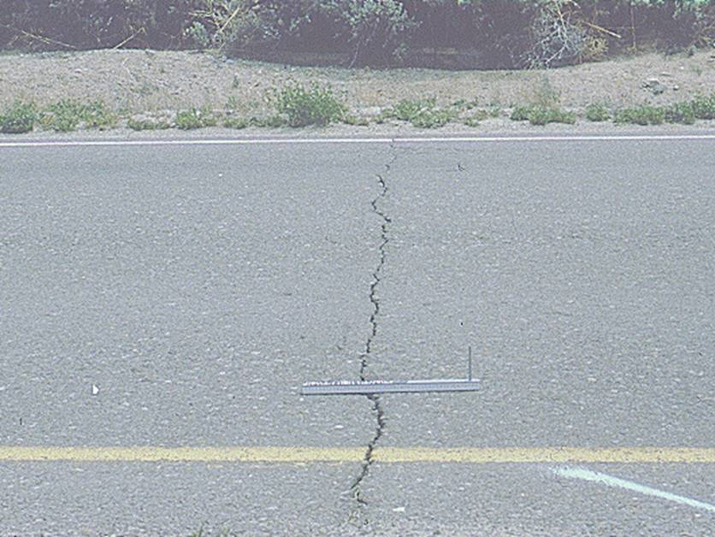

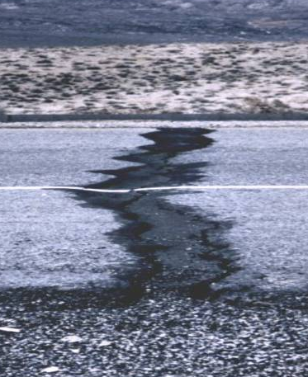
Thermal Cracking
Notes:
These are some examples of thermal cracking. Thermal cracking usually occurs at equal intervals between 20-40 ft. Sometimes the crack width increases every year as shown the bottom right picture and sometimes it is referred as durability cracking.

Slide 14

Block Cracking
Notes:
This is a third type of cracking referred to as block cracking. It occurs mostly due to HMA aging.

Slide 15

Roughness

Slide 16
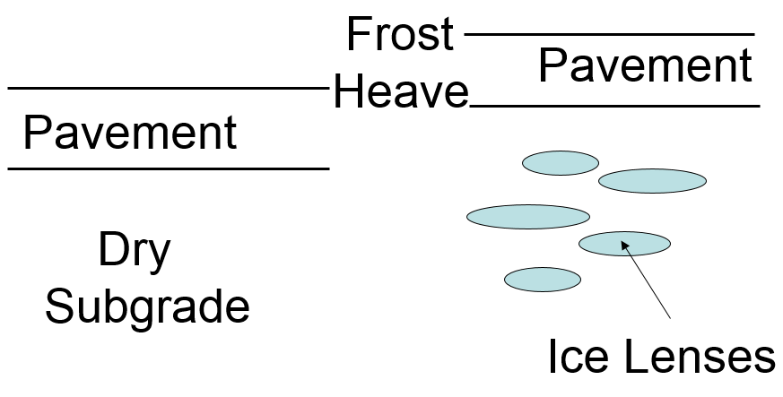
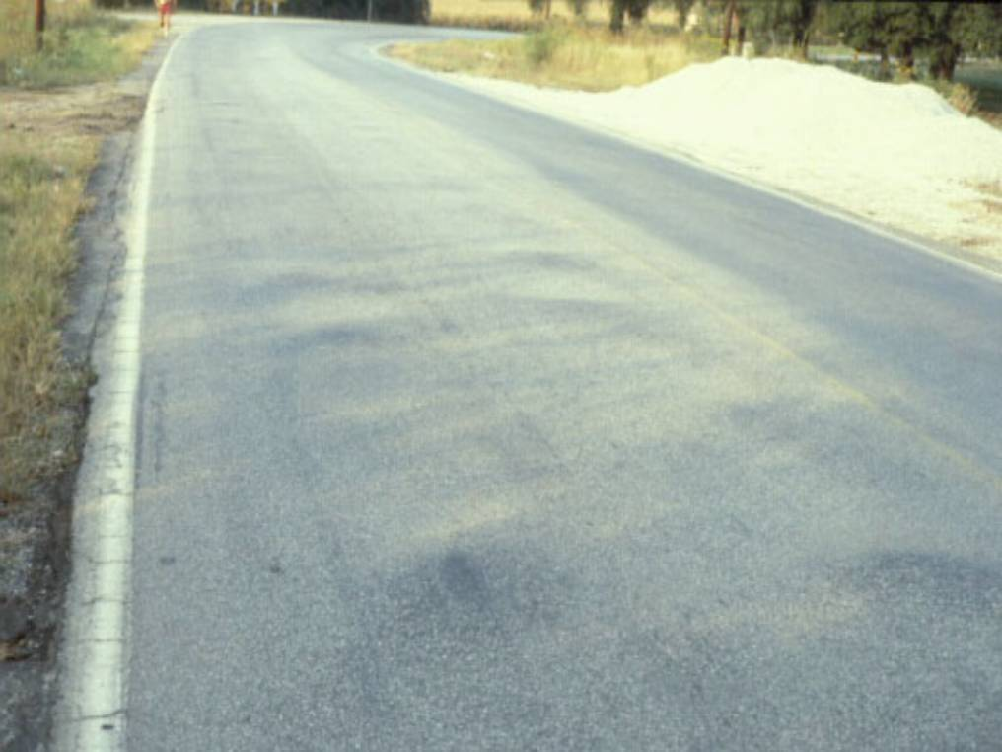
Frost Effect
Frost Heave
Notes:
When the subgrade is wet and the temperature drops below freezing, ice lenses are formed. Since the volume of ice is higher than the volume of water, frost heave occurs as shown. When the cycles of freeze and thaw are repeated many times in the season cracking and potholes are developed as shown.

Slide 17
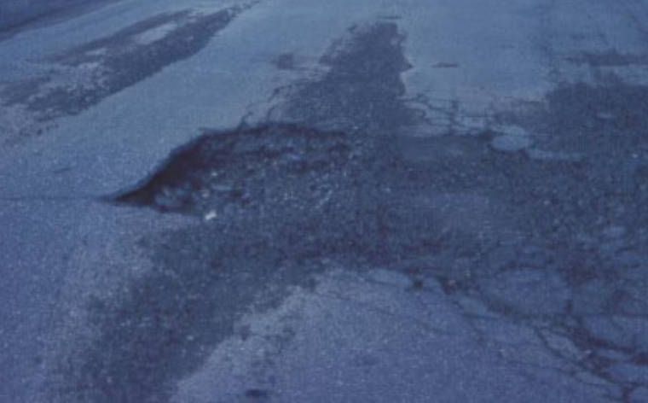
Poor
Drainage

Slide 18
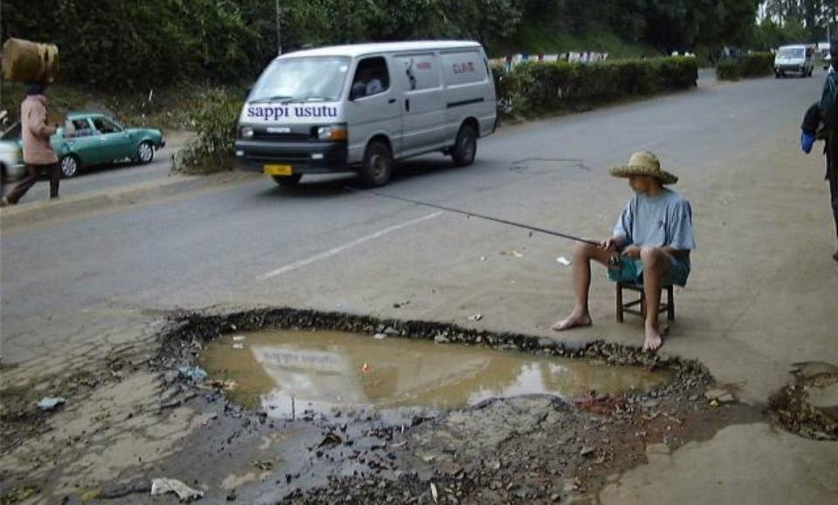
Notes:
Comic slide.

Slide 19

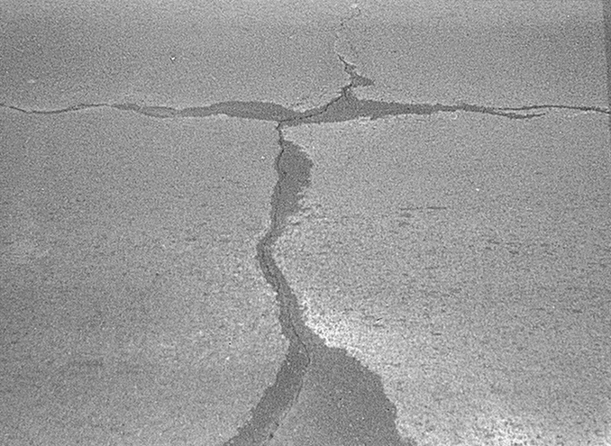
Water Bleeding & Pumping
Depression due to Pumping
Notes:
Water may bleed and pump through the crack. Also, depression (cupping deformation) may develop at the crack due to pumping of fines through the crack.

Slide 20

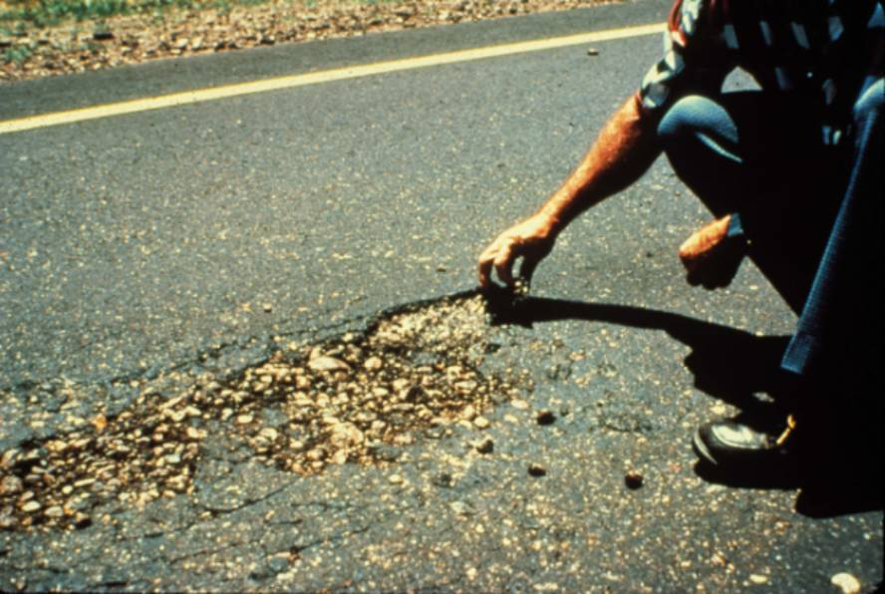
Stripping
Separation of bitumen from aggregate
Notes:
If the aggregate is hydrophilic (water loving), it is attacked to water more than asphalt. In this case, the bond between aggregate and asphalt is lost and aggregate particles are stripped.

Slide 21
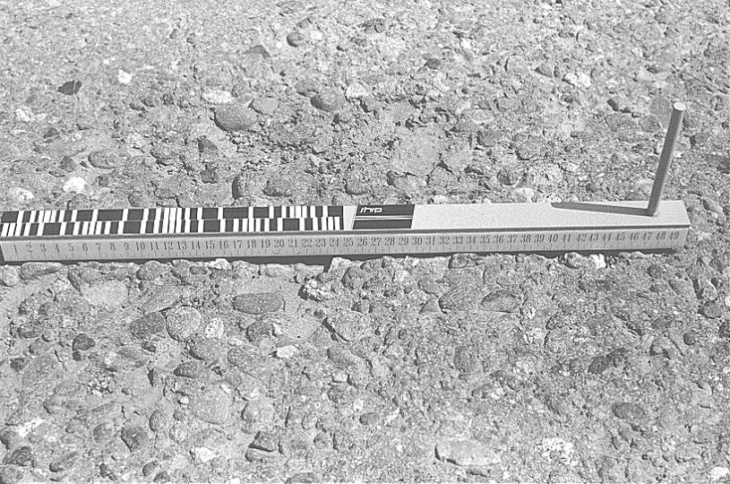
Raveling
Notes:
Raveling is mostly due to aging.

Slide 22

Notes:
Comic slide.

Slide 23

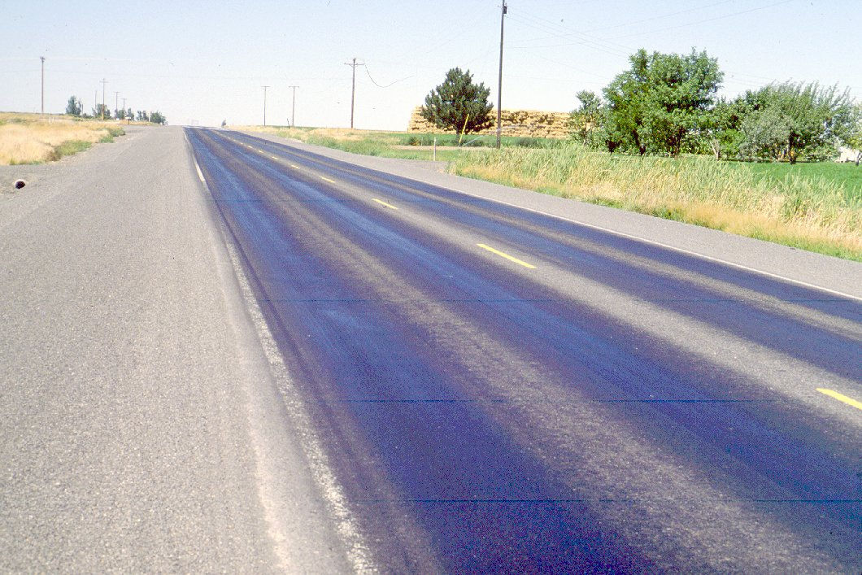
Bleeding/
Flushing
Notes:
Bleeding occurs due to too much asphalt in the HMA, which is squeezed between aggregate particles and migrates to the surface. Bleeding may result in skidding when pavement is wet and possible hydroplaning.

Slide 24
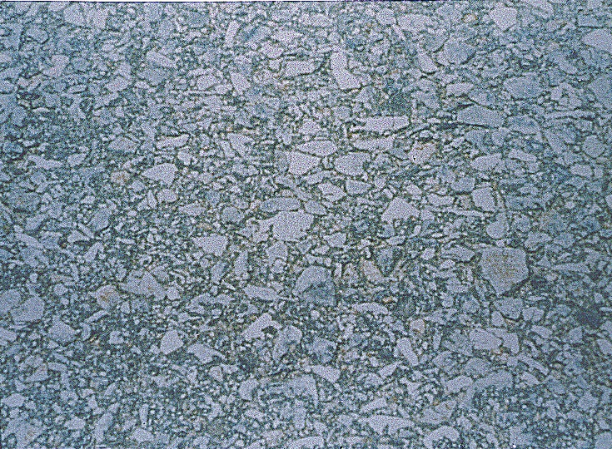
Polished Aggregate
Notes:
Aggregate may get polished because of its low abrasion resistance. Polished aggregate may result in skidding when pavement is wet and possible hydroplaning.

Slide 25
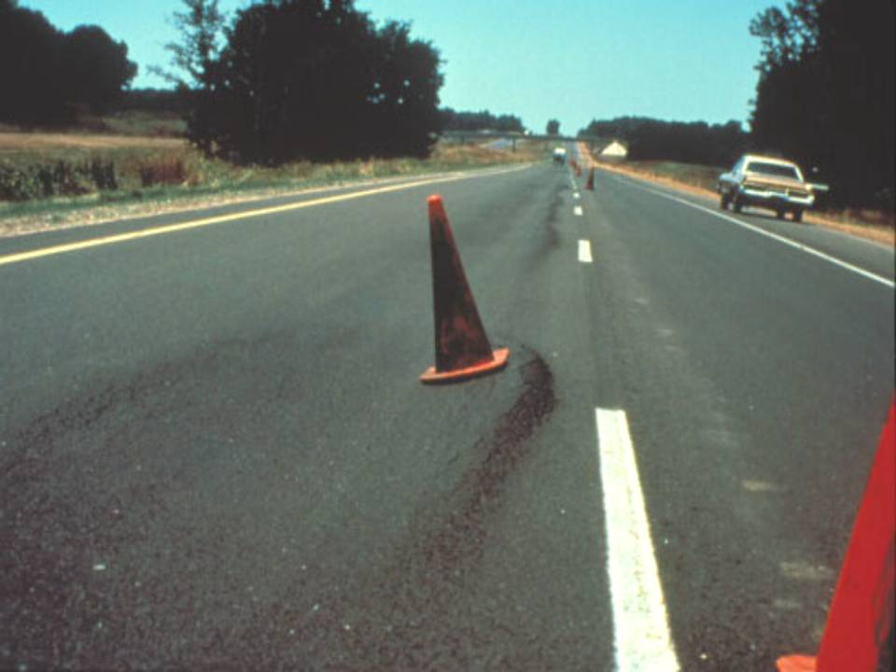
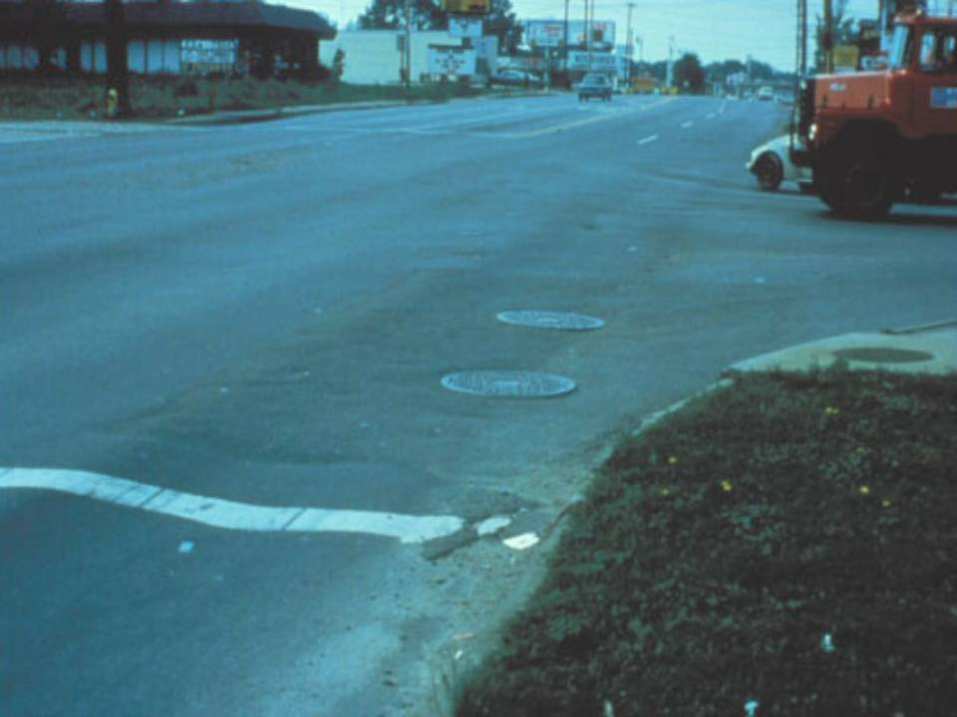
Shoving
Shoving at Intersections
Notes:
Shoving occurs because of the instability of HMA. Instability of HMA could be due to too much asphalt in the mix, too soft asphalt for that region, rounded aggregate, and/or too many fines.

Slide 26

Shoving

Slide 27


Slippage Cracking
  Poor bond between layers
  Unstable HMA

Slide 28
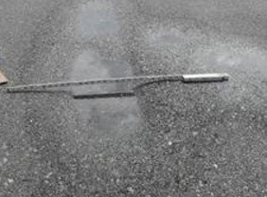
Depression

Slide 29
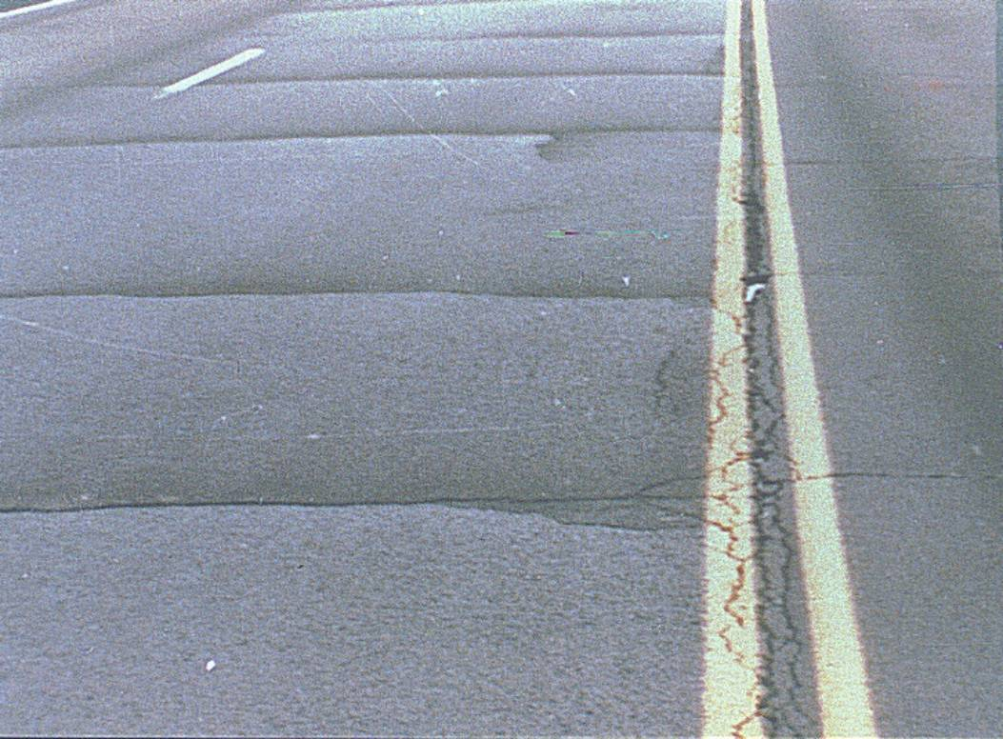
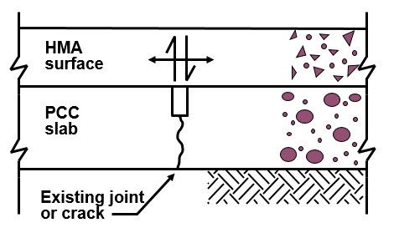
Reflective Cracking
Notes:
If a jointed or cracked concrete pavement is overlaid with an asphalt layer, joints or cracks might reflect on the overlay. Same thing occurs if a cracked asphalt pavement is overlaid with asphalt overlay. This occurs because of the horizontal and vertical movements of the joints or cracks, which results in stress concentrations at the bottom of overlay and development of reflected cracks.

Slide 30
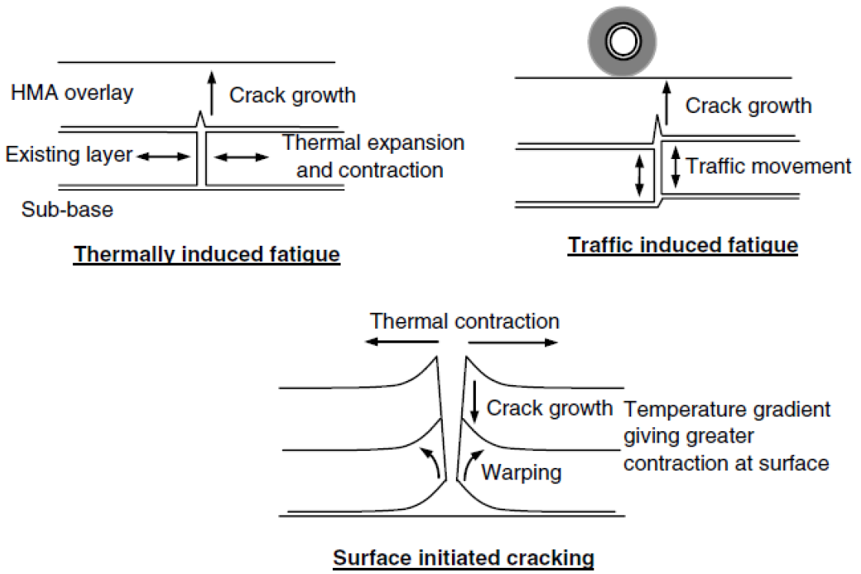
Reflective Cracking Mechanism

Slide 31
Combination of Distresses
Combine treatments to repair all distresses
Curing between treatments

Slide 32
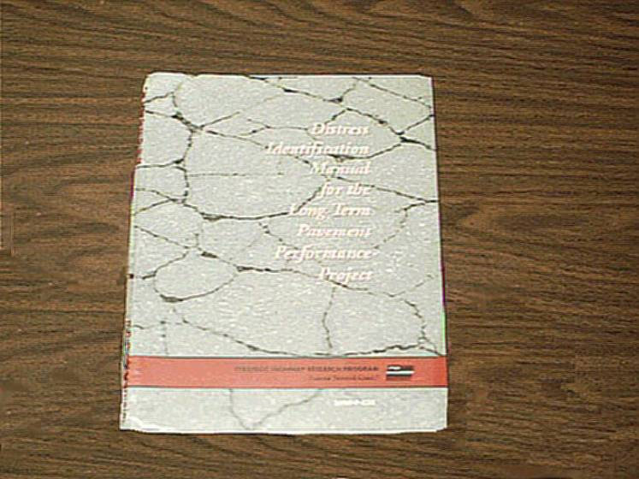
Distress Identification Manual

Slide 33
Preventive Maintenance
Preventive maintenance is not structural
Durability is key
Durability is related to treatment selection, material selection and proper construction

Slide 34
Environment
Preventive maintenance is effective for correcting environmental distress
    Prevents water intrusion
    Renews the surface

Slide 35
Construction Considerations
Speed of construction
Life of the treatment

Slide 36
Treatment Design
No structural design
Material selection
  Aggregate characteristics
  Binder
  Quantities
Specifications

Slide 37
How effective are these treatments?
It depends on pavement condition
The better the condition before the treatment, the more effective the treatment is.
It varies with the type of treatment

Slide 38
Chip Seal
Extent of Problem
Distress Type
Minor
Major
Fatigue Cracking
Linear / Block Cracking
“Stable” Rutting
Raveling
Flushing/Bleeding
Roughness
Friction Loss
Moisture Damage
Shoving
Effective
Marginal
No Impact

Slide 39
Microsurfacing
Extent of Problem
Distress Type
Minor
Major
Fatigue Cracking
Linear / Block Cracking
“Stable” Rutting
Raveling
Flushing/Bleeding
Roughness
Friction Loss
Moisture Damage
Shoving
Effective
Marginal
No Impact

Slide 40
Milling with Thin HMA Overlay
Extent of Problem
Distress Type
Minor
Major
Fatigue Cracking
Linear / Block Cracking
“Stable” Rutting
Raveling
Flushing/Bleeding
Roughness
Friction Loss
Moisture Damage
Shoving
Effective
Marginal
No Impact

Slide 41
Ultrathin Bonded Wearing Course (Novachip)
Extent of Problem
Distress Type
Minor
Major
Fatigue Cracking
Linear / Block Cracking
“Stable” Rutting
Raveling
Flushing/Bleeding
Roughness
Friction Loss
Moisture Damage
Shoving
Effective
Marginal
No Impact

Slide 42
Cold & Hot In-Place Recycling
Extent of Problem
Distress Type
Minor
Major
Fatigue Cracking
Linear / Block Cracking
“Stable” Rutting
Raveling
Flushing/Bleeding
Roughness
Friction Loss
Moisture Damage
Shoving
Effective
Marginal
No Impact

Slide 43
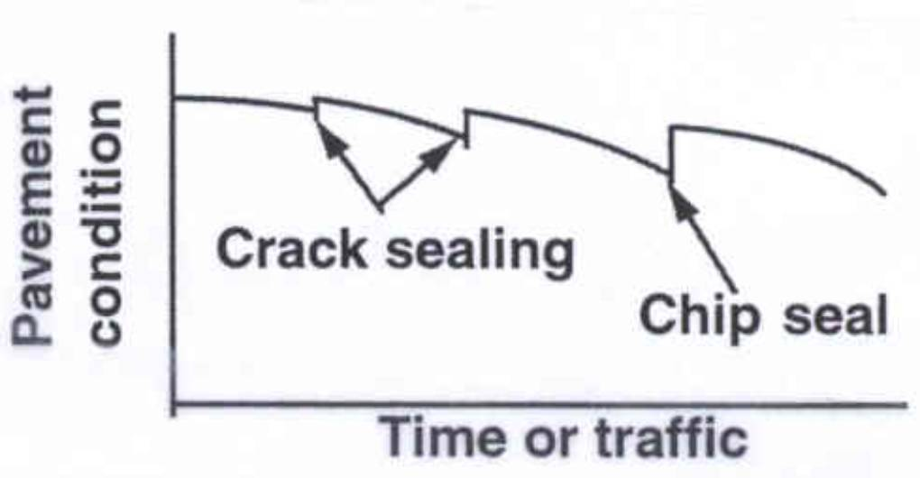
Periodic Applications
Pavement
Condition
Crack sealing
Chip seal
Time or traffic

Slide 44
Quality Control
Method or Recipe Specification (Past)
End Result (Quasi-Present)
Quality Assurance (Present)
Performance Based (Future?)

Slide 45
1. Method or Recipe Specification (Past)
VILLAGE
COUNTY
STATE
CITY
Department of Transportation Library

Slide 46
Method Specification (continued)
Agency defines means and methods for performing work
Split responsibility
  Contractor
  Agency

Slide 47
2. End Result Specifications
Agency defines required properties
Contractor controls process to achieve properties
Responsibility is contractor’s

Slide 48
3. Quality Assurance Specifications
Separates responsibility for process control and product acceptance
Ensures that inspection
plays an essential role
QC
Plan

Slide 49
4. Performance Based Specifications
Contractor warranties performance for a specified period of time
Contractor controls design, materials, and construction

Slide 50
Monitoring Performance
Collect
Store
Analyze
Notes:
Monitoring the long-term performance of maintenance treatments is essential for sustaining a preventive maintenance program for the long haul. This step should not be ignored once the program has been implemented.
Early analysis is important; an agency could continue bad practice for years if there is no proof that the treatment is not performing as expected. Due to the relatively short service lives with respect to new pavement design and rehabilitation, early analysis will also be more meaningful.

Slide 51
Monitoring Performance
New applications of existing methods
Application of emerging technology
Need to evaluate cost-effectiveness

