Slide 1
Pavement Preservation - Benefit, Timing & Practice
Mike Mamlouk, ASU
Mo Rahman, Ergon Asphalt
Rob Duvall, City of Phoenix
Bob Erdman, Cutler Repaving
Larry Scofield, Am Conc Pvmt Assn

Slide 2
Objectives
Concept of preventive maintenance
Selection of most cost-effective maintenance treatment
Maintenance materials
Maintenance treatments for both asphalt and concrete pavements

Slide 3
Topic | Time
The Case for Preventive Maintenance | 8:00-9:00
Engineering a Preventive maintenance Program | 9:00-9:30
Break | 9:30-9:45
Maintenance Materials | 9:45-10:30
Crack Treatments for Flexible Pavements | 10:30-11:00
Break | 11:00-11:15
Fog Seal and Rejuvenators | 11:15-11:30
Chip Seal | 11:30-12:00
Lunch | 12:00-12:45
Chip Seal (Continued) | 12:45-1:15
Slurry seal and Microsurfacing | 1:15 – 2:15
Break | 2:15 – 2:30
Thin Overlays (Conventional, Asphalt Rubber, UBWC | 2:30 – 3:00
Recycling (Types, Hot In-Place Recycling) | 3:00 – 3:15
Concrete Pavement Preservation (Seal & Reseal, Diamond Grinding, Full & Partial Depth Repair) | 3:15 – 4:00

Slide 4
Preventive Maintenance

Slide 5
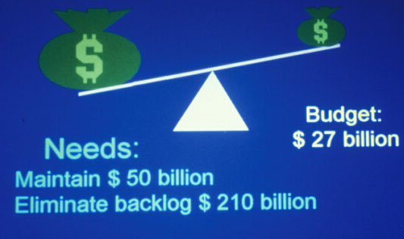
Typically
Low Budget
High Needs
Preventive Maintenance Could be the Answer
Not enough to maintain current conditions
Not enough to eliminate backlog
Notes:
In any agency (including ADOT), the typical budget is less than the amount of money needed to maintain the current road condition. Obviously, it is not enough to eliminate the backlog and upgrade the all roads to a good or very good condition.
This clearly shows that if we keep using the same approach in maintaining roads, the road condition will get worse. This shows the urgent need to use preventive maintenance.

Slide 6
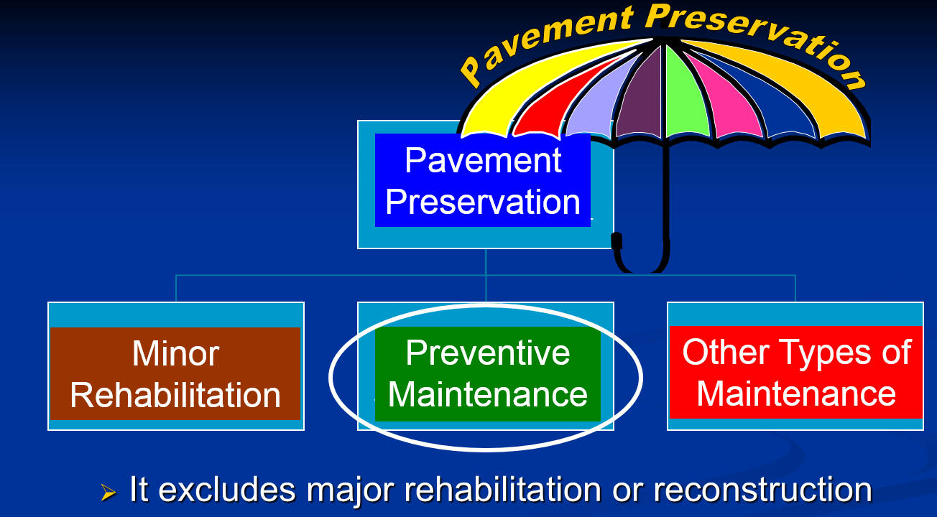

Slide 7
What is Preventive Maintenance?
A program strategy to:
  arrest light deterioration
  retard progressive failures
  reduce the need for routine maintenance and service activities

Slide 8
Objective of Preventive Maintenance
Keep the pavement condition above a level that would require corrective maintenance or other strategies

Slide 9
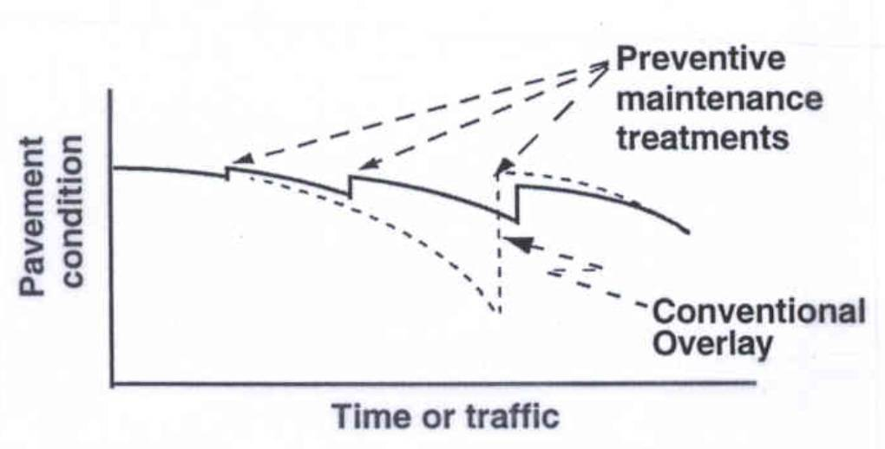
Preventive Maintenance

Slide 10
Treatments for Asphalt Pavements
Crack treatment
Fog seal
Chip seal
Cape seal
Slurry seal and Microsurfacing
Ultrathin bonded wearing course (Novachip)
Thin hot-mix overlay
Recucling

Slide 11
Treatments for Concrete Pavements
Seal & Reseal
Diamond Grinding
Full & Partial Depth Repair

Slide 12
Maintenance Treatments
Have been historically used on low-volume roads in rural areas
With improved materials and processes are now being used on higher volume roads
Relatively low costs

Slide 13
When should a pavement preventive maintenance treatment be applied?

Slide 14
How much oil should a car burn before changing oil?

Slide 15
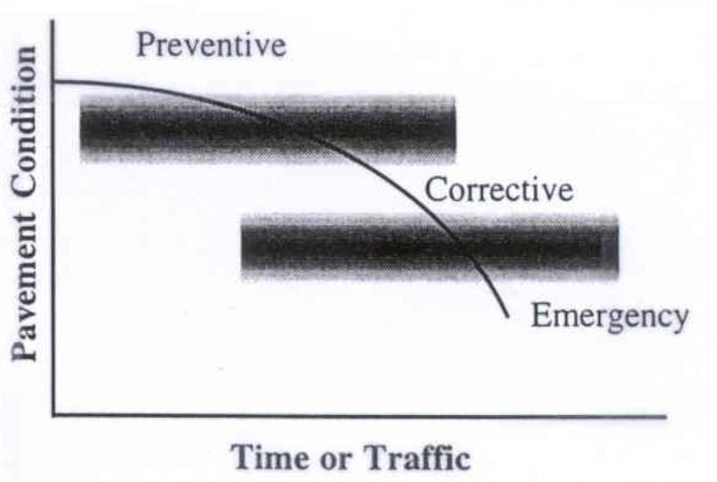
Maintenance Types
Preventive
Pavement Condition
Corrective
Emergency
Time or Traffic

Slide 16
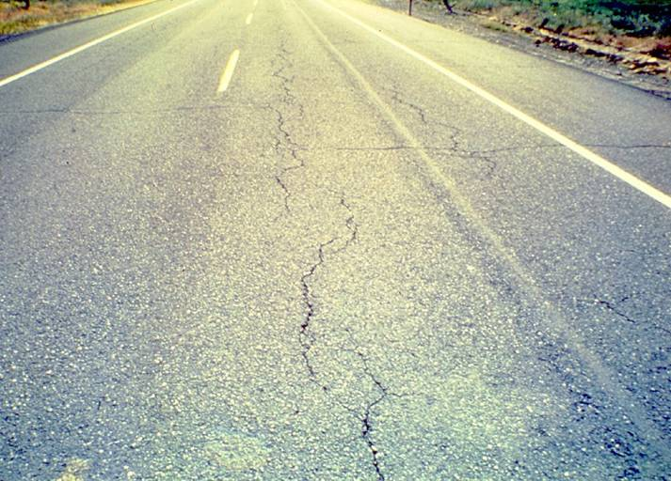
Candidate for PM?
Notes:
This HMA pavement is showing some significant fatigue cracking in the wheel paths. Is this pavement a good candidate? This pavement is not a good candidate for preventive maintenance as it is experiencing what appear to be “significant” structural failures. Significant structural failures exclude pavements from consideration for preventive maintenance as they clearly indicate that the preventive maintenance “window of opportunity” has passed.

Slide 17

Candidate for PM?
Notes:
This pavement is showing significant rutting in the wheel paths. Is this pavement a good candidate? This pavement is not a good candidate for preventive maintenance as it is experiencing what appear to be “unstable HMA.”

Slide 18
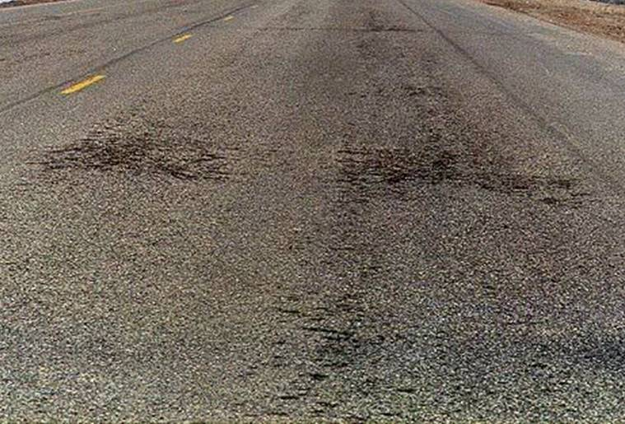
Candidate for PM?
Minor surface defect
No structural damage
Notes:
The only distress that this HMA pavement is showing is raveling (some areas are quite significant). Is this pavement a good candidate for preventive maintenance?
“Yes,” this pavement is most likely a good candidate for preventive maintenance. Raveling is a distress that can be addressed (as well as prevented) with different preventive maintenance techniques. Although this pavements functional performance will currently benefit from the application of a PM treatment, ideally it should have received a PM treatment before it was allowed to deteriorate to this condition (a true preventive application).

Slide 19
“Good Candidates” for PM
  No structural damage
  Minimal distress (extent & severity)
  Relatively young in age
  Few historical problems with similar projects
Estimate pavement condition and future performance!
Notes:
What do you need to know to determine if a particular project is a good candidate for PM? What are the characteristics of pavements that you would consider “good” candidates for preventive maintenance? What do we need to know to make this decision? (Ask the audience for some help in determining a list of items. Some examples of pavement characteristics are shown on this slide. Possibly make a list on a white board).
After a list of pavement characteristics has been determined, try and get the audience to interpret these characteristics and really focus in on what we need to know to determine if a pavement is a good candidate for PM.
We really need to know two things to make an educated decision about whether or not a given project is a good candidate for preventive maintenance (i.e., we are trying to determine where the pavement is on its pavement performance curve.)
We need to estimate the current “condition” of the pavement (the next slide discusses what we mean by “condition”).
We need to estimate the expected “future performance” of the pavement.

Slide 20
How to Determine Condition
Conduct surveys
    Type, extent, and severity of distress
    Identify poor PM candidates
Additional information / historical records
Engineering judgment
Notes:
Distress Data from Surveys
Look at current visible distress data. There are a lot of other types of distress that could be visible on a pavement. Examples include the following:
Material-related problems (e.g.. rutting, bleeding)
Subgrade softening/moisture-related damage (e.g. rutting)?
Traffic-related surface problems (e.g. fatigue)
Do these other visible distresses help determine whether or not a pavement is a good candidate for preventive maintenance? Yes.
Are pavements that contain any other distress type excluded from consideration for preventive maintenance? The answer from the audience should be “it depends?” On what does it depend? Distress type, severity, extent, estimated cause, etc. all help decide if a particular project is a good candidate for PM.
The type, amount, and severity of distress/deficiencies will typically give indications of the underlying problems. Identifying deficiency causes will help exclude pavements from consideration for preventive maintenance.
What if your pavement is not showing any visible distress? Is it a good candidate? Most likely “Yes.” What types of information would you need to estimate where such a pavement on its deterioration curve. Historical records (i.e. age, material quality, design, etc.) Past performance of similar pavements in a similar climate.
Additional Information
Other sources of information are used to develop an understanding of how a given pavement is expected to perform.
Engineering Judgment
Finally, there is no straight forward answer at this point. Engineering judgment must be used to determine this “window of opportunity” for preventive maintenance. It is important to note that although we don’t know the specific “indicators” for preventive maintenance, or the optimum timing, we do know what we can prevent, and how PM treatments generally influence pavement performance.

Slide 21
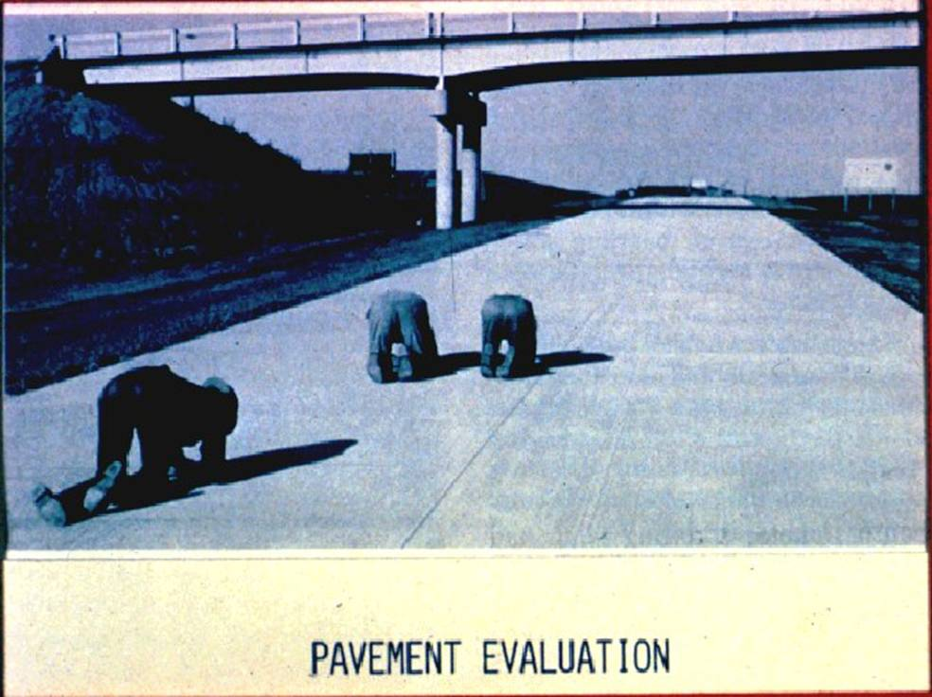
Knees and Elbows Survey !!!

Slide 22
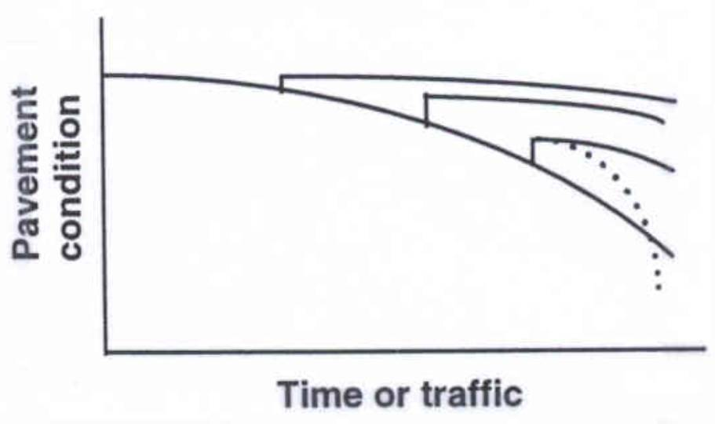
When?

Slide 23
What will PM Do?
Preventive
Maintenance
Good
Pavement
Condition
Poor
Time (Years)
Notes:
Make point that if you start PM when pavement is in good condition, you can continue to maintain a high LOS with repeated applications of relatively inexpensive PM treatments.

Slide 24

When is it Too Late for PM?
Potholes
Severely deteriorated cracks
Unstable rutting
Shoving
Weak structure
Notes:
See if the class can identify that signs of structural deterioration are indicators that preventive maintenance is not appropriate.

Slide 25
Functions of Maintenance Treatments
Provide a new wearing surface
Seal cracks in the surface
Waterproof surface
Improve pavement surface friction & surface drainage

Slide 26
Functions of Maintenance Treatments (Cont.)
Slow pavement weathering & aging
Improve surface appearance
Provide visual delineation between mainline pavement and shoulder

Slide 27
Developing a Preventive Maintenance Program
Design Condition
Pavement condition

Slide 28
Design Conditions
Existing pavement
Traffic
Environment

Slide 29
Pavement Distress
Traffic load
Environmental
Interactions

Slide 30
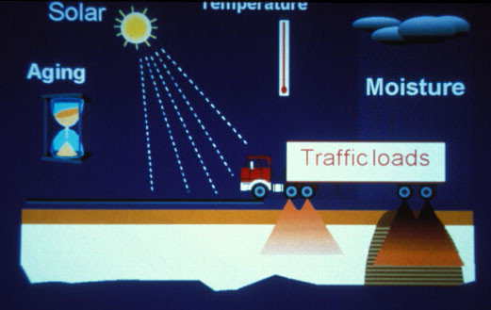
Solar
Temp.
Aging
Moisture
Traffic loads

Slide 31
Pavement Evaluation
Structural
Roughness
Skid resistance
Distress

Slide 32
Federal Funding
Preventive maintenance can be federally funded
  if demonstrated to be cost-effective
Information needs
  Types of treatments
  Performance
  Cost

Slide 33
Effective Preventive Maintenance
Good
$1.00 for preventive maintenance here
Condition
is 4 to 5 times more cost-effective than here
Poor
Age
Notes:
Spending money to apply preventive maintenance treatments to pavements in good condition is much cheaper than waiting until the pavement is in poor condition. The concept is that by conducting preventive maintenance activities, we can slow the deterioration process and end up with a flatter curve. However, this figure is rarely presented with any supporting information to suggest that it is anything other than an idealized representation of the costs of different strategies.

Slide 34
When Should PM be Applied?
Preventive
Maintenance
Good
Reconstruction
Pavement
Condition
Defer
Action
Poor
Rehab. .
Time (Years)
Notes:
Going back to the earlier slide used to illustrate the concept of pavement deterioration and performance, it is easy to super-impose the regions of the deterioration curve where the different categories of maintenance, rehabilitation, and reconstruction would be applicable. As is indicated, preventive maintenance is an activity that is exercised early in the pavement life when the overall condition of the pavement is at relatively high level. Given this, it should be clear that the distress surveys required for a preventive maintenance program must take place early in the pavement life (say, 3 to 6 years for flexible pavements).
It is important to “learn from your pavements” as these ranges will differ for each group of pavements with similar characteristics (pavement type, materials, environment, construction quality, traffic, etc.) In addition, to determining the appropriate timing of first preventive maintenance application, one also must determine the most appropriate frequency for additional applications.
Point out that we currently don’t know when the window for preventive maintenance ends. It is most likely different for every combination of pavement type, climatic conditions, materials, subgrade support, etc.

Slide 35
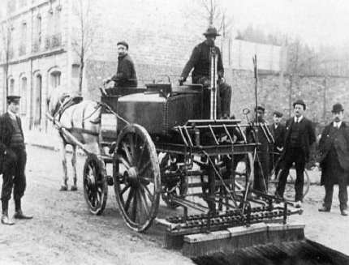
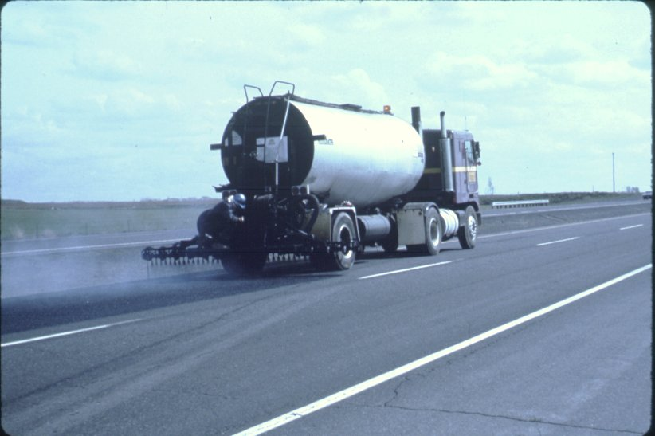
Conclusions
Historically used on low-volume roads
Now being used on higher volume roads

Slide 36
Conclusions (Cont.)
Existing pavement condition is important to treatment’s performance
Preventive maintenance should be viewed as a program over time
Preventive maintenance is cost-effective

Slide 37
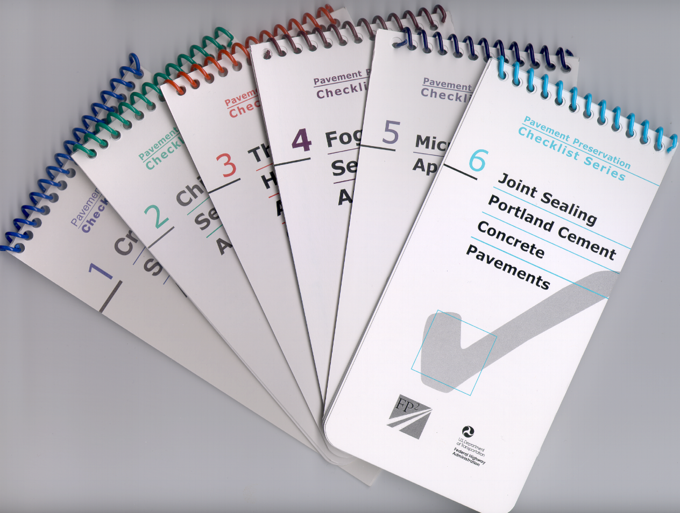
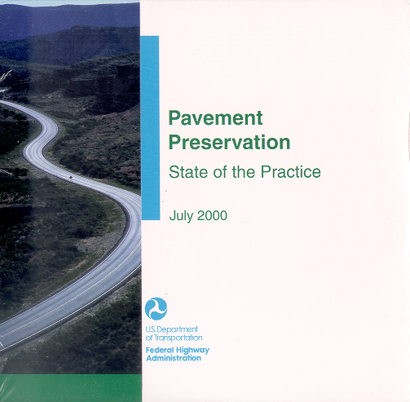
State-of-the-Practice
Pocket
Guides

