Slide 1
15th Annual
Arizona Pavement/Materials Conference
November 15 and 16, 2018
Arizona State University
Tempe, Arizona

Slide 2
ADOT/Industry
Chip Seal Partnering

Slide 3
Emulsion Chip Seal Issues
-Background-
Perceived Project Failure(s)
Potential Moratorium on Emulsion Chip Seal
Initial ADOT/Industry Meeting
3 Task Groups Formed (Committees Meet)
Task Group Assignments
• Chip Seal Project Selection Criteria
• Chip Seal Design/Test Strip
• Chip Seal Pre-construction Meeting

Slide 4
ADOT/Industry Partnering Goals
-Emulsion and Hot Applied Chip Seal-
Preserve Usage of Emulsion Chip Seal
Improve Overall Chip Seal Quality
Draft Chip Seal Guidance Document
Specification Improvement(s)
Individual Project Approach
Procedural Improvements – Test Strips
Equal Responsibility/Equal Risk
Designers Plugged In
Improved QC/QA

Slide 5
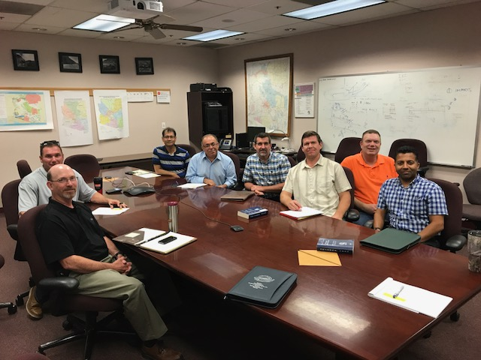
Project Selection Criteria Committee

Slide 6
Chip Seal Project Selection
Task Group Team Members
Jeff Smith – Cactus Asphalt (Co-Chair)
Paul Burch – ADOT
(Co-Chair)
Justin Shawler – SealMaster
Kevin Robertson – ADOT
Ali Zareh – ADOT
Jim Pulice – Cactus Asphalt
Scott Weinland – ADOT
Craig Wilson – ADOT
Dharminder Sharma – ADOT
Ashek Rana – ADOT
Mark Collings – SealMaster

Slide 7
Chip Seal Project Selection
Task Group
Chip Seal Project Selection Criteria
  General guidance to Pavement Designers and Maintenance Engineers
  Looks at type of chip seal
    Emulsion Chip Seal
    Hot Applied Chip Seal
  Pavement Condition, Traffic Volume, Climate

Slide 8
Chip Seal Design/Test Strip
Task Group Team Members
Mo Rahman – Ergon Asphalt (Co-Chair)
Murari Pradhan - ADOT
Sam Huddleston – Marathon Petroleum
Nye McCarty – ADOT (Co-Chair)
Brian Waterbury – Wood PLC

Slide 9
Chip Seal Design/Test Strip
Task Group
Chip Seal Design
  McCleod Method (ARIZ 819)
    Determine starting application rates
  Additional Testing
    Vialit Retention Test
    Sweep Test
  Field Reconnaissance (Pre-Activity Walkthrough)
    Identify issues which might affect production/application rates
    Evaluate previous maintenance work (patching, crack sealing, timing of treatment, etc)
    Determine test strip location(s)

Slide 10
Chip Seal Design/Test Strip
Task Group - Continued
Test Strip
  Equipment
    Verified to be in proper operating condition
      Spray tips clean
      Calibrated chip spreader and distributor truck
  Material quality
    Cover material consistent with initial acceptance samples, proper moisture content
    Bituminous material on hand with certs and at proper temperature
  Pavement surface swept and cleaned
  Contractor QC personnel on site to observe test strip
  Initial application rates
    Bituminous material and cover material rates verified

Slide 11
Chip Seal Design/Test Strip
Task Group - Continued
Visual observation
  Boot truck and chip spreader functionality
    Uniform coverage of bituminous material and spray overlap
    Uniform application of chips
    Emulsion has fully broken
  Rolling procedure
    Adequate embedment
  Brooming
    Void space between chips ( approx 20%)
    Accumulation of chips on shoulder (no more than 5% chip loss)
  Observe traffic on test strip and periodically check during production.
    Look for chip loss, flushing or tracking
  Document!

Slide 12
Chip Seal Pre-Construction Meeting
Task Group Team Members
Greg Erks – VSS International (Co-Chair)
Joshua Wentzlof – ADOT
Bill Malaby – Holly Frontier
Paul Berry – ADOT
Sam Huddleston – Marathon Petroleum
Jessica Banner – ADOT
(Co- Chair)
Keith Ryan – Quality Emulsions
Rick Risner – Sunland Asphalt
Carl Ericksen – ADOT
Brad Parker – Vulcan Materials

Slide 13
Chip Seal Pre-Construction Meeting Task Group
Pre-Construction Meeting
  Have the appropriate people in the same room
    Identify key personnel and exchange contact info
  Discuss schedule
    Start date, work hours, daily production, any restrictions (holidays, special events, etc…)

Slide 14
Chip Seal Pre-Construction Meeting Task Group - Continued
Materials
  Bituminous Materials
    Type /grade, source, application temperature
    Pre-work testing completed and approved
    Certs and BOL delivered with each load of bituminous material
  Aggregate Material
    Cover Material & Blotter
      Sources – is pre-coating required
      Samples submitted for pre-work testing
      Chips onsite or being hauled
      All spec requirements met?
  Discuss weather limitations

Slide 15
Chip Seal Pre-Construction Meeting Task Group - Continued
Equipment
  Distributor truck must be certified within 1 year
Traffic Control
  Max distance for lane closure
  Max wait time for pilot car line (if required) & number of pilot cars
  Message board verbiage
Surface prep
  By what methods

Slide 16
Chip Seal Pre-Construction Meeting Task Group - Continued
Test Strip
Application of bituminous material
  Rate determined in design but verified by test strip
  Pavement has been evaluated for potential application rate changes and marked in field
  Patching and/or crack seal completed prior to project
  Applications rates will not vary by more than 10% without inspector’s approval
  Construction of transverse joints

Slide 17
Chip Seal Pre-Construction Meeting Task Group - Continued
Application of cover material
  Rate determined in design but verified by test section (blotter if necessary)
  Cover material will be kept damp and free of running water or will not be accepted - (emulsion chip seals)
  Water onsite for use
  Stockpile management
  Determine how many times per day to verify and document application rates
  Application rates will not vary by more than ___% without inspector’s approval

Slide 18
Chip Seal Pre-Construction Meeting Task Group - Continued
Onsite Variables
  Inspector and Contractor need to make field adjustments together in the best interest of the project with support of the Resident Engineer
  Constructability differences due to elevation changes need to be discussed prior to start of production
  Rate changes due to pavement surface identified and marked in field (additional test strips)

Slide 19
Chip Seal Pre-Construction Meeting Task Group - Continued
Rolling
  Sufficient number of rollers to cover width of chip seal in one pass
  Rollers properly ballasted
  Minimum of 3 passes will be required
  Rolling completed within specified time frames
  Bring in additional rollers if necessary
  Rollers must be directly behind the chip box prior to start of each pass
  Contingency plan if a roller breaks down

Slide 20
Chip Seal Pre-Construction Meeting Task Group - Continued
Brooming
  Enough sweepers on hand to keep up with production and type of sweepers required
  Contractor must have the ability to have the entire daily work area completely swept prior to the stop time approved in the pre-con meeting
  Production will cease or be modified if adequate brooming is not available

Slide 21
Chip Seal Pre-Construction Meeting Task Group - Continued
Additional Discussion Items
  Consider evaluating weather conditions and temperatures in regards to the minimum traffic free period. Some projects could be swept and open to traffic sooner depending on climate
  Inspectors need to have an open line of communication with the Resident Engineer for onsite issues to minimize resolution time

Slide 22
Project Example
-Highway 180 St. Johns Arizona-
Holbrook Region

Slide 23
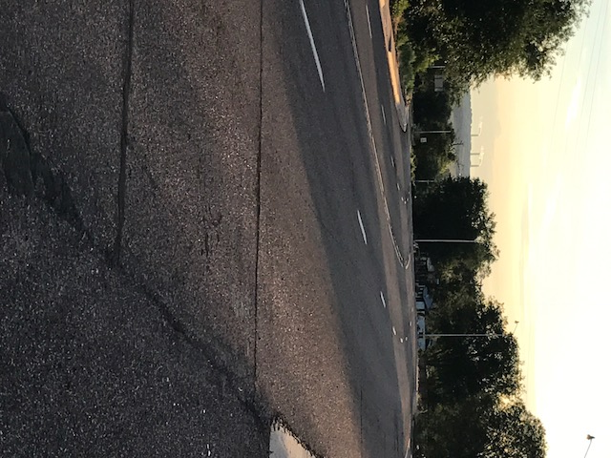

Slide 24
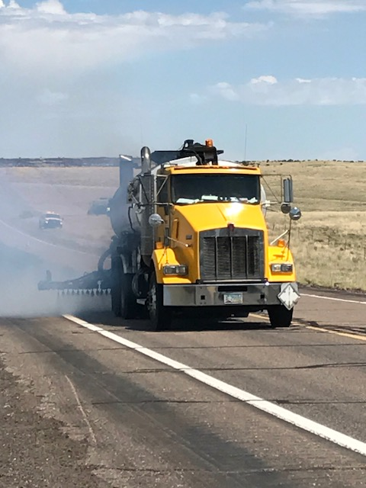

Slide 25
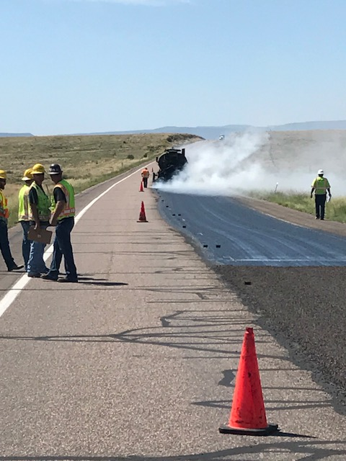

Slide 26
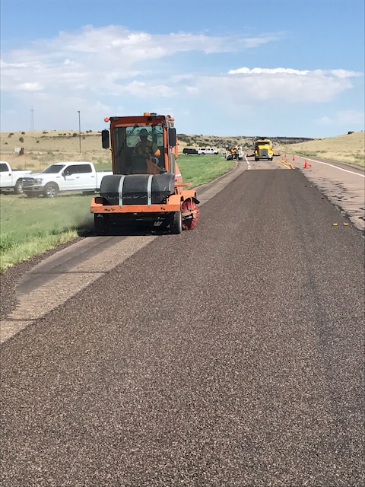

Slide 27
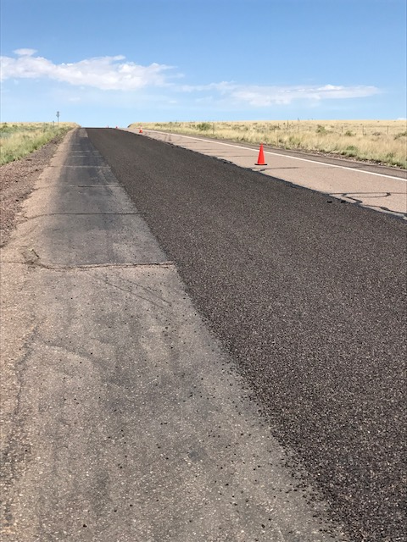

Slide 28
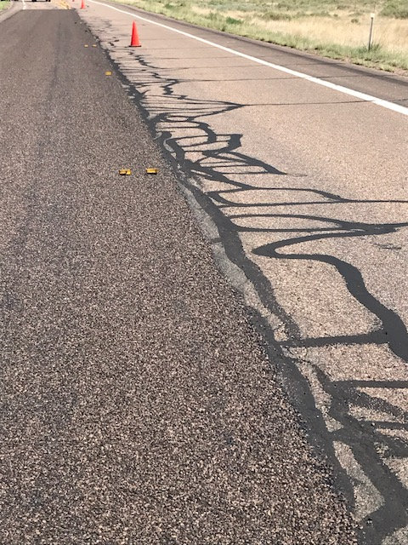

Slide 29
What We Did
Prior to Project
Chip Seal Design – Hot Applied Binder
Binder Design + Performance Grading
Vialit Aggregate Compatibility Testing
During Project
Partnering Meeting
Test Strip Application
Inspection After Sweeping
Application Rate Agreement – Project Commences

Slide 30
What We Learned
How to Partner
Onsite Pre-construction Meeting - Critical
Understand Your Project - Variables
Understand Your Materials
Inspection/Crew Communication - Critical
Make Decisions for the Good of the Project
Binder/Aggregate Rates Must Match Up
Verify Application Rates Daily – Frequently
Partnering was Successful

Slide 31
Potential Specification Changes
Require Chip Seal Design on Every Project
Require Test Strip on Every Project
Binder Application Rate, Minimum = Optimum
Aggregate Application Rate, match Binder
Faster Sweeping Time/Improved Procedures
Fog Seal with Sand (Emulsions)
Fog Seal Without Sand (Hot Applied)
Aggregate Pay Item to Square Yard
Pay for Moisture, Non-coated Aggregate

Slide 32
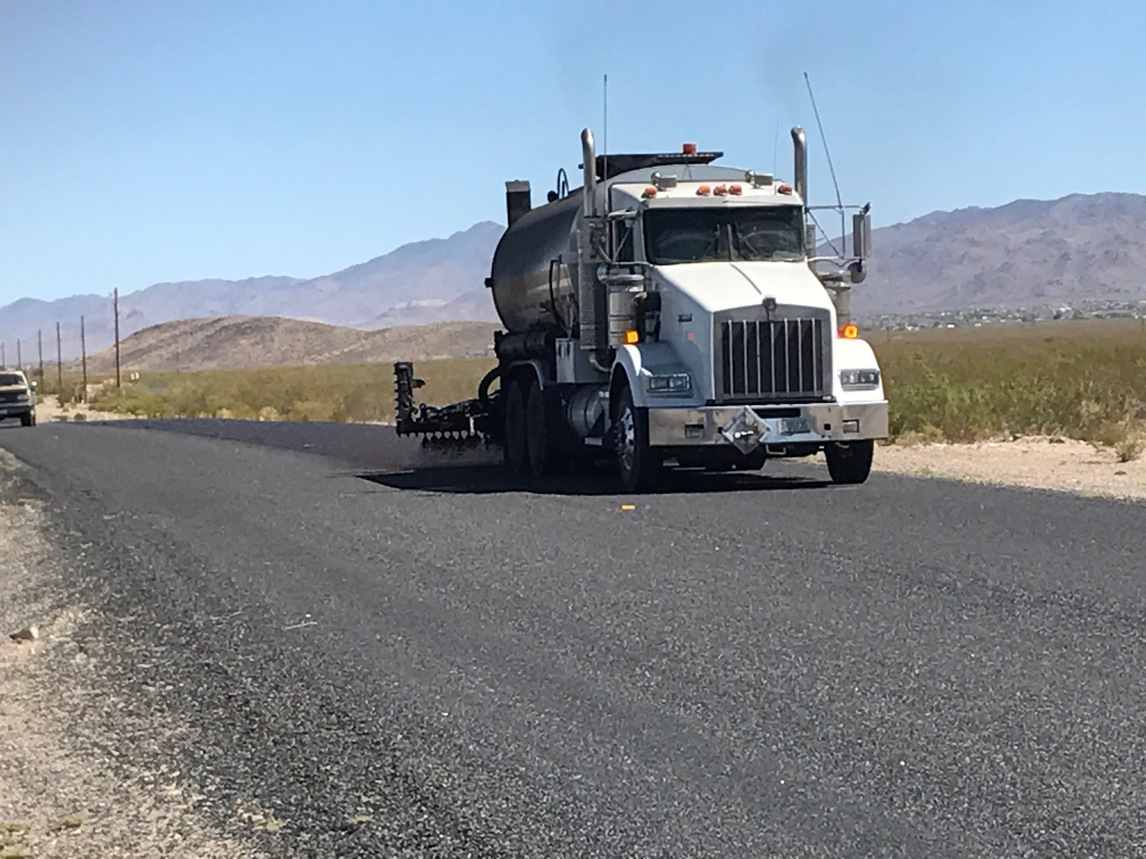
Fog Seal Without Sand

Slide 33
Thank You
Questions?

