Slide 1


Adding Longevity to Concrete Roads
Larry Scofield, IGGA/ACPA
2-18-20

Slide 2
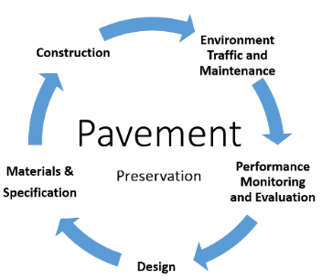
Concrete Pavement Preservation
Original PMS Concept
Circle of Life

Slide 3
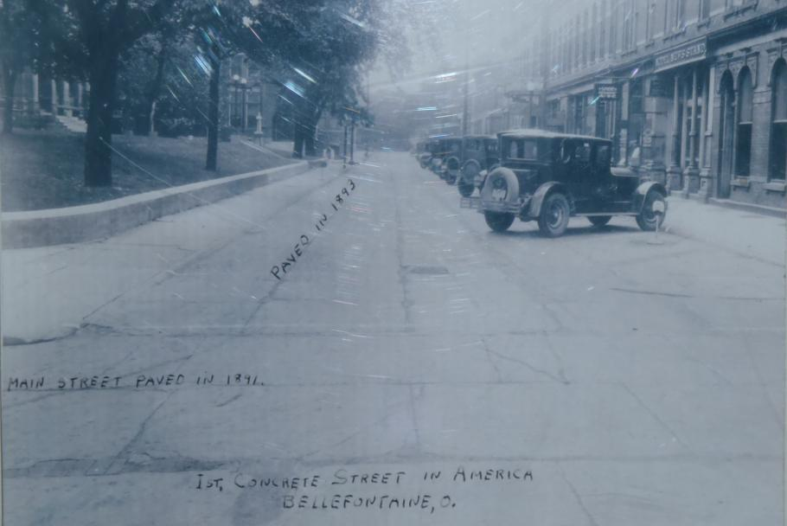
Why Concrete Pavement Preservation
Bellefontaine, Ohio 1925
2020= 129th Anniversary

Slide 4
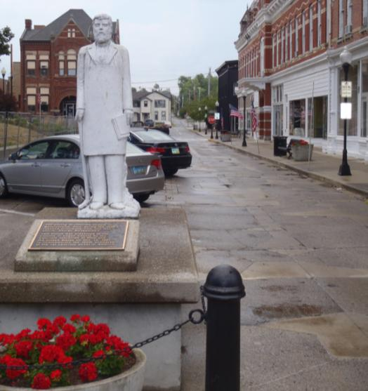
Court Avenue is 127 Years Old

Slide 5
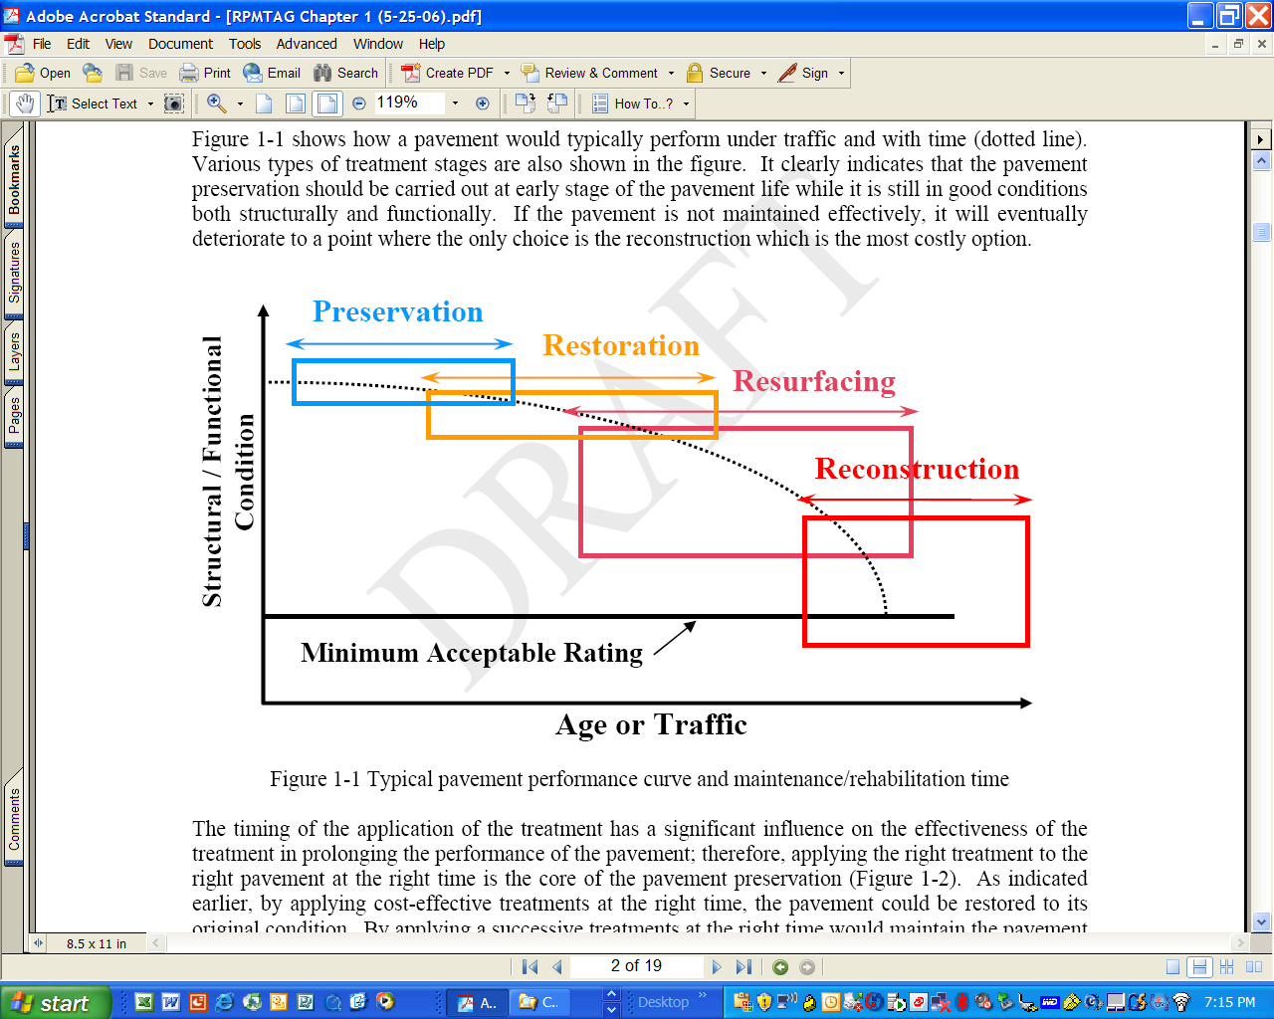
Typical Pavement Performance Curve
Classic curve infers investments made early are more beneficial
Assumes that all pavement types and strategies perform equally
Leads to over simplification and anecdotal approaches in lieu of solid data/analysis
127 Years

Slide 6
Increased Traffic Carrying Capacity
Original
Pavement
Preserved
Pavement
CPP
Structural / Functional
Condition
Terminal Condition
Additional Life
Age or Traffic
Notes:
The point of this slide is to promote the idea of repairing it when it needs it (dental work) just like they do AC pavements. Concrete will last even longer. But this is tied to having data to make decisions (data rich environment) like should we diamond grind at 8 to 10 years and that is better then waiting until 20 years, etc.

Slide 7
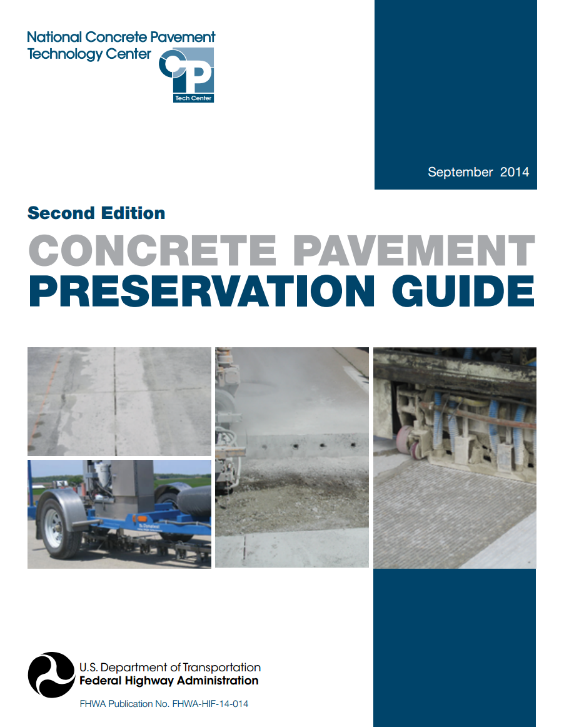
Concrete Pavement Preservation Guide

Slide 8
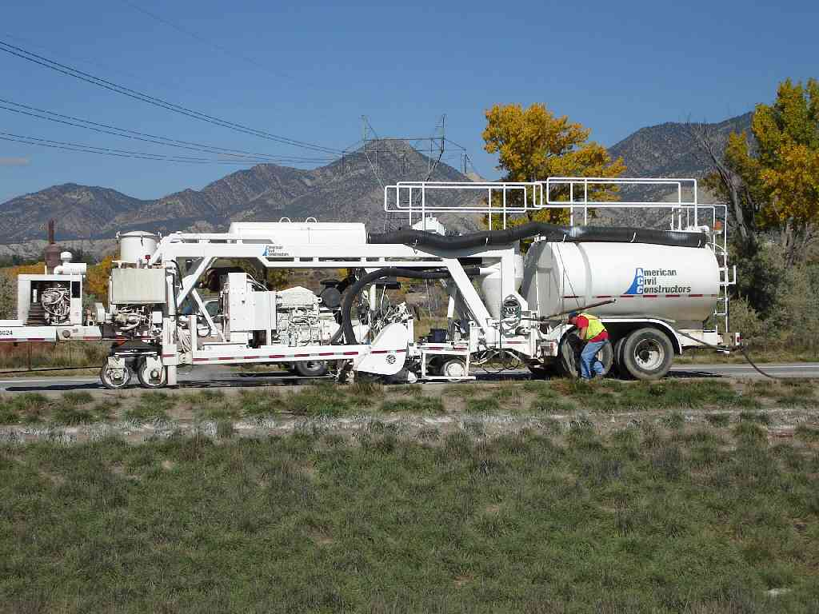
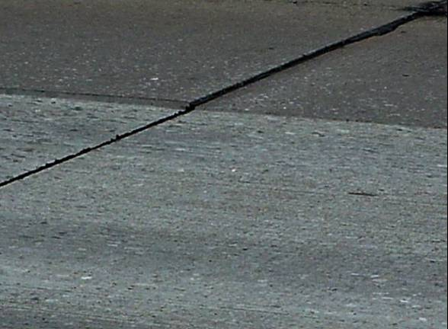
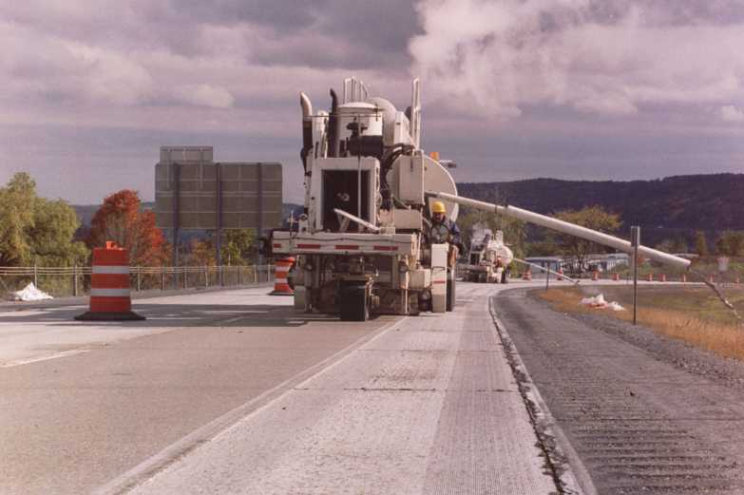
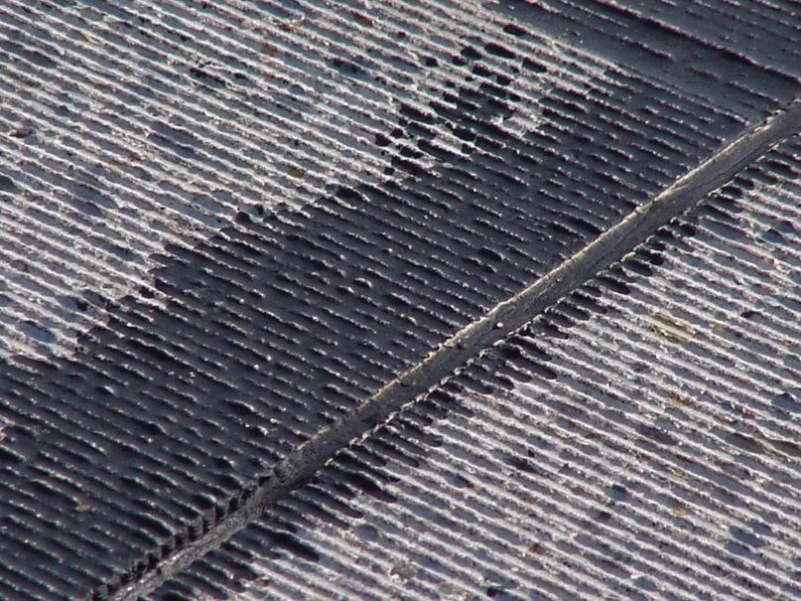
Grinding Concrete

Slide 9


Map of Mohs Hardness for US Aggregate
Courtesy: MultiQuip

Slide 10
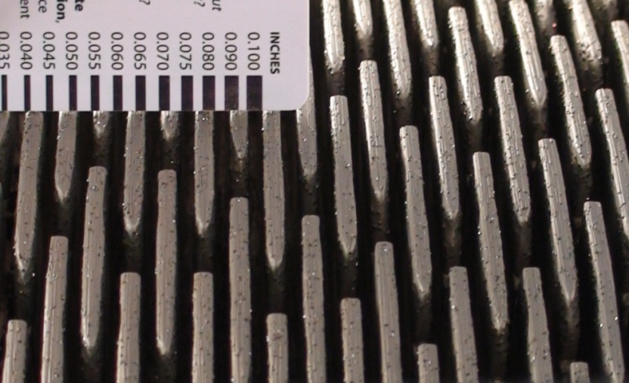
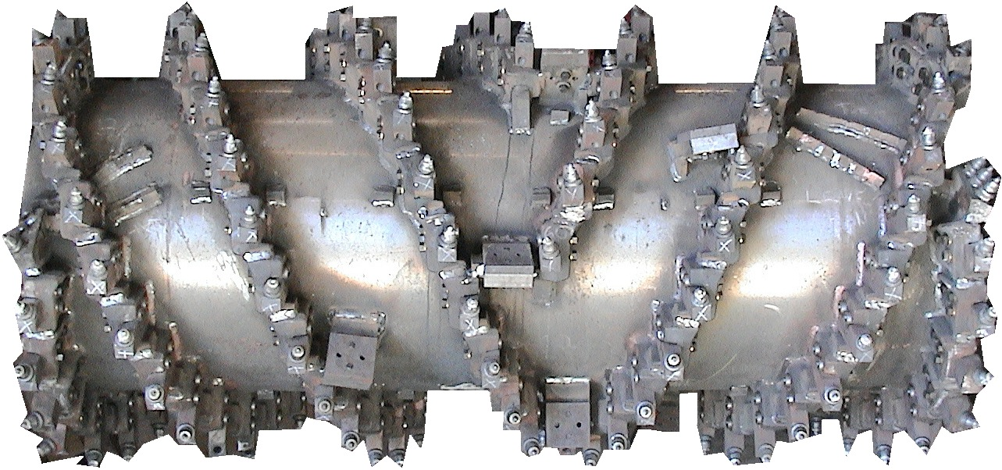

Grinding Versus Milling
Standard Milling Head
Grinding Head

Slide 11
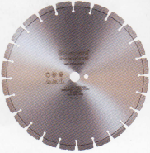
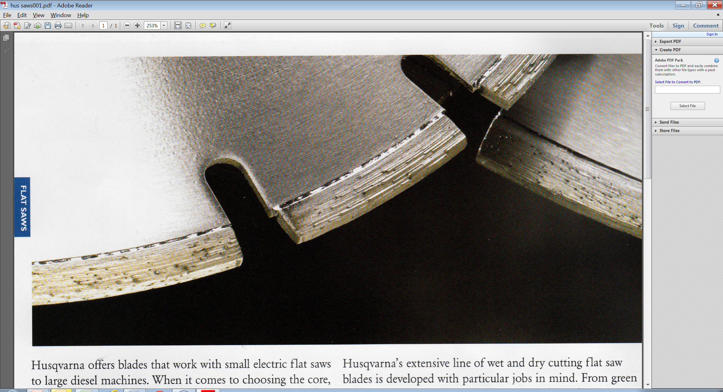
Diamond Blade Components
Core
Segment
Synthetic Diamond
Laser Weld
Gullet (slot)
Notes:
A diamond blade is constructed from two parts; a steel core which has gullets (slots) cut into it and segments which are laser welded to the core between the gullets. The segment is comprised of a large number of synthetic diamonds held in place by a metal matrix called a bond. In the photo above, the black dots on the segment that have trails behind them are synthetic diamonds in the matrix or bond. The laser weld attaches each of the segments to the core. A typical segment might have a height of 0.5”. Of this height, the bottom (portion nearest the weld) 0.70” to 0.12” does not contain diamonds and is comprised of only the bond material and is referred to as the backer pad. As a result, segments cannot be worn all the way to the core. By the time segment height wears this far, the segment width has probably lost its tolerance as well.
The synthetic diamonds are what grind away the concrete material. It is important to note that the diamonds do not cut away the material, rather they grind it away. As such, the diamond themselves break and become less effective during their life so the segment, by design, is constructed so that the bond allows the synthetic diamonds to break away when its useful grinding life has been expended.
Blade goal is to minimize diamond cost per area of grinding/cutting, while achieving desired production rates.
Image left: Closeup photo of diamond grinding blade showing core, segments and diamonds
Image top right: Photo of diamond grinding blade pointing out segment area

Slide 12

Spacers Are Used To Separate the Cutting Blades
Blade
Spacer

Slide 13
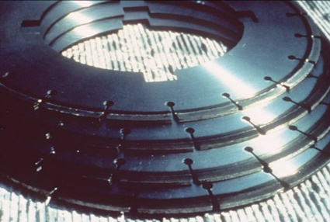
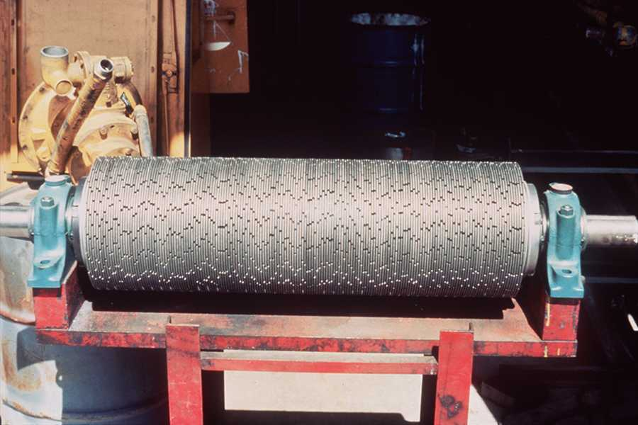
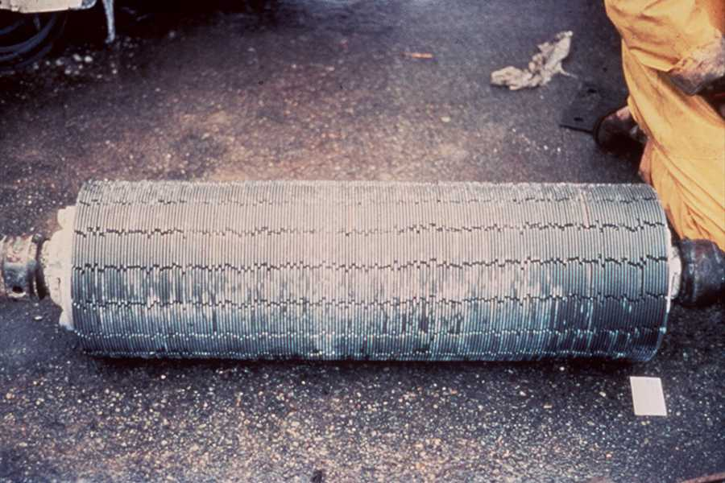
Stacking A Head
=
+
Blades
Spacers
Notes:
Stacking a head refers to placing the blades and spacers on an arbor which typically ranges in diameter from 5” to 8” with an 8” arbor being the most common for larger machines. As described previously, the head consists of a series of blades and spacers stacked together which is then mounted onto the grinding equipment. The picture on the right indicates a head stacked without randomizing the segments. The photo on the left indicates a head with the segment locations randomized during mounting. Some believe that the random blade arrangement provides less vibration and longer service life.
As can be seen in the photos for the blades and spacers at the top of the slide, there are notches on the interior of the cores to index the blades to specific arrangements on the arbor. This is how the blades are properly oriented.
Mounting blades oriented in the correct direction when stacking a head is critical: Grinding blades are designed to cut up and out of the pavement at the front of the head (location nearest the forward direction). This requires the blades to be oriented on the arbor in the correction orientation for their design. Each blade will have an arrow (See Slide 5) indicating its direction of cut.
Providing blade protection on the ends of the head: Since blades on the end of the head typically incur the greatest depth of cut, they tend to wear quicker. As a result, some owners prefer to provide blade protection on each end of the head. This can be accomplished through two different approaches; the use of SURCs on the blades, or by using larger segments widths. Slide 7 provides a discussion of SURCs. When SURCs are used they are typically used on the last two to three blades. The second approach is to use wider segments on the outside one or two blades on each end. The segment width might be increased from 0.125” to 0.187” for example. The red arrows point to the locations where the blade protection is used.

Slide 14
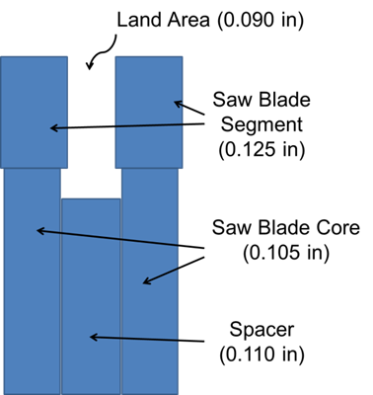
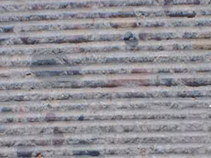
How Blades Create the Corduroy Texture
Land Area
Notes:
The drawing on the left indicates two blades separated by a spacer and, in particular, how the land areas (ridges) shown in the right hand photo are created. That is, blades create the grooves and the land area is formed by material extending up between the two blades as they grind into the surface. The hardness of the aggregate and spacer size impact the resulting shape of the corduroy texture. Spacers are typically 1” to 2.5” less in diameter than the blades. The size of the spacers can impact the resulting land width as the shorter the spacer the more opportunity for the blades to deflect and vibrate changing the grind and fin break-off characteristics. Spacer diameter is important for correct grinding operations.

Slide 15
Why Blade Spacing is Important
Fins

Slide 16
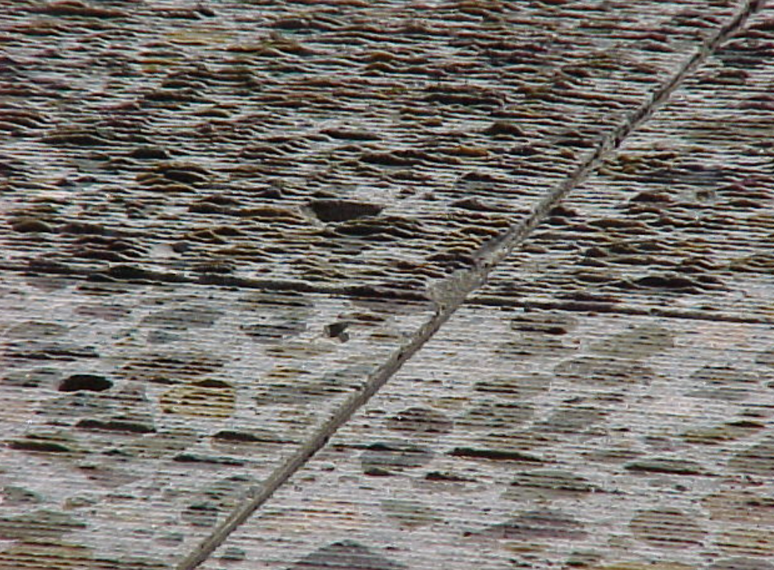
60 Blades vs 52 Blades per Foot
52
60

Slide 17
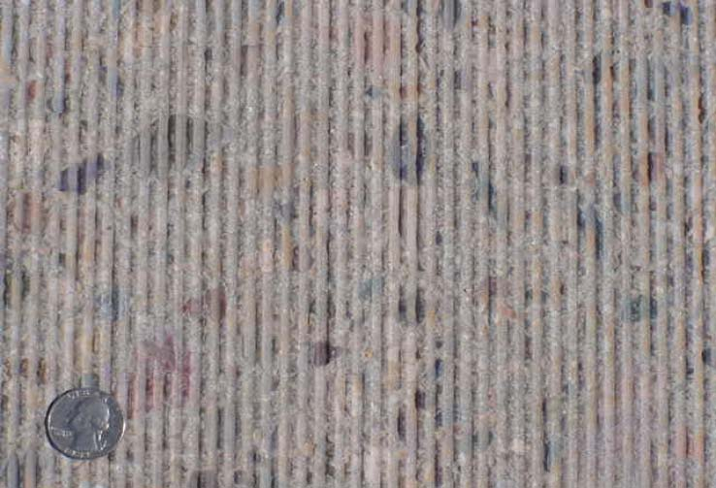
Well Constructed Texture

Slide 18
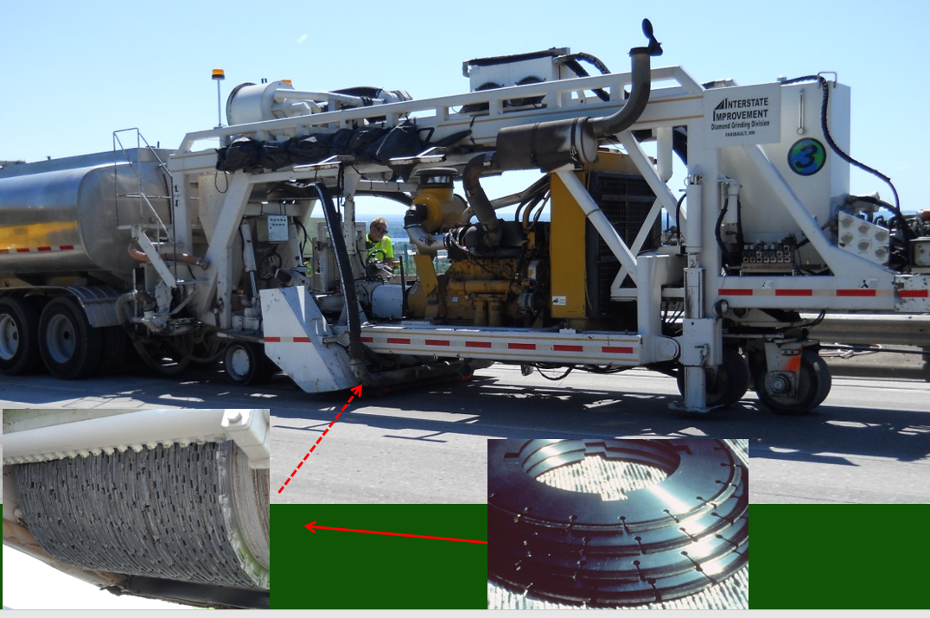
Diamond Grinding Equipment

Slide 19
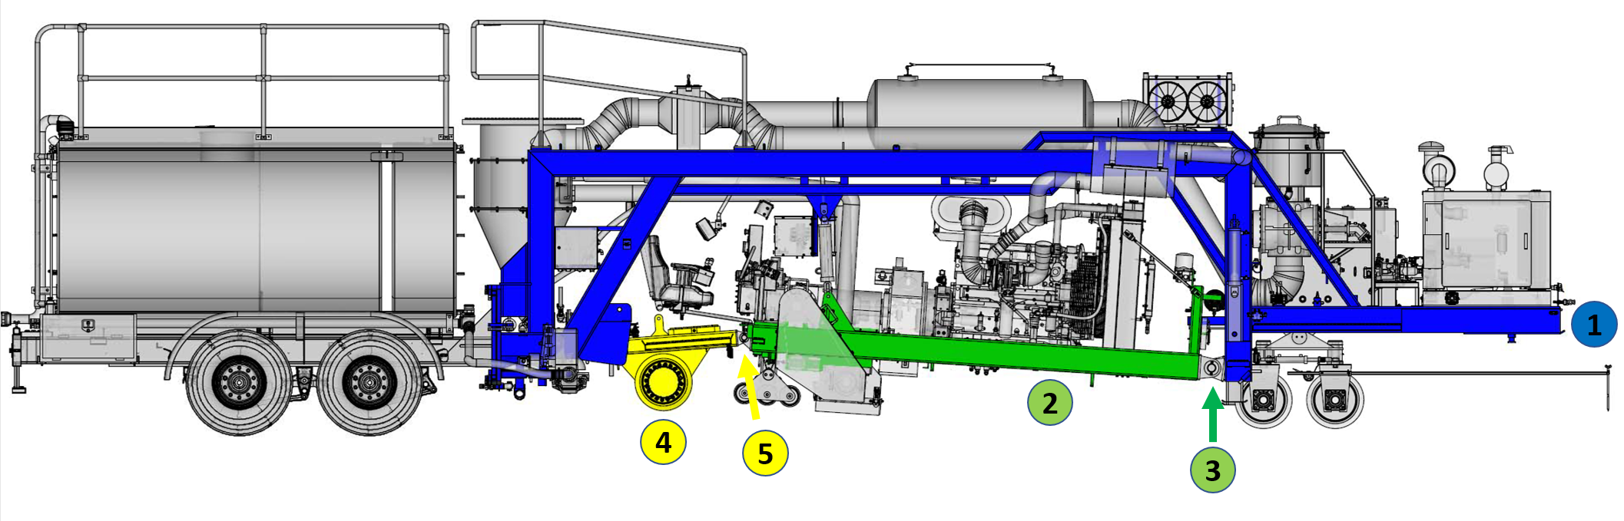
Frames on Diamond Grinder
Notes:
Overhead Frame: The overhead frame (1) extends from the front of the machine towards the rear as indicated in blue. It provides the backbone to which the other frames are connected. The overhead frame supports most of the slurry recovery system, the front tandem wheels, as well as the front engine. The upper frame is the only frame which does not pivot at some location; its designed to be rigid throughout its length.
Main Frame: This frame (2) supports the grinding head and associated functions. This includes the center engine, the operator controls, the grinding head and grinding power transfer equipment. This frame is designed to pivot at the front, where it attaches to the overhead frame (3), to enable a planing action (grinding) to occur as the machine travels along the pavement.
Traction Frame: The only purpose for the traction frame (4) is to support the traction wheels which propel the equipment. This frame can pivot on each end allowing it to rotate as necessary such that it does not interference with the movement of the main frame during the grinding operation (5).

Slide 20
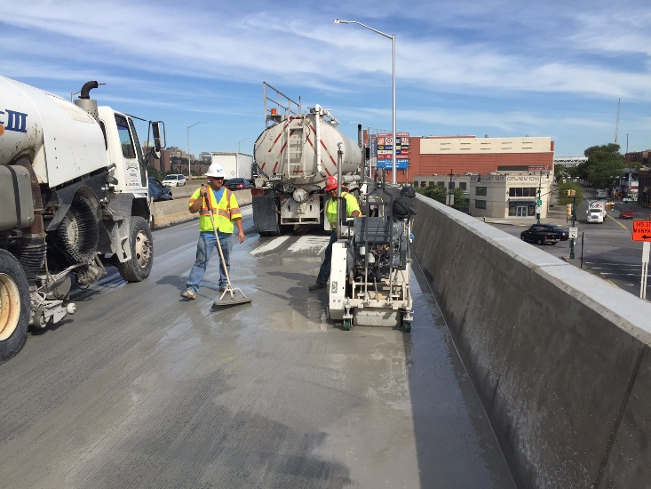
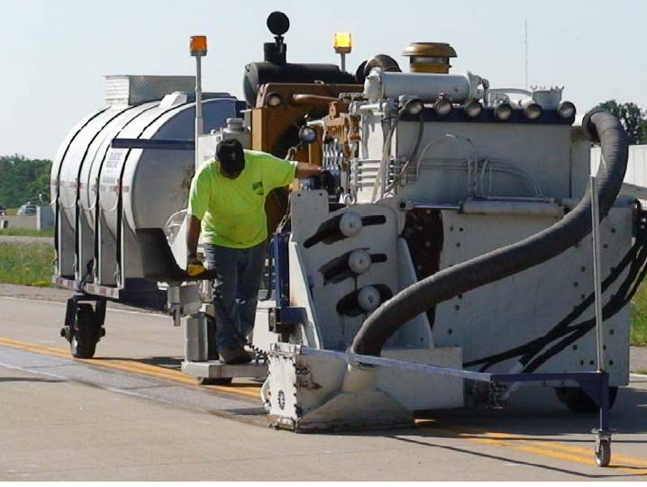
Grinding Close to Barriers and Obstructions
Notes:
Most highway type grinders can only grind to within 18” to 24” of a lateral obstruction. The exception to this is the DP PC4500 that uses a 4 ft head and can grind to within 9 ½” of a lateral obstruction.
To accomplish closer grinding for most equipment, one of three approaches is generally used:
Non Conforming Grinder Attachment: This is a contractor specific custom device, developed to be attached to full size grinders. This attachment is usually proprietary in nature and typically uses a slurry recovery system. The top photo indicates such an operation.
Specialty Grinding Equipment: Equipment exists that can grind to within 4” of a curb face with a 2ft wide grinding head. This is a production grinder which also includes slurry recovery. (Lower Left Photo)
Walk Behind Grinder: This, as the name implies, is a separate piece of manually operated equipment used to grind closer to an obstruction. This type of equipment does not use a slurry recovery system and is much slower in operation.
Image Description:
Top Photo: Custom attachment to full size grinder to allow grinding closer to a barrier
Lower Left Photo: Specialty grinding equipment that can grind to within 4 inches of a lateral obstruction such as a curb
Lower Right Photo: Manual walk behind grinder to make grinding pass close to obstruction

Slide 21
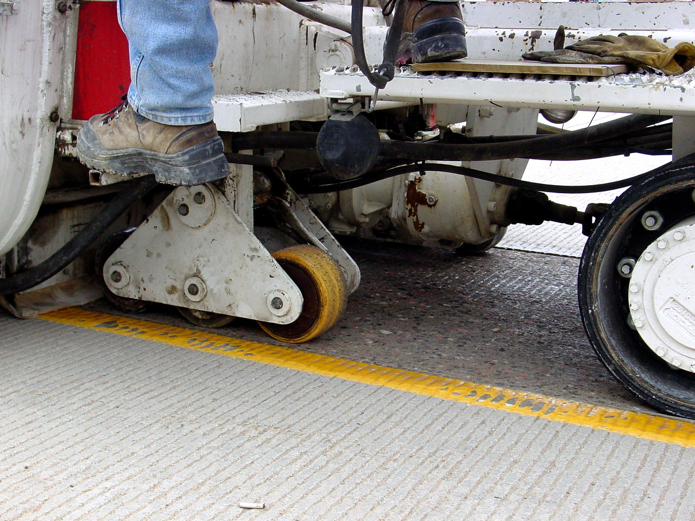
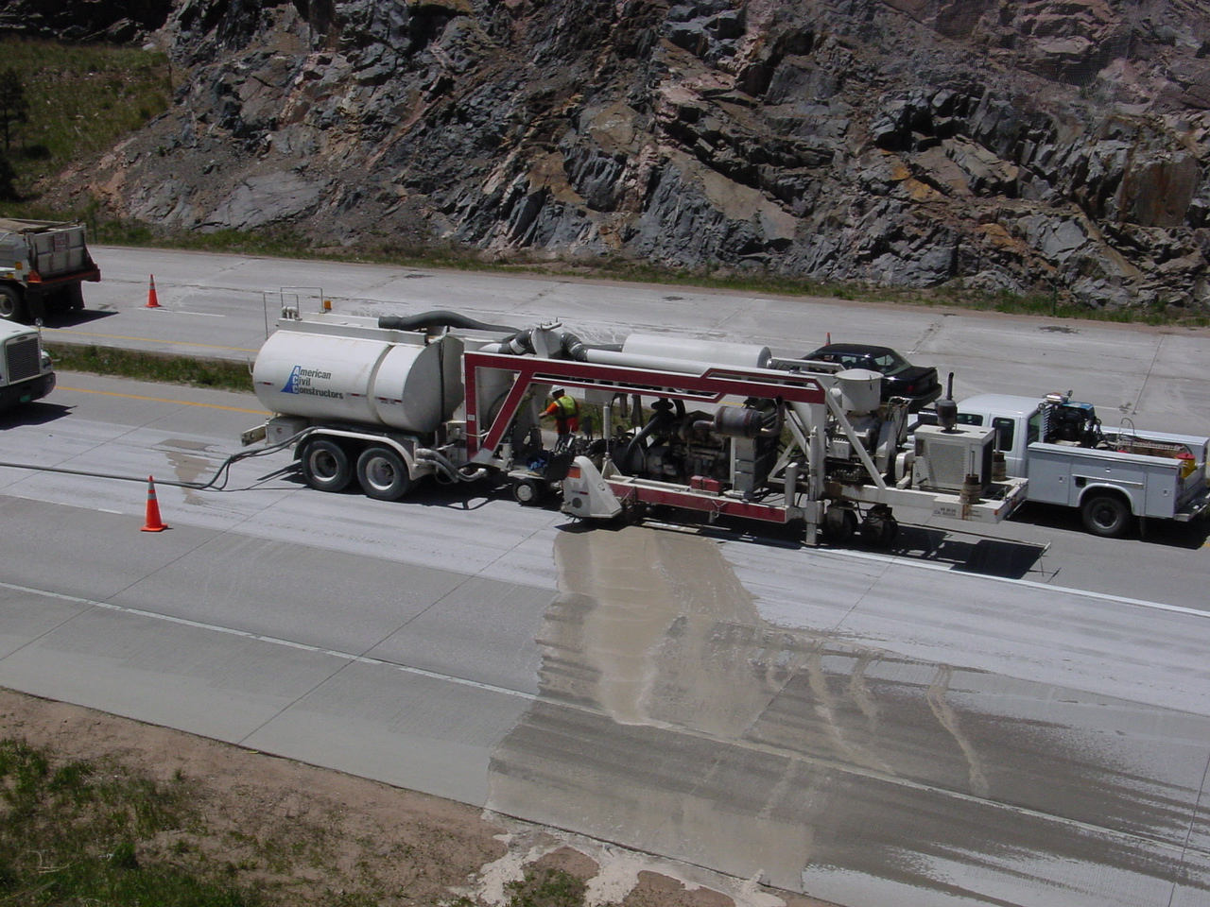
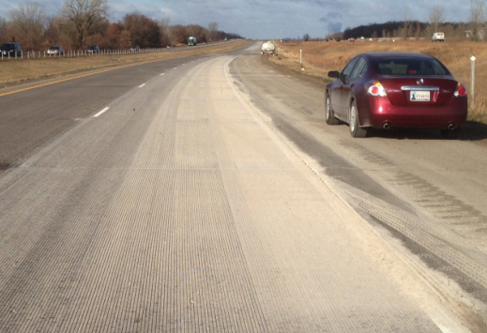
Diamond Grinding Slurry
Proper Slurry Recovery System
Slurry
Slurry Recovery Failure
Poor Recovery
Notes:
Slurry is a by product of the diamond grinding process. It is formed by mixing of finely ground particles produced during the grinding process with water used for cooling the head. The water is introduced to the head to increase service life and reduce environmental dust.
Slurry is an inert, typically nonhazardous material, but must be removed from the roadway surface and disposed of. The photo on the left indicates what slurry look likes and what happens if it is not contained. The photo on the upper right indicates what it should look like behind the grinding unit with a properly working slurry recovery system. The photo on the lower right indicates the results of a poorly working recovery system.
For rural applications, it is common to dispose of slurry along vegetated shoulders of a roadway in areas which are not located by streams or water ways. Slurry is generally a higher pH liquid and should not be allowed to enter into waterways, ground water, or drainage facilities.
For urban applications, it is common to retrieve the slurry and haul it to offsite disposal facilities in water tight tankers. The slurry is then processed at the facility to separate the solids from the water. Sometimes the water is then recycled and returned to the field where it is again used for cooling the heads.
Once the solids have been removed from the water, they can be used for fill material, re-used in other concrete products, or other applications.

Slide 22

Means for Improving pH prior to Slurry Recovery and Disposal
Typical for grinding slurry
Notes:
Chemicals are sometimes added to the water tank to reduce the pH of the water prior to going to the grinding head. In this manner it is easier to control the final pH of the slurry. Historically, pH reduction has occurred through the addition of muriatic acid into the water tank. In recent times, a liquid chemical, called slurry safe, has been introduced that allows addition into the water tank as
a liquid.
pH testing can be incorporated into the project daily operations. pH test kits can range from pH paper to electronic instruments.

Slide 23
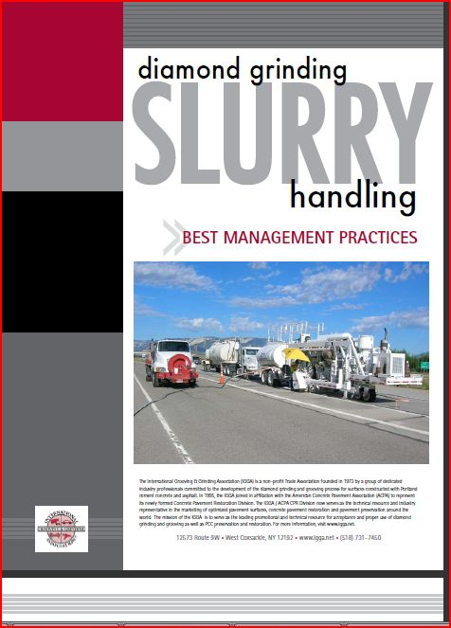
IGGA Best Management Practices for Slurry Handling
Notes:
Although national and local requirements will define how slurry is controlled and disposed of on any given project, an excellent source of best management practices was developed by the International Grinding and Grooving Association and is an online ready reference for this subject and should be consulted for additional information.
Image Description: A graphic of the IGGA best management practices document.

Slide 24
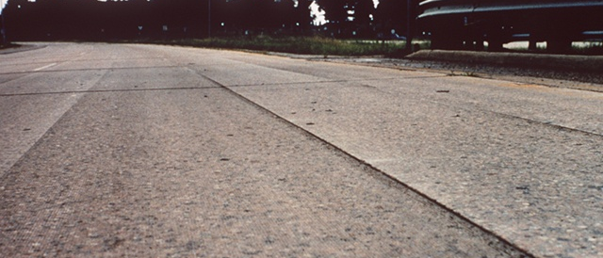
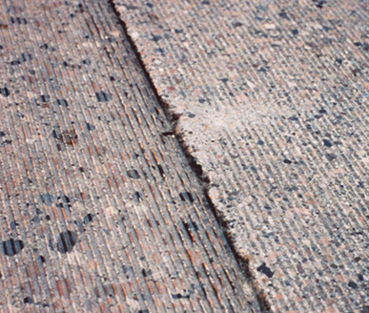
Poor Match Between Passes
12 ft straight edge
< 1/4 in/12 ft
< 1/8 in/12 ft
Pass 1
Pass 2
Pass 3
Pass 4
Notes:
Since a typical grinding head is 3’ to 4’ in width, it takes three to four passes per lane to grind the full lane width and many more to go full roadway width with multiple lanes. In accomplishing grinding, it is very important to maintain the roadway template and also to match the pass boundaries between consecutive passes so that vertical offsets are minimized. Once formed, they can pond water and cause lateral stability issues for tires that travel longitudinally along the match line, particularly when the pass boundary is within the wheelpath. Although flush pass boundaries are desirable, it is often difficult to achieve and some tolerance is necessary as indicated in the drawing. A maximum deviation from the lowest point to the straightedge should be less than or equal to ¼ inch. For adjacent passes, the vertical offset should be less than or equal to 1/8 inch.

Slide 25
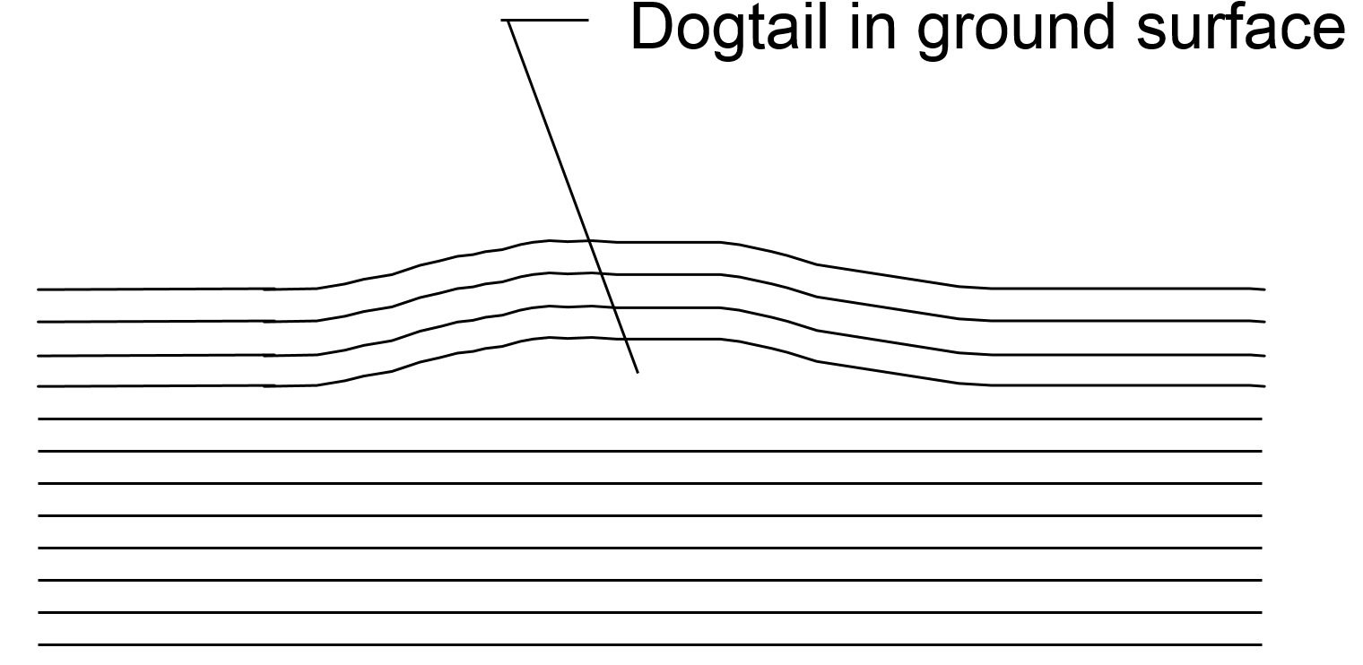
Dogtails
Notes:
Good grinding practices indicate that there should be no more than 1 inch overlap between consecutive grind passes. This provides only a 1” window of steering tolerance for a very large piece of equipment which goes around curves and super elevations in accomplishing its work. Sometimes the adjacent pass leaves an unground area (as indicated in the drawing) and this is called a dog tail. Most dog tails are typically not noticeable by traffic, but long sustained dogtails, like vertical offsets described in slide 3, can pond water or provide lateral stability issues. Typically, however, they are only cosmetic concerns.
The exception to the 1 inch tolerance requirement is when lanes of different widths are ground. In this situation, the proper corduroy texture can be produced even though significant overlapping occurs. This is accomplished by grinding slightly deeper on the overlap side to ensure proper macro texture is produced. This eliminates the need to re-stack the head for each lane width change.

Slide 26
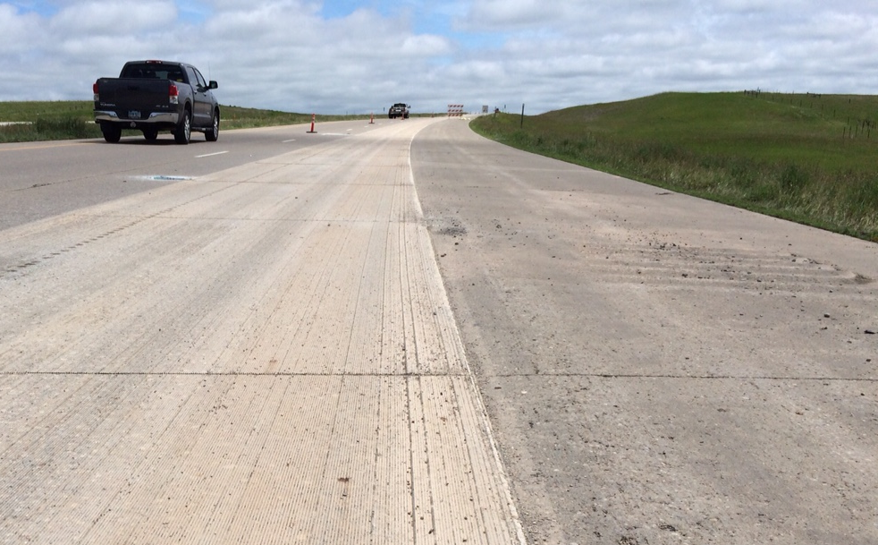
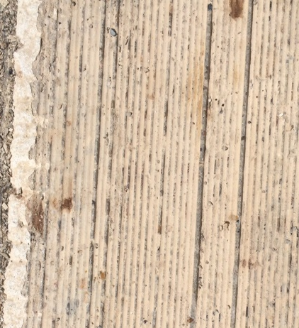
Damaged Blades and Non Uniform Texture
Notes:
blade diameters stacked on a head need to be the same to produce a uniform corduroy texture. The photos on the left and right are from different projects but exhibit similar issues. The blades were not all the same diameter, some may have been burned out, and for the photo on the right, it appears different size spacers could even have been used. These approaches do not develop the uniform corduroy texture which is desirable (see red markers for examples). Uneven texture depths can result in tire squirming issues for passenger cars as well as louder tire pavement noise generation.
Blades do go bad during grinding and agencies usually allow the grinder to continue working with only one or two blades bad; but if more than that occurs, the bad blades should be replaced at the end of the shift. In the case of these projects, different blades should have been used to stack the head. This texture is far too inconsistent to be acceptable.

Slide 27
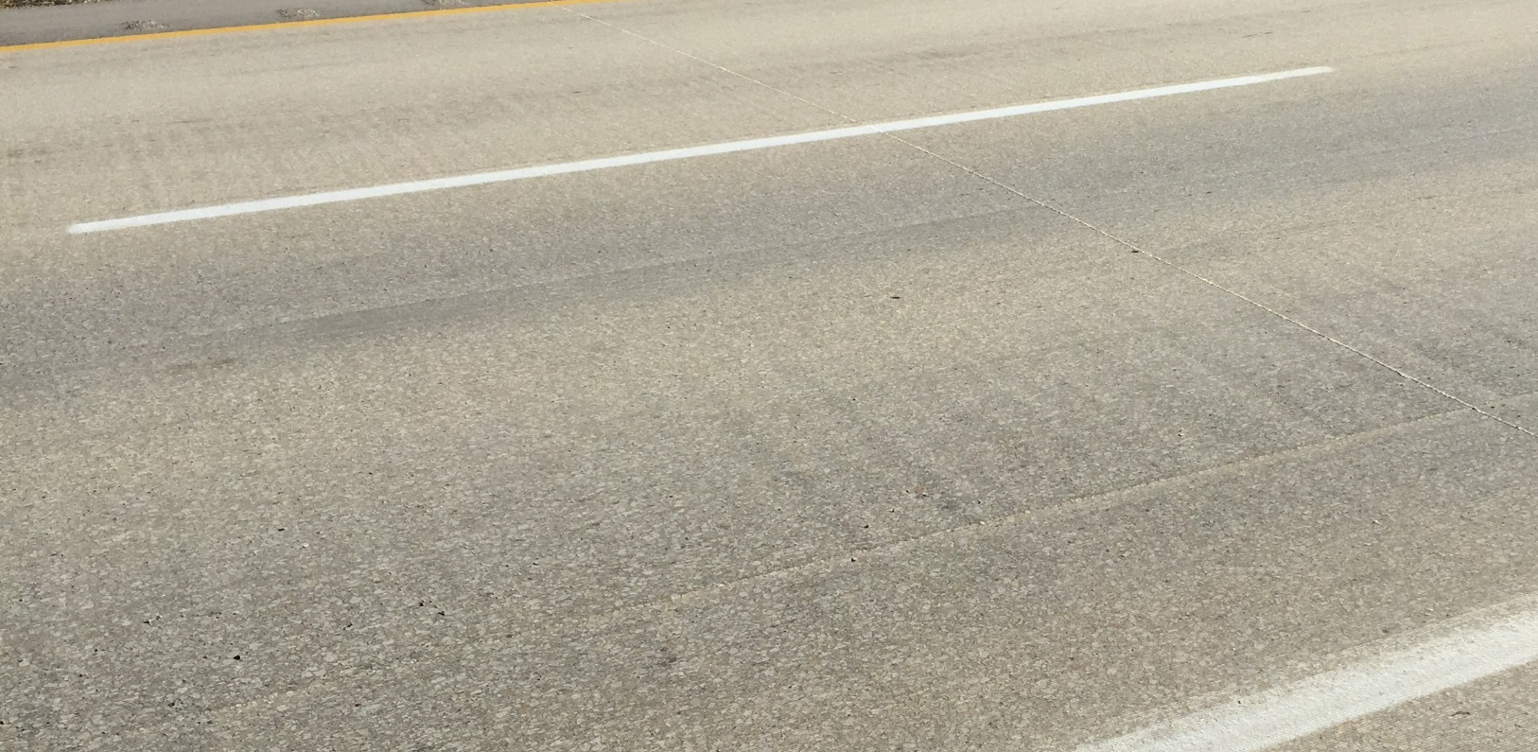
Chatter Produced From Indexing
Ripples in Pavement
Notes:
The photo above indicates small rumble strip like profiles produced in the pavement during the grinding operation. The result of this is a poorly riding pavement which could be worse than the original ride quality before the grinding operation. When this occurs, grinding should cease and the affected areas reground. Although out of round profile wheels are often mistakenly credited with creating this type of issue, it is likely that this is an indexing problem. It could be due to an incorrect blade specification where the blades are too hard for the material being ground and/or too deep of cut in combination with too hard of blades. More than likely however, it is either a ground drive control malfunction, an improperly set cruise control, or a malfunctioning ground drive pump. The exact cause would need to investigated for each specific instance to remedy the situation.
If this situation is suspected based on ride quality, but is not evident during the daytime, viewing the section at night with headlights (assuming no traffic) makes these kinds of feature more visible. Conversely, if this situation can be seen, but it does not influence ride qualities, then it becomes more of a cosmetic concern.
Although out of round profile wheels are often discussed as culprits to this issue, it should be remembered that profile wheels typically are attached through a pivot point and, as such, it’s unlikely various wheels could act in unison to create this type of problem. Target machines have 4 profile wheels and DP machines 6 profile wheels.

Slide 28
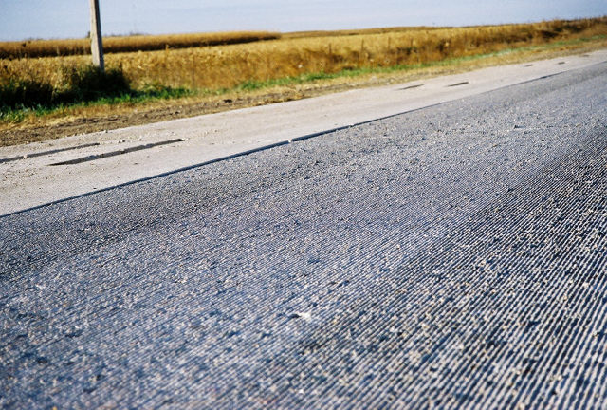
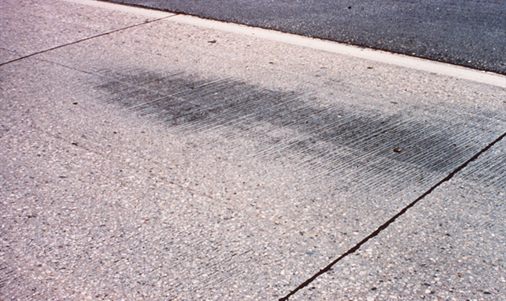
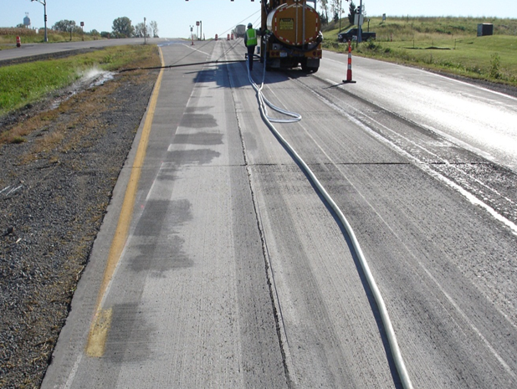
Holidays
Typical Holiday
Curl & Warp
Feathering Holidays
Notes:
Holidays or “brown outs” are unground or partially ground areas that result from low spots in the original concrete surface (see upper left photo).
Specifications usually indicate just a ride requirement or a ride requirement and a percent coverage requirement. For projects that only have a ride requirement, the amount of holidays is not critical since the grinding depth is only a function of that necessary to achieve ride quality. It should be understood that the only way to remove holidays is by grinding deeper. Since grinders must grind into and out of these areas to remove the holiday, the additional concrete removal is affecting a much larger section of pavement by reducing its thickness. An owner should always consider this when requiring additional grinding to remove holidays. In most instances this is only cosmetic, and will not be noticed by the traveling public. In areas with wheel ruts that originally used transverse tining, a noise issue could be present if none of the original transverse tining is removed. However, noise reduction success has been achieved with even partial depth grinding of transverse tining.
When a percent coverage specification is also involved, the amount of holidays are controlled by the specifications. For preservation grinding, a requirement of 95% coverage is typically used. This indicates that 5% of the area can have holidays. Any thing in excess of that needs to be corrected.
When grinding badly curled and warped pavements or faulted pavements, considerable thickness removal could be required and owners should always consider whether achieving the coverage requirement is necessary. Achieving the ride specification should be the controlling consideration to prevent further thickness reduction unless other conditions exist such as polishing aggregate.
The photo on the lower left also indicates holidays resulting from the feathering process in attempting to feather into other grades.

Slide 29
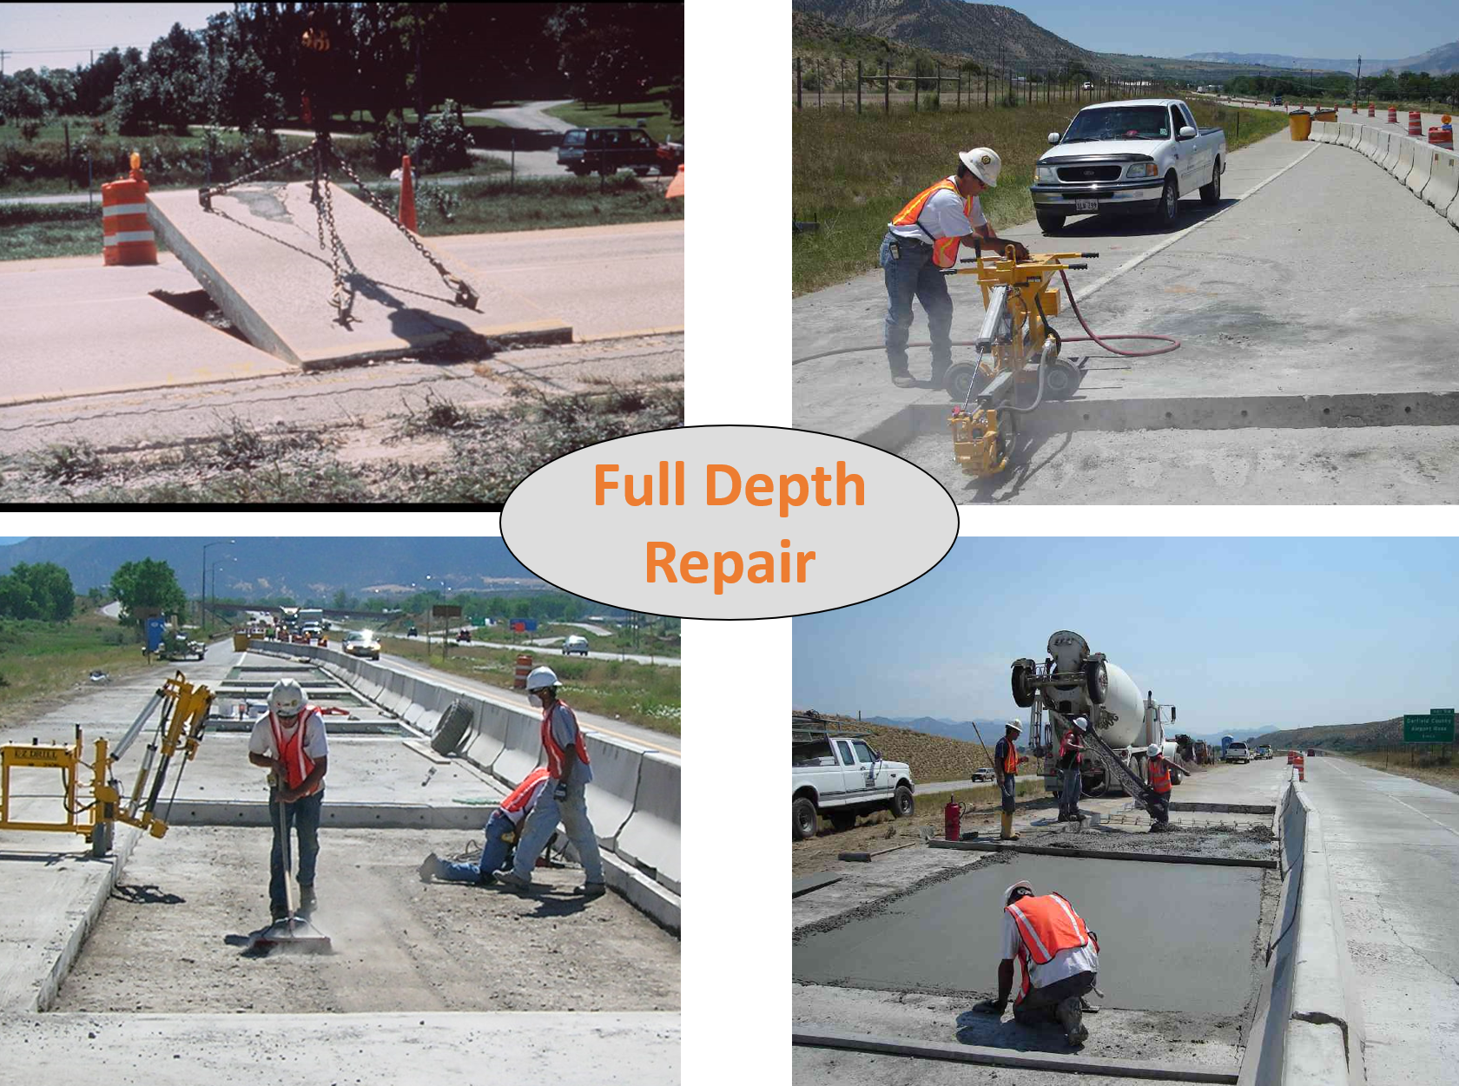
Different Types of FDR

Slide 30
Full-Depth Repair Use
Purpose
  Restore Structure
  Restore Ride
Used For
  Joint Deterioration
  Transverse Cracking
  Longitudinal Cracking
  Broken Slabs and Corner Breaks

Slide 31
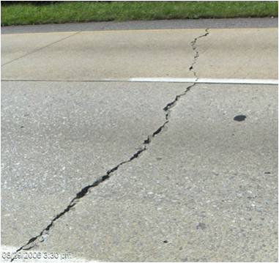
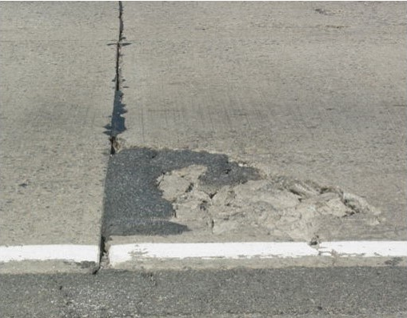
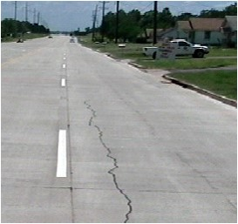
Repairing Cracking
Corner Breaks
Transverse Cracks
Longitudinal Cracks

Slide 32
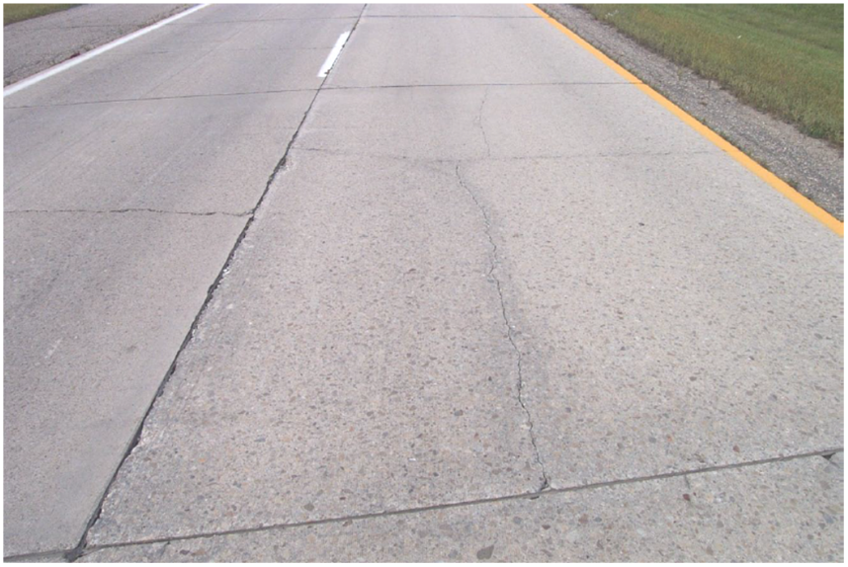
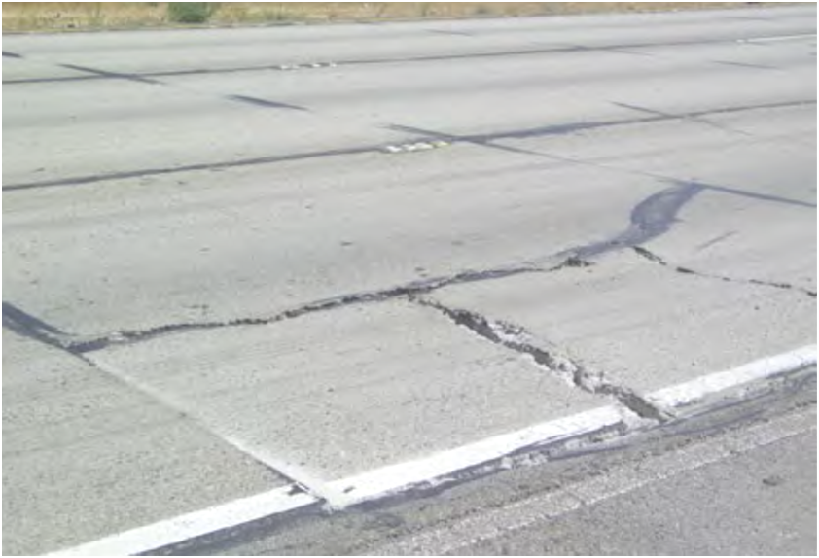
Repairing Broken Slabs
Multiple Cracks

Slide 33
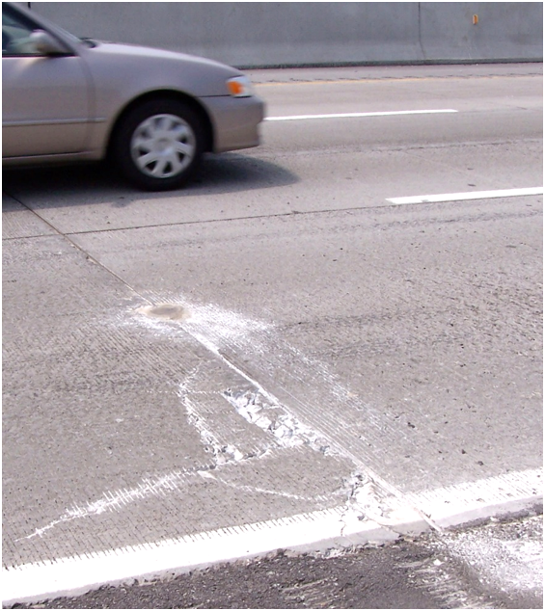
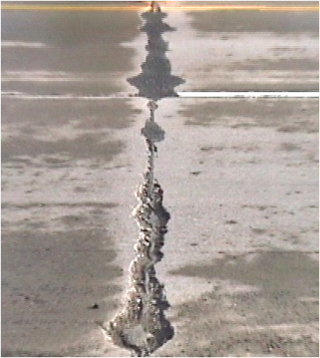
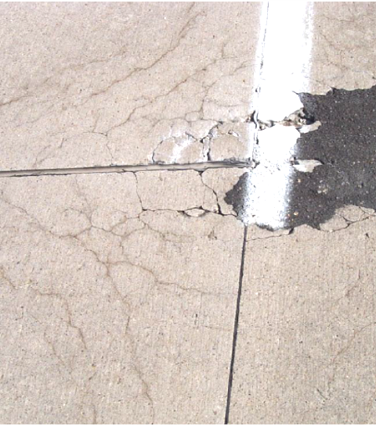
Repairing Joint/Crack Deterioration

Slide 34
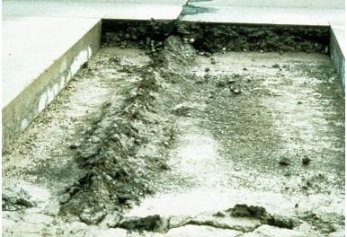
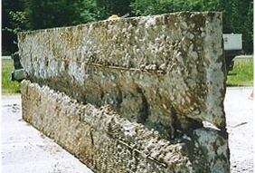
Its Not Only What You See From Above!

Slide 35
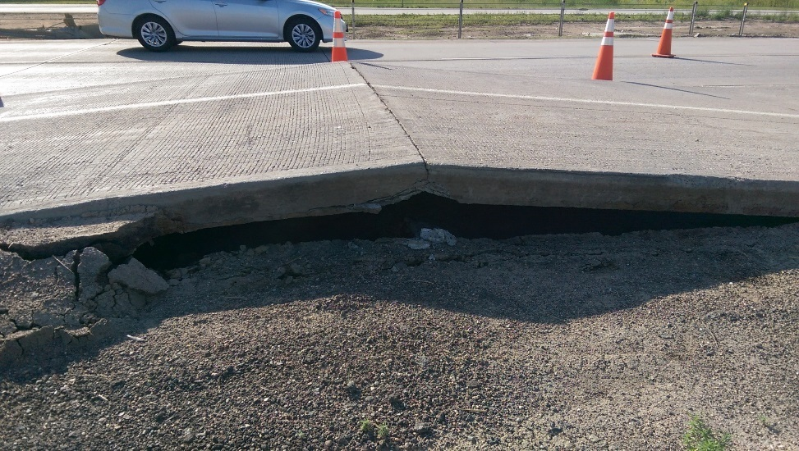
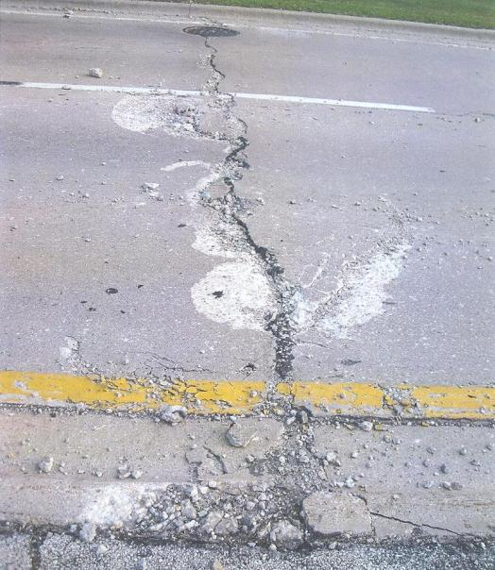

Replacing Vaulted and Shattered Slabs

Slide 36


Types of Distress That Cannot Be Addressed
Extensive MRD (like ASR)
Grade Issues Requiring Removal
Excessive Pavement Deterioration

Slide 37

What Is A Full Depth Repair

Slide 38

Full Depth Repair
Notes:
Same thing for full depth repair.

Slide 39
Full Depth Repair Process
Identify and Mark Areas
Selection of Materials
Sawing Repair Boundaries
Removal Methods
Base Preparation
Installing Dowels and Tie Bars
Casting and Finishing Slabs

Slide 40


Identify and Mark Repair Areas

Slide 41

6 Ft Minimum Width Requirement

Slide 42

Repair Boundary Determination

Slide 43

Materials

Slide 44



Slide 45

Sawing Repair Boundaries
Pressure Relief
Perimeter Cut

Slide 46


Wheel Saw Cuts

Slide 47

Basic Sawing Pattern for Smooth-Faced Perimeter Joints
Pressure-relief cut
(as needed)
Full-depth saw cut
(through existing joint)
Full-depth saw cut
Full-depth saw cut
Min. 3 to 5 inches
Shoulder
If concrete shoulder, saw through joint
If asphalt, saw out 6 to 12 inches for forms
Notes:
This graphic illustrates the basic sawing pattern for smooth-faced perimeter joints. In this example of a typical repair of a distressed joint, the marked perimeter is indicated in amber. These are the locations for the transverse and longitudinal perimeter joints.
The transverse perimeters receive a full-depth saw cut using a diamond-bladed saw to form a smooth-faced joint suitable for installing dowel bars for load transfer.
The longitudinal joint separating the two lanes is made by cutting directly through the existing longitudinal joint line. How the longitudinal joint separating the lane and shoulder is treated depends on the type of shoulder. If the shoulder is concrete, sawing is performed through the existing joint. If the shoulder is asphalt, you may try to use it as the form for the concrete patch, but in many cases the shoulder will not be in good enough condition. If that is the case, saw back on the shoulder 6 inches (and up to 12 inches if it is in very poor condition).
The cut shown in green is a pressure-relief cut. This may be necessary to prevent saw binding when making perimeter cuts, as well as to minimize the occurrence of spalling of the adjacent concrete during concrete removal.
Now we'll discuss sawing techniques for different places that you'll make smooth-faced perimeter joint cuts.
Image: Diagram of a jointed concrete pavement showing the perimeter saw cuts and pressure-relief cut in typical locations for a patch with smooth-faced perimeter joints.

Slide 48

Two Types of Longitudinal Joint Face

Slide 49

Sawing Procedure for Full-Depth, Transverse Cuts
Set cut depth to fully reach slab bottom
  Nominal thickness plus 1/2 inch
Saw toward any live traffic lane and avoid turning your back on traffic if possible (use spotter if necessary)
If saw blade binds then use pressure-relief cut in patch area
Determine if over-sawing is acceptable
  OK if sawing over existing joint
  OK if sawing into shoulder
  Avoid if would weaken an adjacent traffic lane
The rule of thumb is to set the depth to the nominal thickness plus 1/2 inch.
Notes:
Now that you know how to select the correct equipment, make relief cuts, and follow the base sawing pattern for perimeter joints, let’s discuss the actual sawing procedure.
The following are considered the best practices in sawing procedures for full-depth, transverse cuts.
Set your saw’s cut depth to fully reach the bottom of the slab. The rule of thumb is to set the depth to the nominal thickness plus 1/2 inch. For instance, if the slab is on average 9 inches thick, then set your saw to a 9.5-inch depth.
When sawing with a live traffic lane in adjacent lanes, avoid turning your back on traffic if possible. This is easier on transverse cuts than on the longitudinal cuts. To keep your saw in the protected lane you may have to saw with your back to live traffic. A spotter is recommended in these cases.
If your saw blade binds significantly and frequently in a short period, notify your team and request either a change in timing or a pressure-relief cut in the patch area.
Determine whether over-sawing is acceptable. It is usually acceptable to over-saw when sawing directly in the path of an existing joint; however, avoid over-sawing if it weakens an adjacent slab. In these cases, stop cutting when the edge of your blade reaches the longitudinal joint. If sawing toward a shoulder, it may also be acceptable to over-saw into the shoulder.
Image: Photo of a worker sawing full-depth perimeter joints.

Slide 50
Removal Methods

Slide 51

Pin and Chain

Slide 52

Torque Claw

Slide 53

Lateral Pressure

Slide 54

Vacuum Suction

Slide 55
Breakup and Clean-Out Method: Buffer Cuts
Top View
Longitudinal perimeter cut
`
Start breaking here then
move outward
Buffer cuts
Transverse perimeter cut
Shoulder isolation cut
Reduce break energy
near perimeter joints
Side View
Notes:
This diagram shows where to create buffer cuts to arrest breaking energy and facilitate the use of larger breaking equipment. The buffer cuts are made about one foot away from each transverse or longitudinal boundary cut. If the edge of the patch is against an asphalt shoulder, the perimeter cuts should suffice and an additional buffer cut is not necessary.
Once buffer cuts are made, start breaking the concrete in the middle of the patch area and move outward. As you are breaking past the buffer cuts and near the perimeter joints, reduce the breaking energy.
Image: Diagram showing where buffer cuts should be made for the breakup and clean-out method.

Slide 56

Base Preparation

Slide 57

Restore, Grade, and Compact

Slide 58

Checking Perimeter Edges

Slide 59



Dowels and Tiebars
NOTE A: Tie bars are used only if the pavement joint was designed to be tied and then only if repair is full slab length or at least 15 feet long;

Slide 60

Handheld Drilling

Slide 61

Base Referenced Drill

Slide 62

Slab Referenced Drill

Slide 63

Boom Mounted Drills

Slide 64

Anchoring Dowel Bars or Tie Bars

Slide 65

Mixing and Insertion Procedure

Slide 66

Place Grout Retention Disk & Oil Bars

Slide 67

Preparing Longitudinal Joint and Installing Separator
Use minimum 1/4-inch thick separator for repairs less than one slab length (typically 15 feet)
Place only along longitudinal edges with existing concrete lane or shoulder
Typical materials:
  Asphalt fiberboard
  Closed-cell polypropylene foam
Cut to match depth and length of edge
Notes:
Now let’s discuss considerations for longitudinal joints.
Longitudinal repair perimeter joints require preparation before adding the new concrete. For repairs less than one slab length (typically 15 feet), place a bond-breaking or separator board along any longitudinal face with an existing concrete lane or concrete shoulder.
The board should be a minimum 1/4-inch thick. Place the board only along longitudinal edges with an existing concrete lane or shoulder, and do not wrap it into the transverse joint. There are a variety of materials available for this purpose, including asphalt fiberboard and closed-cell polypropylene foam board.
Cut the board to length and height to match depth and length of the longitudinal joint face. A correctly installed fiberboard should sit flush with the longitudinal face of the repair and extend fully to all corners of the longitudinal joint (as seen in the picture). The separator prevents the patching concrete from binding to the existing adjacent concrete and allows the new repair and the adjacent existing concrete to move independently.
Image: Photo showing a fiberboard separator being placed along the longitudinal joint.

Slide 68

Concrete Placement
Place from chute to distribute
Keep drop height below 3 feet
Avoid excessive shoveling
Consolidate with spud vibrator
  Stay vertical
  Do not drag through concrete
  Avoid touching dowels or rebar
Notes:
First we’ll discuss placing the concrete.
Place concrete into the repair area from a ready-mix truck or other mobile batch vehicles, using the chute to distribute it evenly throughout the patch area. Keep the chute close to the ground so that the concrete does not fall more than 3 feet. The particles in the concrete may separate when the material hits the ground if it is dropped from a longer distance. This is a problem called segregation, and it can lead to very poor quality test results and poor patch performance.
Avoid excessively shoveling the concrete by hand. A little shovel work is likely necessary, but let the chute do the work of distributing the concrete.
Use a spud vibrator to consolidate the repair concrete. Use care to attain good concrete consolidation around dowel bars and along the patch perimeters. Do not drag the vibrator through the mix as this may cause segregation and loss of entrained air (reducing the durability of the concrete to freezing and thawing). Also, try not to come in contact with the embedded dowels or tie bars.
When done properly, concrete in the repair area should encase the dowels and tie bars and the fill patch area completely corner to corner.
Image: Photo of workers placing concrete into prepared patch area from chute of ready-mix truck and consolidating concrete with vertical position of spud vibrator.

Slide 69

Finish and Texture, Finish the Surface
Only use well-maintained equipment
  Screed should be straight, true
  If mechanical, moving parts greased
Coordinate timing closely with placement
  Fast-setting mixes less working time
  Don’t add water to help finishing
Overlap edge at least 6 to 12 inches with screed
Repeat 2 to 3 times if hand screeding
Notes:
After placing and vibrating the concrete, the next step is to finish the surface.
Finishing may be accomplished with hand or mechanical screeds. Regardless of which type you use, make sure your tool is well-maintained. The screed will define the surface of the patch and a bent or otherwise imperfect screed will impart roughness to the patch surface that users may feel in their vehicles. Your screed should be straight and true. A mechanical screed, like a truss or roller screed, should be greased, well maintained, and reliable.
Coordinate the timing of finishing operations closely with placement operations; fast-setting mixes have less working time and finishing should happen promptly. DO NOT add water to help finish the patch surface. Adding water diminishes the properties of the patching concrete and may lead to the inspector requiring your work to be removed and redone at great expense to your company.
When screeding the surface either by hand or with a mechanical screed, overlap the repair edge by at least 6 to 12 inches. This provides a firm surface and helps the screed trace the existing pavement profile. If using a hand screed, repeat the process 2 to 3 times for best results.
Image (top): Photo of roller screeding surface of a repair laterally across pavement.
Image (bottom): Close-up photo of the end of a roller screed showing the overlap with the pavement surface.

Slide 70

Using Skid Steer Screed

Slide 71
Texturing Repair Surface
Match texture of concrete as close as possible
Practical options (broom, tine)
Consider:
  Direction of texture
  Distance between combs (for tining)
Texture as soon as possible after finishing
  Apply with consistent pressure on tool
Notes:
After finishing, the surface should be textured to match, as much as possible, the texture of the surrounding concrete. Keep in mind that if the project surface is to be diamond ground, you do not need to texture it.
Your practical options are to broom the surface or to tine the surface. These options are easier to produce using hand tools on the small area of a full-depth repair than other textures, such as a burlap drag.
To best match an existing texture, consider its direction (transverse or longitudinal) and texture the patch surface in the same orientation. If you are matching a tined texture, try also to match the distance between combs as evident on the existing surface. You may have to bend back some tines on your rake or select a tool with a finer comb to get the best results.
Regardless of the texture, start texturing the surface as soon as possible after finishing operations are completed. This is especially true of fast-setting mixtures that will harden in a very short period. After the concrete sets and hardening is underway, it becomes increasingly difficult to impart a texture in the surface. Using consistent pressure on the texturing tool is also important to ensure the results will be uniform.
Image (top): Close-up photo of broom texturing tool and surface.
Image (bottom): Close-up photo of tining rake and surface.

Slide 72


Applying Curing Compound

Slide 73

Installing Curing Mats

Slide 74
Questions?

