Slide 1
CHIP SEALS
Notes:
This section deals with chip seals and other related treatments.

Slide 2
Chip Seal
An application of asphalt binder covered by a layer of one-sized aggregate
Also known as surface treatment, seal coat, or armor coating
Notes:
A single chip seal is a sprayed application of asphalt binder immediately covered by a single layer of aggregate of uniform size.

Slide 3
Uses of Chip Seal
Wearing course
Waterproofing the surface
Sealing small cracks
Improving surface friction
Notes:
The chip seal course is used as a wearing course. It also waterproofs the surface, seals small cracks, and improves the surface friction. A chip seal could also be the only surface course on low-volume roads.

Slide 4
Use in High-Volume Roads
Limited use due to:
  Possible vehicle damage
  Lack of federal aid in the past
  Lack of effectiveness data
  Short performance life
  Variable life expectancy
Getting more common
Notes:
Chip sealing has been used for many years for low volume roads. Recently, it has been used by many states on higher volume roads with traffic volume greater than 5,000 vehicles/lane/day.
In spite of its benefits, chip sealing has not been widely used in high volume highways due to the possibility of loosing chips and damaging vehicles, lack of federal aid in the past, lack of effectiveness data, relatively short performance life, and the variable life expectancy.
The use of chip sealing on high-volume roads is getting more common in recent years. A recent study showed that 10 States use chip seal on high traffic facilities.

Slide 5
Considerations for Use
Low to moderate traffic volume
Loose chips
Increased noise level
Variable life expectancy
Extended traffic control
Notes:
When selecting the chip seal as a preventive maintenance treatment the following factors have to be considered. Chip seal is best suited for low to moderate traffic volume. Loose chips might cause windshield damage. Chip sealing might also increase the tire-pavement noise levels. The expected performance life of chip sealed pavements varies from one case to another. Finally, the chip seal construction requires a relatively extended traffic control.

Slide 6
Conditions for Success
Structurally sound
Patched and cured
Clean surface with no loose fragments
Dry surface
Pavement temperature > 70ºF
Notes:
Since chip seal does not add much to the structural capability of pavement, the existing pavement has to be structurally sound in order to obtain a long performance life. The existing pavement has to be repaired and patched and allowed to cure before applying the chip seal. The existing surface has to be clean with no loose fragments. The pavement surface has also to be dry with a temperature of more than 20ºC.

Slide 7
Binder Selection
Rapid set emulsion, asphalt cement, or cutback
Emulsion is preferred:
  Used with damp aggregates
  Environmental reasons
  Cost
Notes:
The binder used for chip seals is usually rapid setting type emulsion, although medium setting emulsion could be used with fine aggregates. Asphalt cutback or asphalt cement can also be used. Asphalt emulsion is preferred over asphalt cement since it can be used with damp aggregates. Emulsion is also preferred over cutback because of environmental requirements and the slight saving in cost.

Slide 8
Aggregates for Chip Seals
One-sized aggregates (3/8 in.)
Cubic particle shape
Resistant to abrasion and degradation
Several states use precoated chips
Notes:
The aggregates used for chip seals has to be one-sized (uniform) of about 9.5 mm in order to provide good stability and maximum contact with tires. Cubical particle shape is also preferred for the same reasons. Also, aggregates have to have good resistance to abrasion and degradation to resist traffic traction and impact.
About six states routinely use precoated aggregate on high volume roads mostly for dust control during construction.

Slide 9
Application Rate
Enough asphalt to hold aggregate, but not so much that it will bleed
Typical application rates
  Binder: 0.3 – 0.4 gal/yd²
  Chips: 20 – 25 lb/yd²
Notes:
Before construction the chip seal has to be designed in order to find the proper application rates for both asphalt binder and aggregates. The asphalt has to be enough to hold the aggregate particles without raveling, but not so much that it would bleed. Both mathematical and laboratory procedures are available for designing chip seals.

Slide 10
Adjust Rates for:
Local experience
Road condition
Traffic volume
Specific gravity of aggregate
Aggregate size
Aggregate precoating
Notes:
The material quantities shown in the last tow tables should be adjusted based on local experience, road condition, specific gravity of aggregate, aggregate size and aggregate precoating. The quantity of asphalt should be increased if the road is absorbent or badly cracked, or decreased if the road is “fat” with flushed asphalt. The table also assumes an aggregate bulk specific gravity of 2.65. If the specific gravity is outside of the range of 2.55 and 2.75, the amounts of aggregate shown in the table should be multiplied by the ratio of actual bulk specific gravity to 2.65. In addition, the table shows ranges of aggregate gradation and rates of materials. If the aggregate has a gradation on the fine side of the specified range, a binder rate closer to the lower limit of the quantity range should be used. Moreover, if precoated aggregate is used, an asphalt content of about 0.75 to 1% by weight of aggregate, and 90% or more coating is desired.

Slide 11
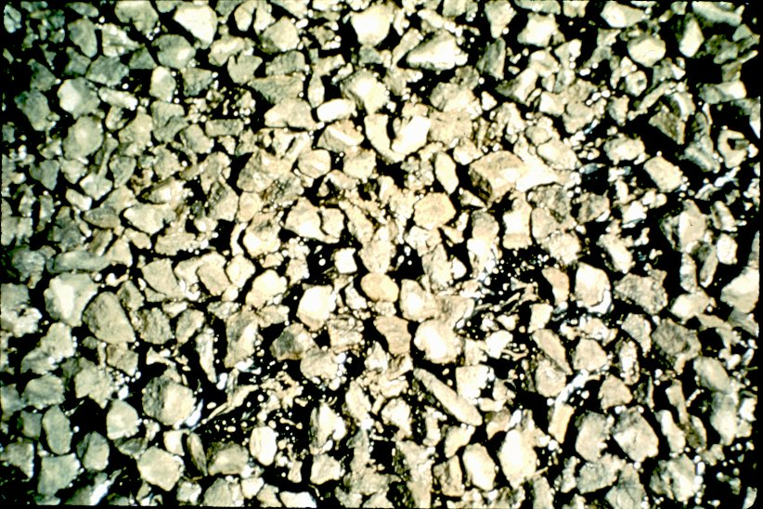
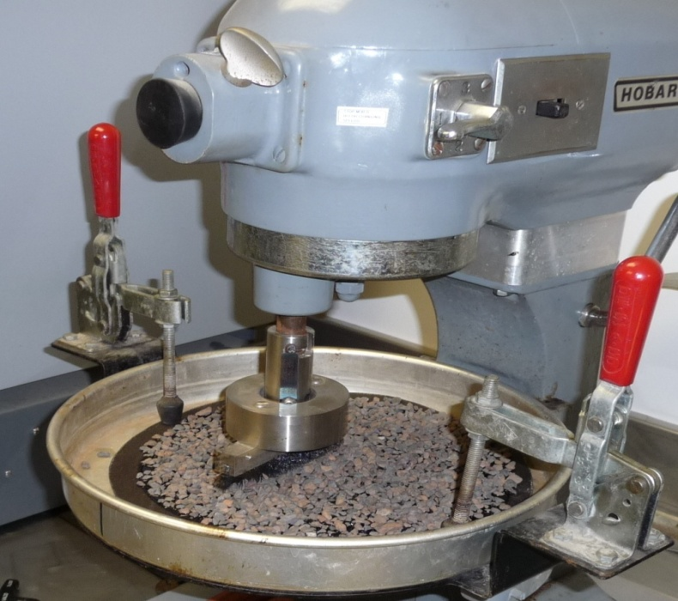
Laboratory Tests
Design Test
  Pan (1 yd x 1 yd)
  Place one layer of aggregate
  Fill with water until top of aggr
  Volume of binder is 2/3 of water
  Adjust binder rate to road condition and traffic volume
Sweep Test
Notes:
A rather simple laboratory procedure to estimate the required amount of aggregate and asphalt is to spread the aggregate to be used over an area of 1 m². A 1 m x 1 m x 25 mm pan can be used for this purpose. Aggregate is placed in the densest condition anticipated to exist in the field. Determine the weight of the aggregate used which equals to the required weight of the aggregate to be used in the field in kg/m². The pan is then carefully filled with water until the surface of the water comes just to the top of the aggregate. The volume of water is determined and approximately two-third of that volume is the quantity of asphalt required in the field. It is important to adjust the asphalt content to the condition of the road in the field and traffic volume. The quantity of asphalt should be increased if the road is absorbent or badly cracked, or decreased if the road is “fat” with flushed asphalt. Also, if traffic volume is high, the quantity of asphalt should be decreased due to the increased compaction by traffic which results in reorientation of aggregate particles to their flattest position and therefore increased embedment.

Slide 12
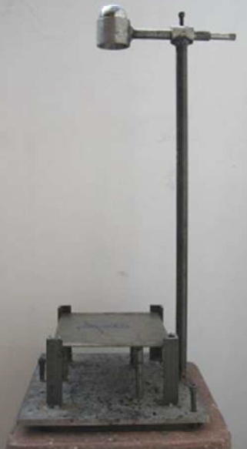
Vialit Test
  Place binder
  Place chips
  Cure
  Drop a ball 3 times on inverted plate
  Determine % aggregate retained

Slide 13
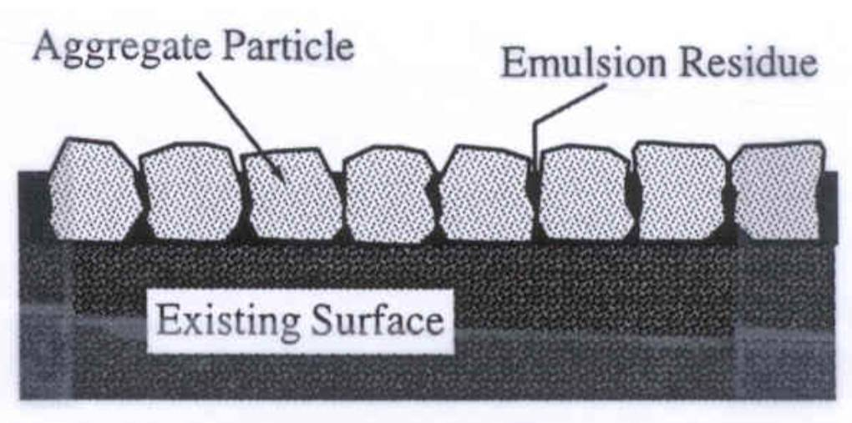
Optimum Configuration

Slide 14
Optimum Rock Distribution

Slide 15
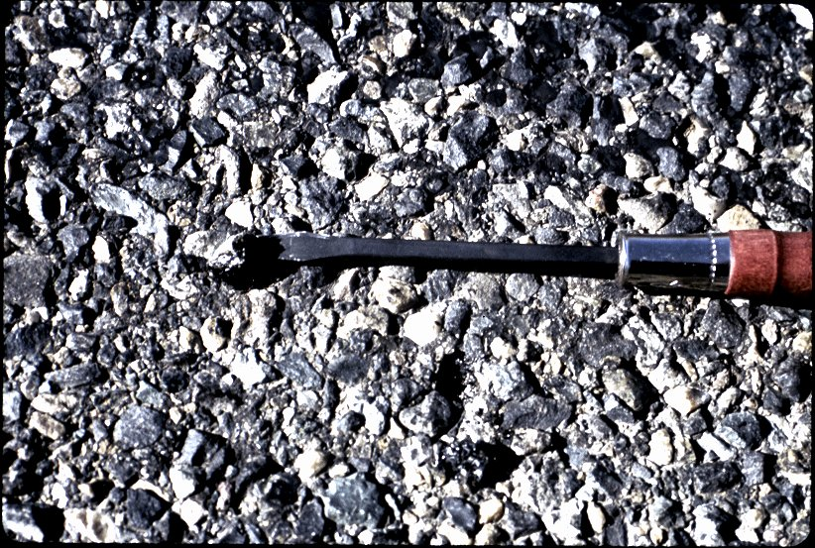
Embedment Check

Slide 16
Preparation & Weather
Survey pavement condition
Patch, seal, and cure
Air temperature > 50ºF
Pavement temperature > 70ºF
Dry surface
No threat of rain
Notes:
Before applying the chip seal the condition of the existing pavement has to be surveyed. Damaged areas has to be patched and wide cracks have to sealed. After curing the surface is to be cleaned with a power broom.
Many specifications require the air temperature be at least 10ºC before chip sealing begins. Some require the road surface temperature to be above 20ºC before work starts. Chip sealing should never be started when the surface is wet or when it is threatening to rain.

Slide 17
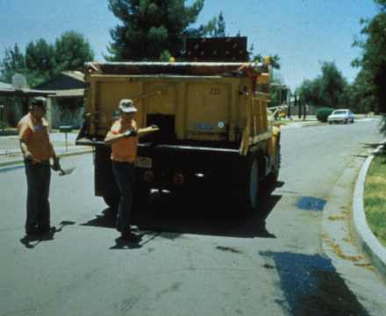
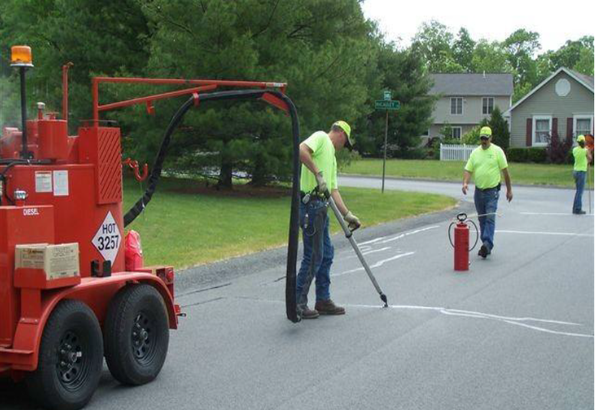
Patching and Crack Sealing

Slide 18
Construction Procedure
Clean with power broom
Spray binder
Spread aggregate immediately
Roll immediately
Allow binder to cure
Sweep excess aggregate
Notes:
It is important to follow correct construction procedure in order to obtain long-lasting chip seal application.
Asphalt binder is sprayed after which aggregate is spread immediately. The pavement is rolled immediately to embed aggregate particles and orient them on their flat side. After the binder is cured sweep excess aggregate.

Slide 19
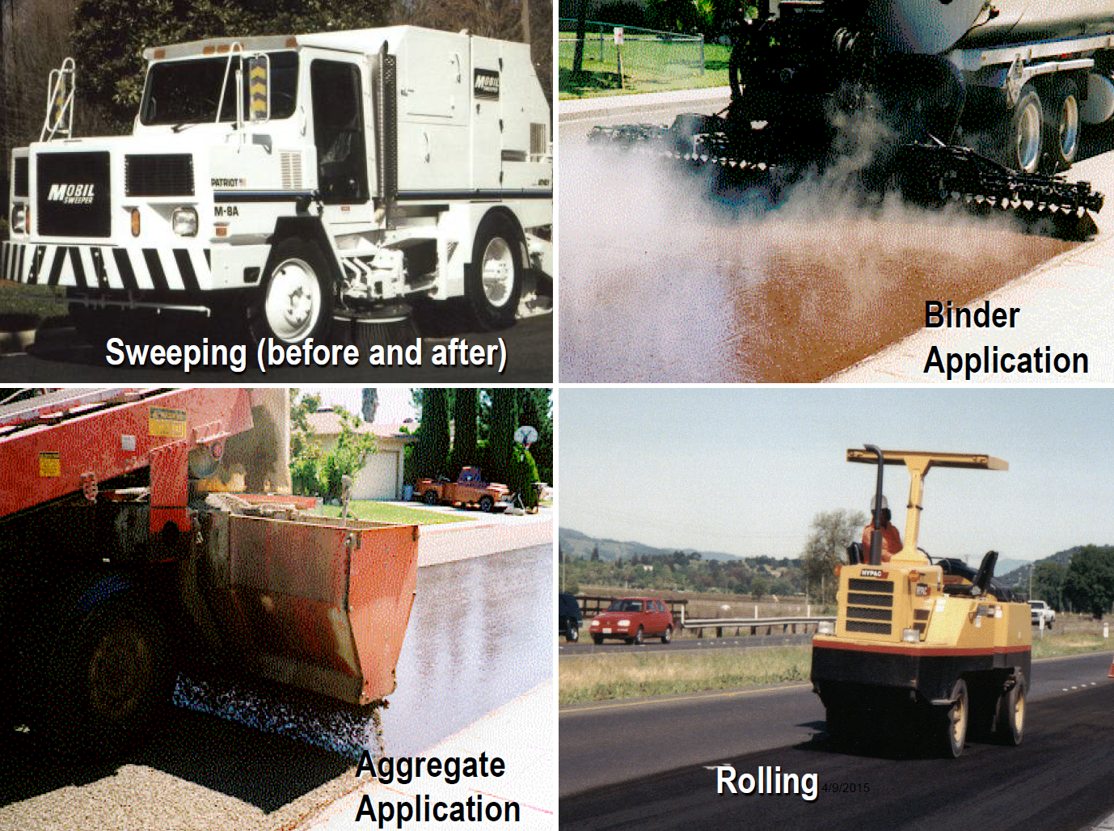

Slide 20
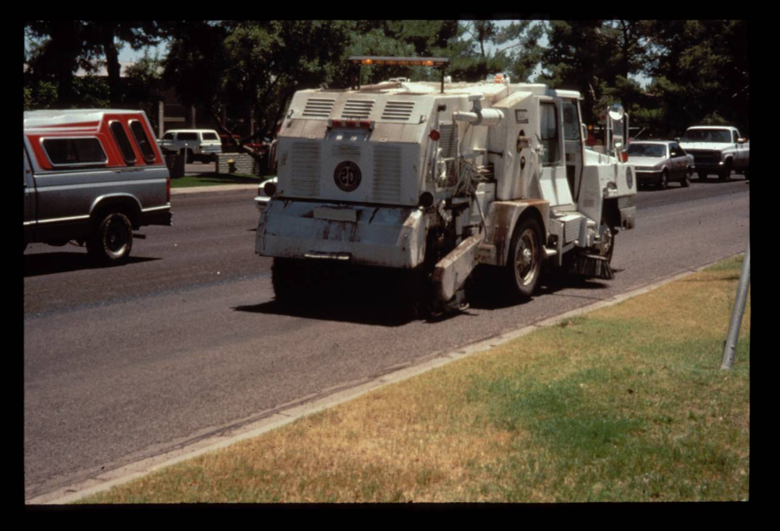
Brooming

Slide 21
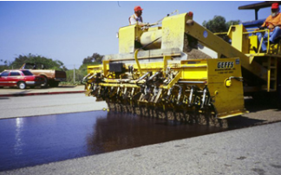
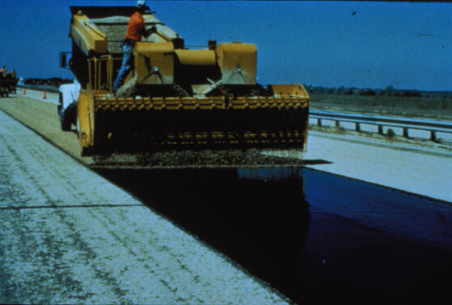
Binder Spraying
Rock Application

Slide 22
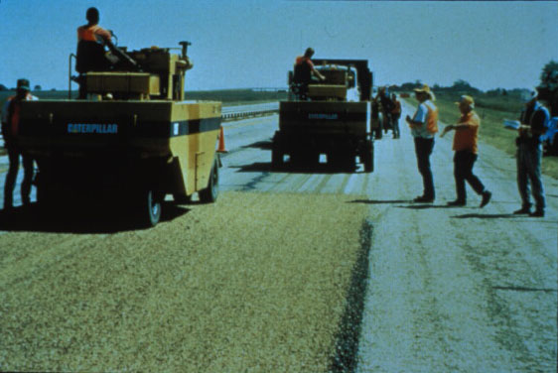
Rolling

Slide 23
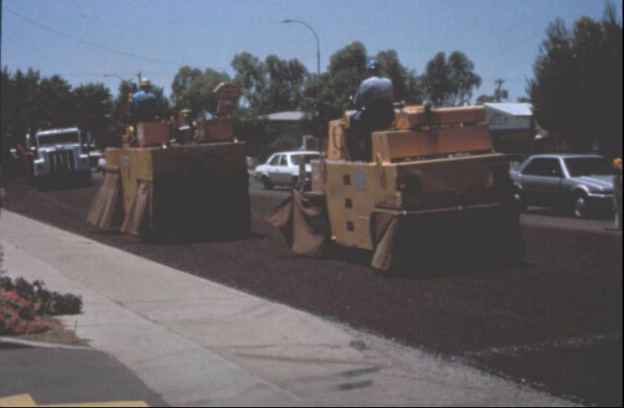
Covered Rollers

Slide 24
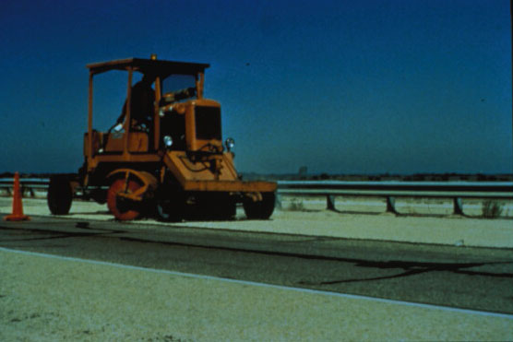
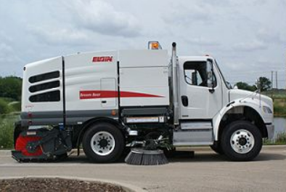
Light Brooming

Slide 25
Traffic Control
Open road to traffic after rolling and removing excess chips
Limit speed to 15 - 25 mph for 2 hours
Use pilot car
Notes:
The road may be opened to traffic after rolling is completed and excess aggregate is removed. Traffic speed should be limited to about 25 to 40 km/h for about 2 hours on newly placed chip seals. This time may be increased in humid weather or reduced if modifiers or asphalt cements are used. A pilot car can be used to control the traffic speed.

Slide 26
Inspection & Acceptance
Nozzles are clear and at the right angle
Spray bar at correct height
Pump at proper pressure
Verify spray bar calibration
Notes:
Before work begins equipment should be checked to make sure it is in good working condition. Nozzles should be clear and at the right angle, the spry bar is at the correct height, and the pump is set at proper pressure. The calibration of the spray bar should be verified.

Slide 27
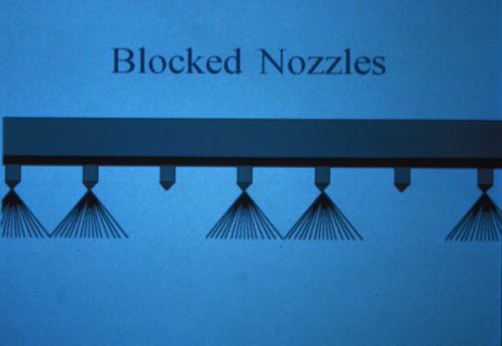
Blocked Nozzles

Slide 28
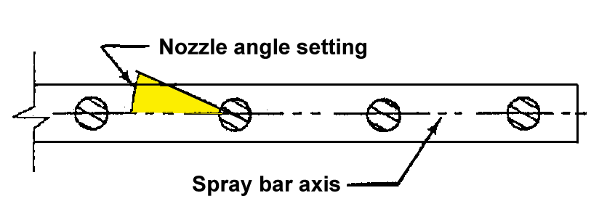
Nozzle Angle

Slide 29
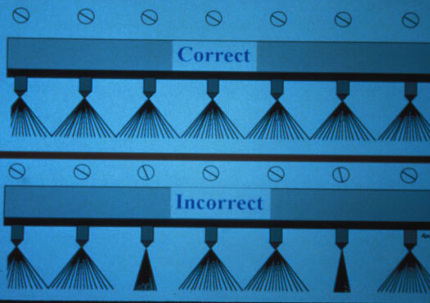
Nozzle Angle

Slide 30
Spray Bar Height
Spray bar
Nozzle
Single overlap
Double overlap
Triple overlap
Double overlap recommended

Slide 31
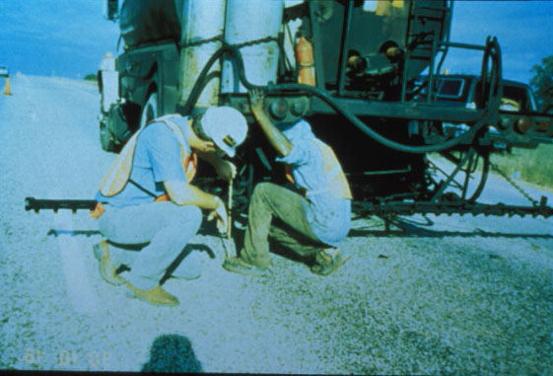
Adjusting Spray Bar Height

Slide 32
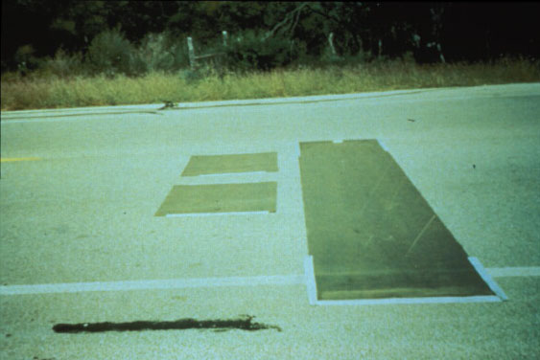
Spray Bar Calibration

Slide 33
Inspection & Acceptance
Proper temperature of asphalt
Proper speed of asphalt distributor
Aggregate spreader working properly
Calibrate chip spreader
Notes:
Asphalt should be at the proper temperature before spraying. The asphalt distributor should be driven at the appropriate speed. The aggregate spreader should be checked to ensure proper working condition. The application rate of aggregate should be calibrated as shown in a later slide.

Slide 34
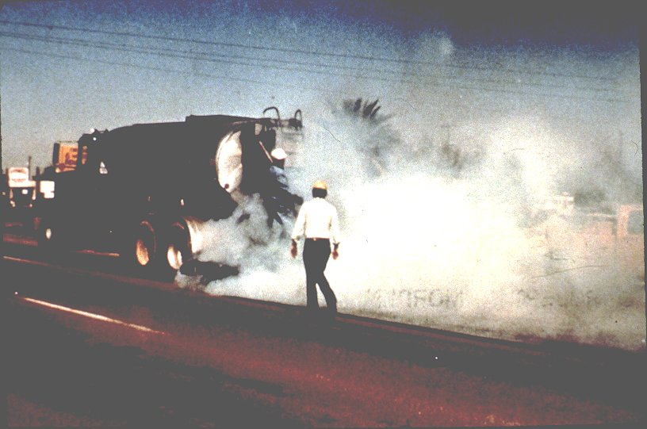
Too Hot Emulsion

Slide 35
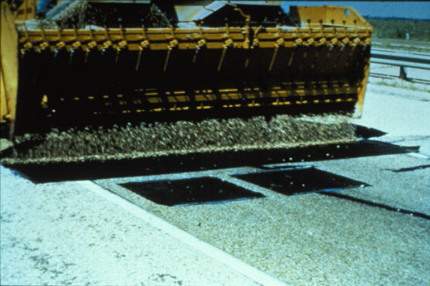
Calibration of Chip Spreader

Slide 36
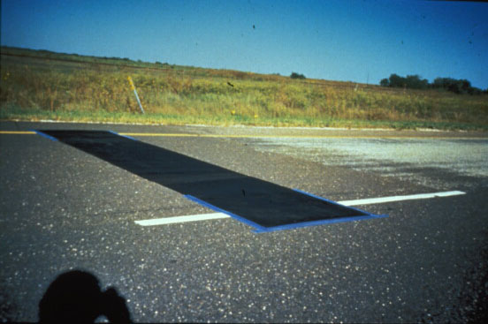
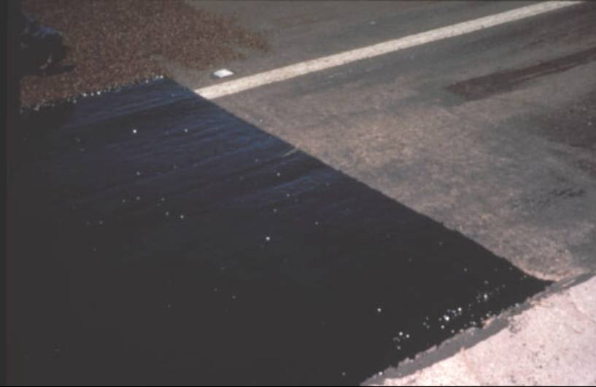
Transverse Joints

Slide 37
Specifications
Materials
Application rate
Construction details
Weather conditions
Method of measurement
Basis of payment
Notes:
Typical state specifications include description of work, application rate, construction details, weather conditions, method of measurement, and basis of payment.

Slide 38
Chip Seal Performance
4 to 7 years on highways with 5,000 vpd/lane
Pavement condition before application is critical
Notes:
Chip seals typically provide good performance on highways with 5,000 vpd for about 4 to 7 years. Several chip seal projects were constructed under the SHRP SPS-3 project. Preliminary indications show that timing of chip seal application is critical to its performance and cost effectiveness.

Slide 39
Performance (Cont.)
Performance depends on
Traffic
Pavement condition
Size, rate and type of aggregate
Binder type and rate
Environmental condition
Notes:
Chip seal performance has been mixed. It has been performed for many years in some projects, where as in others it failed fairly early. The performance varies depending on several factors such as traffic volume and load; existing pavement condition; size, rate and type of aggregate; type and rate of binder; and environmental conditions.

Slide 40
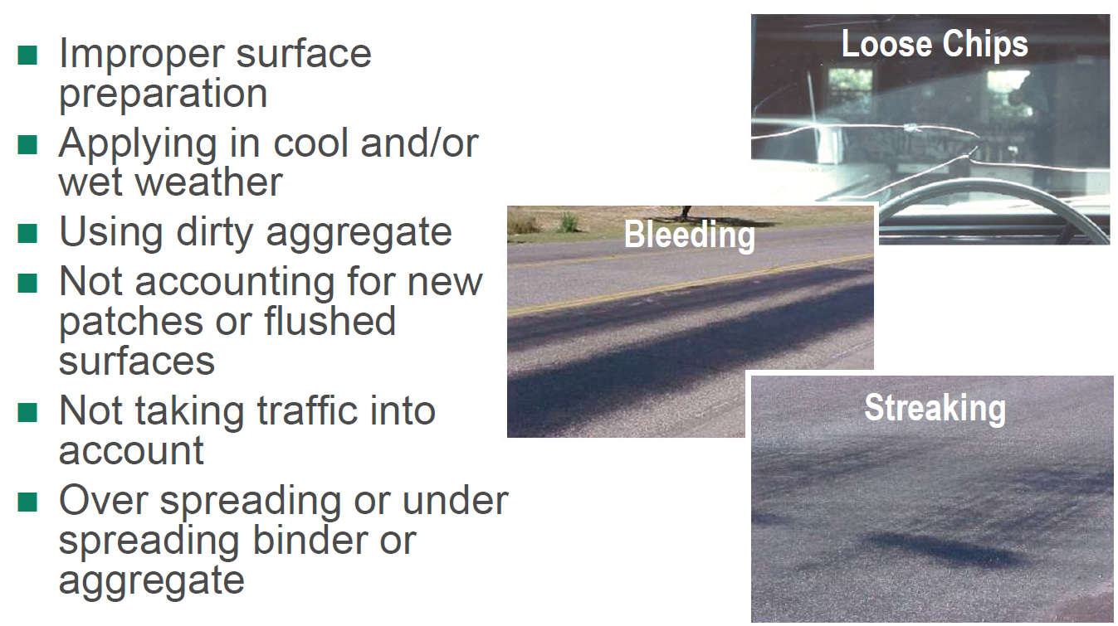
Chip Seal Problems

Slide 41
Variations on Chip Seal
Alternate binders
Double and triple chip seals
Precoated chips
Light-weight chips
Sand seal
Scrub seal
Sandwich seal
Cape Seal
Notes:
Several variations can be used with the chip seal to address some of the previously noted problems. These variations include using single, double or triple chip seal; use of modified binder; use of asphalt cement; use of precoated chips; sand seal; and sandwich seal. The use of multiple chip seals fill the voids between aggregate particles and increase the service life.
Sand seal, sandwich seal and cape seal are other alternatives to chip seals.

Slide 42
Alternative Binders
Polymer modified emulsion
Crumb-rubber modified asphalt
Asphalt cement
Notes:
Some states such as Arizona, California, Texas, and Washington use polymer-modified chip seal on their high-volume roads. Modified emulsion reduces temperature susceptibility, provides better adhesion to the existing surface, and allow the road to be opened to traffic earlier. Both recycled rubber and synthetic polymers have been used as modifiers. The cost of crumb rubber modified (CRM) chip seals is about twice the cost of conventional seals, while the use of synthetic polymers adds very little to the cost of conventional chip seal.
The use of asphalt cement as a binder allows opening the road to traffic earlier. However, it increases the cost and requires clean aggregate and special equipment for acceptable results.

Slide 43
Double Chip Seal
2 or 3 alternate applications of asphalt and aggregate
Each successive layer = 1/2 of preceding layer
Notes:
A double or triple chip seal consists of two or three alternate alternate applications of asphalt and aggregate, respectively. The nominal top size of the cover aggregate for each successive course should not be more than one-half that of the preceding one. When using multiple chip seal applications, the first layer should be cured before the application of the second layer.
Chip seal is also known as seal coat, surface treatment, or armor coating.

Slide 44
Double Chip Seal (Cont.)
Layer thickness = Aggregate size of first course
Double chip seal costs 1 1/2 times single chip seal
Double chip seals last > twice single chip seals
Notes:
The aggregate size of the first course determines the surface layer thickness, while the aggregate in the following layers fill the voids in the preceding layers.
Double chip seals cost about 1 1/2 times single chip seals. However, double chip seals usually give more than twice the service life of single chip seals.

Slide 45
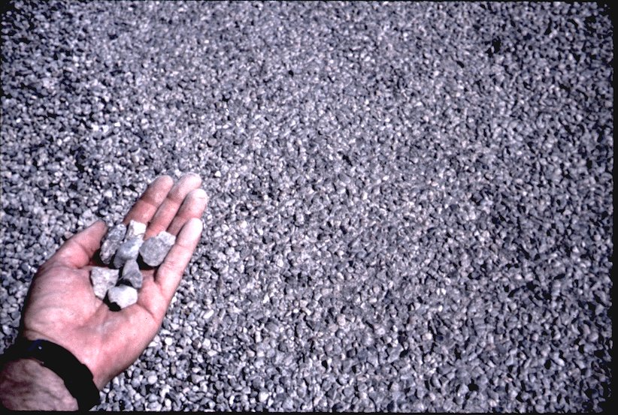
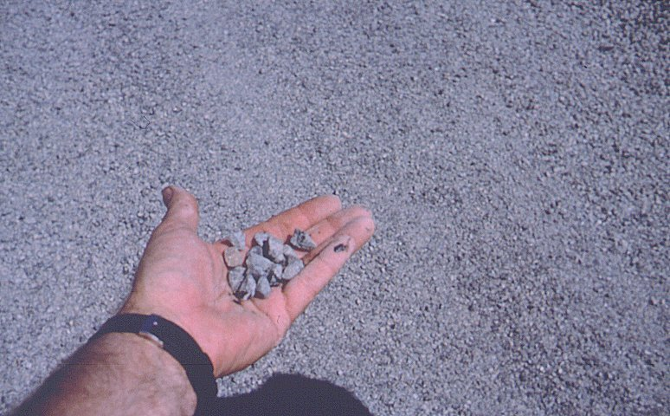
First Layer 3/4 in. Chips
Second Layer 3/8 in. Chips

Slide 46
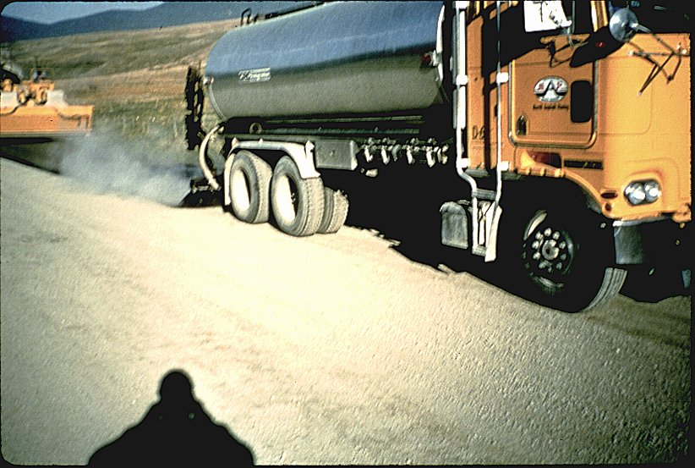
Second Binder Application

Slide 47
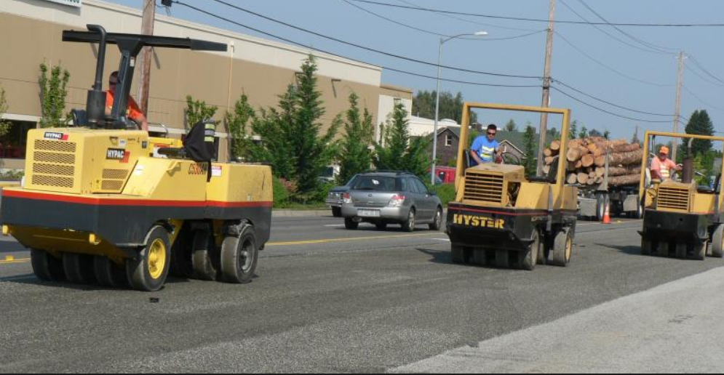
Rolling

Slide 48
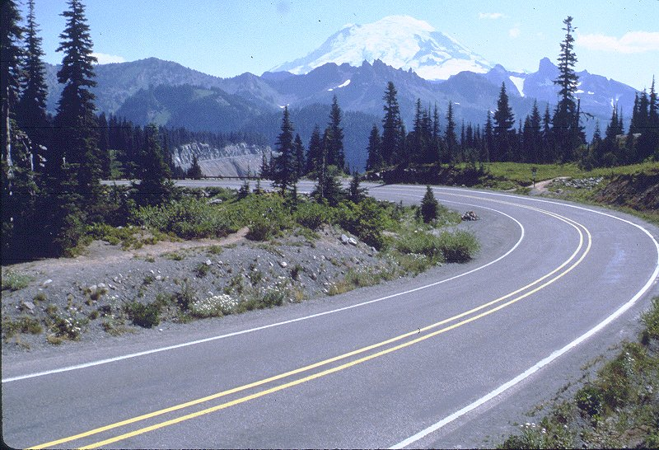
Double Chip Sealed Roadway

Slide 49
Precoated Chips
Eliminate dust
Improve bond
Coated chips should separate and flow readily thru spreader
Binder is asphalt cement
Notes:
Precoated aggregate is used by some states such as Illinois, Oregon, Pennsylvania, Texas, Utah, Virginia and Arizona. Precoating eliminates surface dust and improves adhesion between aggregate and binder. Early adhesion is advantageous on high-volume roads to allow early opening of the road to traffic. In this case an asphalt cement content of about 0.75 to 1% by weight of chips and 90% or more coating are desired. A mixing temperature of about 140ºC is recommended. Correctly coated aggregate particles should separate from each other easily and flow readily through spreaders.

Slide 50
Light-Weight Chip Seal
Use light-weight chips instead of regular chips
Used to reduce the risk of breaking windshields

Slide 51
Sand Seal
Asphalt binder followed by sand cover (No. 8)
Binder is rapid or medium setting emulsion
Mostly for low volume roads
Notes:
Sand seal is an application of asphalt followed by a sand cover aggregate. The sand or stone screenings should be 6.35 mm sieve size or smaller. The binder used for sand seals is usually a rapid setting (anionic or cationic) or a medium setting (anionic or high float) emulsion. Therefore, sand seal is essentially the same as chip seal except that finer aggregate is used as cover. It has mostly been applied to low-volume roads. Some agencies have applied sand seals on moderate to high volume roads and reported good performance.

Slide 52
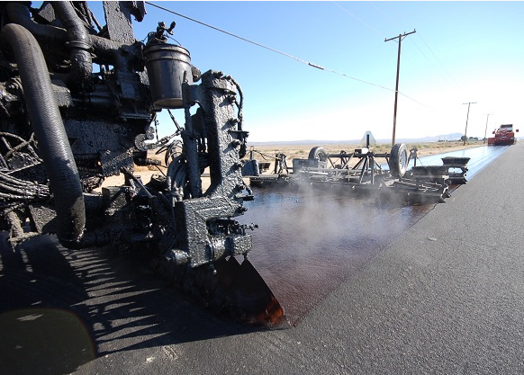
Scrub Seal
Application of sand or small-sized aggregate on broomed layer of polymer-modified asphalt
Notes:
A scrub seal consists of a layer of polymer-modified asphalt that is broomed into the voids and cracks of the pavement, followed by the application of sand or small-sized aggregate. The mixture is then broomed again and rolled with a pneumatic-tired roller. Scrub seals have been used since the 1950s, with California and Arizona being some of the pioneers in its use. Only recently have other states started to look at scrub seals as a viable maintenance treatment. Scrub seals are intended to rejuvenate the asphalt surface and to fill voids and surface cracks.
Other interesting facts:
Scrub seals are showing good performance on lower volume roads (less than 7,500 ADT).
Generally easy to apply and relatively inexpensive.
They have been used extensively in California and Arizona, and recently seeing more use in Missouri.
Some concerns regarding low friction levels on some roadways.
A disadvantage is that is requires some special equipment.
2 - 3 hour cure time.

Slide 53
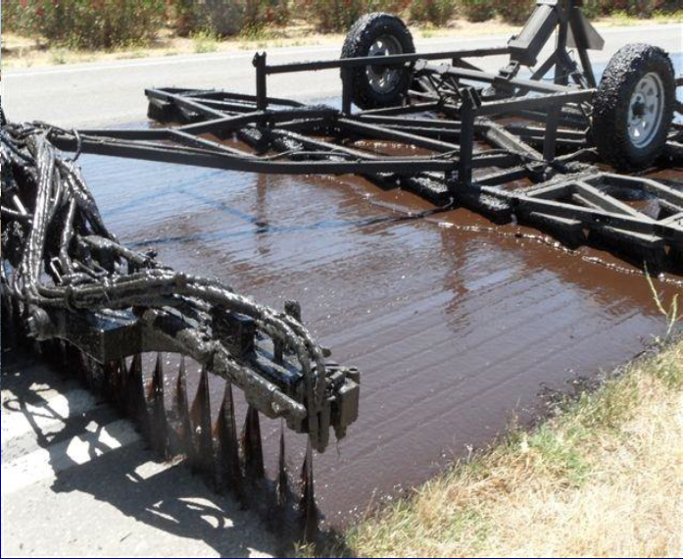
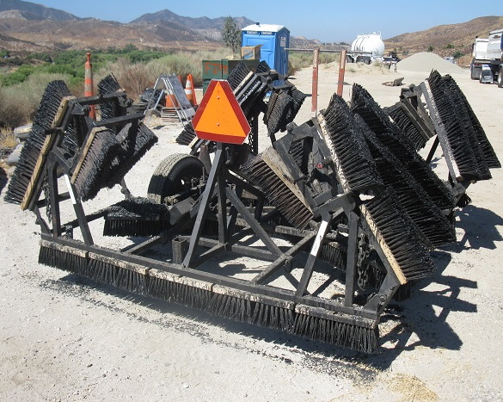
Scrub Seal

Slide 54
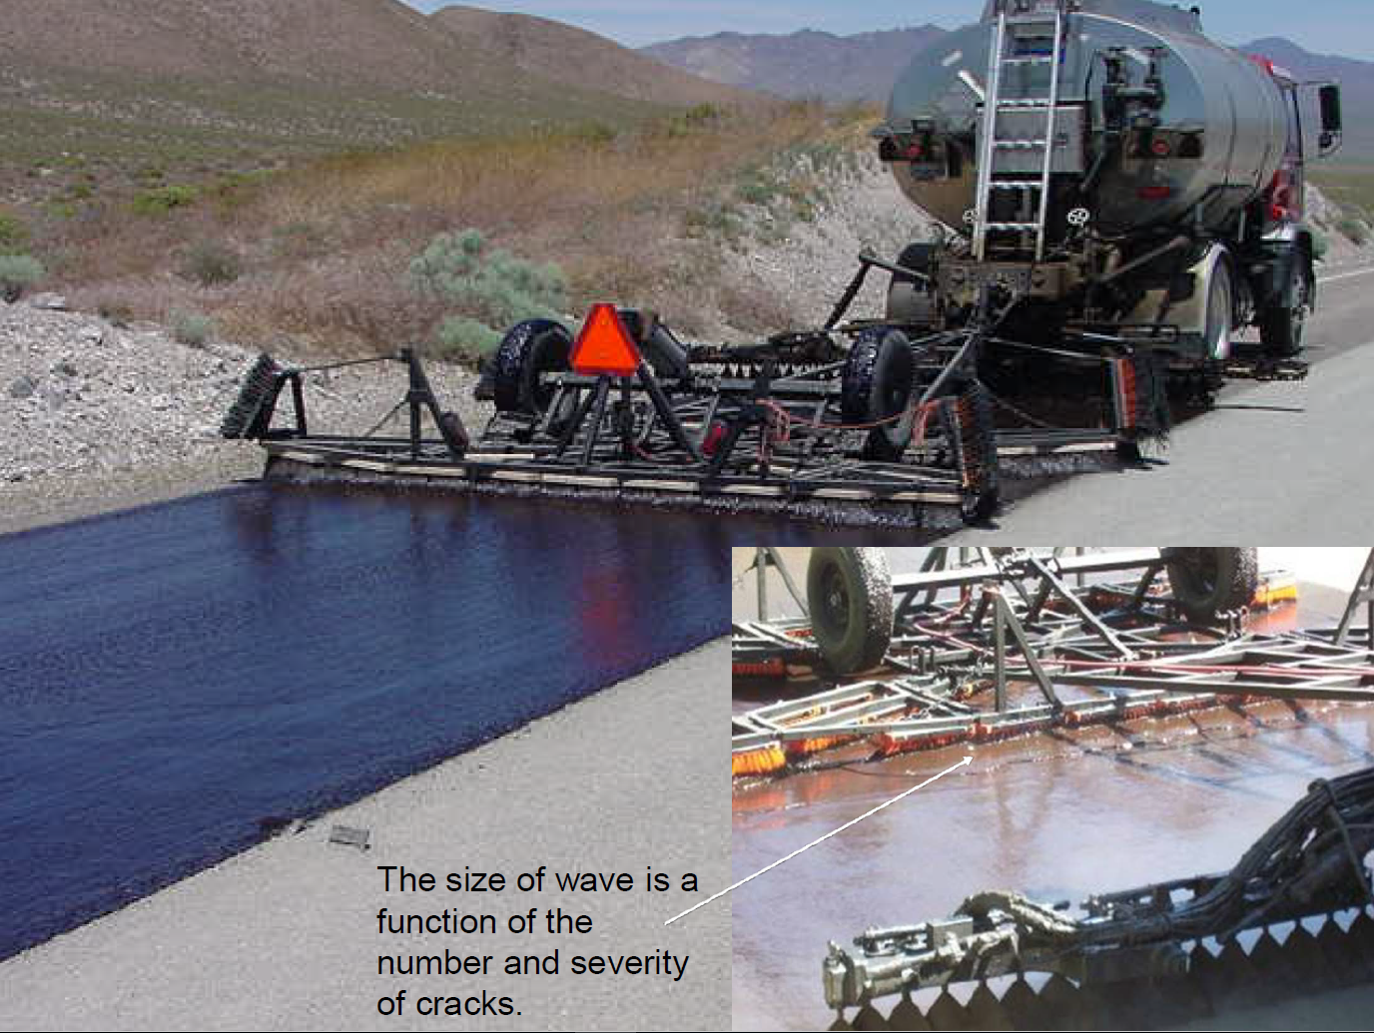

Slide 55
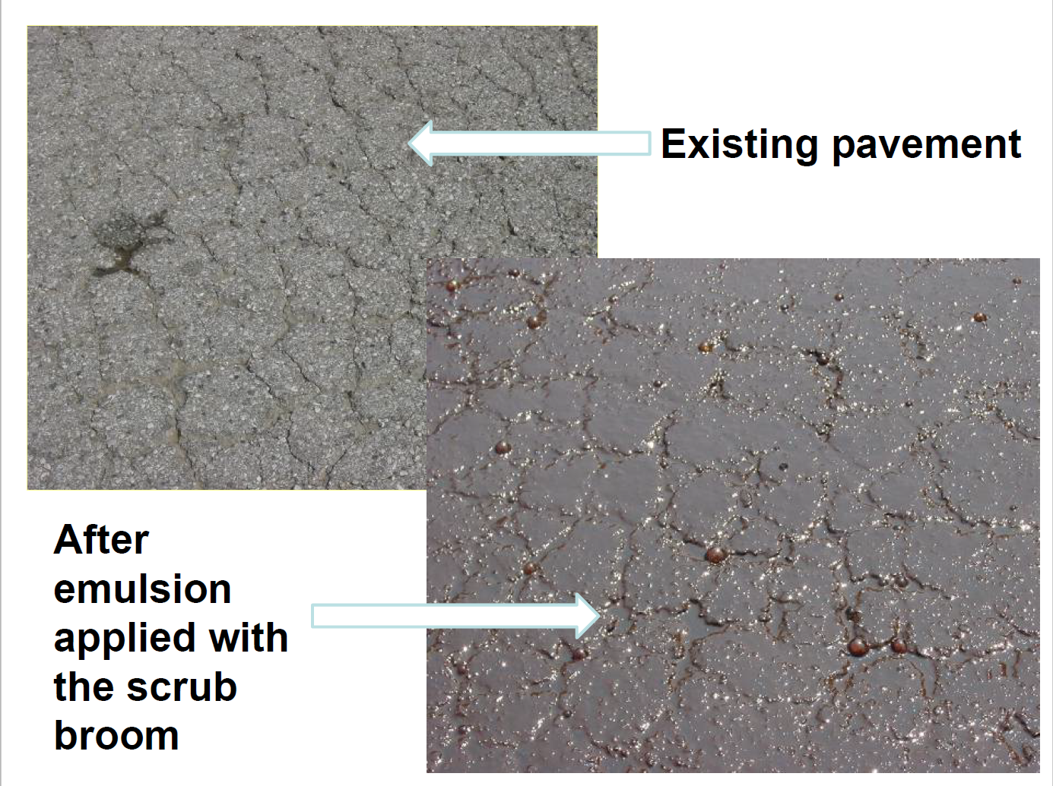

Slide 56
Uses of Scrub Seal
Fill and seal small cracks and voids
Enrich hardened/oxidized asphalt
Preparation for another treatment
Not preventive maintenance, but rather corrective

Slide 57
Sandwich Seal
One application of binder
between two layers of chips
  Small Chips (No. 8 – No. 4)
  Emulsion
  Large chips (No. 4 – 3/8 in.)
Notes:
Sandwich seal is an application of binder sandwiched between two layers of aggregate. In this process, one-sized aggregates 4.75 to 9.5 mm are spread on a clean and dry pavement at a rate of about 80% of the amount needed to provide coverage at one stone thickness and then compacted. Asphalt emulsion is then applied at a rate of 1.2 to 1.5 times the amount for a conventional single course treatment. A second course of one-sized 2.36 to 4.75 mm is applied and rolled.

Slide 58
Sandwich Seal Construction
Spread bottom layer chips
Roll with light-weight steel roller
Spray emulsion
Spread top layer chips
Roll slowly with pneumatic roller
Notes:
Before applying the sandwich seal the existing pavement has to be clean and dry. All aggregates used in the sandwich seal application have to be clean. A light-weight steel roller may be used to seat the first layer of aggregate. A slow-moving pneumatic roller is used to compact the top aggregate layer.

Slide 59
Cape Seal
Chip seal topped with either slurry seal or micro-surfacing
Named after Cape Province of South Africa
Notes:
A cape seal is chip seal topped with a slurry seal or micro-surfacing. The name is derived from the Cape Province of South Africa where it was originally developed.

Slide 60
Micro-Surfacing on Chip Seal

Slide 61
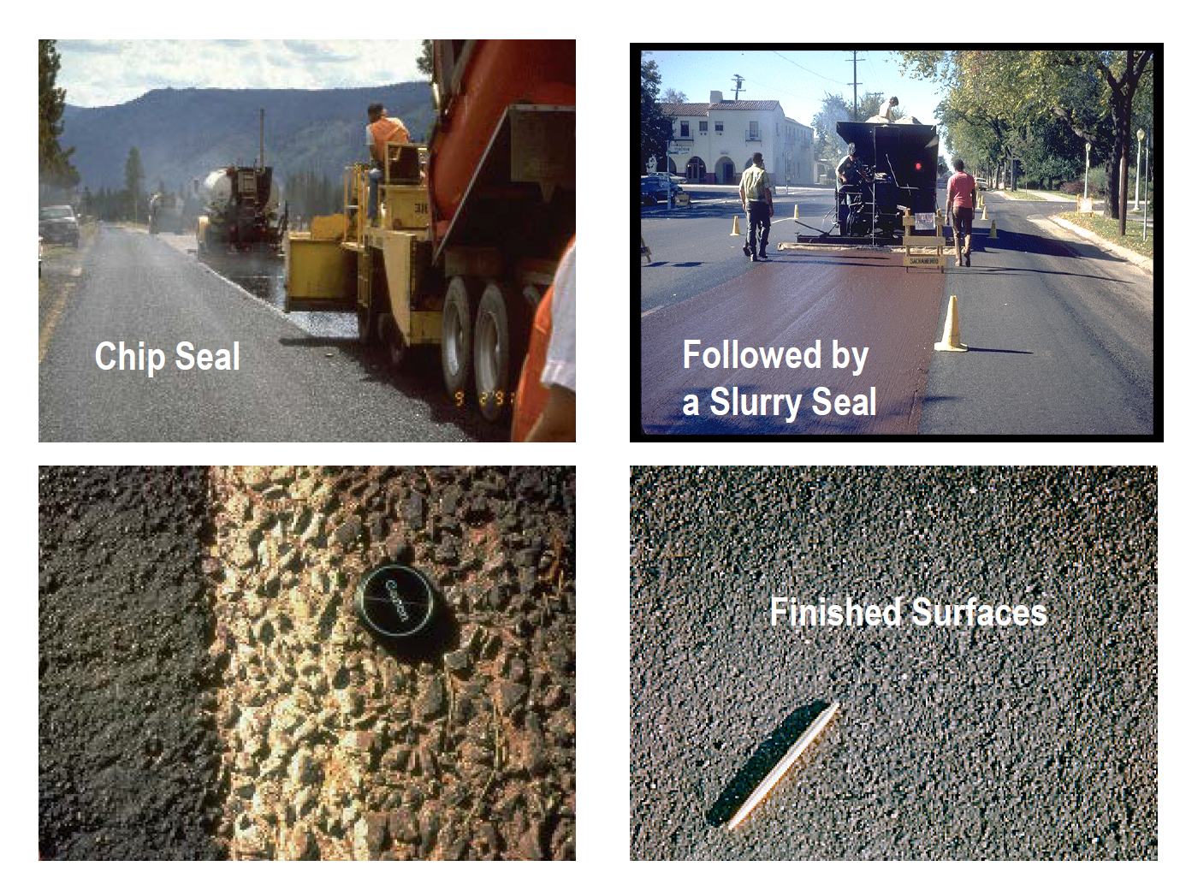

Slide 62
Properties of Cape Seal
Dense surface with improved skid resistance and a relatively long service life
No loose cover stones
More suited for high traffic volume roads
Notes:
The cape seal provides a dense surface with improved skid resistance and a relatively long service life. No loose cover stones are typically produced. These properties of cape seal make it very suitable for high traffic volume roads.

Slide 63
Cape Seal Considerations
Apply single chip seal
Cure for 4 - 10 days
Broom regularly
Apply slurry seal or microsurfacing
Cure for 2 -12 hr depending on temperature
Notes:
A single course of chip seal is applied in the conventional manner. A cure time of 4 to 10 days is required for the chip seal before applying the slurry seal. During that time the surface has to be regularly broomed in order to provide better adherence of the slurry. After the chip seal has been cured, the slurry seal is applied to fill the voids between the cover stones. After applying the slurry seal, traffic should be detoured for about 2 hours in warm weather, and 6-12 hours or more in cool weather.

