Slide 1
CRACK
TREATMENT
OF FLEXIBLE
PAVEMENTS
Notes:
This section of the workshop deals with crack treatment of flexible pavements.

Slide 2
Crack Sealing
Routine maintenance
Involves cleaning & sealing
Prevents/reduces intrusion of
Water
Incompressible materials
Notes:
Crack treatment of flexible pavements is a routine maintenance activity that basically involves cleaning out the cracks which are wide enough to clean, and then filling the clean cracks with a sealant material. Crack treatment prevents or reduces intrusion of water and incompressible materials. SHRP projects H-105 and H-106 provided useful information related to crack treatment which is summarized below.

Slide 3
Conditions for Success
Type of maintenance depends on crack
Density
Severity
Pattern

Slide 4
Crack Treatment Design
Crack Sealing
Seal out water & incompressible materials
Crack Filling
Seal out water & preserve adjacent pavement
Notes:
Although little distinction has been made in the past between crack sealing and crack filling, it is important to understand the objective of crack treatment so that the most cost-effective and long-lasting treatment is applied.
Crack sealing is defined as the placement of specialized materials either above or into working cracks using unique configuration to prevent the intrusion of water and incompressibles into the crack. Crack filling is the placement of materials into nonworking cracks to substantially reduce infiltration of water and to reinforce he adjacent pavement.

Slide 5
Working vs. Nonworking Cracks
Working crack moves more than 1/8 in.
Nonworking crack moves less than 1/8 in.
Notes:
Working refers to horizontal and/or vertical crack movements greater than or equal to 3 mm, while nonworking refers to movements less than 3 mm.

Slide 6
Sealing vs. Filling
Sealing
For working cracks with limited edge deterioration
Filling
For nonworking cracks with moderate/no edge deterioration
Notes:
Generally, crack sealing is more difficult to accomplish than crack filling. Sealing requires considerably more forethought, greater costs, and the use of specially formulated materials and more sophisticated equipment.
Normally, working cracks with limited edge deterioration should be sealed, while nonworking cracks with moderate to no edge deterioration should be filled.

Slide 7
SHRP Guidelines
Crack Edge Deterioration
Density Low Moderate High
Low None CT ?? CR
Moderate CT CT CR
High ST ST Rehab.
CT = Crack Treatment (Sealing / filling)
CR = Crack Repair
ST = Surface Treatment
Preventive
Maintenance
Notes:
The appropriate type of maintenance for cracked asphalt pavements depends on the density and general condition of the cracks. If cracks are abundant (i.e., high in density) and do not exhibit high degree of edge deterioration, they may best be treated through chip seals, slurry seals, or a similar treatment. If cracks are low to moderate in density and have typically progressed to a point of high edge deterioration, then crack repair strategies, such as partial-depth patching or spot patching, may be warranted. Finally, if cracks are moderate in density and show moderate to no deterioration at the edges, they may be treated effectively through sealing or filling operations.

Slide 8
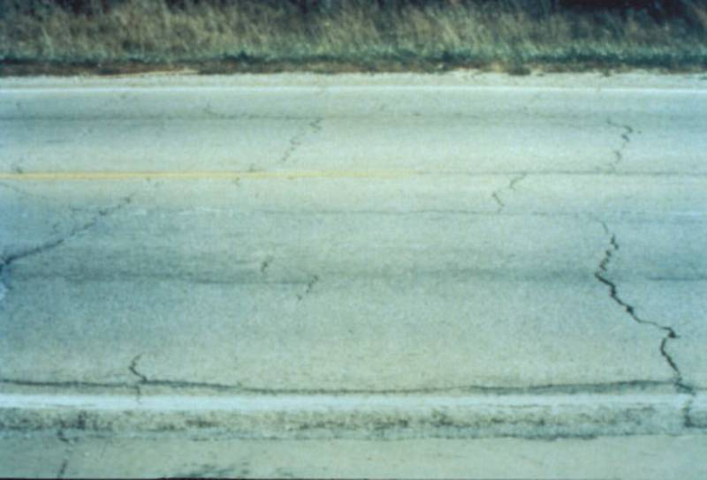
High Density, Moderate Edge Deterioration

Slide 9
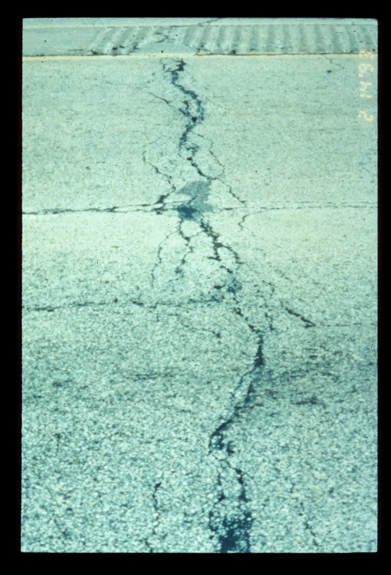
Moderate Density, High Edge Deterioration

Slide 10
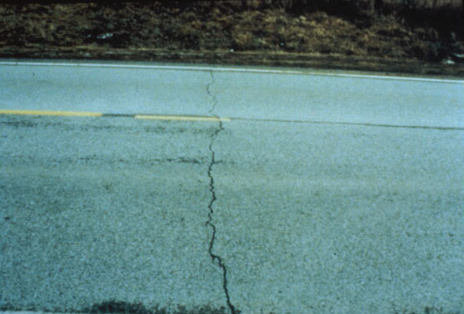
Low Density, Moderate Edge Deterioration

Slide 11
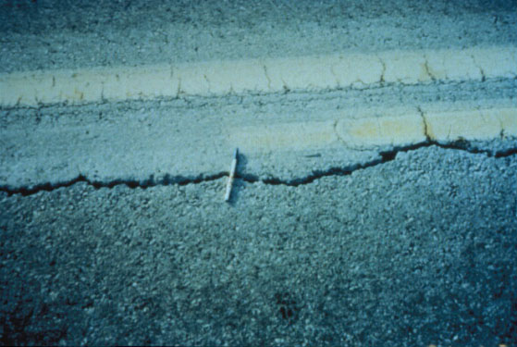
Low Density, Moderate Edge Deterioration (Nonworking)

Slide 12
Sealing/Filling Materials
Cold applied thermoplastic
Hot applied thermoplastic
Chemically cured thermosetting
Notes:
Materials for sealing/filling asphalt pavement cracks may be divided into three categories:
1. Cold applied thermoplastic materials such as: a) liquid asphalt (emulsion or cutback), and b) polymer-modified liquid asphalt.
2. Hot applied thermoplastic materials such as: a) asphalt cement, b) mineral-filled asphalt cement, c) fiberized asphalt , d) asphalt rubber, e) rubberized asphalt, and e) low-modulus rubberized asphalt.
3. Chemically cured thermosetting materials

Slide 13
Thermoplastics
Asphalt has little flexibility & very temperature- susceptible
Rubber & other additives improve flexibility
Notes:
Asphalt cement, liquid asphalt, mineral-filled asphalt cement, and fiberized asphalt possess little flexibility and are very temperature susceptible. Therefore, they are limited to use as fillers for nonworking cracks.
The addition of rubber polymer improves the flexibility of the asphalt. The degree of flexibility basically depends on the type and nature of the asphalt, percentage of vulcanized rubber used, and how the rubber is incorporated into the asphalt (i.e., mixed or melted in). Other additives are often incorporated into the asphalt, either exclusively or along with rubber, to increase resilience.

Slide 14
Chemically-Cured Thermosettings
Cure by chemical reaction from liquid to solid
Self-leveling silicon is an example
Notes:
Chemically cured thermosetting materials are cured by chemical reaction from liquid state to solid state.
Self-leveling silicone is one of these sealant materials which is cold-applied and does not require tooling since it is self-leveling.

Slide 15
Sealing Configurations
Flush-fill
Reservoir
Overband
Combination:
Reservoir and overband
Notes:
Sealant and filer materials can be placed in cracks in numerous configurations. These configurations are grouped into four categories: a) Flush-fill, b) Reservoir, c) Overband, and d) Combinations or reservoir and overband.

Slide 16
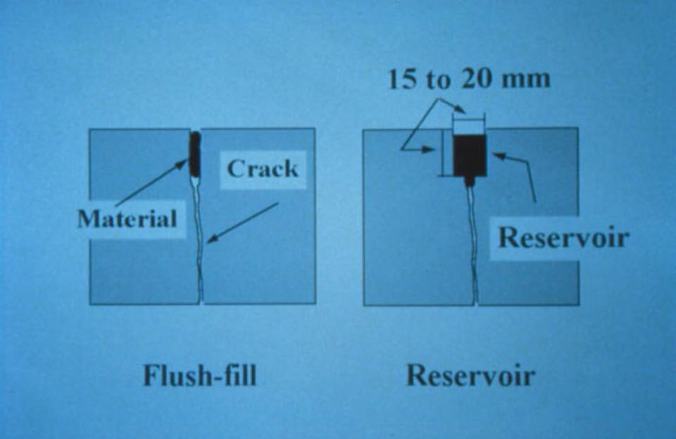
1/2 –3/4 in.

Slide 17
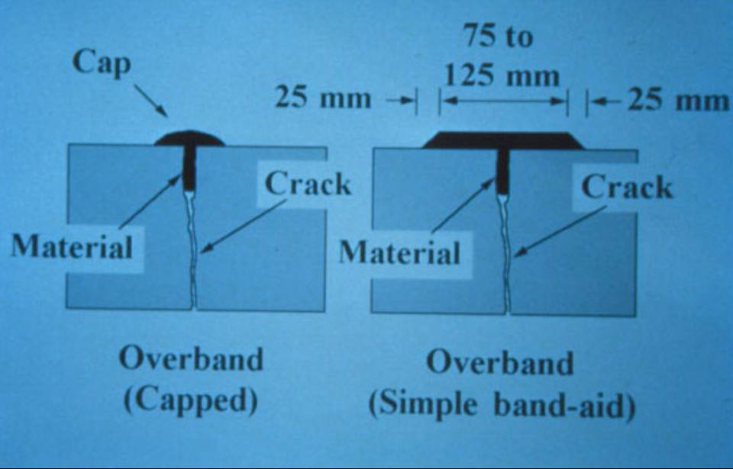
3 - 5 in.

Slide 18
Crack Treatment Procedure
Crack routing (Optional)
Crack cleaning & drying
Material preparation & application
Material finishing/shaping (Optional)
Blotting (Optional)
Notes:
Crack treatment consists of at least two and up to five steps, depending on the type of treatment (sealing or filling), treatment policy, and available equipment. These steps are: 1) crack cutting (routing or sawing), 2) crack cleaning and drying, 3) material preparation and application, 4) material finishing/shaping, and 5) blotting.

Slide 19
Pavement Preparation
Crack routing
Rotary-impact router
Diamond blade
Notes:
Open cracks should be routed to a width of 10 mm and a depth of 20 mm using either a rotary-impact router or diamond-blade crack saw. Routing is used to allow the sealant to enter the crack.

Slide 20
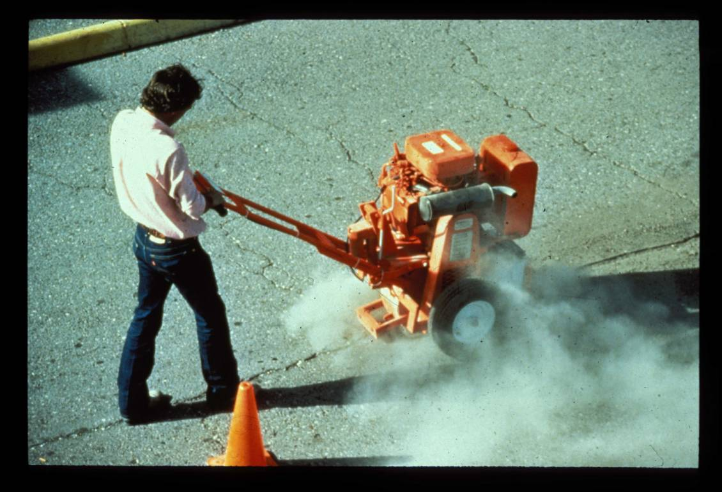
Rotary Impact Router

Slide 21
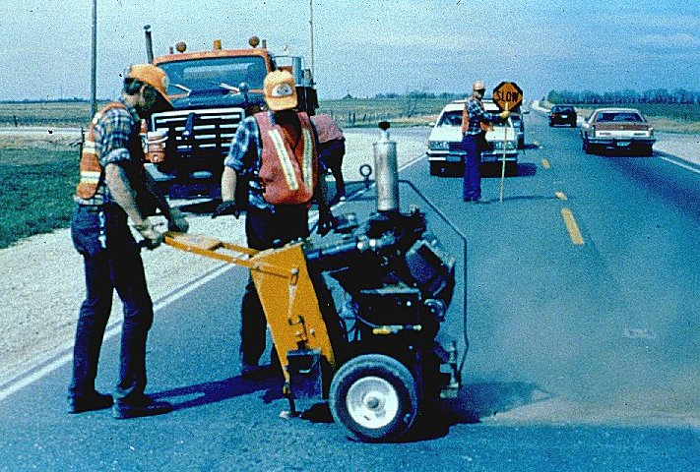
Diamond Blade Saw

Slide 22
Pavement Preparation (Cont.)
Cleaning & drying
Broom
Compressed air
Sandblasting
Hot air blasting (heat lance)
Notes:
This next step is to clean and dry the crack. For best results, the crack should be cleaned with a stiff-bristled broom, compressed air, hot airblasting using a heat lance, or sandblasting.

Slide 23
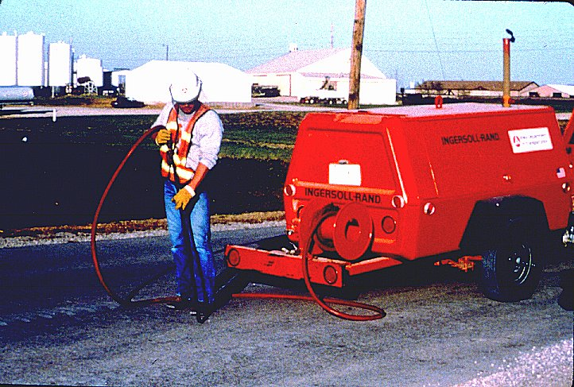
Air Blasting

Slide 24
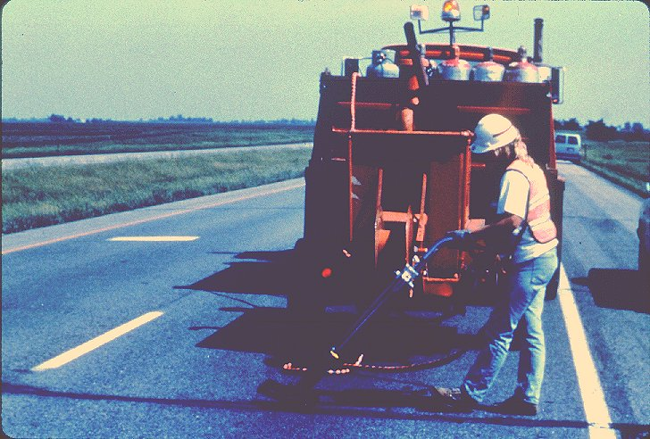
Hot Compressed Air Lance

Slide 25
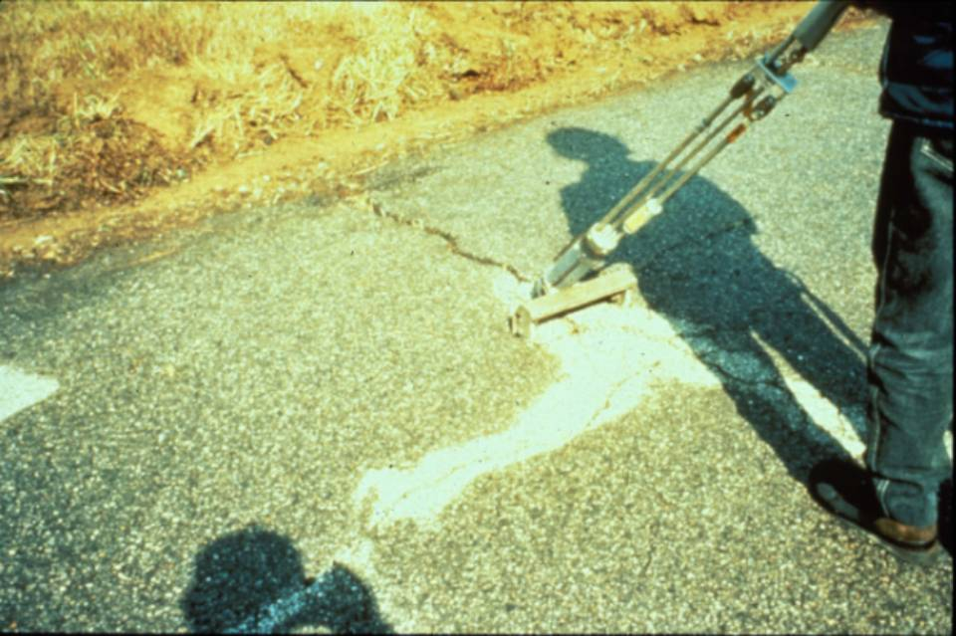
Excessive Hot Air Lance

Slide 26
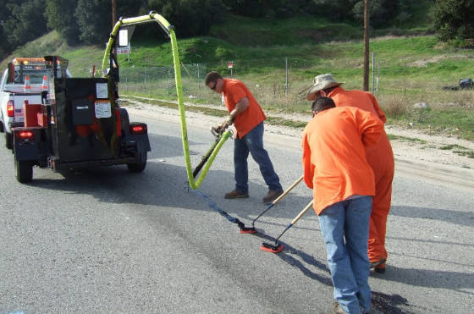
Sealing

Slide 27
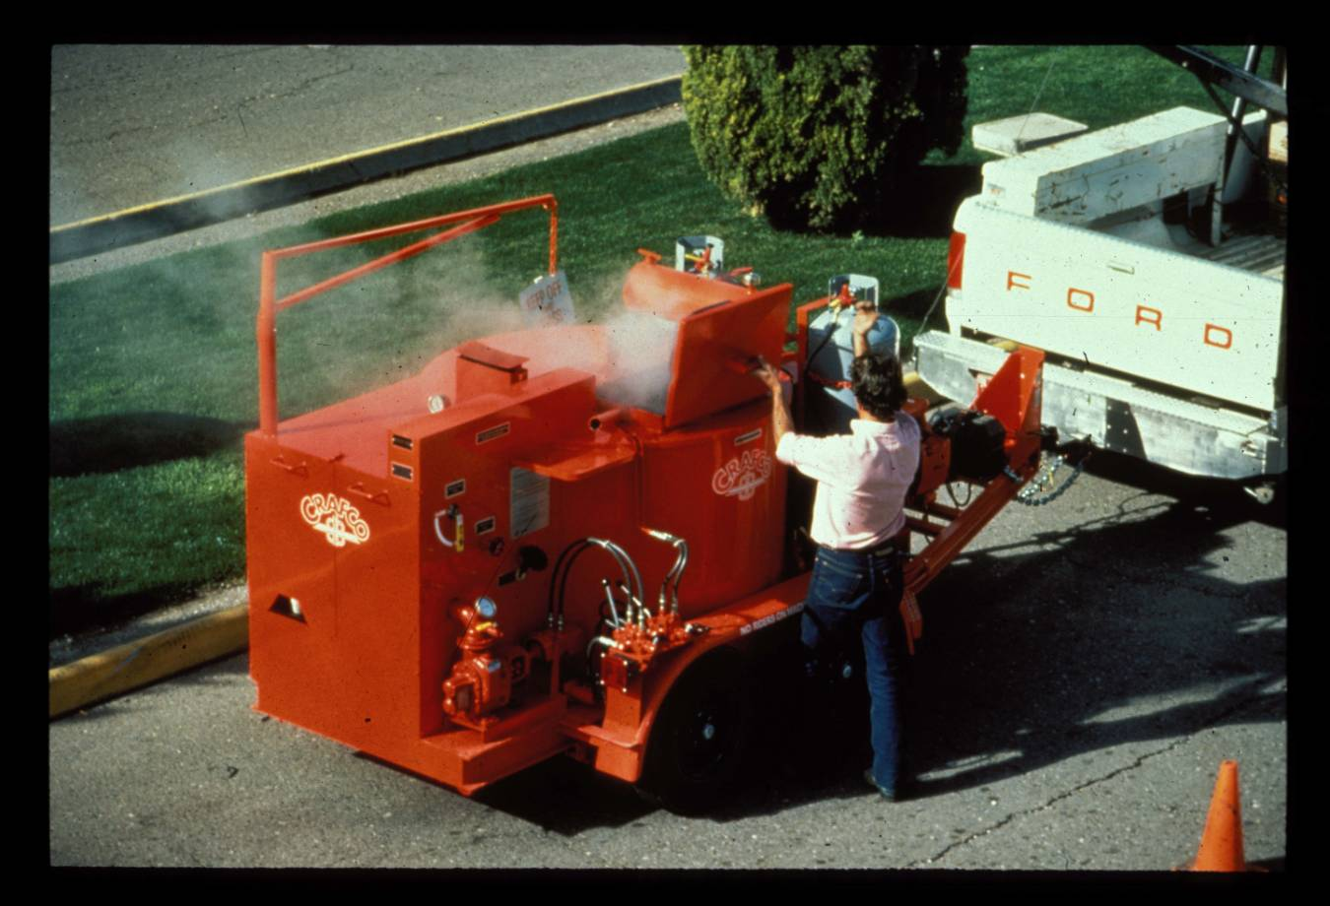

Slide 28
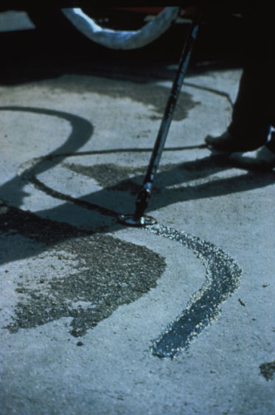
Applicator with a Shoe

Slide 29
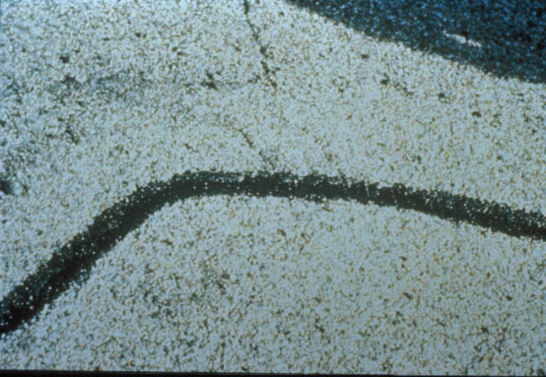
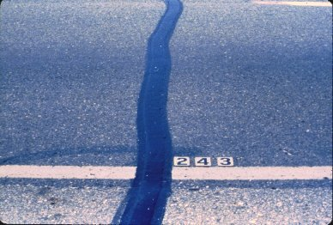
Sealed Cracks

Slide 30
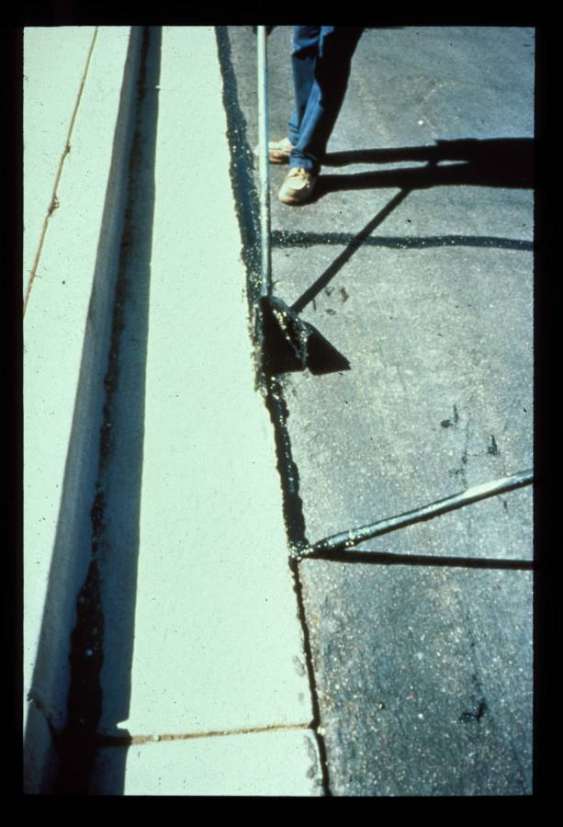
Edge Sealing

Slide 31
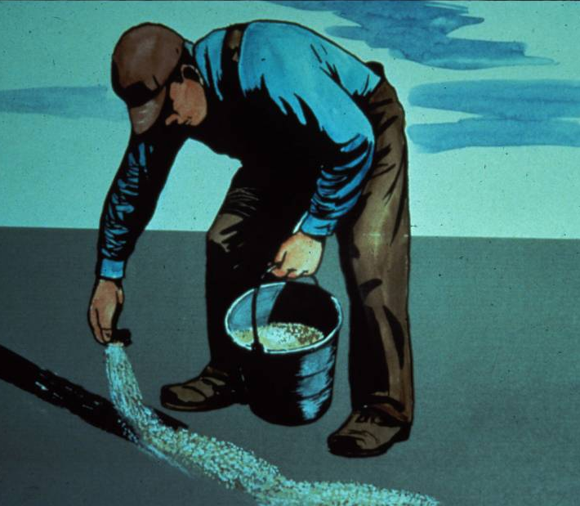
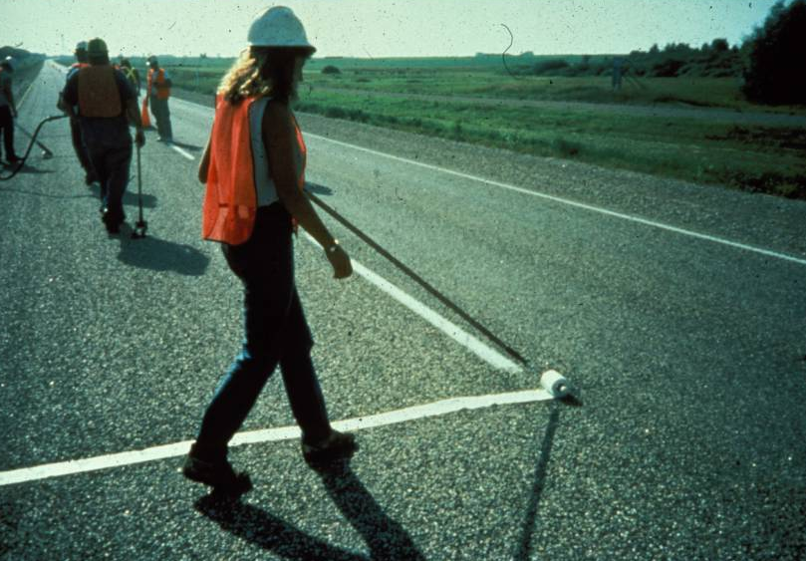
Covering Crack Sealant

Slide 32
Weather Conditions
When crack is open in cool weather (45 to 65ºF)
Spring or fall
Notes:
Ideally, crack sealing should be conducted shortly after working cracks have developed to an adequate extent and at a time of the year when temperatures are moderately cool (7 to 18ºC), such as in the spring or fall.

Slide 33
Traffic Control
Detour traffic until seal cures
Cover sealant with “Cleanse Oil” or sand for quick opening
Begin filling at pavement centerline
Notes:
Traffic should be routed until the sealant material cures. If the pavement is to be opened to traffic immediately after sealing, the material must be protected against pick-up by tires by dusting the cracks with fine sand, mineral dust or a similar material.
It is a good practice for workmen to begin filling operations at the centerline and back towards the edge of the pavement in order to avoid backing into the stream of traffic.

Slide 34
Crack Treatment Performance
Retards deterioration
Retards cupping deformation
May extend life by 4 years
Notes:
Crack sealing effectively retards internal and external deterioration and slows down the progress of cupping deformation (depression of pavement profile at the transverse crack). It was found that rout-and-seal treatment of transverse cracks can extend the serviceability of the pavement by at least four years.

Slide 35
Crack Treatment Limitations
Limited to low severity cracks
Limited service life
Must be repeatedly applied
Notes:
Crack sealing is limited to low severity cracks. High severity cracks such as fatigue cracks are seldom routed and sealed individually because the intensity of the crack patterns usually warrants an area treatment rather than individual crack treatment. Such treatment may involve removal and replacement, overlay, or seal coat for low severity fatigue cracking.

