Slide 1
On the Path to Autonomous Vehicles
Dr. Bill Sowell, MBA, PhD
Vice President- Eberle Design, Inc. & Reno A&E (USA)
Vice Chairman- International Road Federation (IRF) Executive Committee & Board of Directors
Chairman- IRF Intelligent Transportation Systems (ITS) & Systems Engineering Committee
Chairman- NEMA 3TS Performance Measures Technical Committee (TS-9 Standard)
© COPYRIGHT 2018. Eberle Design, Inc. All Rights Reserved.

Slide 2
Agenda
Introduction and Definitions
History
Today
Potential
Autonomous Vehicle Programs
Predictions and Conclusions
Notes:
In the course of this presentation we’re going to address the following subjects [READ AGENDA].
[MOUSE CLICK] We are also going to find out what the common house mouse, cosmic rays, and the human eye have to do with our subjects. Can you guess?

Slide 3
Introduction

Slide 4
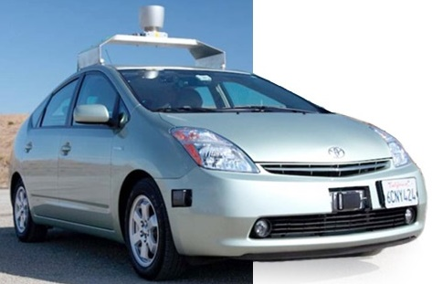
Vehicular Automation
Vehicular automation involves the use of
Mechatronics (Mechanics + Electronics)
Artificial Intelligence (AI)
Multi-agent System
to assist a vehicle's operator Automatic Driver Assist System, or “ADAS”.
These vehicle features may be labeled as “intelligent” or “smart”.
A vehicle using automation for difficult tasks, especially navigation, may be referred to as “semi-autonomous”.
Notes:
Let’s begin by introducing the main terms we’ll be using today.

Slide 5
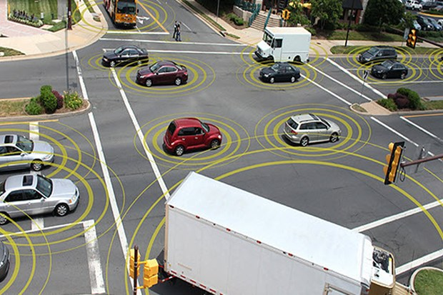
Definitions
An autonomous car is a type of autonomous vehicle capable of fulfilling the human transportation capabilities of a traditional car.
An autonomous vehicle, is capable of sensing its environment and navigating without direct human input (ie, truck, small delivery, paratransit, drones).
Notes:
What is an autonomous vehicle? What is an autonomous car? [READ FROM SCREEN]. Note the generality of the second term (autonomous vehicles); it can refer to many other types of vehicle besides cars like trucks, sea ships, drones, etc. The key is that all of them can navigate without the need of direct human input.

Slide 6
History

Slide 7
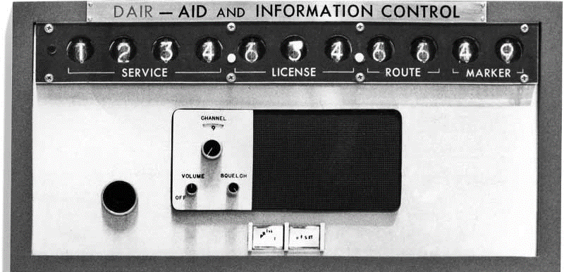
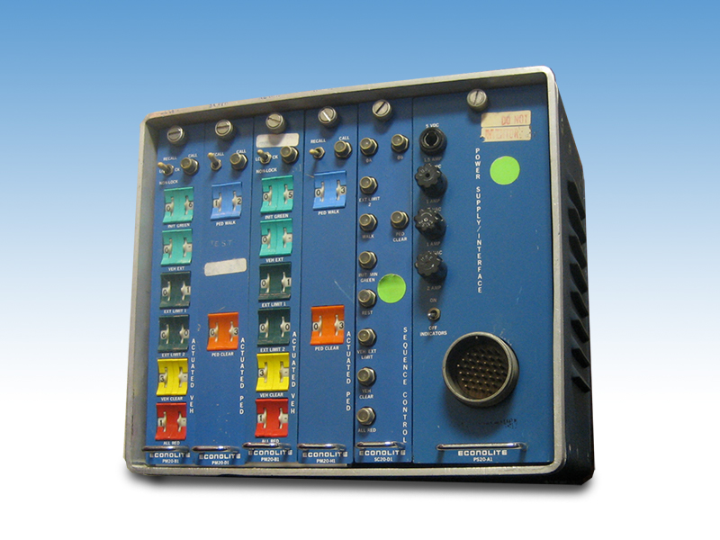
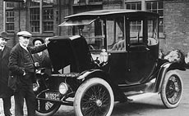
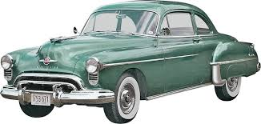
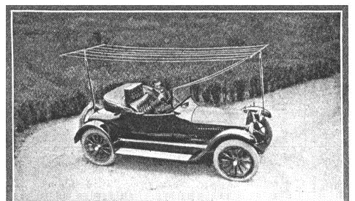
Timeline
Electronically Controlled Highways
Vehicles Powered And Controlled By Buried Cables or magnets
Wayside Communicators Relaying Computer Messages
Detector Circuits
Special Radio Receivers
Audible And Visual Warning Devices
Transmitting Antenna for radio
1890
1920
1930
1950
1960
Electric cars invented (William Morrison) and commercialized as taxis
First 4-way three-color traffic control device, basis for the modern traffic signal (William Potts, a Detroit Traffic Police Superintendent)
Embedded circuits and radio controllers
First solid state digital intersection traffic controller
GM engineers design the “Driver Aid, Information and Routing (DAIR), which relied on punch cards to provide information for basic turn-by-turn direction
Notes:
So how did we get to semi-autonomous and autonomous vehicles? You may not realize this, but it not exactly new! There has been a continuous succession of innovation and progress in this regard from the very start of the automobile. If you think about it, the very first car ever made was in itself a huge step toward autonomy – from purely animal driven mobility (horses and a few other animals), that required direct and very focused human guidance, to a mechanical invention that replaces the horse. Let’s review some of the most relevant progress since the late 19th century

Slide 8
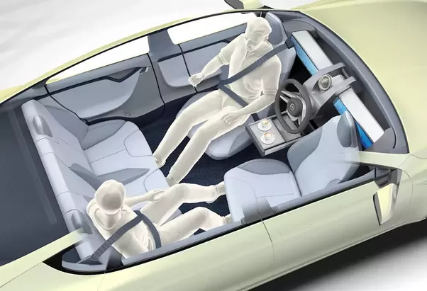
Early predictions
Inspired by the efforts of an electric utility company, Central Power and Light Company, launched an advertorial that was posted in many leading newspapers throughout 1956 and 1957 and predicted the arrival of autonomous cars:
ELECTRICITY MAY BE THE DRIVER.
Notes:
An early prediction was made by an electric utility – as you can see, once you take out the anachronistic features, the image is not that different from one of today’s, 60 years later! One important thing to notice is that this ad also predicted the convergence of electric vehicles with autonomous cars (more on that later)

Slide 9
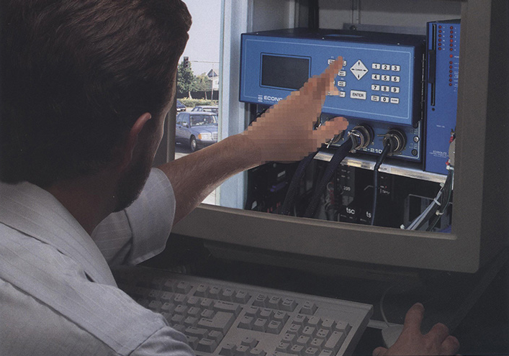
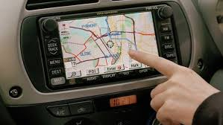
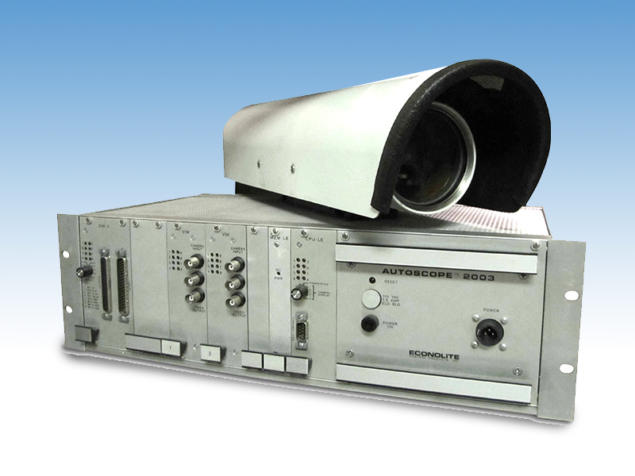
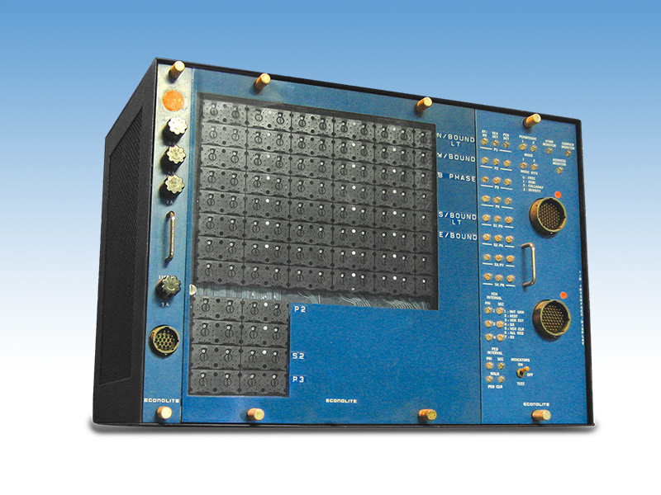
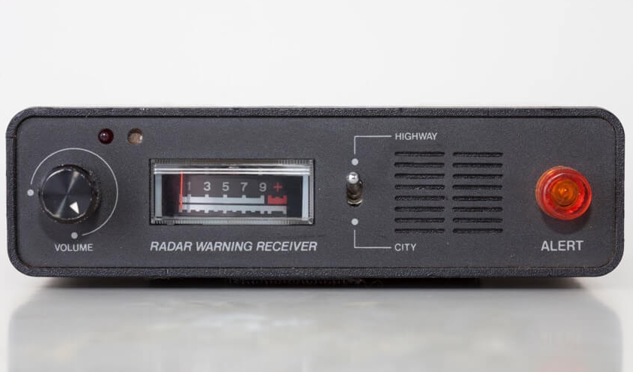
Timeline
Extensive systems engineering work and research
First commercial sale of a video-based vehicle detection system
Onboard video cameras and use of stereoscopic vision algorithms
RFID-tags used for tolling, access control and infrastructure security
Introduction of fully adaptive traffic management systems
Artificial Intelligence (AI) released for commercial use
GPS, LIDAR, 3D mapping, cameras, advanced sensors, etc.
First microprocessor-based intersection traffic controller
1970
1980
1990
2000
2010
Laser radar, computer vision and autonomous robotic control
Off-road map and sensor-based autonomous navigation
Real-Time Control System
First commercial sale of a video vehicle tracking-based detection system
Notes:
Continuing with our timeline….

Slide 10
2007- First Autonomous Vehicles
Stage 1 → Porsche Cayenne. This autonomous vehicle was designed by the Georgia Institute of Technology in collaboration with Science Applications International Corporation (SAIC) for the Defense Advanced Research Projects Agency’s (DARPA) Urban Challenge in 2007.

Slide 11
Today

Slide 12
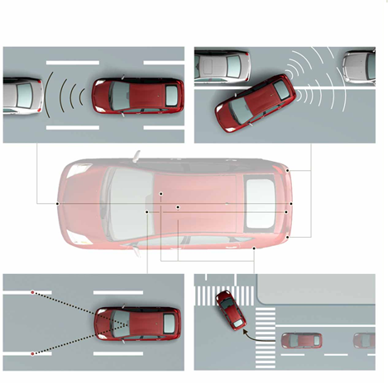
Vehicle Hardware
RADAR
Optics
LIDAR
GPS
Processors
Wheel Speed Sensors
Notes:
So let’s take a closer look at what has been developed and is available today.

Slide 13
Location, Surroundings, Hazards, other Vehicles

Slide 14
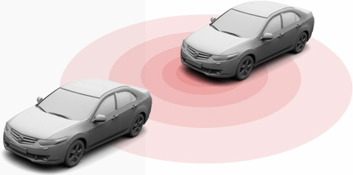
RADAR - Radio Detection & And Ranging
Traditional RADAR sensors are used to detect dangerous objects in the vehicle’s path that are more than 100 meters away.
Accident-Prevention Systems (APS) trigger alerts when they detect something in a blind car’s blind spot.
The radar chirps between 10 and 11 GHz over a 5 millisecond period, transmitting the radar signal from a centrally located antenna cone.
Two cone receivers, separated by approximately 14 inches, receive the reflected radar energy.

Slide 15
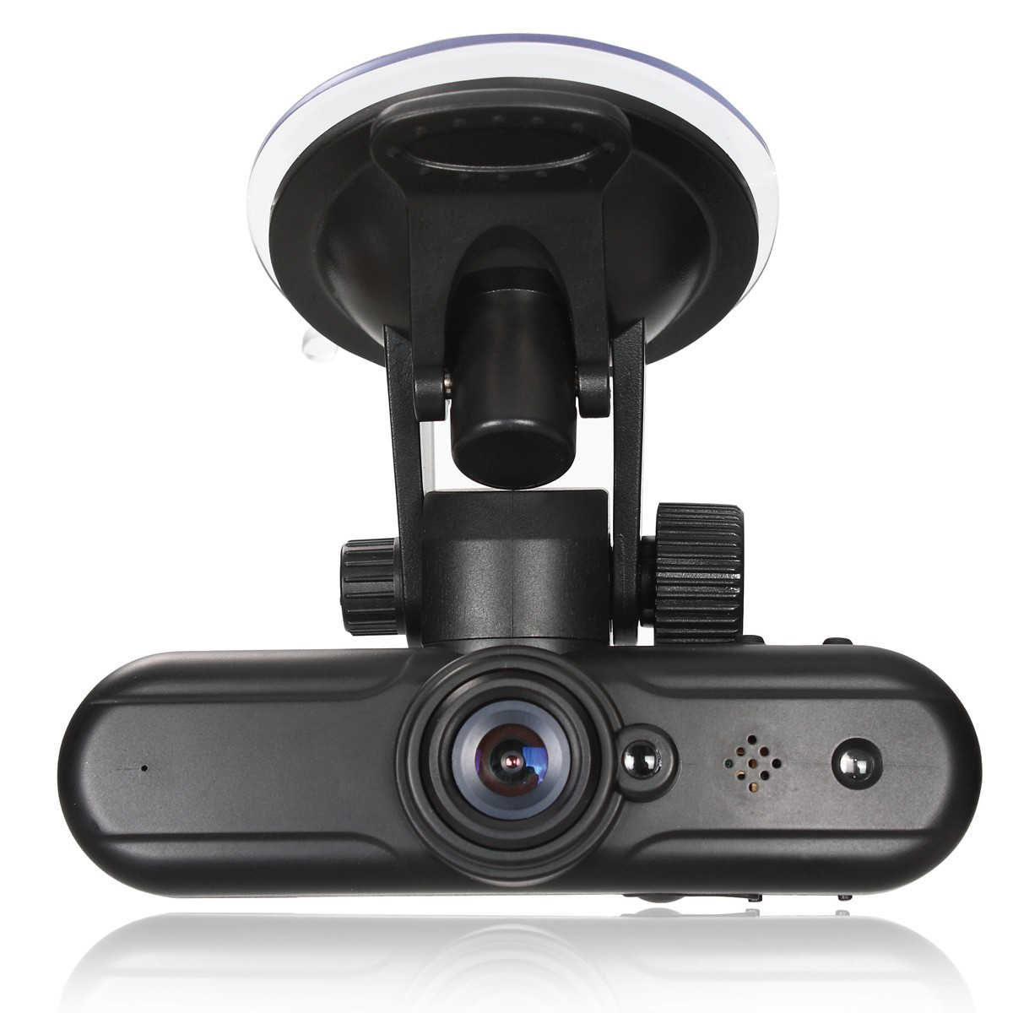
Optics
A camera mounted near the rear-view mirror build a real-time 3D image of the road ahead, spotting hazards like pedestrians and animals.
It is also used to identify road markings and traffic signals.

Slide 16
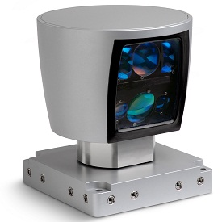
Lidar

Slide 17
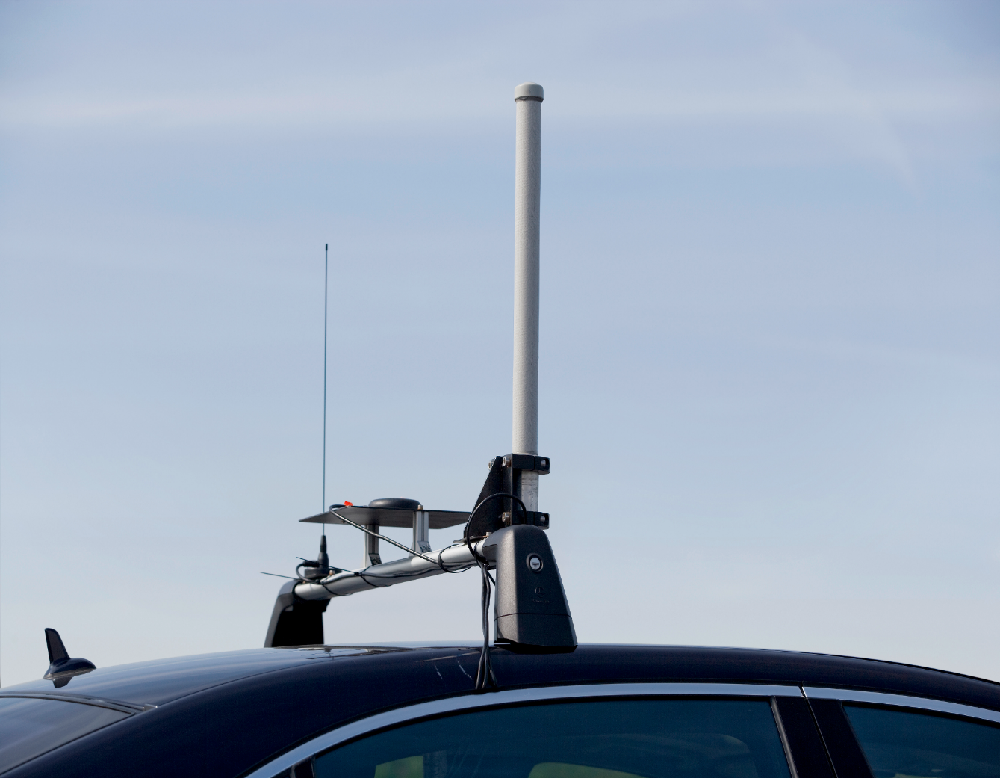
GPS
A Global Positioning System (GPS) keeps the car on its intended route with an accuracy of 3-4 meters. (Versus desired accuracy of 30 centimeters)
With GPS covering the macro location of car, smaller on-deck cameras can recognize smaller details like red lights, stop signs and construction zones.

Slide 18
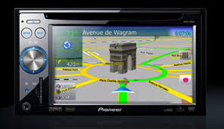
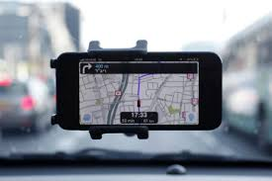
Navigation Systems
In-dash navigation today:
Pros: seamless integration with vehicle.
Cons: Expensive; limited data and performance; inferior to smart phone apps like Waze, Google Maps.
Smart Phone apps:
Pros: no additional expense needed; superior performance to in-dash.
Cons: small screen size; not integrated, harness needed.

Slide 19
Processors
Some seven (7) dual-core 2.13 GHz processors and 2GB of RAM are needed to make sense of the data collected by the car’s instruments.
Some cars run as many as 17 processors to share the computing load.

Slide 20
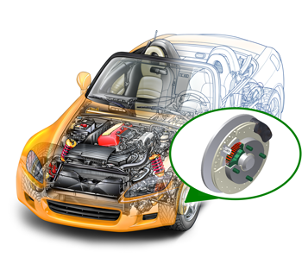
Wheel Speed Sensors
Wheel Speed Sensors measure the road-wheel speed and direction of rotation.
These sensors provide input to a number of different automotive systems including the anti-lock brake system and electronic stability control.

Slide 21
Working
The signal from the sensors are used by the On-Board Unit (OBU) & Electronic Control Unit (ECU) for decision-making using a software code.
Based on the information from the sensors, the Electronic Control Unit gives signal to the actuators, which in turn control the vehicle.
Also, real time information of the surroundings is output to the user interface located inside the vehicle.

Slide 22
Autonomous Vehicle operation

Slide 23
Potential Benefits, Challenges and Obstacles

Slide 24
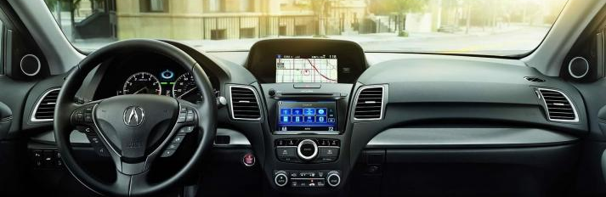
Future Navigation
With the arrival of connected vehicles, in-dash navigation systems will become far more powerful as they will be updated in real time by the overall fleet – routing, traffic conditions, and road pavement conditions – even the location of a new pothole!
In-dash will be complimented by phone app for additional functionality (one account, data transfer)
Example: HERE next generation navigation in-dash and app, was released in 2019 which learns from driver preferences and make informed suggestions for routing.

Slide 25
Benefits
Safety:
Gradually fewer traffic collisions and injury accidents (as technology is deployed and gains acceptance)
Improved response time of first responders to accidents- police, fire, paramedics
Ultimately: the realization of “Vision Zero”- No more roadway fatalities or serious injury accidents
Efficiency:
Lower speed limit with decreased gap and headway for autonomous cars…leading to…
….Increased roadway capacity and reduced traffic congestion
Alleviation of parking scarcity- integrated parking guidance systems
Reduction of physical road signage- move toward “in vehicle” signage
Smoother ride with decreased stops
Human Factors:
Relief of vehicle occupants from driving and navigation chores
Removal of constraints on occupants' state of mentation/impairment
Government and Regulatory:
Reduction in the need for traffic police and vehicle insurance premiums
Notes:
In sum, many great potential benefits – and none more important or consequential than the ultimate realization of VISION ZERO – the end of unnecessary deaths, from today’s approximately 1.2 million per year, to ZERO.

Slide 26
Elimination of “Dilemma Zone”
Notes:
For example, let’s compare how a human would fare against a machine in terms of the distance required to stop (the “dilemma zone”)

Slide 27
Obstacles and Challenges
Safety (Technology and Legal)
Liability for damages due to vehicle systems malfunction (who pays?)
New custom chips will have to be developed for true AI for autonomy, needing far more reliability, accuracy and redundancy *
New software will have to be developed with far greater power, reliability, accuracy and redundancy **
Autonomous cars relying on lane markings cannot decipher faded, missing, or incorrect lane markings – significant attention will be required on all roadways
Temporary construction / work zones which are not posted to any maps or databases
Determination of the severity of traffic lane obstacles, as in the question of safely straddling a pothole or roadway debris ***
What about pedestrians and bicyclists? Will they require smartphones or DSRC transponders?
Notes:
*As early as 2010, there was already an example of vehicle chips, processors and software being affected by stray cosmic rays. By 2009, Toyota had to recall 7.7 million vehicles. It was digital forensics that later found it was possible for a ray from outer space to change a 1 to a 0, and in some cases trigger the acceleration.
**As of 2017, a modern vehicle contains over a million lines of software code. By comparison, a common field mouse has about 200 million lines of code in its DNA. Logically, an autonomous vehicle in the future will have as much if not more lines of code than a common mouse.
*** In sum, as you can see despite some advantages of existing AI over the average human, in many ways – a competent human driver is still far more dependable than any automated system today…. [Transition over to next slide]

Slide 28
Human vs. Machine Vision
Notes:
….For example, let’s compare human vs. machine vision

Slide 29
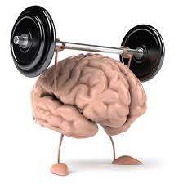
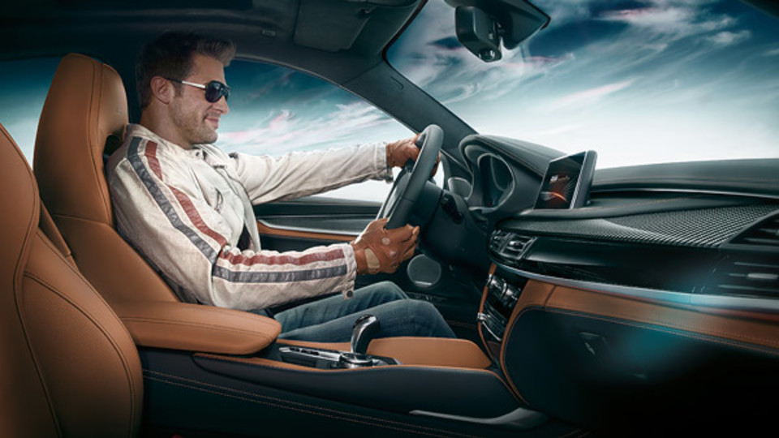
Obstacles and Challenges (2)
Human factors:
Resistance for individuals to forfeit control of their cars to machines *
Reliance on autonomous drive produces less experienced drivers when manual control is needed, such as in work/construction zones **
Security:
Cybersecurity - Electronic security of in-vehicle systems, roadside systems and control network
Terrorism - Potential misuse by bad actors (car bombs)
Notes:
*After all, think of how luxury car makers market their vehicles today? It’s all about the driving experience
**For as the say: If you don’t use it, you lose it!

Slide 30
Obstacles and Challenges (3)
Government and Regulatory:
Implementation of legal framework and establishment of a comprehensive government-led, consensus-based regulatory framework for self-driving cars *
Lack of government funding to upgrade existing, and install new intersection equipment with Roadside Units (RSU) to receive wireless data via DSRC/5G/C-V2I from all connected vehicles
All solutions must be multi-modal in nature and include Class 1 rail, light rail, bus, ride sharing, autonomous taxis, etc.
Privacy:
Continued loss of personal privacy/ personal movement can be easily monitored
Notes:
* We all know that governments everywhere always lag behind in this respect. For example, think how long it took them to deal with ride-sharing companies like Uber and how many different approaches were developed.

Slide 31
Autonomous Vehicle Programs
1. Short to Mid-term Applications
2. Mid to Long-Term Applications
3. Long-Term Applications

Slide 32
1. Short to Mid-Term Applications/Deployments

Slide 33
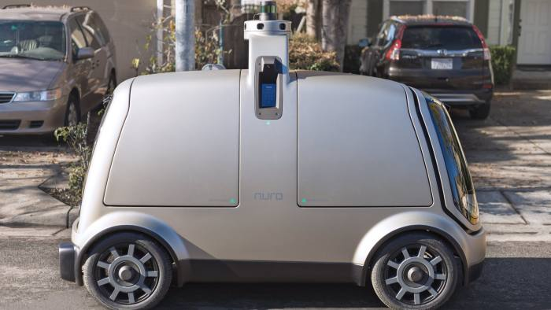
Autonomous Delivery Vehicles
Nuro’s prototype self-driving vehicle is about half the width of a standard sedan. Tests by end 2018.

Slide 34
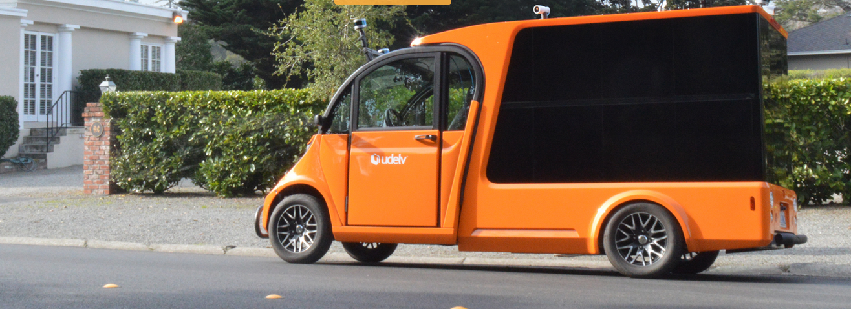
Autonomous Delivery Vehicles (2)
Udelv, a competitor, is demonstrating its delivery vehicle, ferrying groceries from a store in Silicon Valley to two customers.

Slide 35
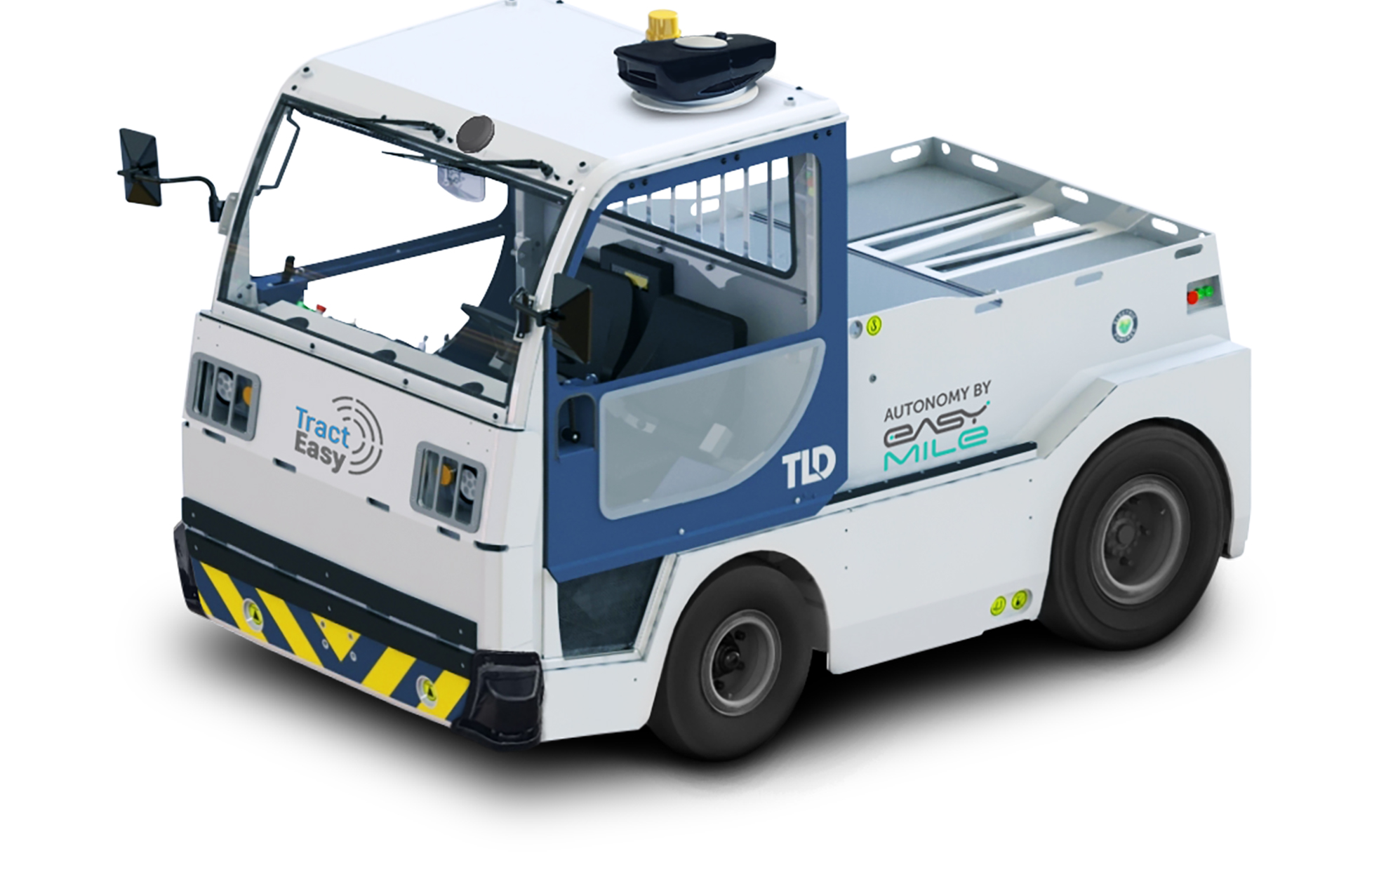
Autonomous Delivery Vehicles (3)
EasyMile, another competitor, demonstrating autonomous baggage tractor for airport use

Slide 36
Benefits
Ideal for e-commerce growth.
So called “first mile, last mile” applications. Door-to-Door mobility is needed.
Ideal for high density urban areas and night time delivery (quiet).
Delivery object does not have to drive smoothly, something that has been hard for autonomous cars.
Regulatory approval easier: the AI doesn’t have to make the complicated decision of [whether to] protect the passengers or the pedestrians because there are no passengers.
More room for error - smaller than ordinary cars.
Unlike other delivery robot start-ups, which design machines to travel at low speeds on pavements alongside pedestrians, these new vehicles will drive on the road and follow the same rules as regular traffic.

Slide 37
2. Mid to Long-Term Applications/Deployments

Slide 38
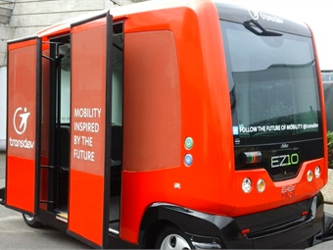
Public Transport
Para-transit (small buses) is an immediate and obvious application.
Immediate and significant benefits (lives saved, accident costs, labor costs).
Low-speed, fixed routing in residential areas and business areas (feeding travelers to bus and subway stations).
Successful tests around the world, U.S. examples:
Transdev in Florida, USA (with EasyMile)
First Transit in Northern California (with EasyMile)

Slide 39
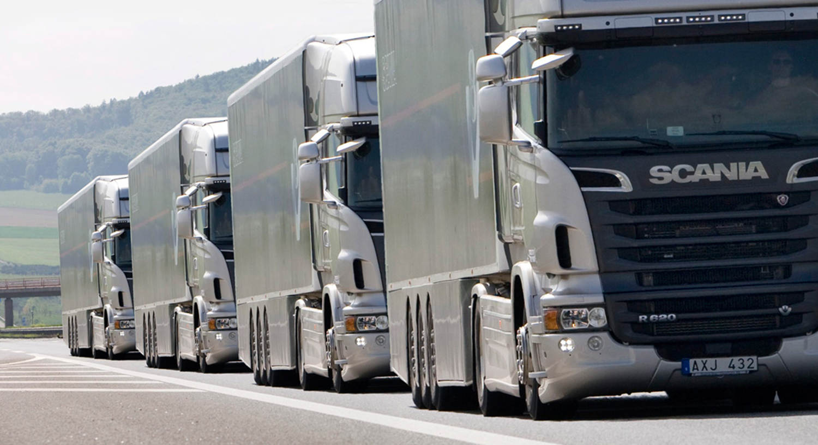
Truck Platooning
Platooning is one of the most effective ways to optimize logistics, transport flows and systems.
Not full autonomy – lead vehicle driver present (faster regulatory approval)

Slide 40
3. Long-Term Applications

Slide 41
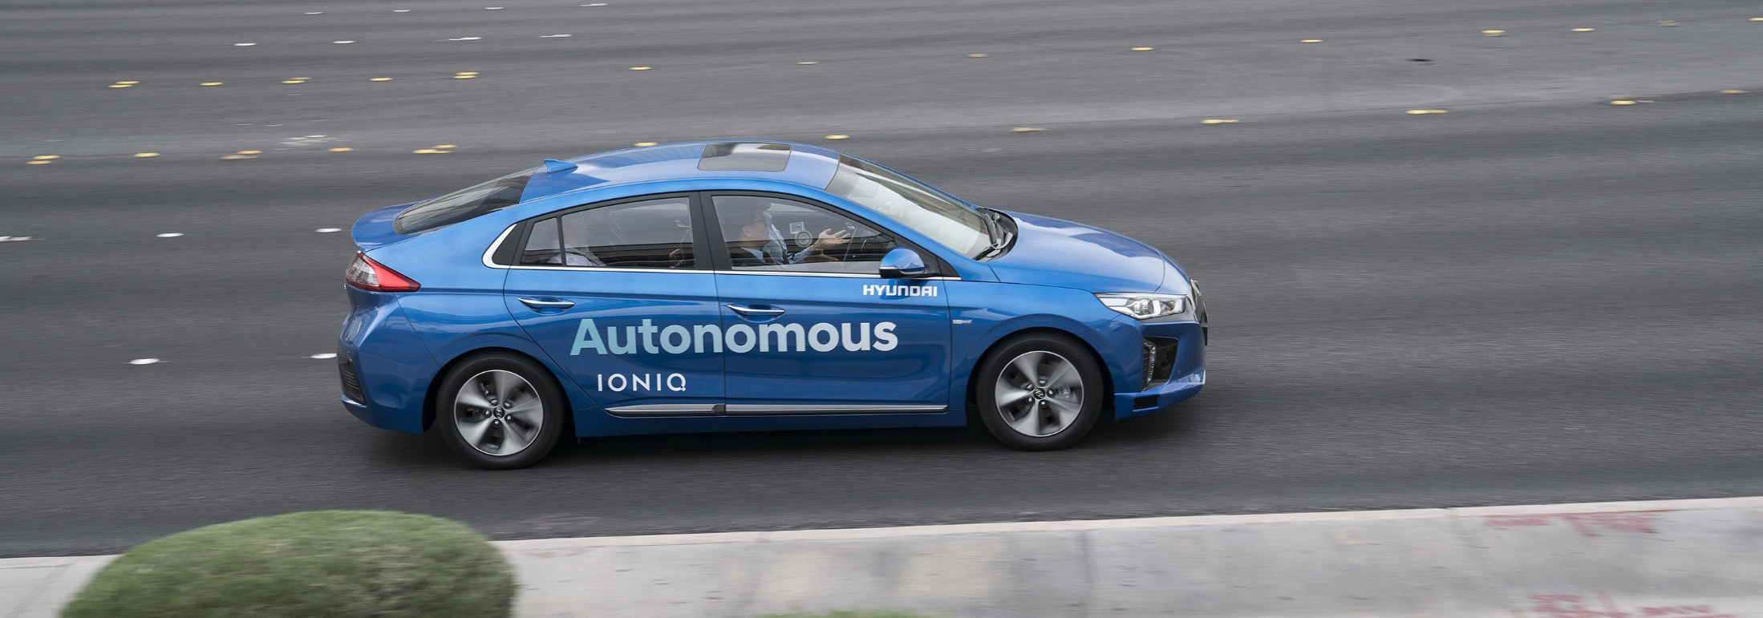
Aurora
Unlike some Silicon Valley start-ups such as Zoox, Aurora wants to partner with traditional carmakers (not go at it alone). Partnerships with Hyundai and others.
Its vehicles have driven more than 5 million miles on public roads.

Slide 42
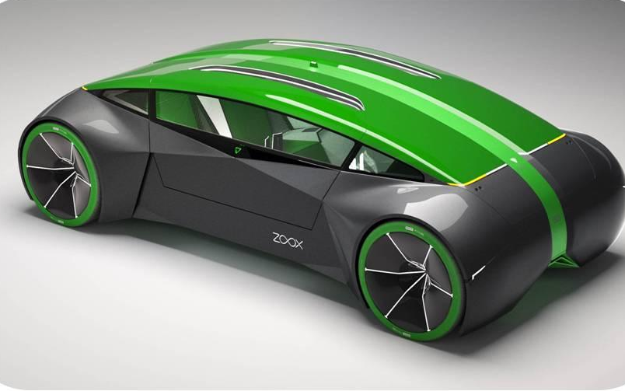
Zoox
Zoox concept car (founded by former Apple engineers)
Notes:
…founded by former Apple engineers -- can you tell?

Slide 43
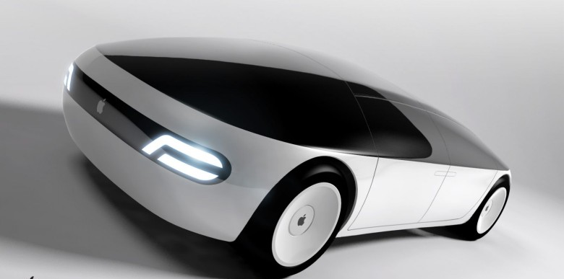
Apple Concept Self-Driving Car
Physical car project shelved for now
Autonomous driving system under development
Deep integration with iOS expected
Autonomous testing permit received from Department of Motor Vehicles (DMV)

Slide 44
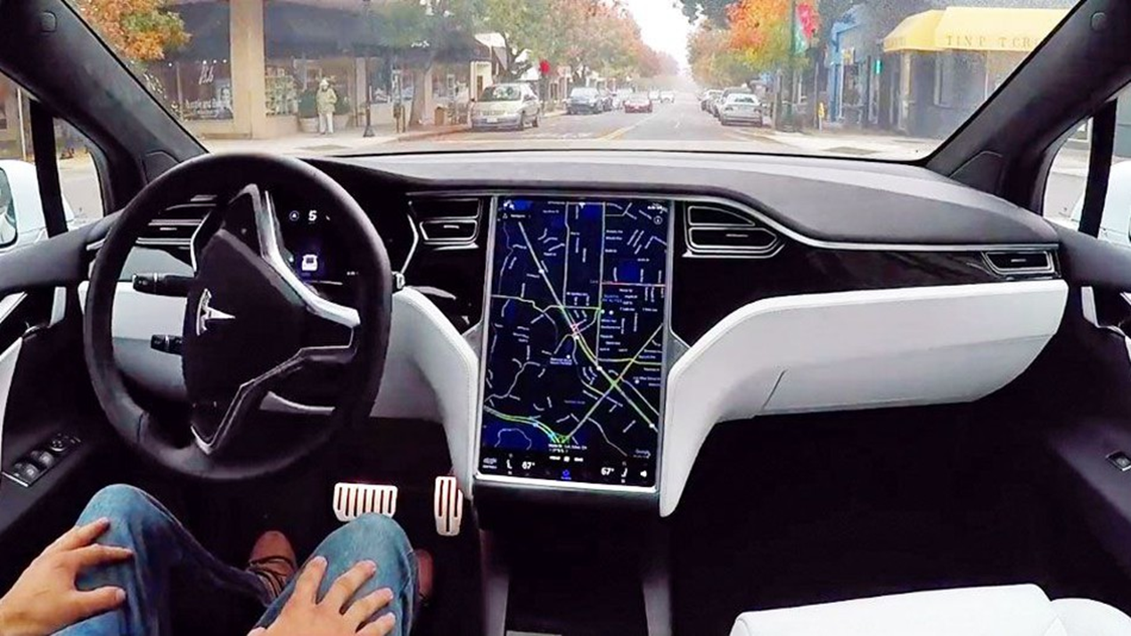
Tesla Self-Driving Car
All new Tesla vehicles produced, including Model 3, have the hardware needed for full self-driving capability at a safety level substantially greater than that of a human driver.

Slide 45
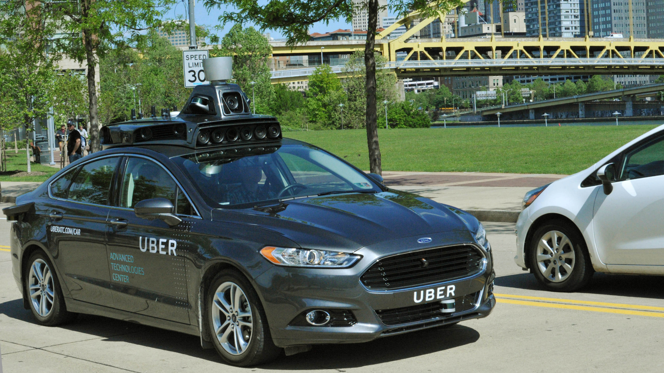
Uber Self-Driving Car
Self-driving tests in San Francisco & Phoenix (suspended)

Slide 46
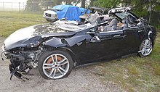
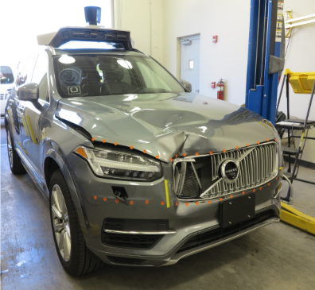
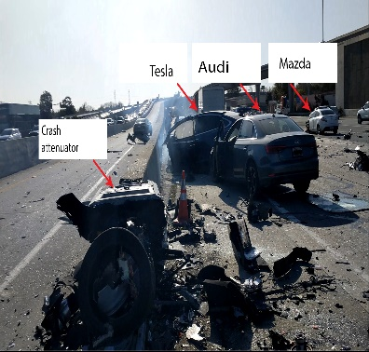
Self-Driving Car Fatalities to date
Date | Incident Number | Country | City | State / Province | Quantity of Fatalities | System Manufacturer | Vehicle Type | Distance Driven by System at Time of Incident | Notes | Post Accident Vehicle Photo
20 Jan 2016 | 1 | China | Handan | Hebei | 1 | Tesla (Autopilot) | Tesla Model S |  | Driver Fatality- Truck collision | Not Available
7 May 2016 | 2 | USA | Williston | Florida | 1 | Tesla (Autopilot) | Tesla Model S | 130,000 miles | Driver Fatality
18 Mar 2016 | 3 | USA | Tempe | Arizona | 1 | Uber | Retrofit- Volvo |  | Pedestrian Fatality
23 Mar 2018 | 4 | USA | Mountain View | California | 1 | Tesla (Autopilot) | Tesla Model X |  | Driver Fatality

Slide 47
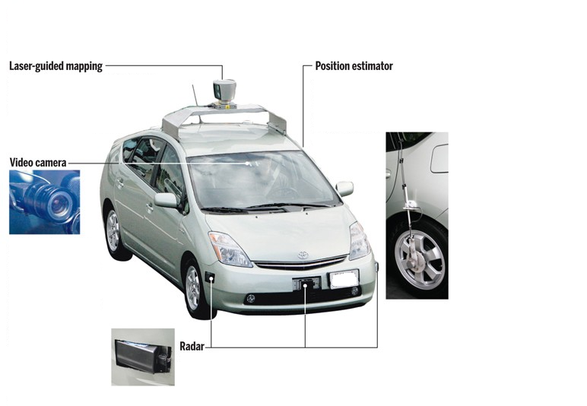
Toyota Prius modified to operate as a Google driverless car

Slide 48
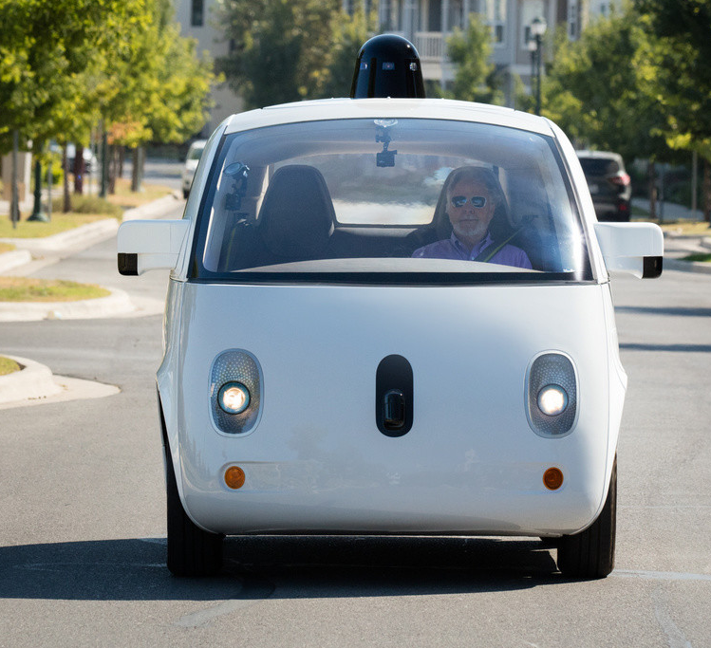
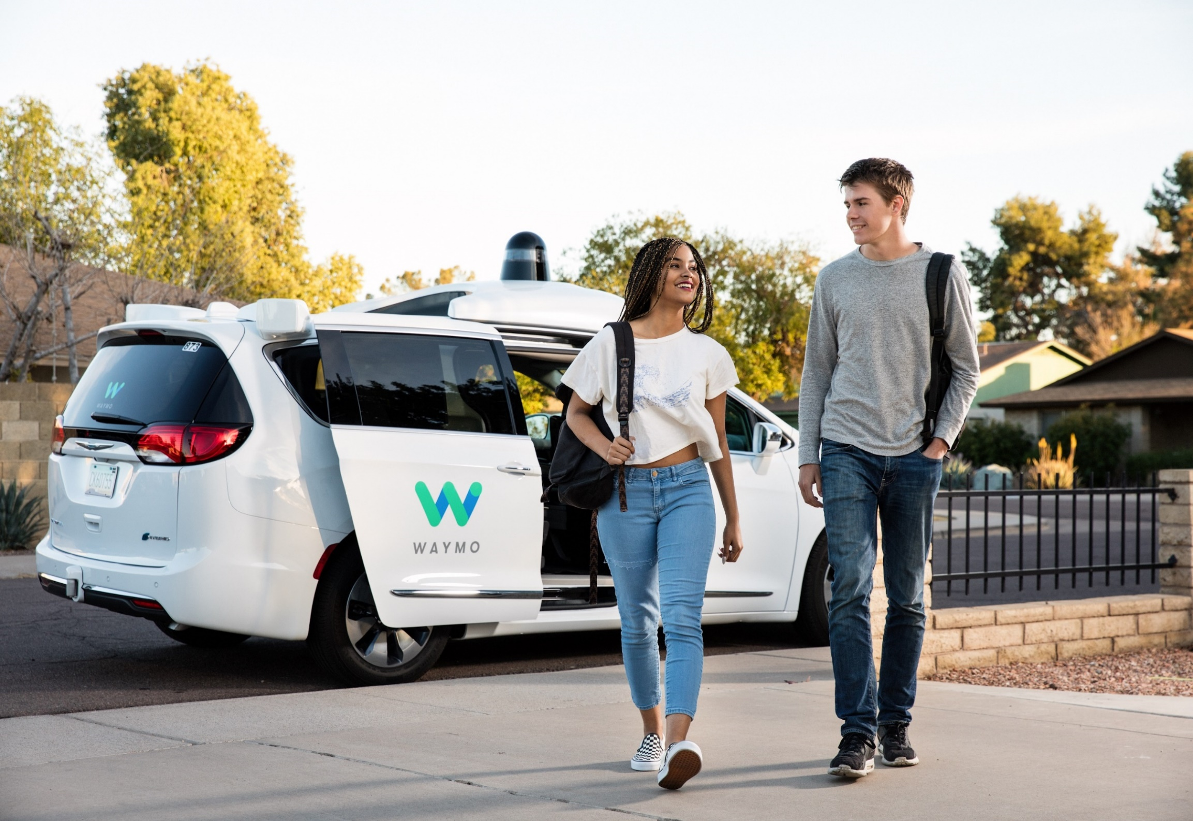
Google Self-Driving Car Project (Waymo)
Over 10 million miles self-driven (as of 11/15/2018)

Slide 49
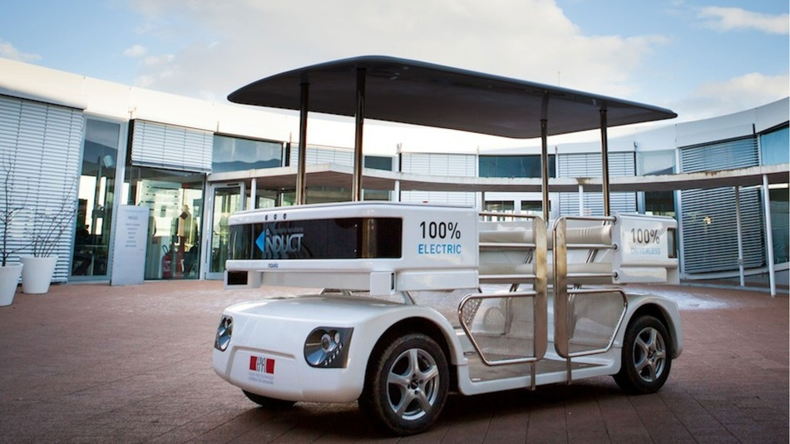
Navia
World’s first commercially available driverless car by France-based robotics company Induct.

Slide 50
Autonomous Trucks
Fastest potential adoption (along with para-transit – small buses) and immediate economic benefit for freight companies (45% of cost of freight is labor).
Examples of current efforts:
European Truck Platooning Challenge (2016), several participants including Daimler).
EU-funded Ensemble initiative to implement and demonstrate multi-brand truck platooning by 2021.
Partially Automated Truck Platooning Demonstration (September 2017)
Showcased the US Federal Highway Administration and Federal Motor Carrier Safety Administration's platooning technologies in the I–66 Corridor.
Heavy trucks followed each other using automated speed and spacing controls. The platooning is based on the Cooperative Adaptive Cruise Control (CACC) System.

Slide 51
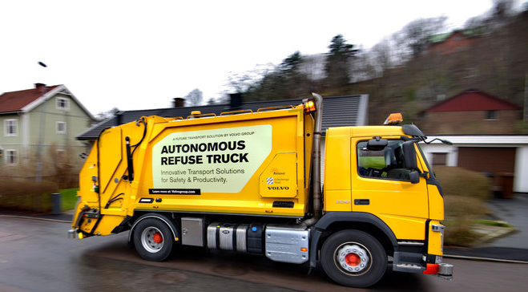
Volvo
Fully autonomous trucks for mining, trash collection, and other hazardous or difficult applications.

Slide 52
Waymo (Subs. Of Alphabet)
Autonomous trucks by Waymo being tested on US highways

Slide 53
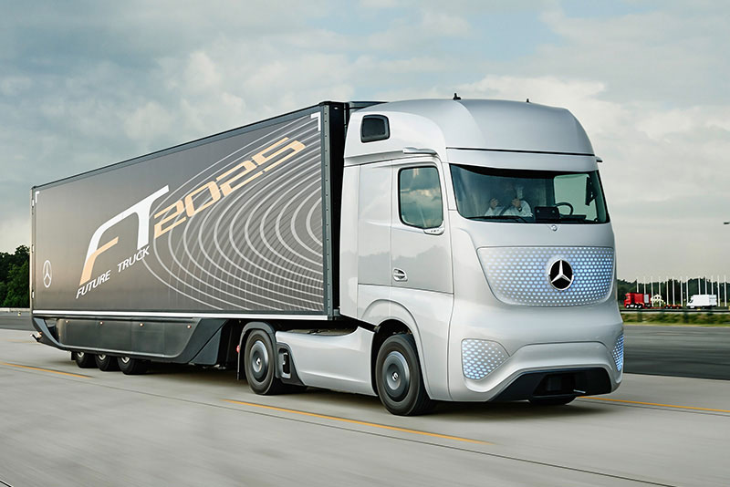
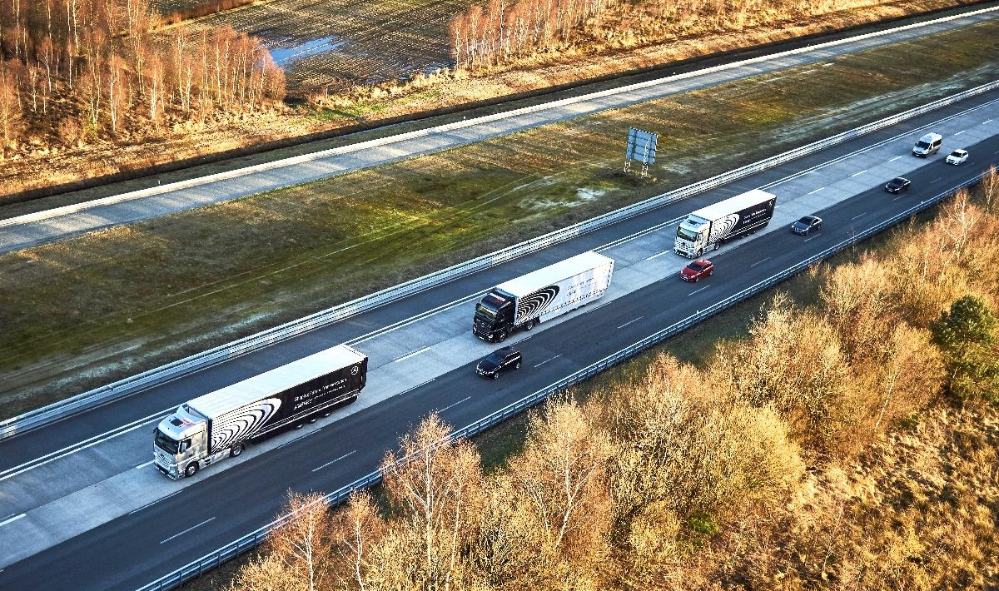
daimler
Autonomous truck by Daimler testing along US highways (driver supervised) and at the CCTA’s GoMentum Station test bed in northern California. Also testing platooning in the US and the EU.

Slide 54
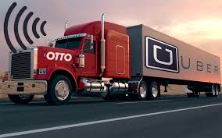
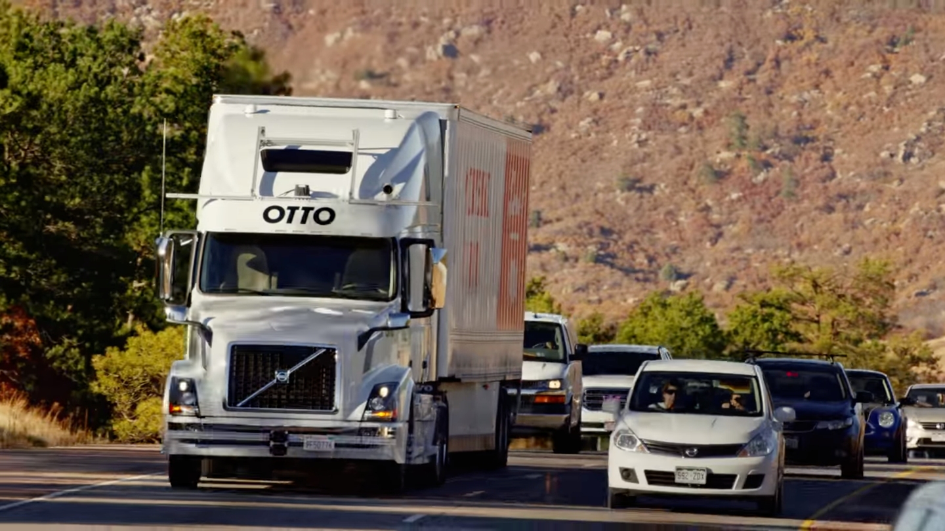
Otto (Subs. Of Uber)
Testing in Northern California

Slide 55
challenges
Human drivers are still required to control the trucks, for example when truck platoons travelling on highways have to separate at junctions.
Several other barriers remain before trucks can shed their human drivers. For starters CONNECTIVITY (as in Connected Vehicles) is essential, and across-brands and types of vehicle via a single harmonized protocol.
Regulatory harmonization between countries (EU, NAFTA, Mercosur) is needed so that trucks can pass smoothly across borders.
“GPS-spoofing” or hacking to re­direct trucks along with their freight for theft is a threat for fleets using autonomous navigation systems
Trailers pulled by cabs need significant changes before they can function autonomously. Trailers, which can be changed between different cabs, will have to be fitted with sensors that allow the lorry to “see” behind it and that can operate with the self-driving system of any given truck manufacturer.

Slide 56
The Future of Big Traffic Data
Traffic data collection must be hardware and detection technology agnostic.
ATMS
(Central traffic management systems)
Auto Manufacturers (Toyota, Volkswagen AG, GM, Hyundai/Kia, Ford, Nissan, Fiat, Chrysler, Honda, Suzuki, Renault)
Tier 1s
(Denso, Continental, etc.)
Ride Share
(Uber, Lyft, Sidecar, Wingz, Summon, Taxify, Haxi)
ITS
(Traffic control electronics & detection)
Mapping
(Here, TomTom)
3rd Party Data Analytics
(Private Sector)
3rd Party Data Warehouse
(Private Sector)
Adaptive Traffic Control (SCATS, SCOOT, ACS Lite, others)
System Integrators / Tolling / etc.
Global Transport Data Exchange Platform™
Detection- Vehicle, Bicycles, Pedestrians
Traffic
Controllers
Road Weather Information Systems
Automated Incident Detection
Autonomous Vehicles
Vehicle-to-Vehicle (V2V)
Vehicle-to-Infrastructure (V2I)
Inductive Loops Magnetometer
Video Fusion & CCTV Analytics with AI
Microwave / Radar
Roadside Unit (RSU)
Onboard Unit (OBU)
Data Aggregation Devices
Weigh-in-Motion Systems (WIM)
Photocitation
Enforcement
IR / Thermal Detection
© COPYRIGHT 2018. Eberle Design, Inc. All Rights Reserved.

Slide 57
How much longer? The roadmap towards full autonomy
L2*
L3*
L4*/L5*
Pilot Fleets
Auton. Road Trains (Commercial + Public)
Retractable Steering Wheels
New without Steering Wheels
Technological
Auto Pilot: City
Standard or New
Auto Pilot: Highway
Standard or New
Autonomous Breaking
Standard or New
Adapt, Cruise Control, Lane-Keep
Standard or New
2010 2015 2020 2025 2030 2035 2040
Legal
Vehicle Crashes reduced 50%
Vehicle Crashes reduced 90%
ADAS inc. V2V/V2I mandate.
Roadmap to full autonomy
Social
ADAS raises Safety and Awareness to Consumer
Consumer embraces L4/L5 autonomous
Consumer demands autonomous
Shared Autonomous is Primary Transport
Source: Neckermann Strategic Advisors Assessment, June 2017

Slide 58
Future of Urban Mobility “Autonomy Plus”
AUTONOMOUS
- Free of human error and physical limitations
CONNECTED
- Real time data shared across entire vehicle fleet; instant learning for AI
SHARED
- Ownership obsolete; full capacity utilization; mobility as a service
ELECTRIC/
FUEL CELL
- Transfer emissions away from urban areas
Notes:
Finally, a few words about the future of mobility in general. You may recall in our initial timeline we showed the first electric vehicle back over a hundred years ago. Well, we all know about hybrids by the major OEMs and Tesla pure electric cars, but they are still a small fraction of the total. However, the ultimate goal of visionaries in the industry (and for those of you who might have attended the ITS World Congress in Montreal recently, this will NOT come as a surprise) is to have not just AUTONOMY, but also connected, electric or fuel cell driven, and shared mobility. In other words, separate innovations and trends will collide – the AI-driven autonomous technology, the old electric technology updated by the use of new and far more efficient batteries, connectivity to other cards and the road side infrastructure, and finally, the sharing economy apps best exemplified by Uber.

Slide 59
Predictions and Conclusions

Slide 60
Official Predictions
By Year | Prediction
2019 | MobilEye, (an Intel Company), expects to release new semi-autonomous car technology
 | Audi plans to market vehicles that can autonomously steer, accelerate and brake at lower speeds, such as in traffic jams.
 | Google expects to release their autonomous car technology.
 | TomTom & Garmin introduce in-dash navigation equal or better than smart phone apps.
 | Microsoft expects to release their autonomous car technology.
2020 | Volvo envisages having cars in which passengers would be immune from injuries
 | Mercedes-Benz, Audi, Nissan and BMW all expect to sell autonomous cars.
2022 | Large testing of autonomous para-transit and shuttles operating at low speeds in many urban areas.
 | Widespread use of autonomous (small) delivery vehicles in major urban areas.
 | Successful test of fully autonomous truck-platooning
 | Apple expects to release their autonomous car technology.
2035 | Most vehicles will be electrically or fuel cell powered / very few internal combustion-engine powered transportation options available.
 | Level 5 Fully Autonomous Vehicles can safely operate in most major cities in North America, Europe, Asia and Middle East. Most vehicles will be shared, not owned, and operated and maintained by future service companies perhaps evolved from today’s automobile dealers. Cities lose revenue stream from violations.
2040 | Most urban travel, in major cities, will be available by Level 5, fully autonomous vehicles

Slide 61
On-going challenges / Conclusions
US DOT / FHWA has failed to date to provide guidance on the deployment of a standard for wireless V2I communications (DSRC/5G/C-V2I), therefore the signalized infrastructure is not yet ready to receive the Basic Safety Message (BSM) from CAV-equipped vehicles.
There is currently no significant funding mechanism available to upgrade the >400K US signalized intersection infrastructure to accept the vast amounts of data of CAV-equipped vehicles.
Very few North American signalized intersections are currently able to pass the SPaT message, real-time R-Y-G timing data, and intersection MAP message back to (Level 4 and Level 5) equipped Autonomous Test Vehicles.
The current security of C-V2I wireless messages is lacking validation and is open to interference.
While taking human decision-making out of the mix will enhance motorist and pedestrian safety, it will add to congestion by slowing vehicular movement, and put more vehicles on the road per capita.
With the transition from internal combustion engines to a totally electric global vehicle fleet in the future, the availability of electrical recharging stations will be a key concern.
With the availability of Level 5 autonomous vehicles, Mobility-as-a-Service (Maas) will be the future.

Slide 62
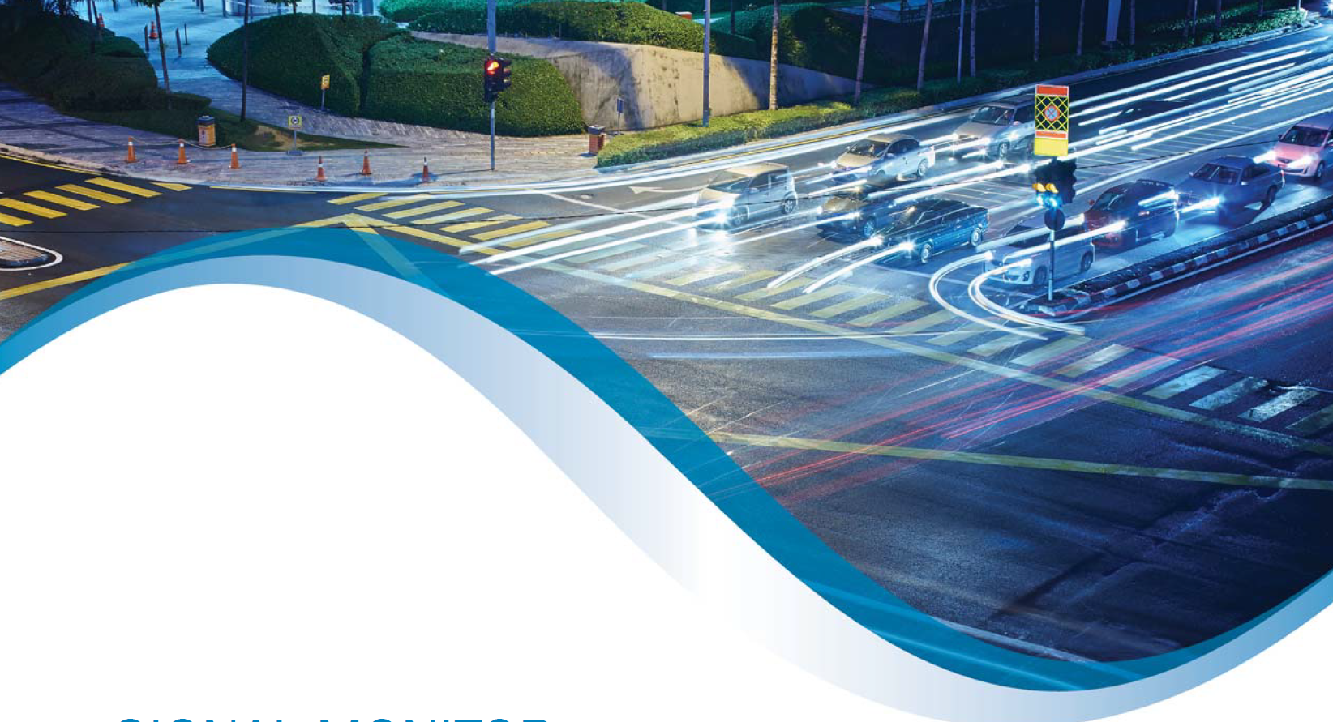
Questions / Discussion
Dr. Bill Sowell, Vice President
Eberle Design, Inc.
3510 East Atlanta Avenue
Phoenix, Arizona 85040 USA
Email: wsowell@EDItraffic.com
Web: www.EDItraffic.com
Mobile & What’s App: +1.602.327.0092

Slide 63
Citations & References
http://en.wikipedia.org/wiki/Autonomous_car
http://www.techradar.com/us/news/car-tech/google-wants-some-form-of-self-driving-cars-on-roads-by-2018-1130660
http://www.cvel.clemson.edu/auto/AuE835_Projects_2011/Vallabhaneni_project.html
www.matronic.de
http://auto.howstuffworks.com/under-the-hood/trends-innovations/driverless-car1.htm
Info graphics
http://drivesteady.com/how-autonomous-vehicles-work
Other Sources:
The Financial Times
The Economist Intelligence Unit
ITS World Congress proceedings

