Slide 1
Pavement Materials Conference
Staying Ahead of the Performance Curve
Dallas Hammit
Deputy Director for Transportation / State Engineer
November 15, 2018
Notes:
1
Mr. Chairman and members of PPAC (the Board), I would like to thank you for the opportunity to present the draft 5-year transportation construction program to you and to ADOT Staff. I also would like to personally welcome members of the public who are here today. We appreciate your interest in the state’s transportation future and the investment decisions we must make as a department each year.

Slide 2

Road Map
Score Card
Technology?
Program
$$

Slide 3
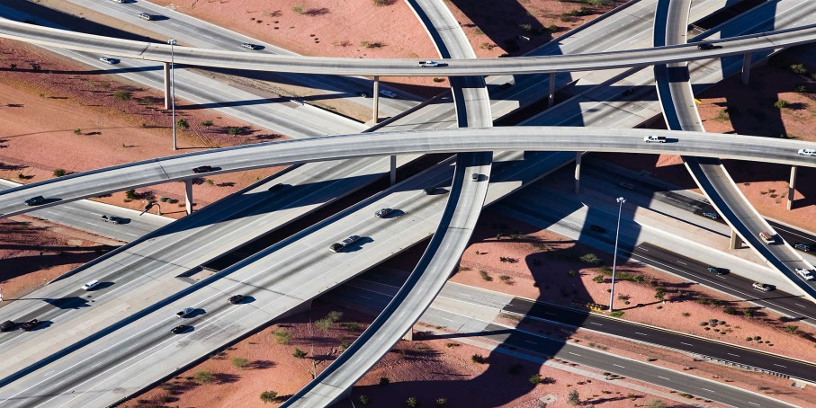
Highway User Revenue Fund (HURF)
Notes:
Now let’s go into the next level of detail.

Slide 4
Highway User Revenue Fund (HURF):
FY2017 Revenues
Notes:
FY17= 3.6% growth and $1,405.4M in revenues
$10.2M below forecast
FY2017 was 1.7% above the pre-recession high FY2007 revenues ($1,382.5M)
FY16 = 5.1% growth
FY15 = 4.0% growth
FY14 = 2.6% growth
FY13 = 0.0% growth
FY12 = 0.5% growth
***Note for Kristine: All HURF graphs in this presentation are net of the State-Lake Improvement and Off-highway Vehicle distributions. We will be including those in HURF FY 2018 and onwards.

Slide 5
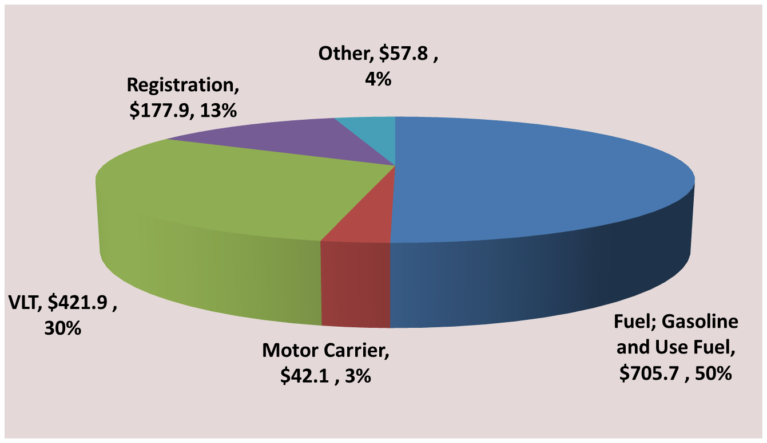
Highway User Revenue Fund (HURF):
FY2017 Sources
Total: $1,405.4 Million
Revenue in millions
Notes:
Not much change in the composition of funds flowing into HURF – 80% from Fuel and VLT
1.9% growth in gas tax FY2017 compared to 5.1% in FY2016 and 2.9% in FY2015
4.3% growth in use/diesel
6.6% growth in VLT

Slide 6
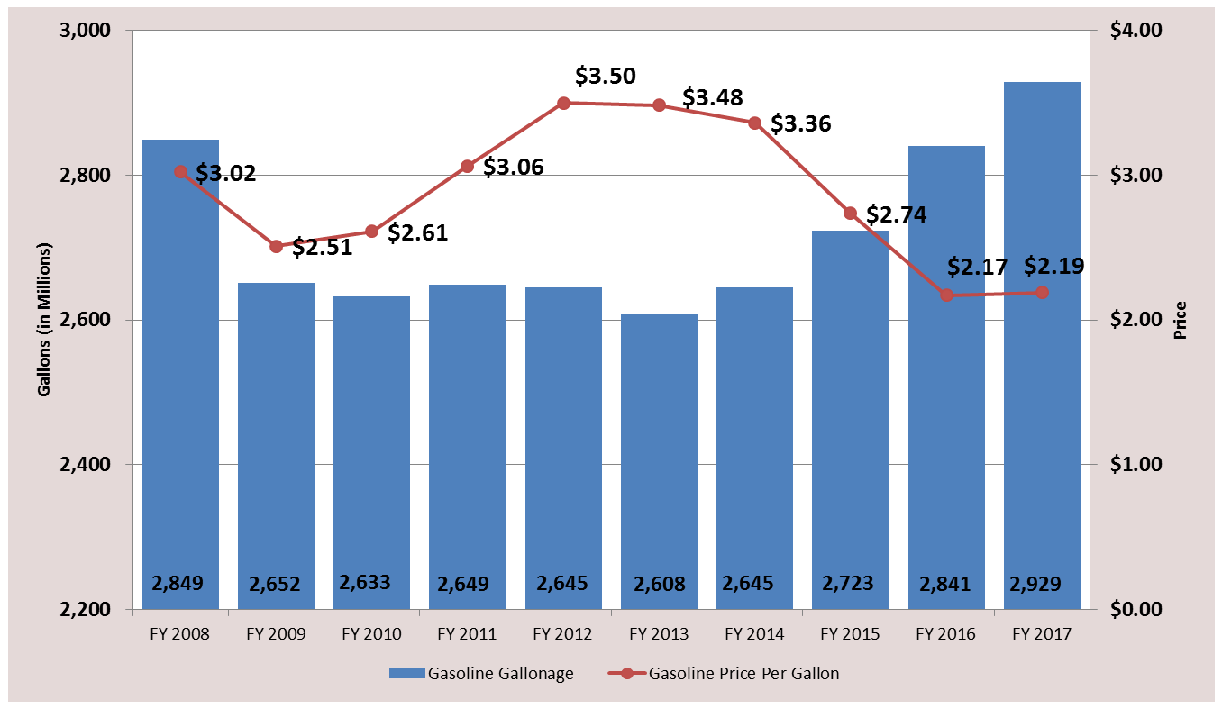
Highway User Revenue Fund (HURF):
Gasoline Gallons Sold and Price Per Gallon
Notes:
Price per gallon relatively flat from $2.17 in FY2016 to $2.19 in FY2017
3.1% growth in gallons sold FY2017 compared to 4.3% growth in FY2016
FY2017 – 2.929B gallons sold versus FY2016 – 2.841B gallons sold
FY2017 was 2.0% above FY2007 levels, FY 2017 is the first year to surpass FY2007 (2.871B gallons sold)

Slide 7

Regional Area Road Fund (RARF)

Slide 8
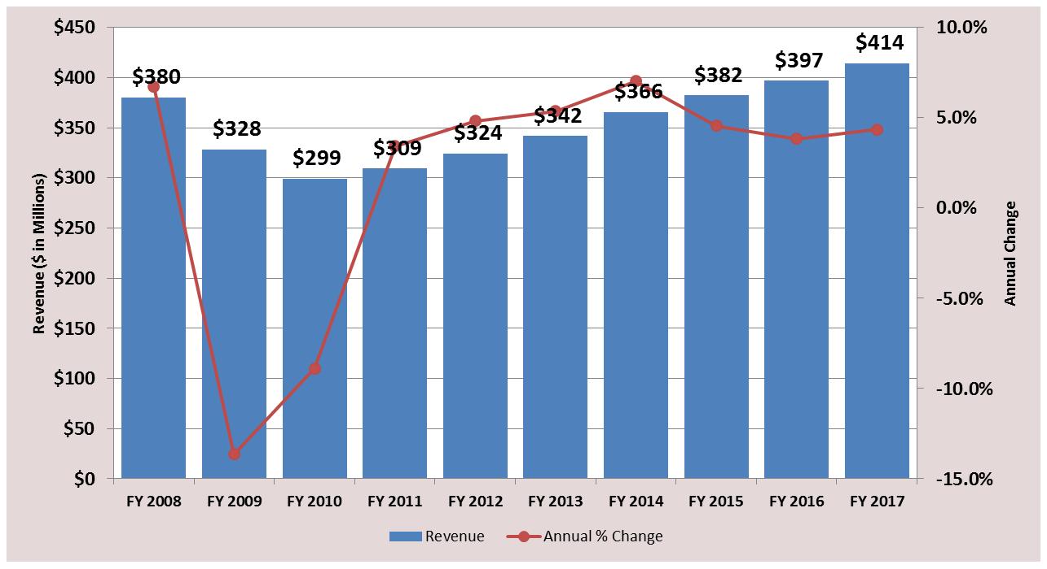
Regional Area Road Fund (RARF):
FY2017 Revenues
Notes:
4.3% growth for FY2017
Retail: 4.6% growth
Restaurant and Bar: 7.3% growth
Contracting: 6.3% growth

Slide 9
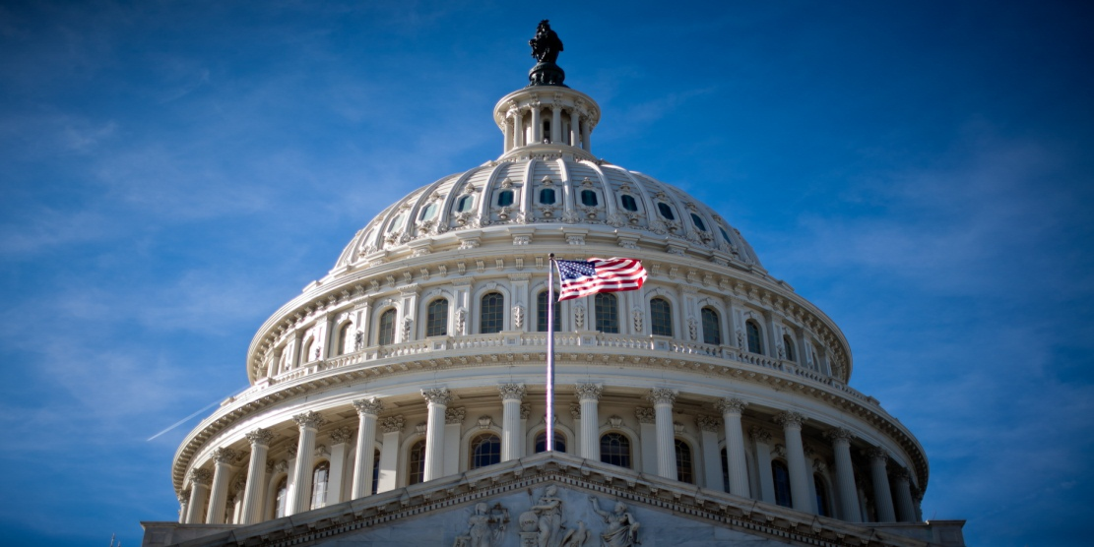
Federal Funding
Notes:
Reimbursement basis

Slide 10
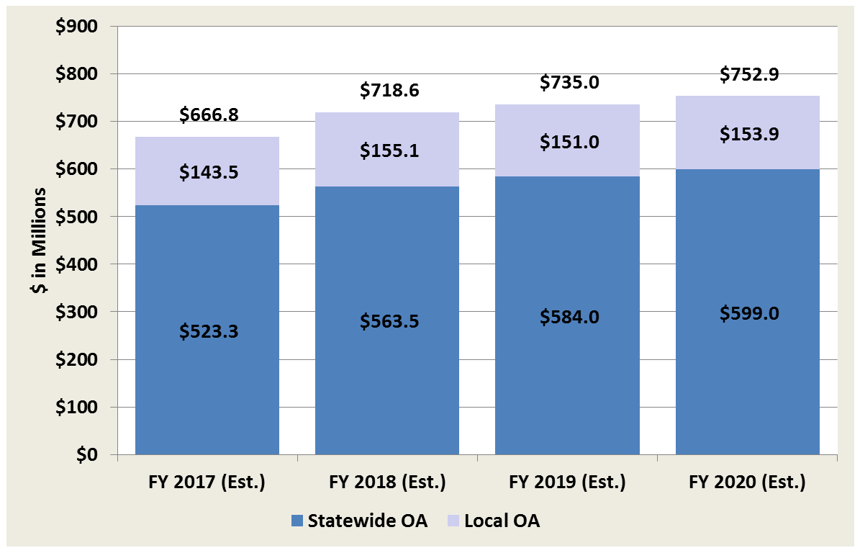
FAST Act Formula Obligation Authority:
State & Local Distribution (Estimated)
Revenue in Millions
Notes:
This chart shows the distribution of the federal funding between the locals and the Statewide program.
FAST Act expires in 2020 and federal revenue levels are assumed flat for the remainder of the program, FY 21 & FY22.
Some of the distribution are statutory (mandated by FHWA) and others are discretionary, where the department has historically distributed the funds to the locals to program.
The statewide OA is what becomes available for the program and is included in the available funding that is provided to MPD for programming, net of prior commitments, such as debt service (and A/C).

Slide 11
How will we move forward?
Long Range Plan

Slide 12

Performance Goals
Safety: Reduce fatalities and serious injuries
Infrastructure Conditions: NHS in state of good repair
Congestion Reduction: On NHS, in particular
System Reliability: Surface transportation efficiency
Freight Movement & Economic Vitality: Access to markets
Environmental Sustainability: Protect/enhance environment
Notes:
RECALL THAT THE PLAN IS PERFORMANCE BASED. WHILE MEASURING PERFORMANCE IS IMPORTANT TO ADOT AND THE GOVERNOR’S OFFICE, WE SHOULD ALSO POINT OUT THAT WE HAVE NEW FEDERAL MANDATES TO MEASURE PERFORMANCE IN LINE WITH SEVERAL FHWA GOALS, AS SUMMARIZED HERE. OUR PROPOSED LONG RANGE TRANSPORTATION PLAN WILL SERVE US WELL IN THIS REGARD, AND ADOT IS CURRENTLY WORKING TO ESTABLISH SPECIFIC PERFORMANCE TARGETS TO MEET THE FEDERAL REQUIREMENTS. IN ADDITION, WE ARE DEVELOPING IMPROVED ASSET MANAGEMENT AND PAVEMENT MANAGEMENT TOOLS TO TAKE US TO THE NEXT LEVEL IN MEASURING AND IMPROVING SYSTEM PERFORMANCE.

Slide 13

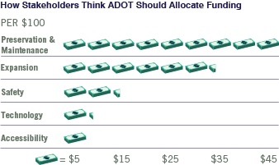
Citizen Survey Results
Preference for System Preservation
Expansion focus stronger in large Metro Areas
All projects promote Safety
Notes:
REMEMBER THAT WE CONDUCTED EXTENSIVE PUBLIC INVOLVEMENT DURING THE EARLY STAGES OF PLAN DEVELOPMENT. OUR ON-LINE CITIZEN SURVEY, WITH NEARLY 6,000 PARTICIPANTS, ALSO INFLUENCED OUR STRATEGY. IT IS IMPORTANT TO NOTE THAT NOT ONLY DID OUR OWN TRANSPORTATION ENGINEERS AND PLANNERS IDENTIFY SYSTEM PRESERVATION AS A TOP PRIORITY, OUR CITIZENS STATED THIS PREFERENCE FOR PRESERVATION AND MAINTENANCE OF OUR CURRENT SYSTEM, AS WELL. THE RESULTS YOU SEE ARE STATEWIDE, BUT NOTE THAT CITIZENS IN THE LARGER METROPOLITAN AREAS SHOWED STRONG INTEREST IN SYSTEM EXPANSION, AND THAT IS ALSO REFLECTED IN THIS FIGURE. THIS COINCIDES WITH THE DEDICATED TAX REVENUES THESE URBAN REGIONS HAVE TARGETED TOWARD SYSTEM EXPANSION. IN GREATER ARIZONA, PRESERVATION AND MAINTENANCE CONTINUE TO BE FOREMOST IN THE MINDS OF ARIZONA CITIZENS. AGAIN, THIS INPUT INFLUENCED OUR RECOMMENDED INVESTMENT CHOICE.

Slide 14
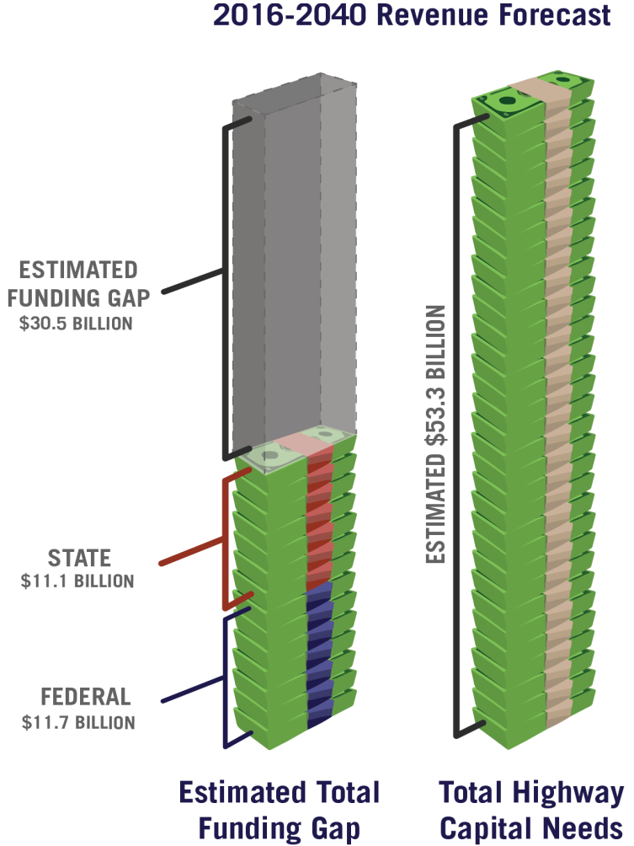
25-Year Highway Needs
Preservation = $9.236 B
Modernization = $9.962 B
Expansion = $34.054 B
Total = $53.3 B
Estimated Funding Gap 30.5 Billion
Notes:
LET’S BRIEFLY REVIEW THE NEEDS INFORMATION WE PRESENTED IN OCTOBER. THIS FIGURE ILLUSTRATES THE 30.5 BILLION DOLLAR FUNDING GAP BETWEEN OUR 53.3 BILLION DOLLAR NEEDS AND OUR 22.8 BILLION DOLLARS IN AVAILABLE REVENUES. (THIS IS FOR OUR 25-YEAR PLAN HORIZON.) CLEARLY, THIS FUNDING GAP COMPELS US TO BE PRUDENT AND STRATEGIC IN HOW WE ALLOCATE OUR LIMITED REVENUES AMONGST OUR PRIORITY AREAS OF NEED. WE MUST PAY ATTENTION TO THE DATA AND ALSO BE INFORMED BY OUR STAKEHOLDER AND CITIZEN INPUT AS WE GO ABOUT OUR PLANNING AND PROGRAMMING BUSINESS.

Slide 15
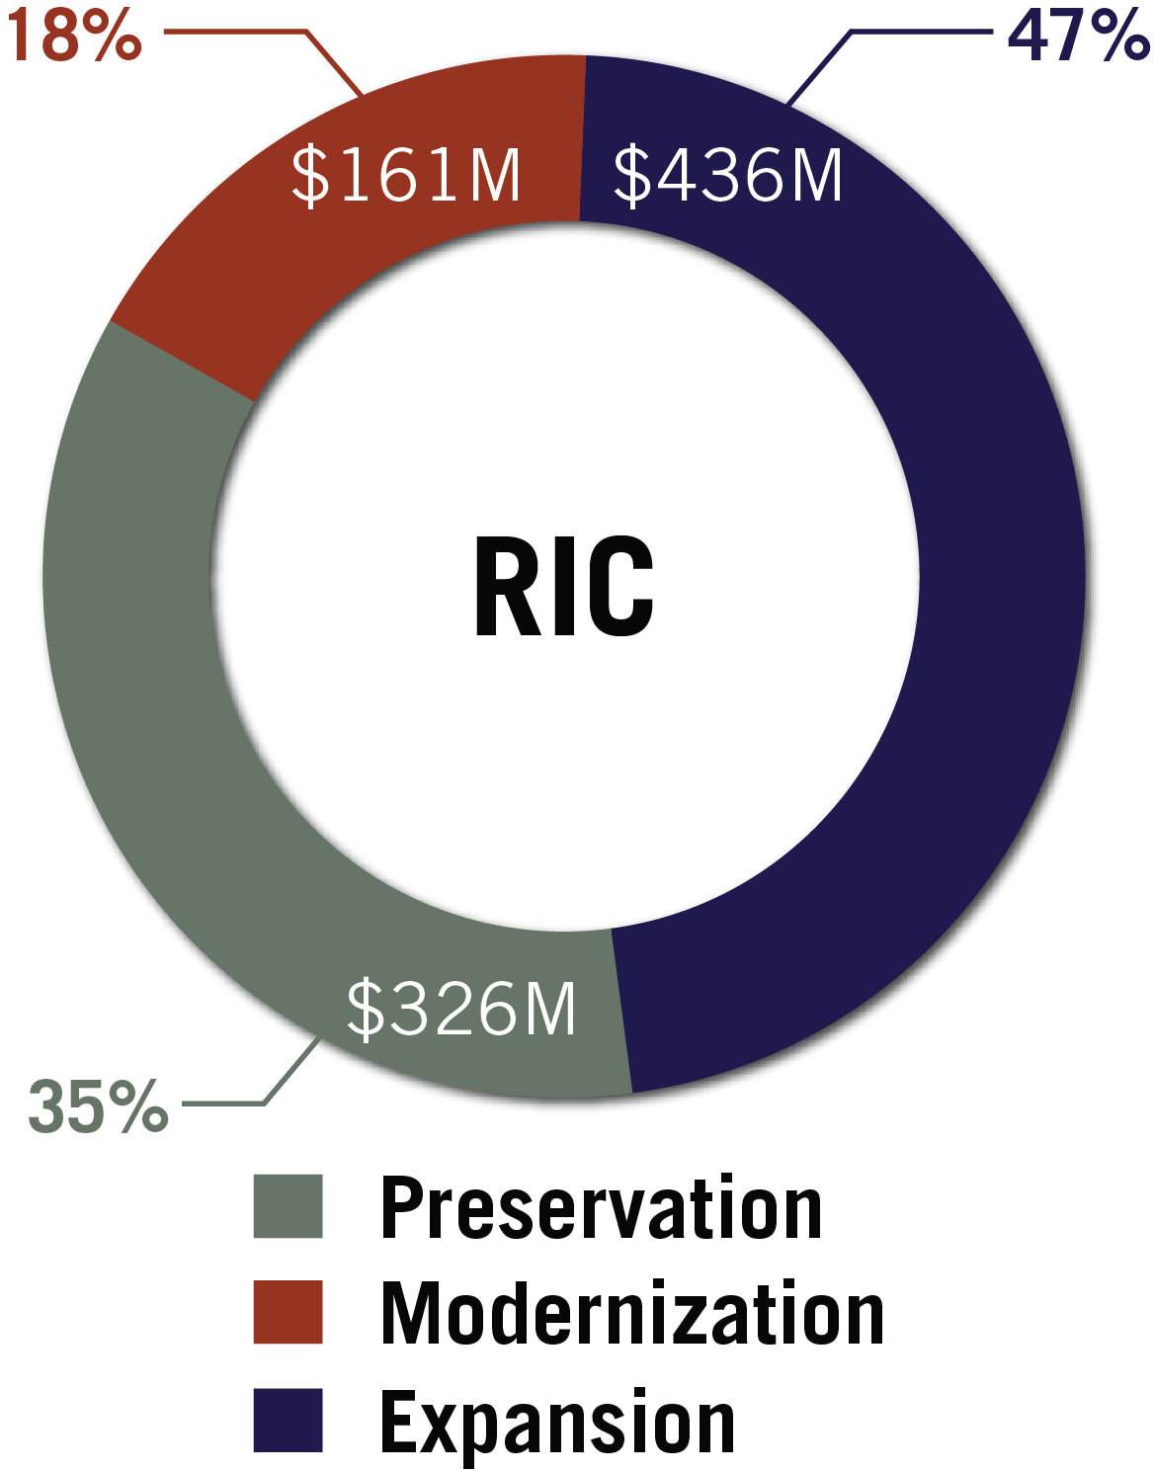
Recommended Investment Choice - Statewide
System Preservation Needs Statewide
Expansion focus in large Metro Areas
Safety remains a priority
Notes:
AS I REVIEW THE RECOMMENDED INVESTMENT CHOICES …OR RICs…THERE ARE SOME ASSUMPTIONS WE SHOULD POINT OUT: FIRST, THE RICs REPRESENT OUR FUNDAMENTAL FRAMEWORK FOR OUR INVESTMENT RECOMMENDATIONS MOVING FORWARD. WE RECOGNIZE ADOT MAKES RECOMMENDATIONS TO THE BOARD, AND IT IS THE BOARD WHO ADOPTS THE PROGRAM OF PROJECTS. SO, WHEN IT COMES TIME FOR ADOT TO RECOMMEND PROJECTS, WE WILL DO SO IN THE CONTEXT OF THE FIVE YEAR PROGRAM PROCESS, INCLUDING THE FULL INVOLVEMENT, DIRECTION AND DECISIONMAKING OF THE BOARD. ADOT IS NOT SELECTING PROJECTS TODAY. SECOND, OUR RECOMMENDED INVESTMENT CHOICE DOES NOT IMPACT THE CURRENTLY APPROVED 2018 THRU 2022 FIVE YEAR PROGRAM. WE INTEND TO DEVELOP AND DELIVER THOSE PROJECTS AS APPROVED BY THE BOARD. THE RIC WE PRESENT TODAY WILL INFLUENCE THE INVESTMENT CATEGORIES WE WOULD INTEND TO EMPHASIZE AS WE ULTIMATELY DEVELOP PROJECT RECOMMENDATIONS FOR THE NEXT FIVE YEAR PROGRAM – THE 2019 THRU 2023 PROGRAM – AND THE FORESEEABLE FUTURE. IT WILL ALL BE DONE IN THE CONTEXT OF THE FIVE YEAR PROGRAM. HOWEVER, WE ARE RECOMMENDING A SIGNIFICANT SHIFT IN DIRECTION TOWARD SYSTEM PRESERVATION AND SAFETY.
THIS FIGURE SHOWS THE STATEWIDE RIC. THE NUMBERS ARE ANNUAL DOLLAR AMOUNTS RATHER THAN 25-YEAR FIGURES. NOTICE A SIGNIFICANT COMMITMENT TO PRESERVATION AND MODERNIZATION. THE INVESTMENT IN EXPANSION IS ATTRIBUTABLE TO THE MAG AND PAG REGIONS, WHERE REGIONALLY DEDICATED FUNDING SOURCES SUPPORT THOSE EXPANSION PROJECTS. NOW, LET’S LOOK AT HOW THE STATEWIDE RIC IS BROKEN DOWN INTO THE MAG, PAG, AND GREATER ARIZONA RICS, RESPECTIVELY.

Slide 16
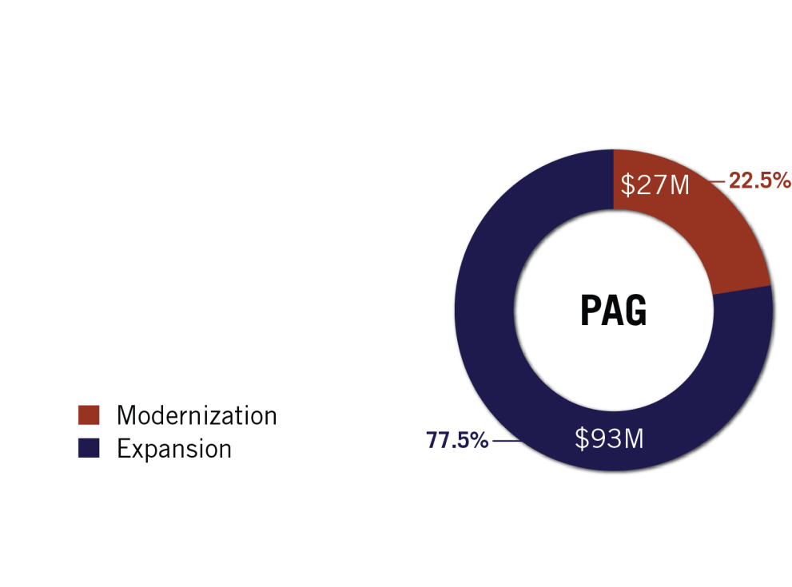
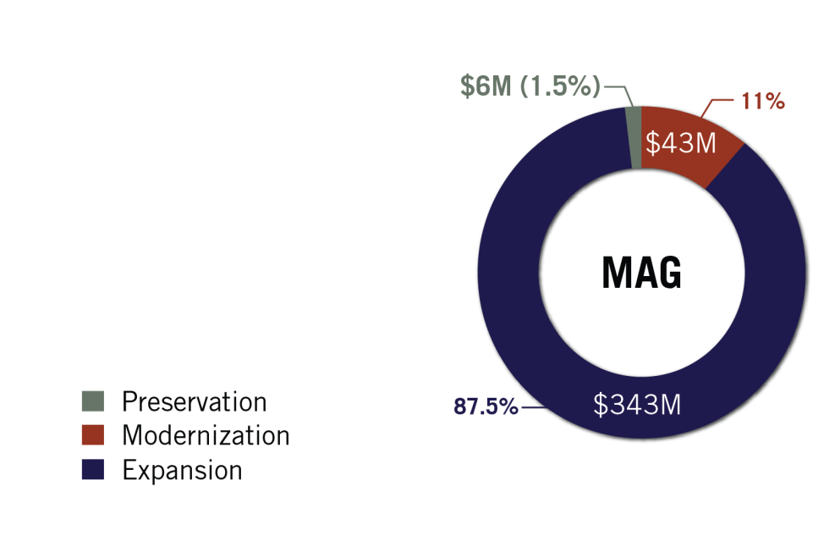
RIC – MAG and PAG – Expansion Focus
Notes:
THE MAG AND PAG RICS ARE DOMINATED BY EXPANSION. THIS RECOGNIZES MAG AND PAG AS THE FEDERALLY DESIGNATED LEAD PLANNING AGENCIES FOR THEIR REGIONS. ESSENTIALLY, THEY LEAD THE PLANNING EFFORT, CONDUCTED IN COOPERATION WITH ADOT, AND ADOT BUILDS THE PROJECTS THAT ARE ON THE STATE FREEWAY/HIGHWAY SYSTEM. AGAIN, REMEMBER THESE AREAS HAVE REGIONAL TAXES DEDICATED LARGELY TO EXPANSION PURPOSES. ………….. AN IMPORTANT FOOTNOTE TO THIS FIGURE IS THAT, IN ADDITION TO WHAT IS SHOWN IN THE FIGURE, ADOT DOES EXPEND REVENUES FOR PRESERVATION OF THE STATE HIGHWAY SYSTEM IN THE MAG AND PAG REGIONS DEPENDING ON NEED AND AVAILABLE REVENUES. THE AMOUNTS EXPENDED VARY BY YEAR.

Slide 17
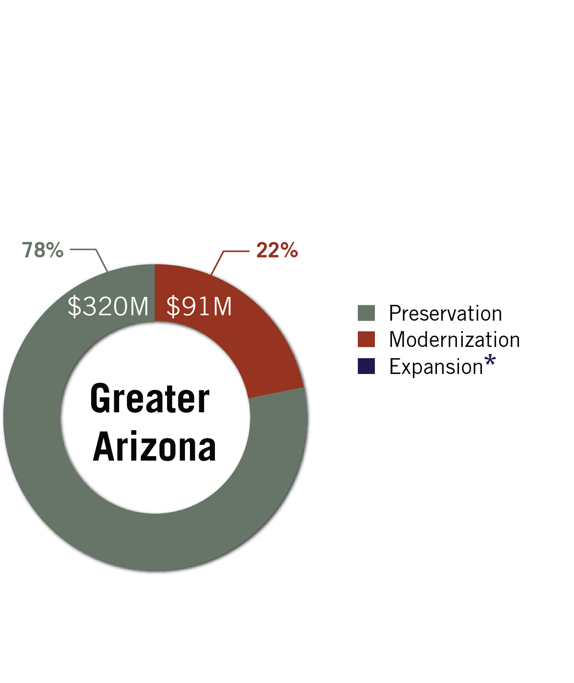
Recommended Investment Choice – Greater Arizona
System Preservation is Priority
Fund the Highway Safety Improvement Program and Avoid System Obsolescence
* Up to 5% of funding reserved for Expansion only to match federal grants or leverage third party contributions (or if Revenues incr.)
Notes:
FOR GREATER ARIZONA, OUR RECOMMENDED PRIORITY IS PRESERVATION OF THE EXISTING HIGHWAY SYSTEM – INCLUDING PAVEMENT AND BRIDGES. OUR PAVEMENT AND BRIDGE ENGINEERS ADVISE US THAT WE MUST INVEST AT THIS LEVEL IN ORDER TO MAINTAIN THE STATUS QUO OF CONDITION. THE REMAINING FUNDING IS RECOMMENDED TO SUSTAIN THE SAFETY PROGRAM AND ENSURE WE ACCOMPLISH ESSENTIAL MODERNIZATION TO AVOID SYSTEM OBSOLESCENCE. WE DO NOT HAVE SUFFICIENT REVENUES TO SUPPORT NEW EXPANSION PROJECTS AND STILL BE ABLE TO PRESERVE OUR FUNDAMENTAL INFRASTRUCTURE. THIS IS A DIFFICULT CHOICE, BUT IT IS ONE WE ARE COMPELLED TO RECOMMEND.
………WE RECOGNIZE SELECTED NEW EXPANSION NEEDS WILL ARISE. THEREFORE, WE RECOMMEND CONDITIONALLY RESERVING UP TO 5% OF THE GREATER ARIZONA PRESERVATION FUNDING (OR ABOUT 20 MILLION DOLLARS) IN A GIVEN FUTURE PROGRAM YEAR TO LEVERAGE FEDERAL GRANT OPPORTUNITIES AND/OR MATCH LOCAL GOVERNMENT OR OTHER THIRD PARTY CONTRIBUTIONS TO CONSIDER PRIORITY EXPANSION NEEDS IN GREATER ARIZONA. NEW EXPANSION MAY ALSO BECOME POSSIBLE IF UNEXPECTED NEW REVENUES ARE PROVIDED. HOWEVER, WE WOULD CONSIDER NEW EXPANSION PROJECTS ONLY UNDER THESE LIMITED SCENARIOS AND ONLY IF SUCH PROJECTS ARE FAVORABLY RATED IN COMPARISON TO OTHER PROJECT ALTERNATIVES.

Slide 18
FY2019 – FY2023
Five-Year Transportation Facilities Construction Program

Slide 19
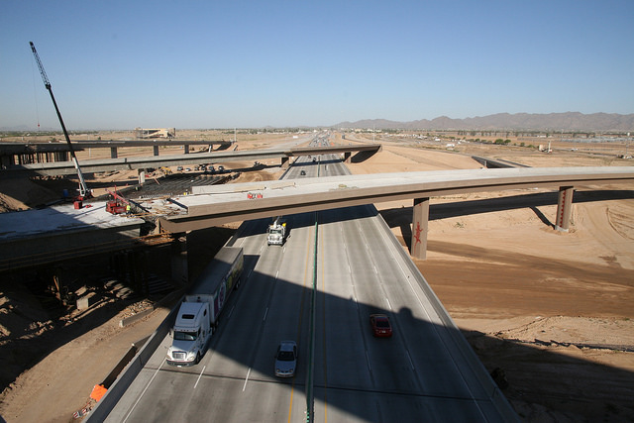
Overview of Asset Condition

Slide 20
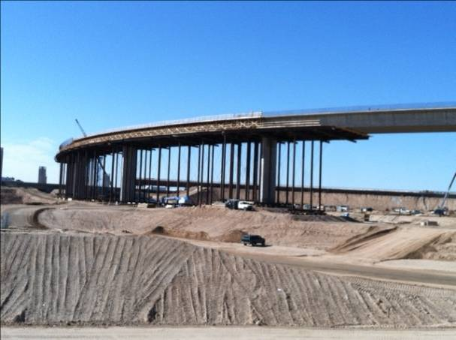
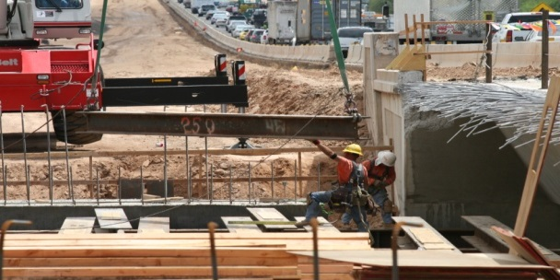
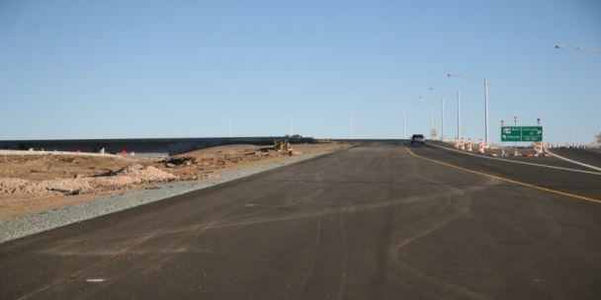
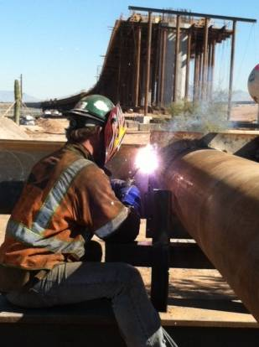
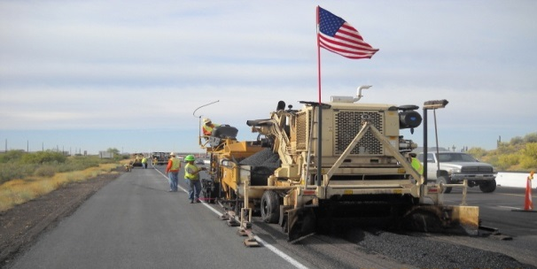
$21.5 Billion = Value of State Highway System Infrastructure
$21.5
Billion
Without a commitment to preservation, the system would cost $200 billion to replace.
Notes:
20.2 Billion is how much the system cost to build today this does not include maintenance (oil Changes)of the system

Slide 21
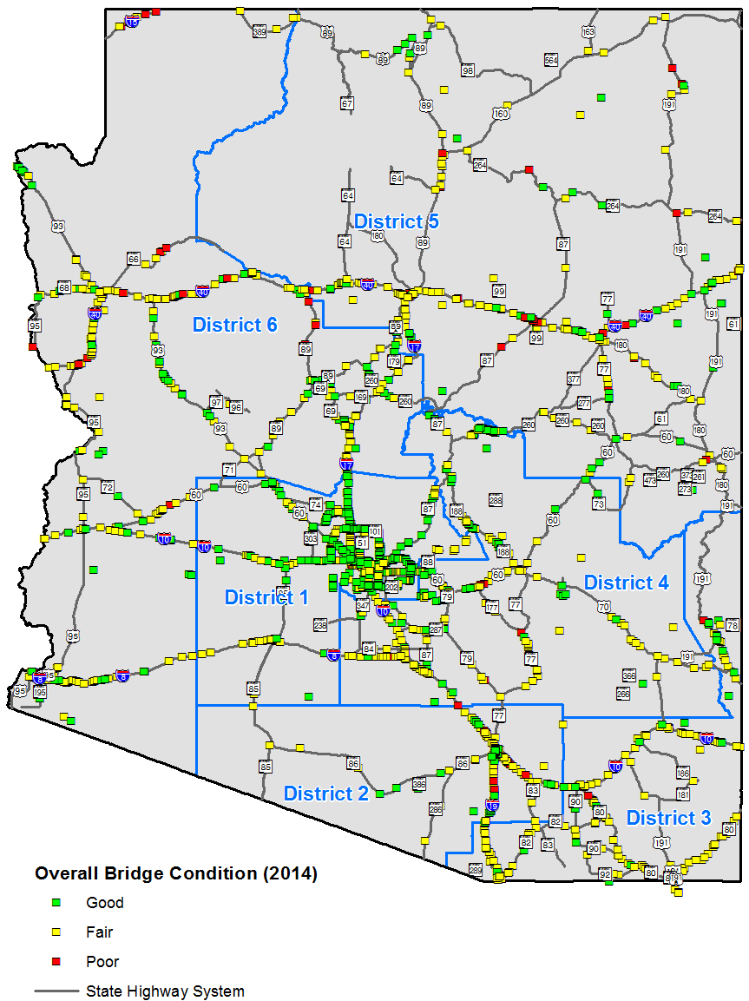
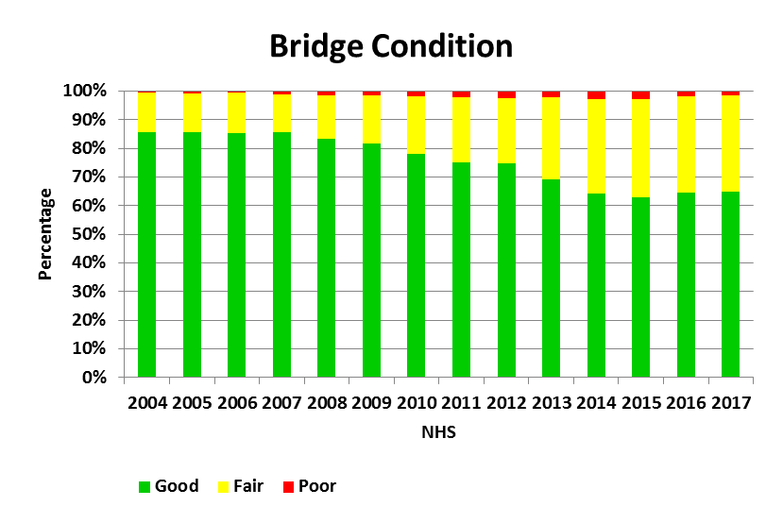

Slide 22
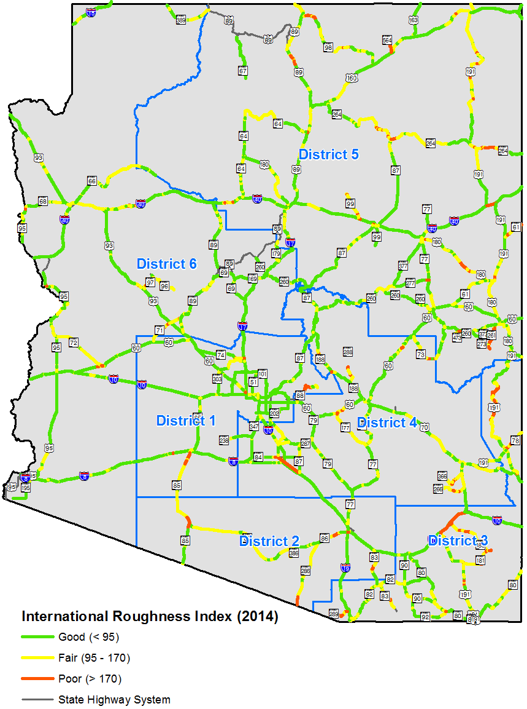
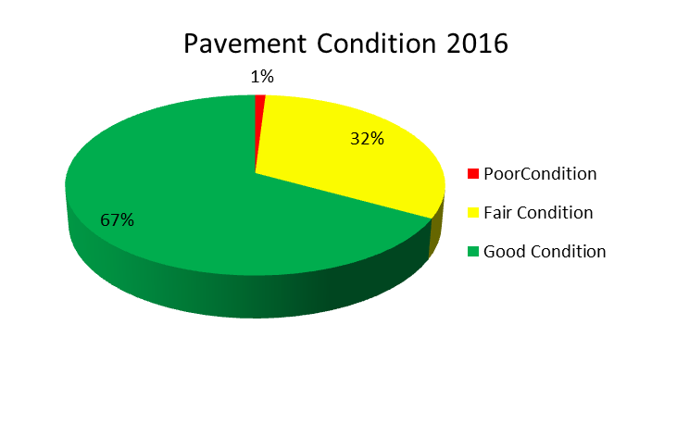
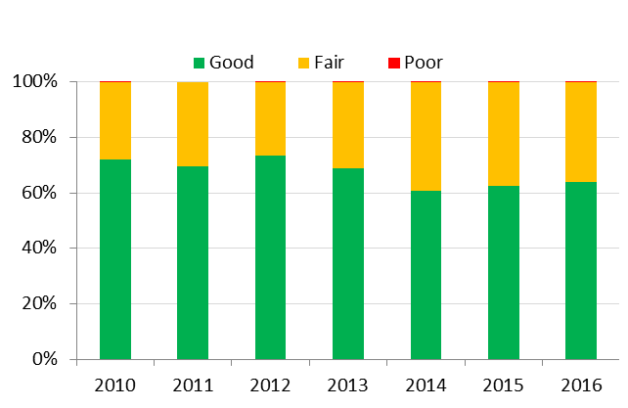
Pavement Condition: Interstate Highway System

Slide 23
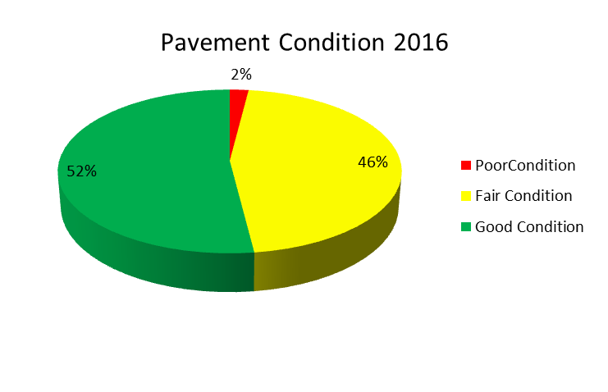
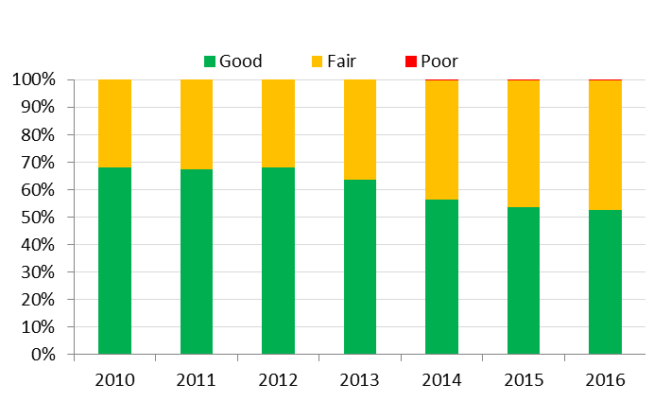
Pavement Condition: Non-Interstate NHS

Slide 24
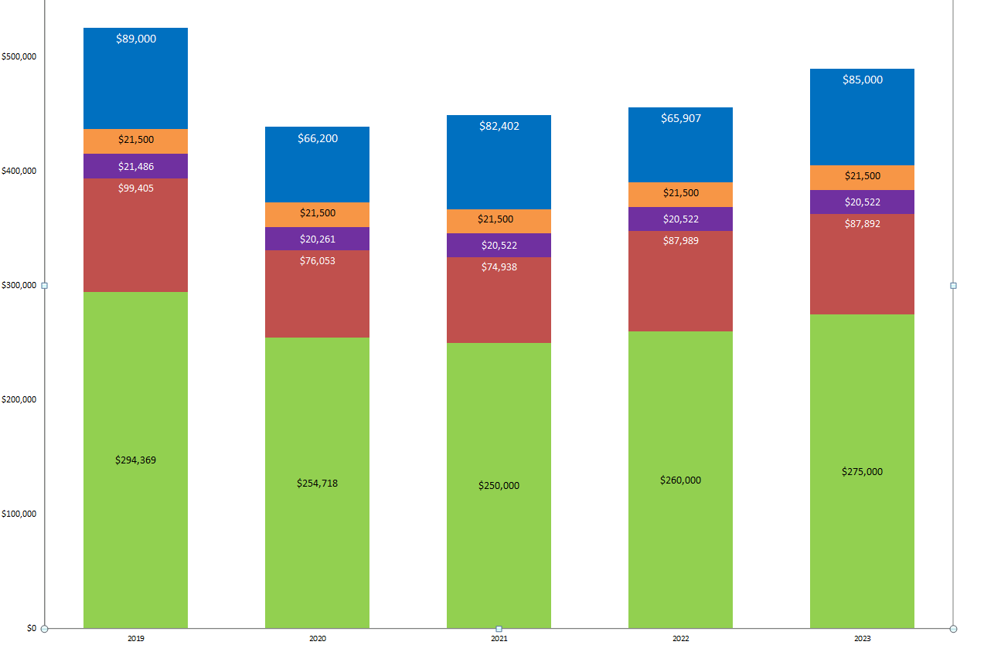
Expansion Projects
Planning Costs
Development Costs
Modernization Projects
Preservation Projects
Preservation Target is $320M Per Year
$26
$65
$60
$60
$45
2019
2020
2021
2022
2023

Slide 25
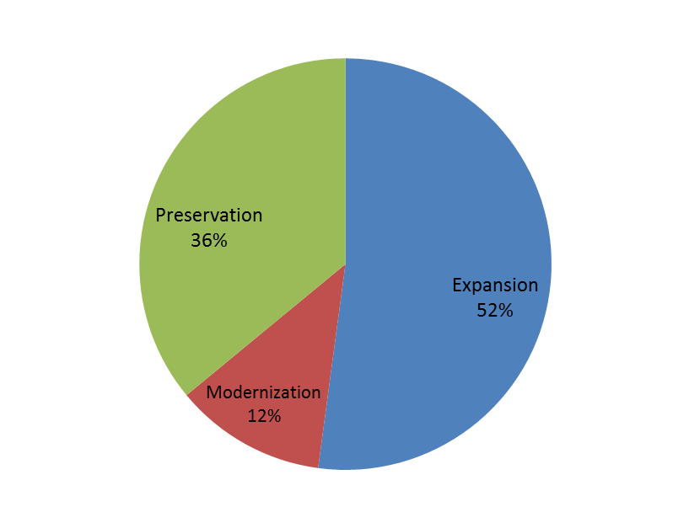
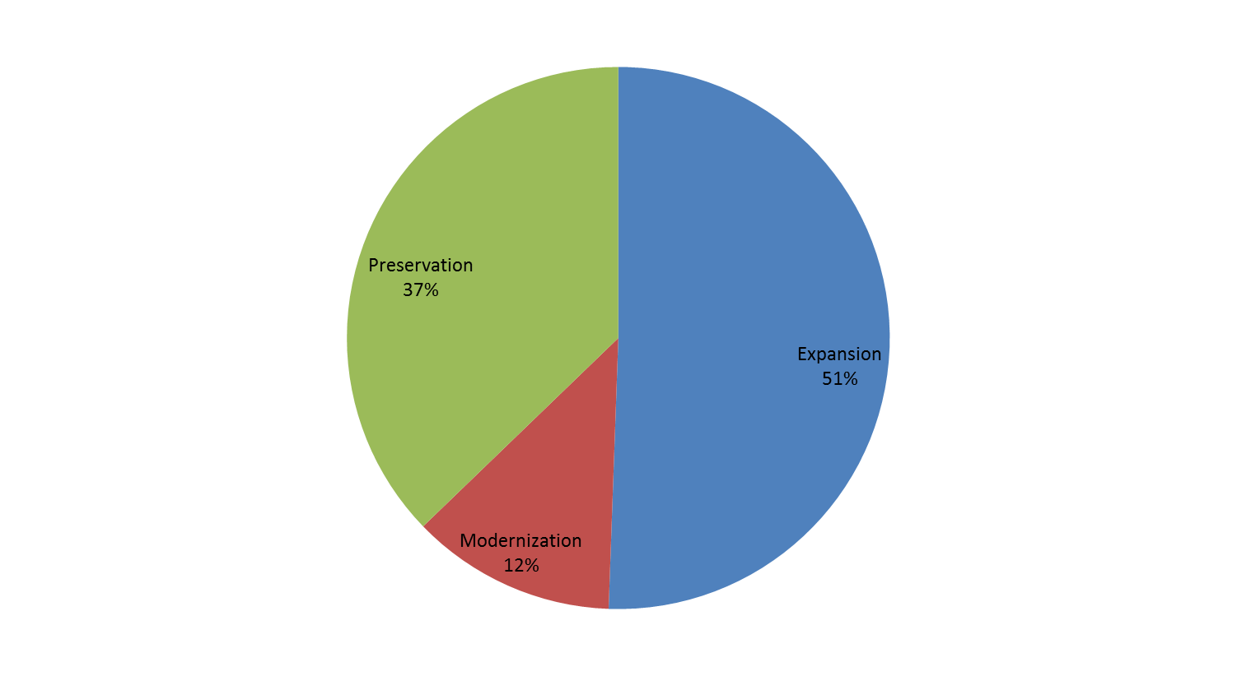
2018-2022 Facilities Construction Program
2019-2023 Tentative Facilities Construction Program
Includes MAG & PAG Funding
Notes:
25
Cover

Slide 26
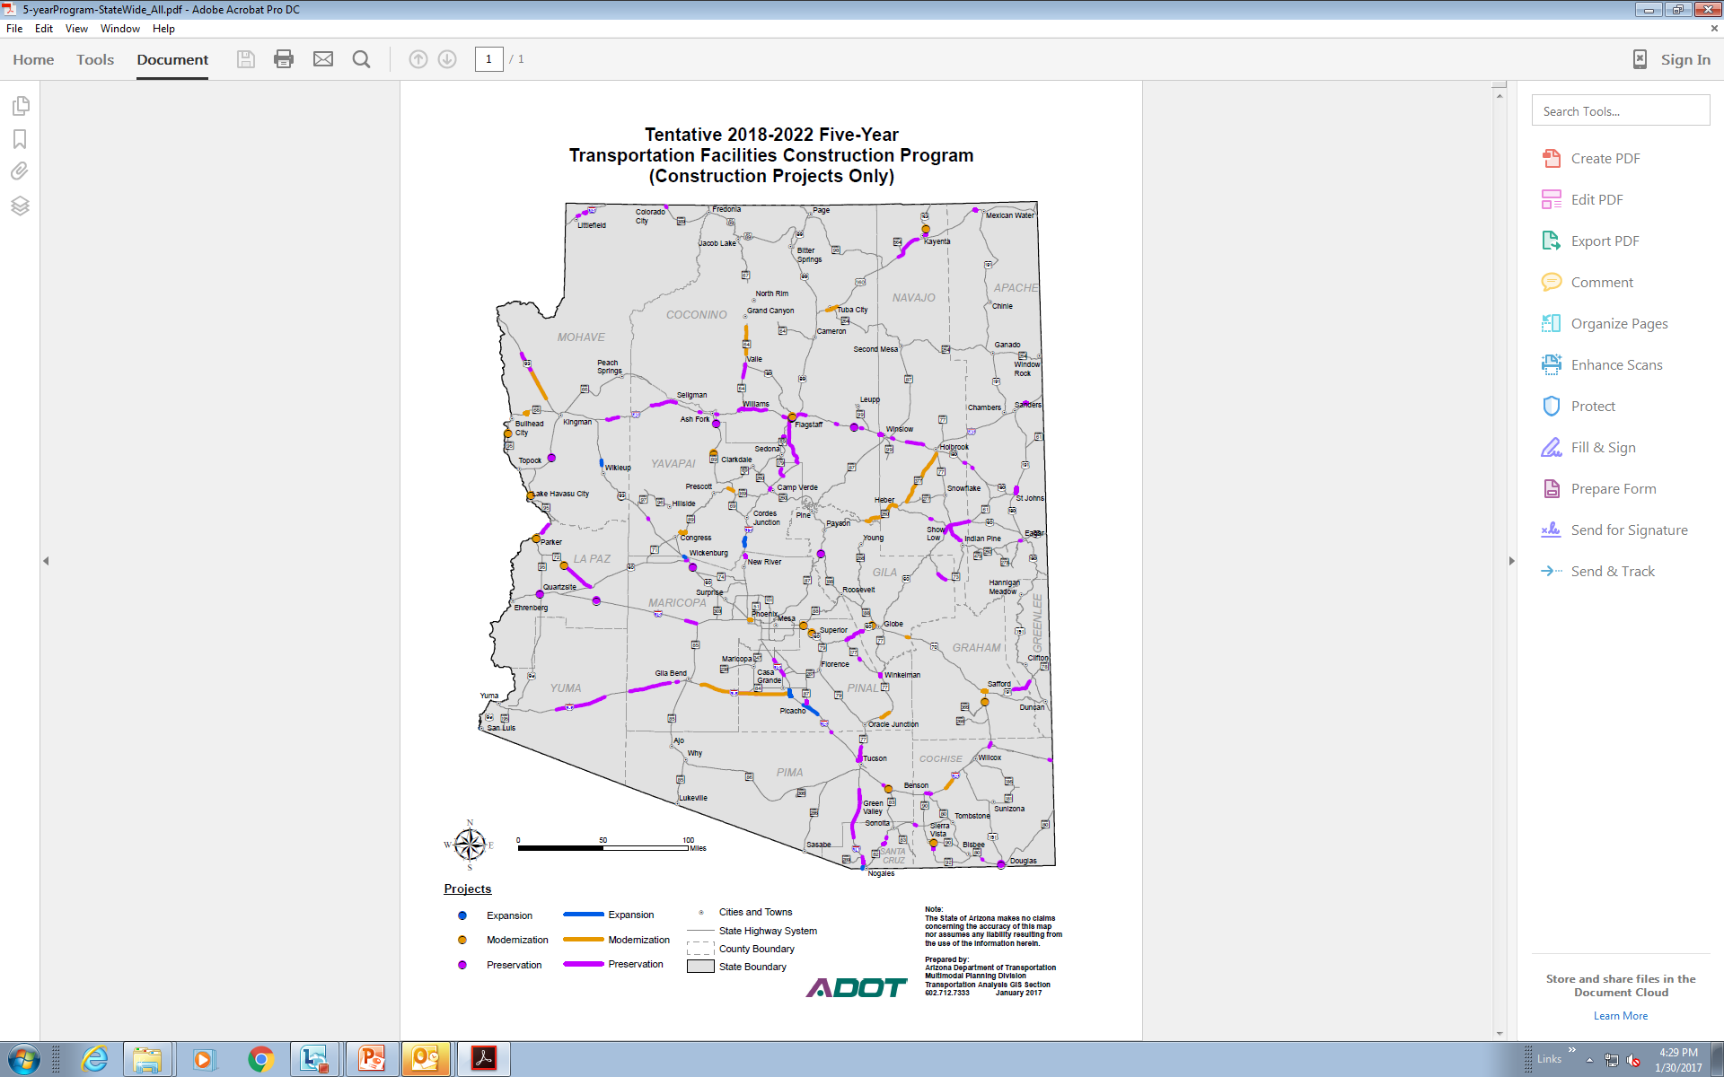
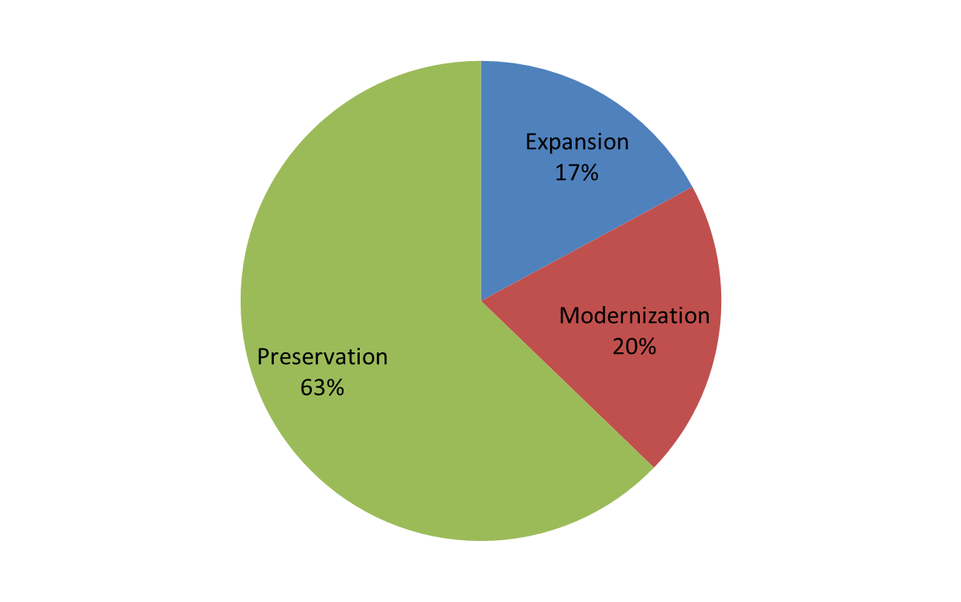
Greater Arizona Tentative 5-Year Highway Delivery Program(FY19-FY23)

Slide 27

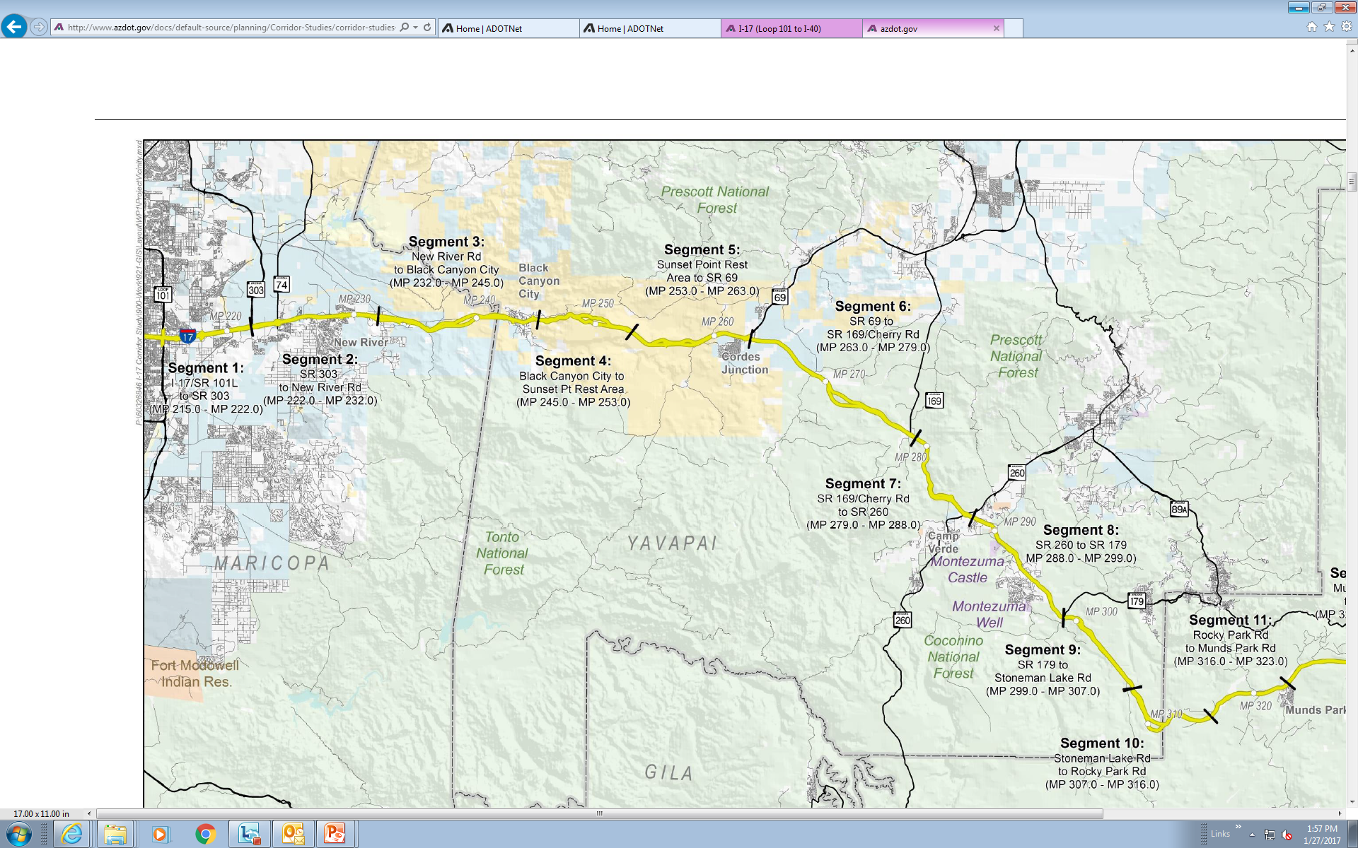
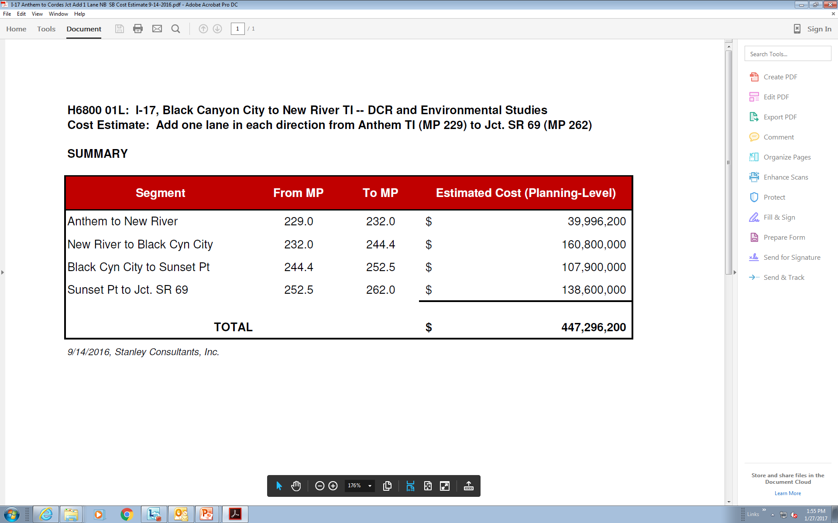
$62.4M; I-17 Anthem to Sunset Point (5YR Program FY21)
$65.9M; I-17 Anthem to Sunset Point (5YR Program FY22)
$50M; I-17 Widening North of Anthem (MAG FY 18 & 20)
$178.3M Total

Slide 28
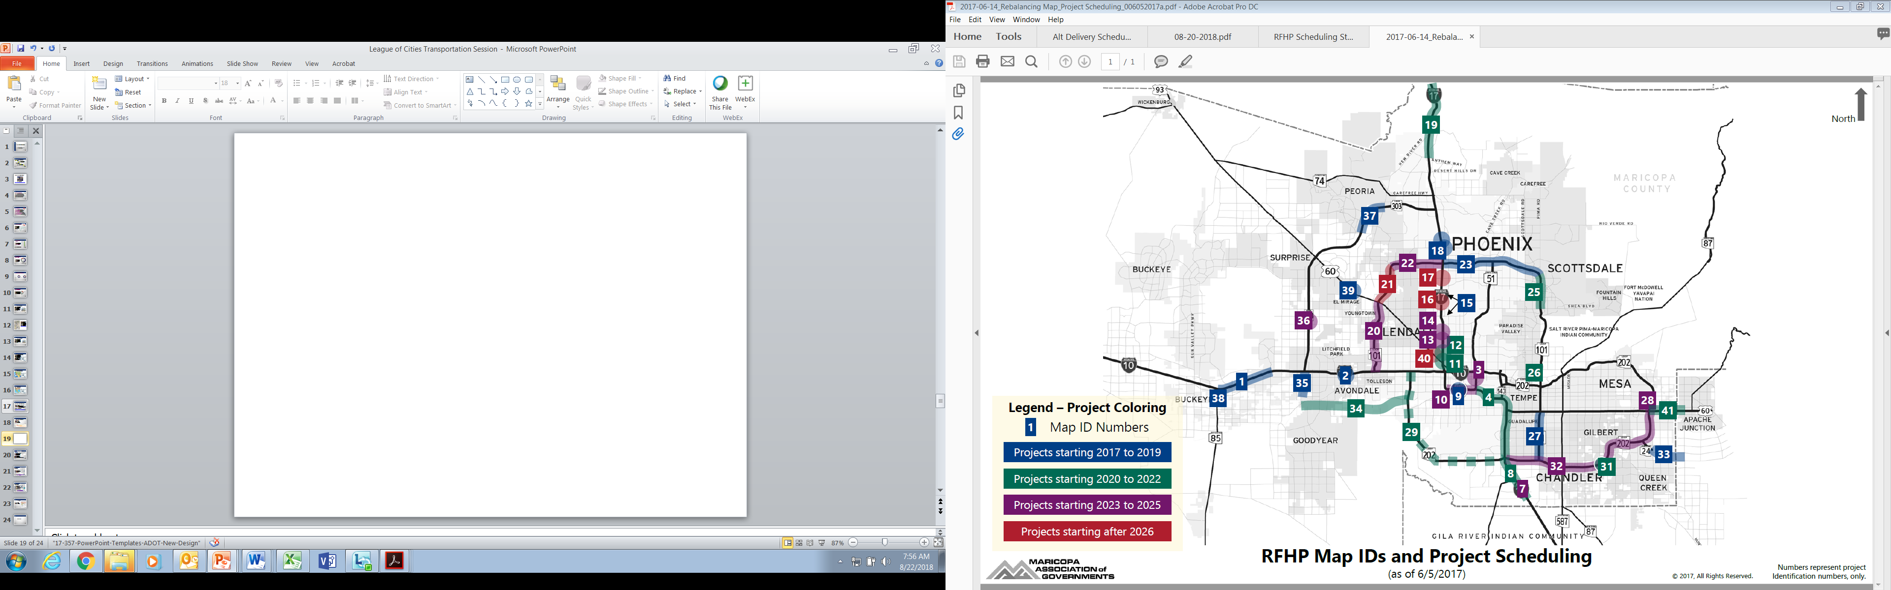
Happy Valley/Pinnacle Peak Tis $49 million (DDI)
SR 101 –I-17 to Pima
$139.3 million (DB)
FY2019
SR 24 –Ellsworth -Ironwood
$56.4million
FY2019
SR 101 –Baseline - 202
$51.4 million (DB)
FY2019

Slide 29
SR 101 –Pima - Shea
$56.4million
FY2020
SR 303 –MC 85- Van Buren
$93.8 million FY2019
I10- I-17 Split - 202 (DB)
$480 million
FY2021

Slide 30
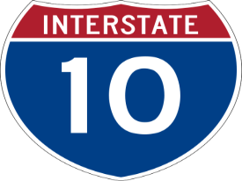
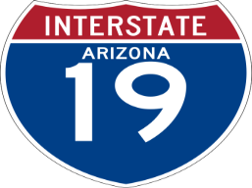
PAG Program
I-10 Houghton Rd TI $45.6M FY 19-21 (DDI)
I-10 Ina Road TI $19.4M FY 20 & 21
I-10 Ruthrauff TI $101.8M FY 19-21
I-10 Ina to Ruthrauff $129.2M FY 20-22
I-19 Ajo Way TI $35.7M FY 19

Slide 31
New Technology

Slide 32
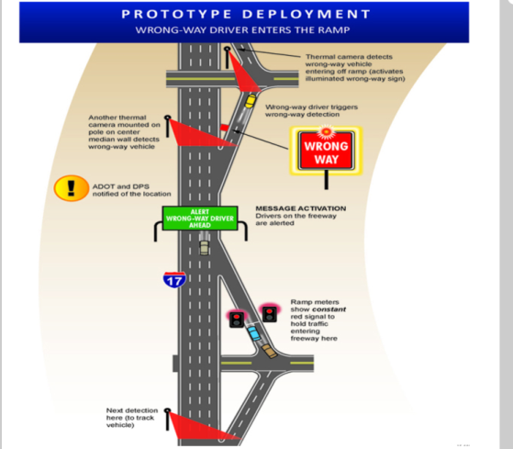
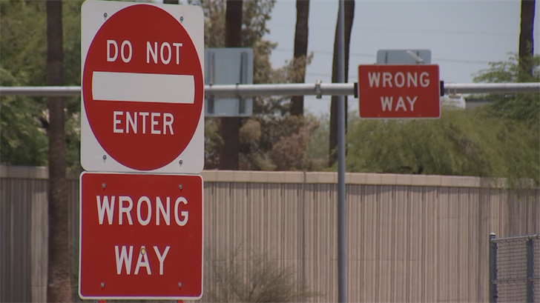
Wrong Way Detection

Slide 33
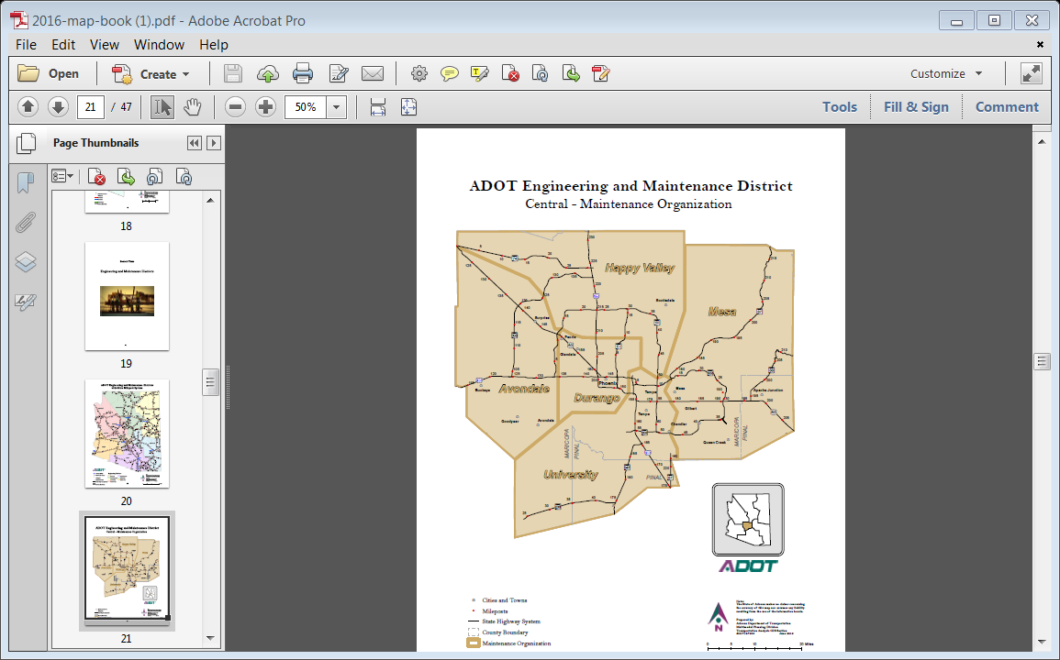
Wrong Way Detection Project

Slide 34
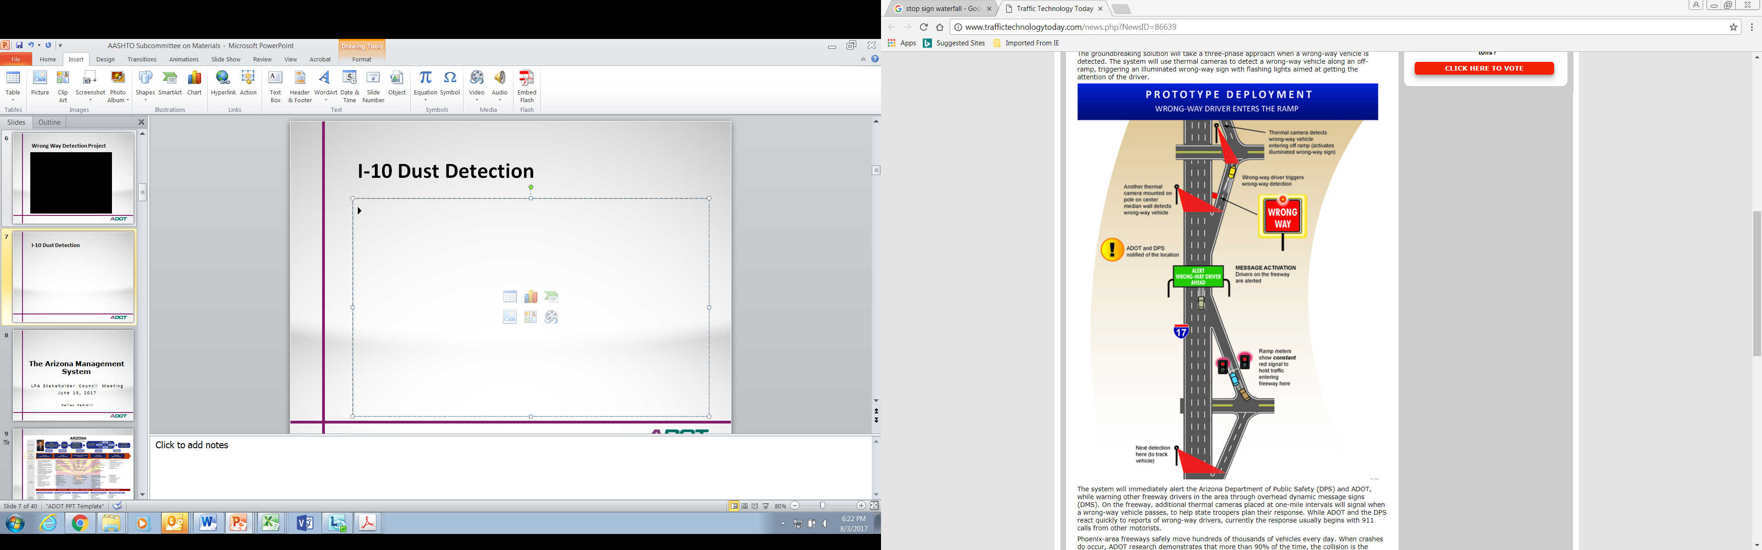
Results since January
37 wrong way events
2 entered the freeway

Slide 35
Keeping Score

Slide 36
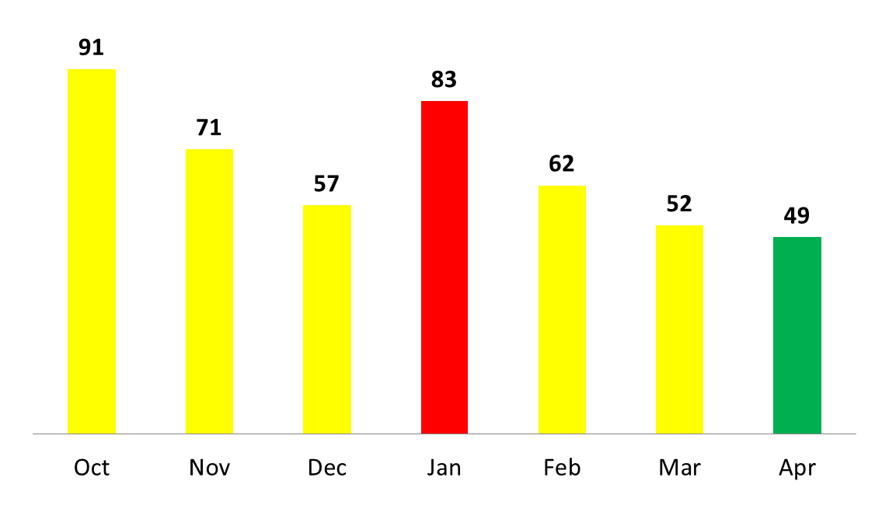
Task Order Execution
150 Days to Target of 50 Days
Notes:
36

Slide 37
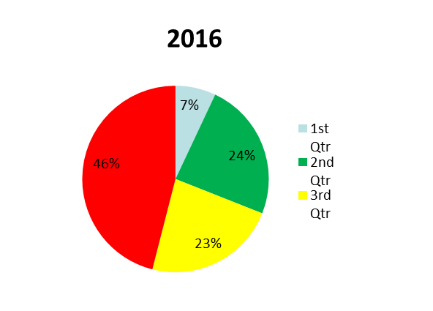
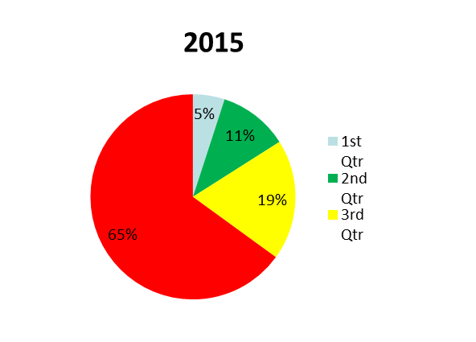
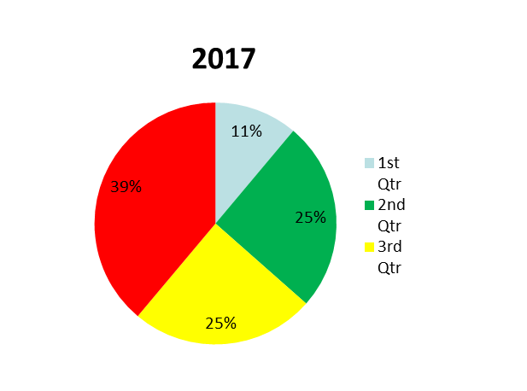
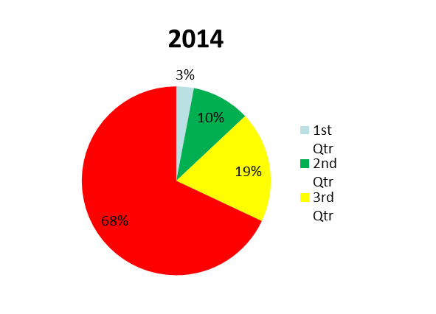
20-30-30-20 Progress

Slide 38
Goal – Reduce Total Fatalities
Notes:
COUNTERMEASURES
TSMO is working with DPS on Safety Corridors. DPS enforcement on four segments: I-10 from I-17 to SR51, and I-10 from L202 to SR187

Slide 39

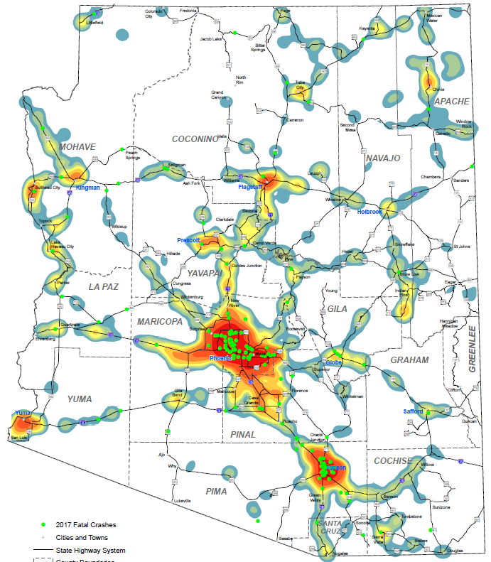
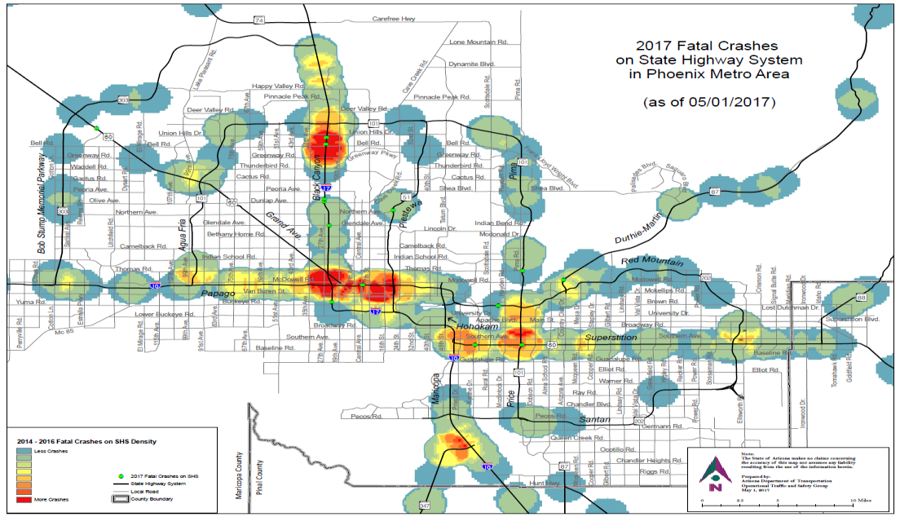
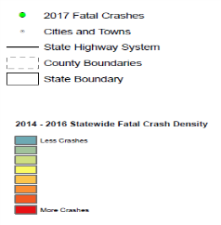
Notes:
This chart shows locations of fatal crashes across the state, and across both the State Highway System and Local roadways. Approximately 1/3 of fatal crashes in 2016 have occurred on the State Highway System.

Slide 40

Pavement Treatments
2086 miles treated in 2017
3000 miles is target for 2018
Crack Sealing
Flushes
96% of Target Met
1641/1700 Total = 96%
No Snow – so good Jan & Feb
6000

Slide 41
Thank you

