Slide 1
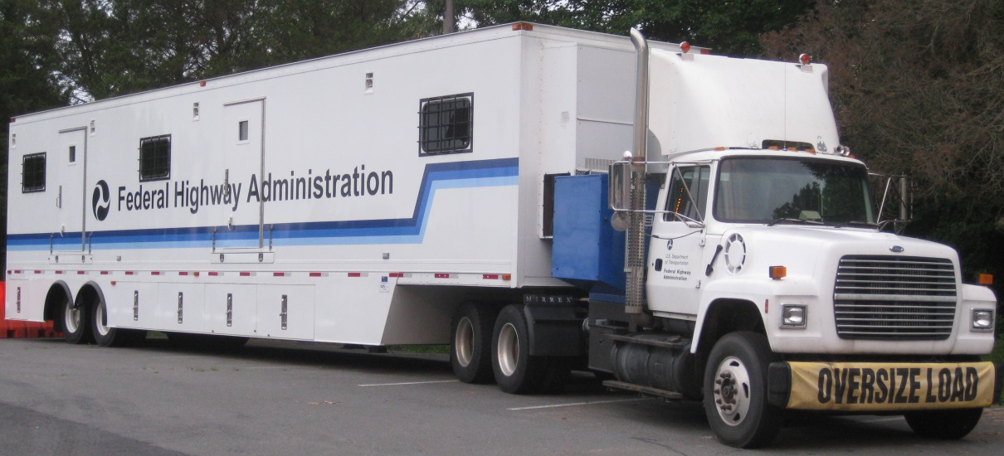
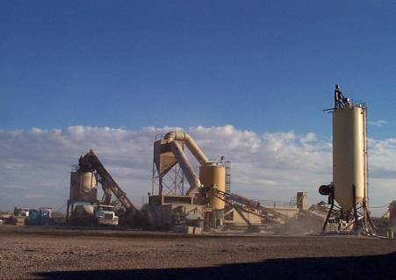
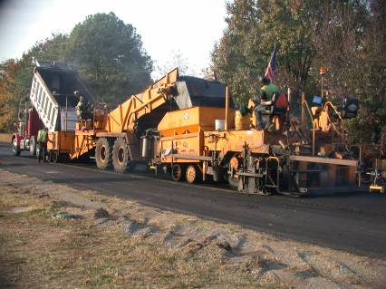
Mobile Asphalt Testing Trailer Program (MATT): Recent Experience in Arizona
All images FHWA unless otherwise noted.
Arizona Pavements/Materials Conference November 15, 2018  Tempe, AZ
Amir Golalipour, Ph.D.
David J. Mensching, Ph.D., P.E.
Office of Preconstruction, Construction, and Pavements

Slide 2
Agenda
FHWA Pavement and Materials
Binder Activities
Asphalt Mixture Performance Tester (AMPT)
Arizona Project Results & Discussions
Questions

Slide 3
Acronyms
AASHTO: American Association of State Highway and Transportation Officials
ABCD: Asphalt Binder Cracking Device
ABTL: Asphalt Binder Testing Laboratory
AIMS: Aggregate Imaging System
AMPT: Asphalt Mixture Performance Tester
BBR: Bending Beam Rheometer
CAA: Coarse Aggregate Angularity
CC: Concentric Cylinders
DSR: Dynamic Shear Rheometer
DTT: Direct Tension Tester
ETG: Expert Task Group
Gmb: Bulk Specific Gravity
GTR: Ground tire rubber
HMA: Hot mix asphalt
HQ: Headquarters
MATT: Mobile Asphalt Testing Trailer
MSCR: Multiple Stress Creep and Recovery
PAV: Pressure Aging Vessel
PEMD: Performance-Engineered Mixture Design
PG: Performance Grading
PRS: Performance Related Specification
QA: Quality Assurance
RAP/RAS: Reclaimed Asphalt Pavement/Reclaimed Asphalt Shingles
RTFO: Rolling Thin-film Oven
RV: Rotational Viscometer
SSR: Stress Sweep Rutting
TFHRC: Turner-Fairbank Highway Research Center
WMA: Warm Mix Asphalt
Note: FHWA does not endorse products or manufacturers. Trade or manufacturers’ names appear in this presentation solely for informational purposes.

Slide 4
Pavement & Materials Discipline
Program Office
Office of Preconstruction, Construction, and Pavements (FHWA HQ, Washington, DC)
Mobile Asphalt Testing Trailer (MATT)
Asphalt Binder Testing Laboratory (ABTL)
Research and Development
TFHRC (McLean, VA)
Technical Services
Resource Center
Divisions
Notes:
Added R&D, Tech Services, and Divisions

Slide 5
Program Objective
Provide Support to National Initiatives
Performance-Engineered Mixture Design (PEMD)
Increased Pavement Density
Development of New QA Concepts for HMA
Understanding Asphalt Rubber Testing
Binder Performance Testing
Provide Assistance with State-specific Issues
Technical Guidance
Forensics

Slide 6
MATT Program History
Projects began in 1988
Demonstration Project 74: Field Management of Asphalt Mixes Using Volumetric Quality Control
Transition to Superpave implementation
Early 1990s
Classroom and hands-on training
Transition to performance-related specifications
Shadow testing
AMPT user since 2003
Innovative materials and practices
WMA, SMA, GTR, RAP/RAS, increased density

Slide 7
MATT visits since 2007
PR
Field Work
Workshop/Hands-on Training/Presentation/ Open House/Technical Assistance
Both
Notes:
NEW SLIDE

Slide 8
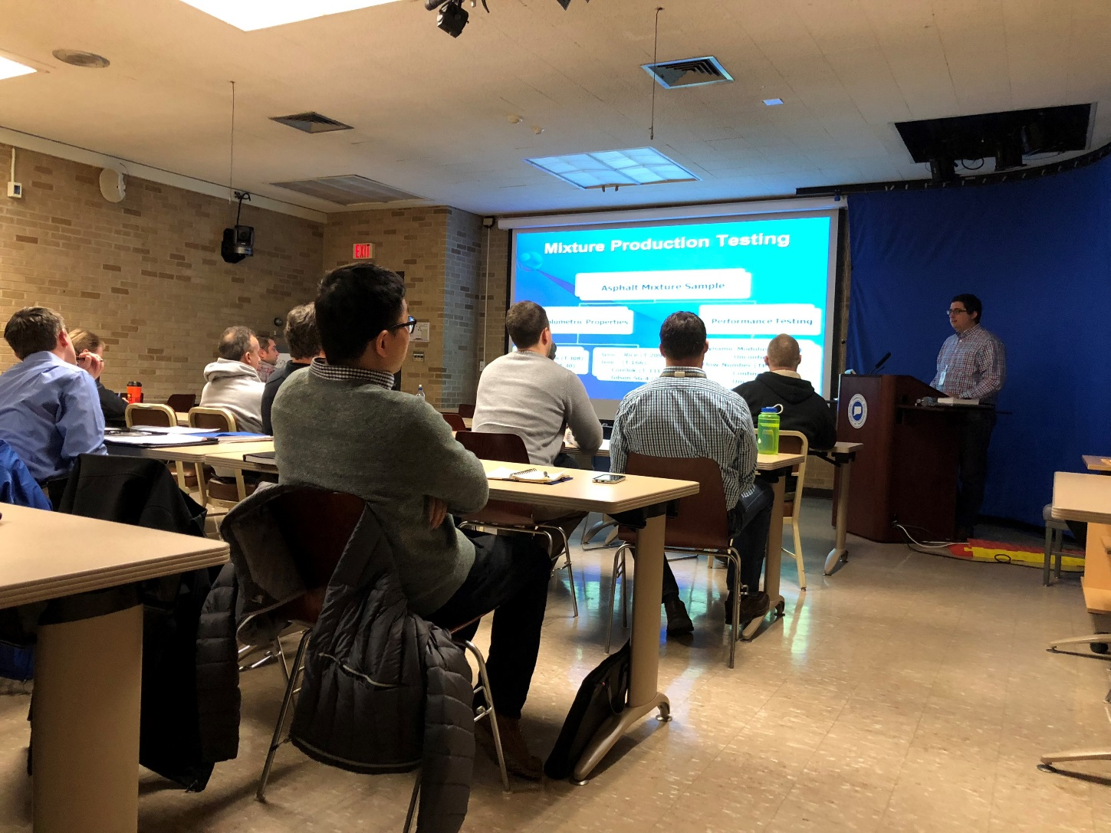
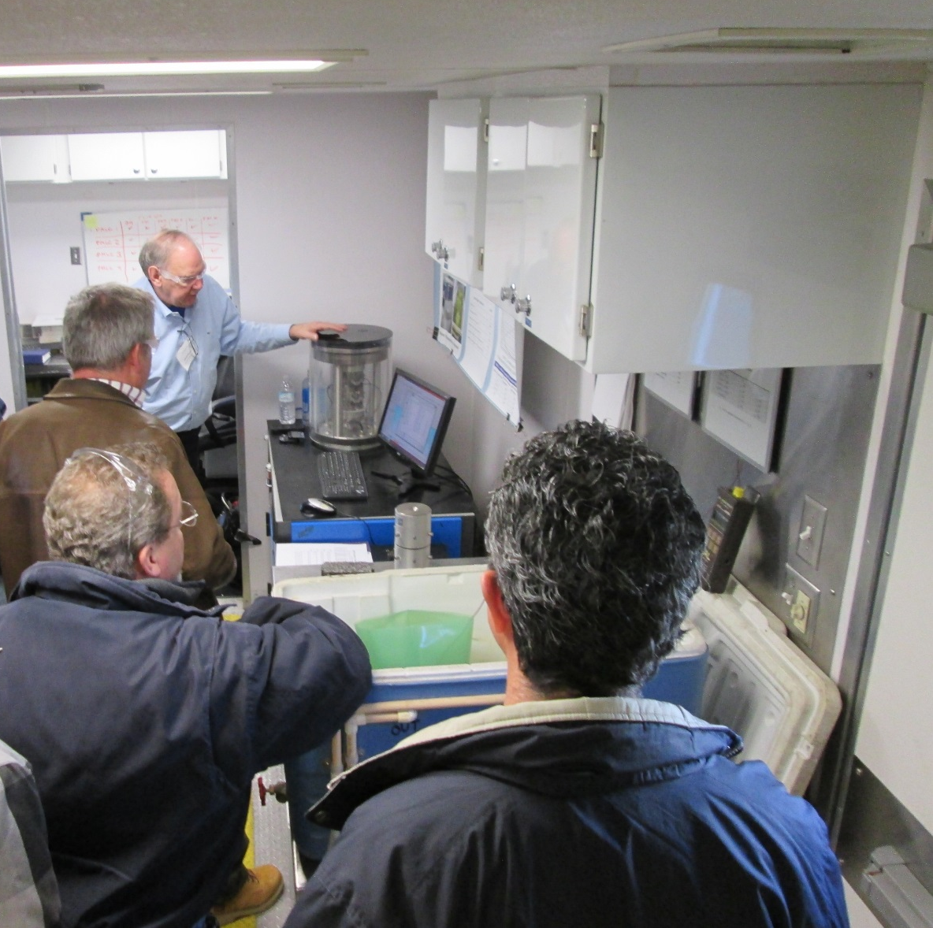
Technical Workshops

Slide 9
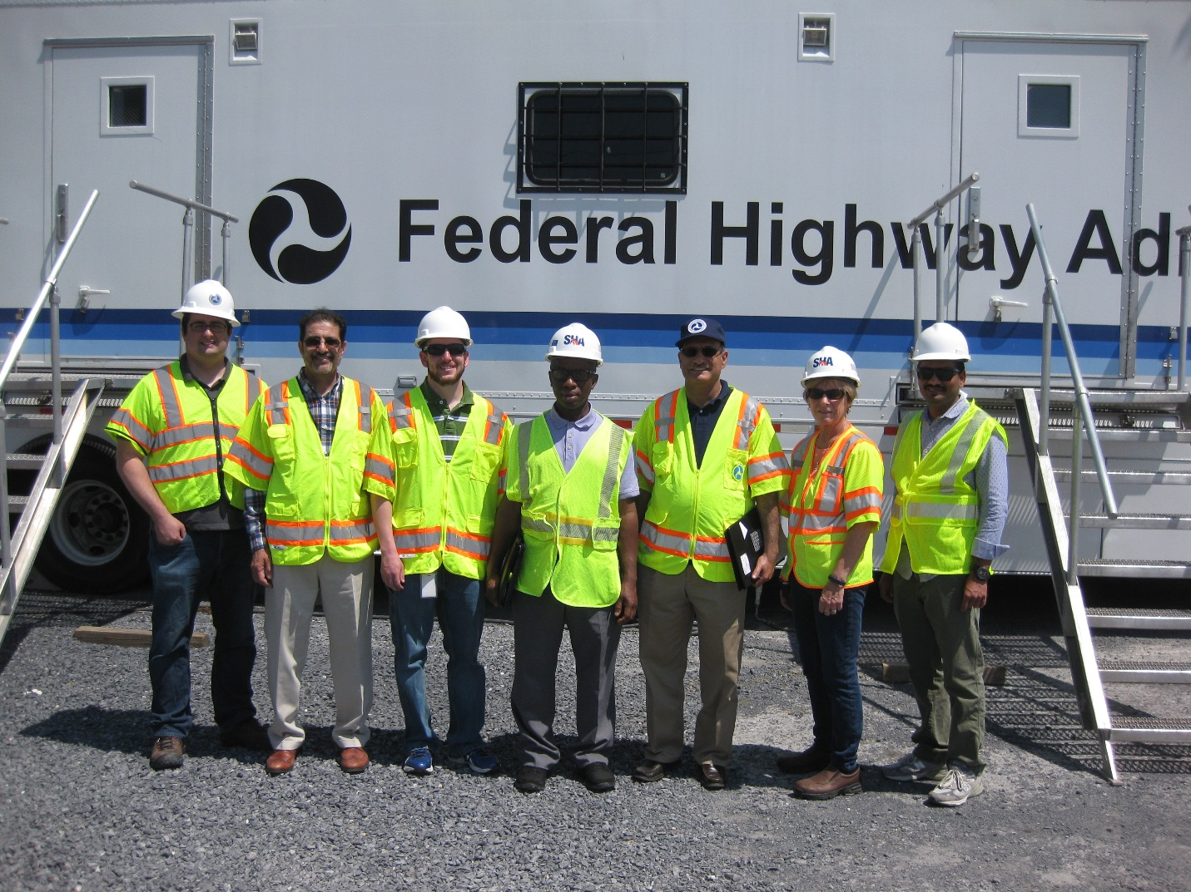
Training
Training for the Maryland State Highway Administration staff

Slide 10
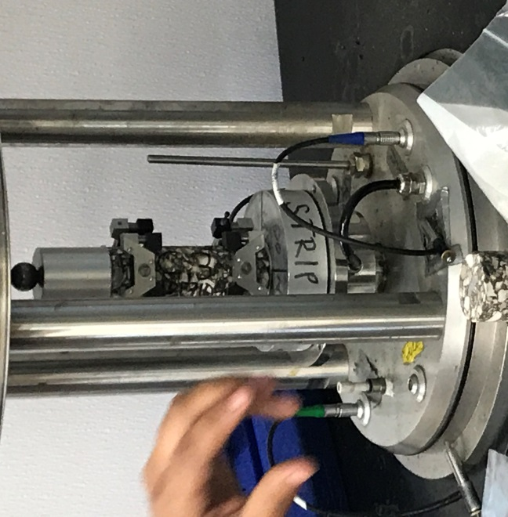
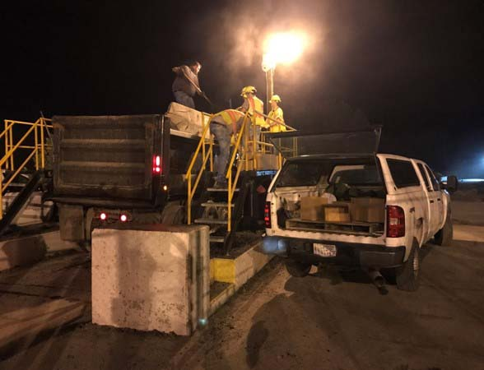
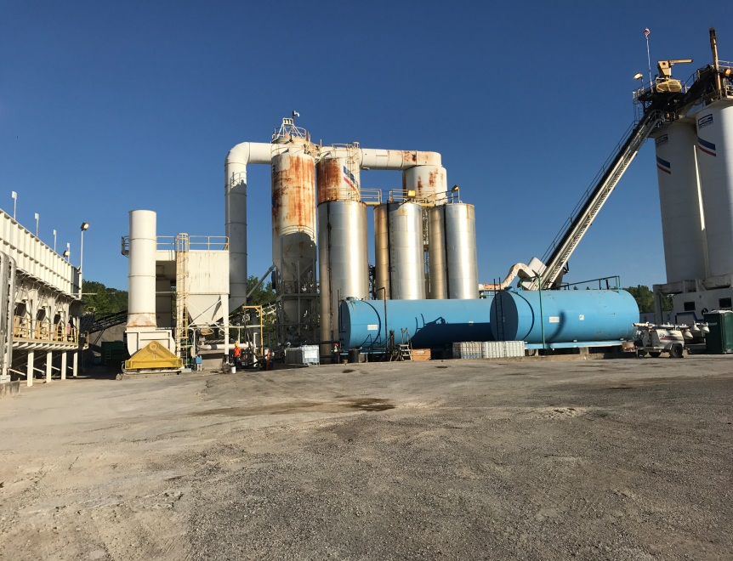
Field visits
Notes:
NEW SLIDE

Slide 11
Other MATT Activities
Conferences
Expert task group support
NCHRP panels and project participation
Division Office rotational assignments
Academic journal papers and presentations
Notes:
NEW SLIDE

Slide 12
Deployment Status: Asphalt Rubber
Seven projects between 2013 to 2015
Collaboration with four State DOTs to evaluate their specifications based on project results
Working with FHWA ETG to develop AASHTO standard for asphalt rubber testing

Slide 13
Binder Activities

Slide 14
Binder Characterization
TEST PROCEDURES
EQUIPMENT
Performance Grading
AASHTO M 320
AASHTO M 332 (MSCR)
AASHTO R 49 (Low Temperature PG)
Solubility & Separation
AASHTO T 44
ASTM D7173
RV
DSR
RTFO
PAV
Vacuum Degassing Oven
BBR
DTT
ABCD (AASHTO TP 92)
Torsional bar testing

Slide 15
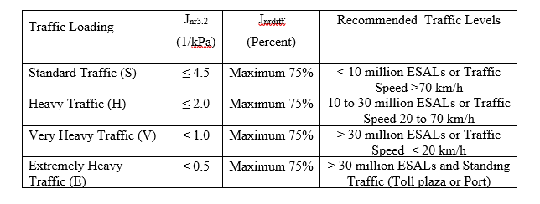
MSCR Criteria: AASHTO M 332 - J_{nr}
Boundaries for J_{nr} values are established based upon traffic level.
As traffic level increases, lower J_{nr} value is required -> basically stiffer binder.

Slide 16
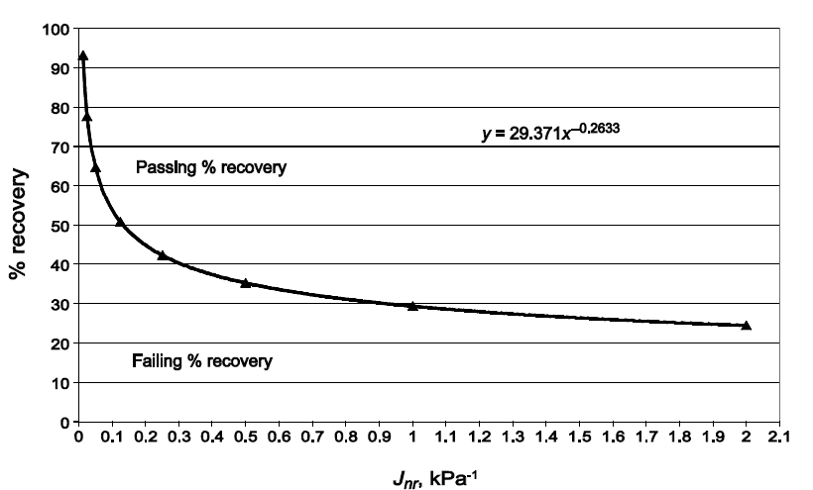
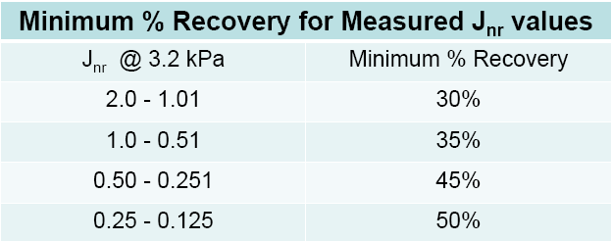
MSCR Criteria: AASHTO R 92 - R%
% Recovery is plotted vs. J_{nr}.
Boundaries are established based upon measured J_{nr} values at 3.2 kPa.
A simple above the line/below the line criteria provides the needed validation of polymer modification.
% Recovery above the line indicates the binder is modified with an acceptable elastomeric polymer.
% Recovery below the line indicates the binder is not modified with an elastomeric polymer.
Source: Asphalt Institute
Good agreement has been established between elastomeric polymer modification and rutting resistance.
Notes:
J_{nr}, or non-recoverable compliance, is simply the unrecovered strain relative to the applied stress.
“Good agreement…” where it come from? What data is there to back this up?

Slide 17
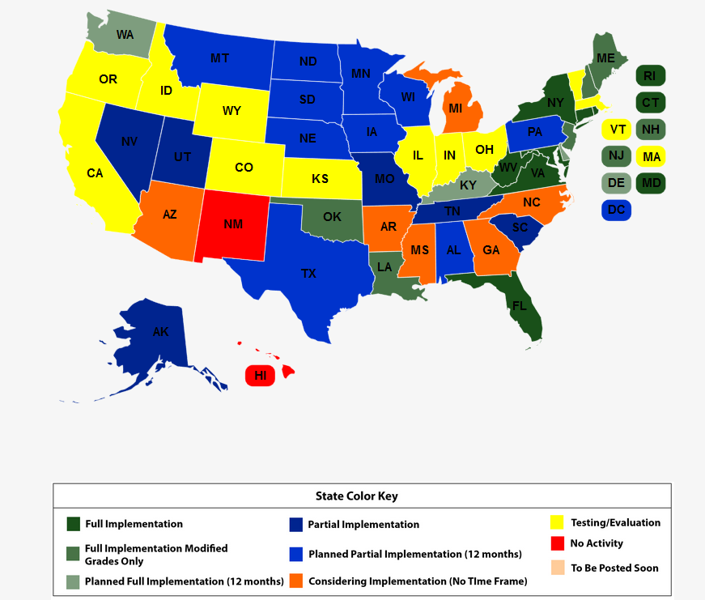
MSCR Implementation
Source: Asphalt Institute
Notes:
NEW SLIDE

Slide 18
DSR Testing Alternative: Asphalt Rubber Binder
Can it fit within existing PG grading system?
DSR Testing Geometry
Caltrans, University of California Pavement Research Center, Anton Paar, etc.
Concentric cylinder (CC) development testing evaluation looks promising.
CC test geometry may overcome specimen preparation limitations of PP geometry.
Draft AASHTO standard in development.

Slide 19
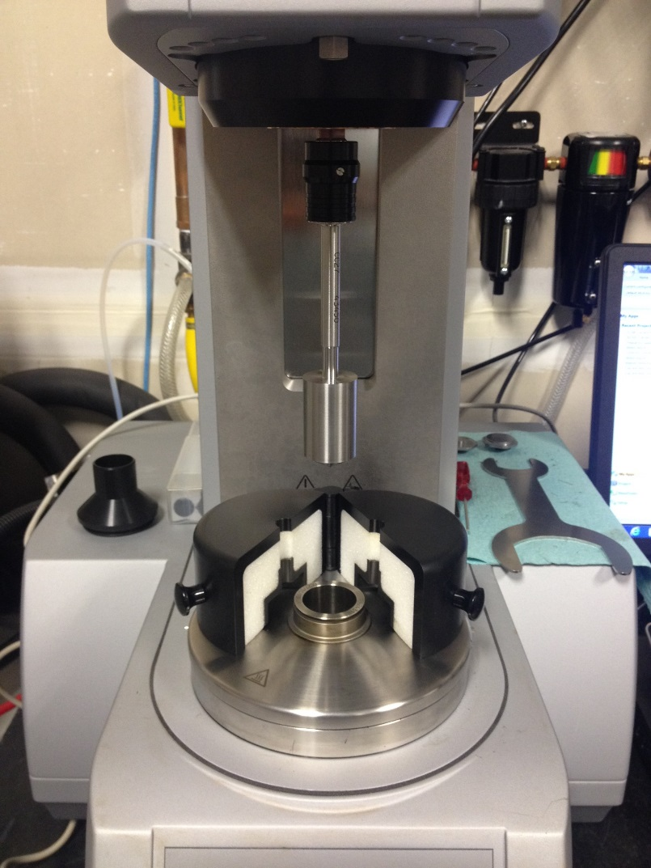
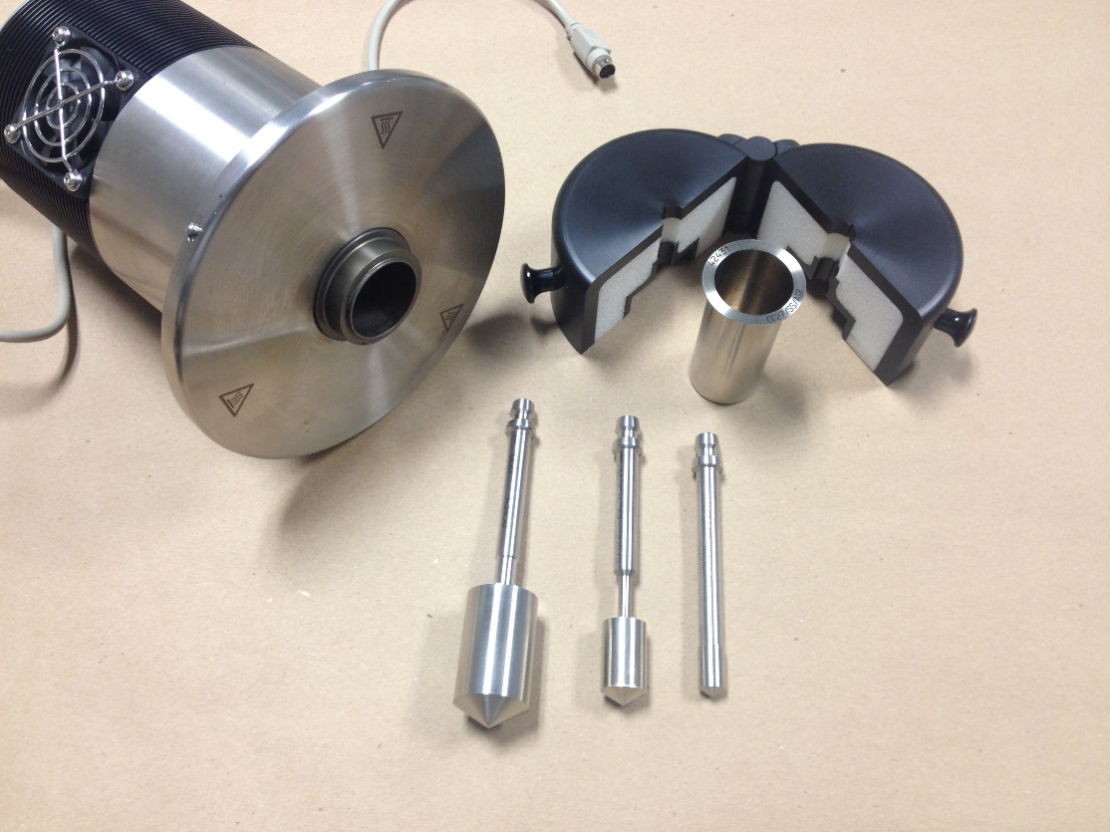
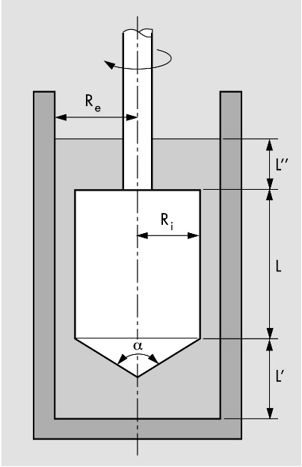
Concentric Cylinder Geometry
Advantages
GTR modified asphalt can be measured with particle sizes up to 2 mm.
No trimming problems and filling problems.
No edge effects.

Slide 20
Low Temperature BBR Test: Binder New Parameter (∆Tc)
∆Tc has been identified as an important parameter related to asphalt binder durability.
∆Tc = S critical temp - m critical temp.
As an asphalt binder ages, ∆Tc value becomes more negative.
Indicating a loss of relaxation properties.
Threshold of -5 °C being evaluated as a cracking criteria.

Slide 21
Mixture Activities

Slide 22
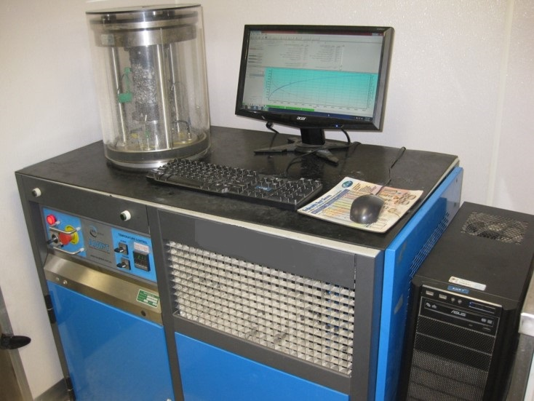
Performance Testing
AASHTO T 378 (former TP 79)
Dynamic Modulus
Mixture Stiffness
Rutting
Fatigue Cracking
Flow Number
Rutting
AASHTO TP 107
Cyclic Fatigue
AASHTO TP XX
Stress Sweep Rutting (SSR)

Slide 23
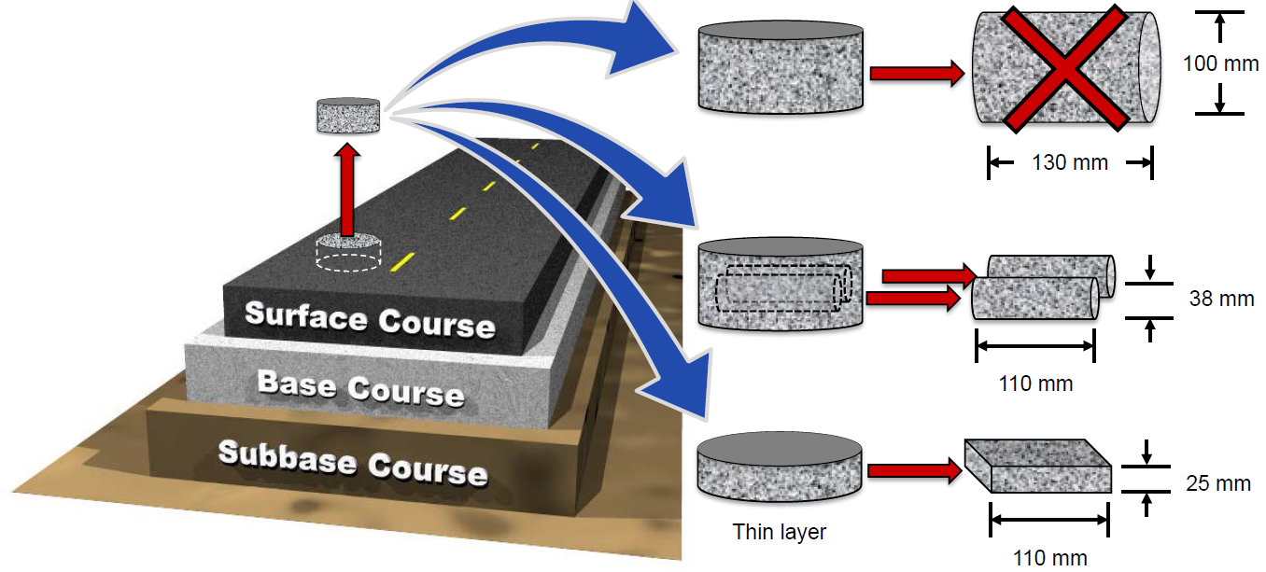
Small Specimen Testing
Proposed to enable field core testing
To improve the efficiency of laboratory specimen fabrication
Image: North Carolina State University

Slide 24
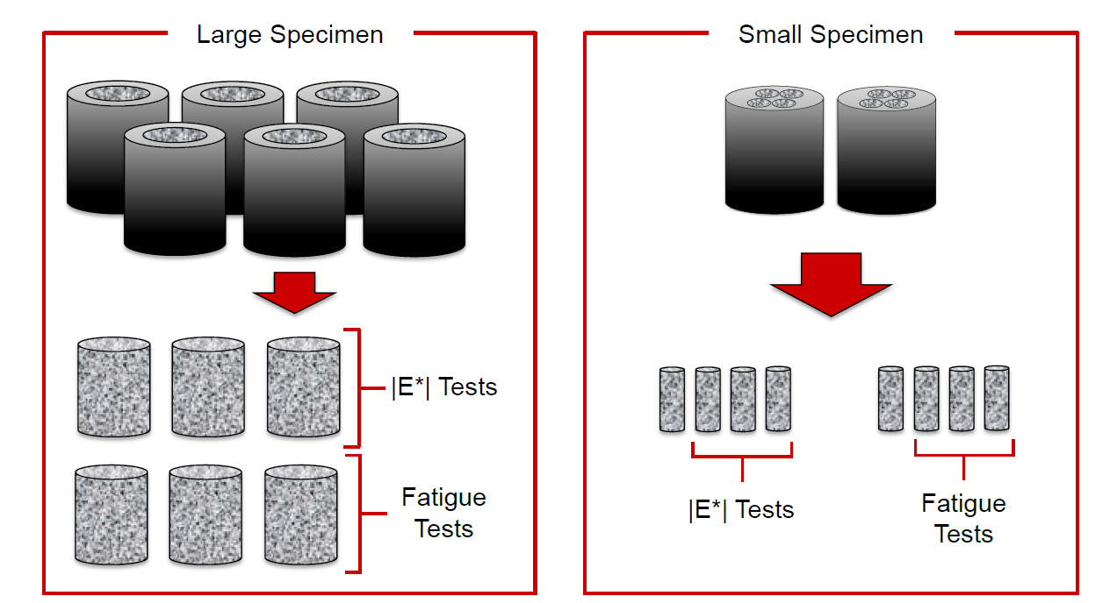
Small Specimen Geometry
Need less material to complete testing matrix
Image: North Carolina State University

Slide 25
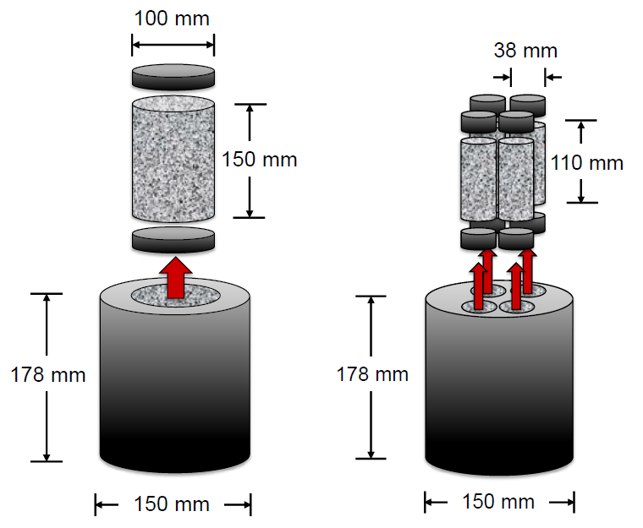
Small Specimen Geometry
Imag: North Carolina State University

Slide 26
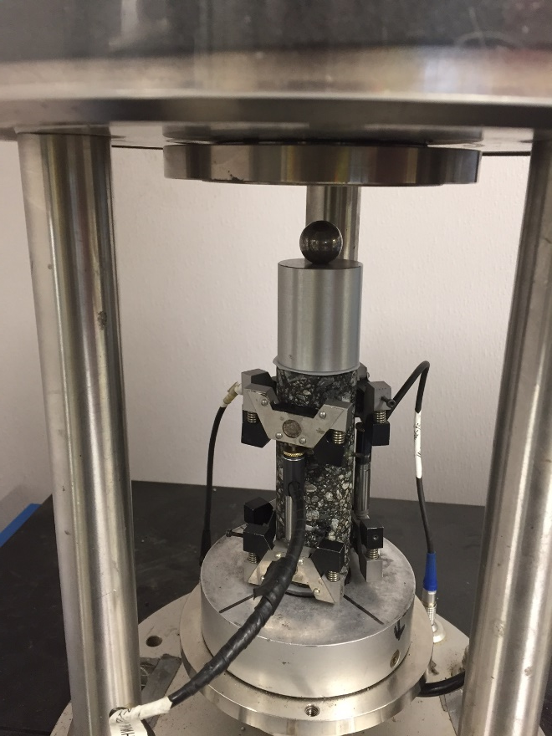
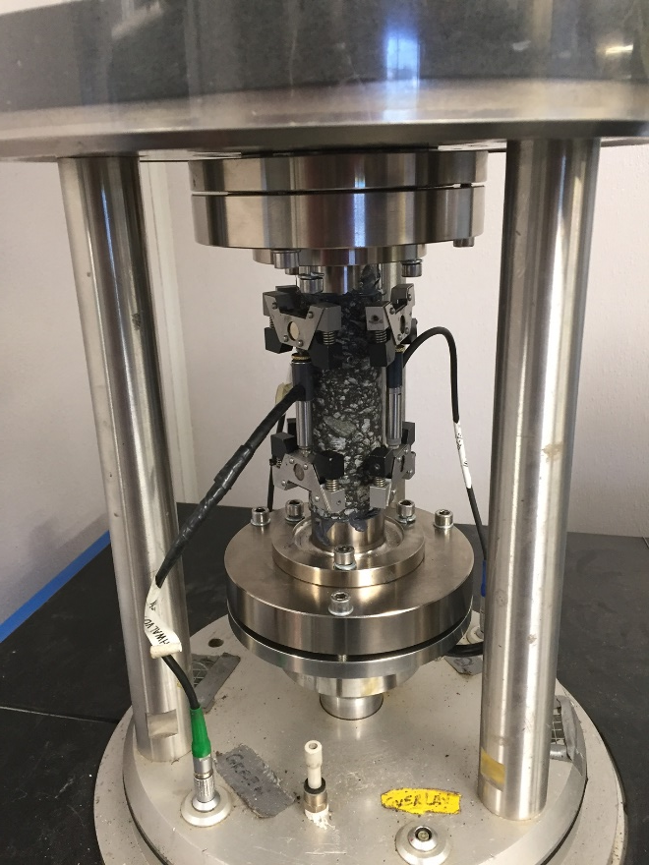
Types of Small Specimen Testing
Small Scale Dynamic Modulus
Small Scale Cyclic Fatigue
Notes:
26

Slide 27
AMPT Small Specimen Advantages
Field core testing
Reduced sampling and material requirements for testing
Same data output generated from small scale testing as full scale testing

Slide 28
Arizona Project

Slide 29
Arizona Project Description - 2015
Open Graded Friction Course (OGFC) mixtures
Three different Terminal blended Asphalt Rubbers
Hybrid Binders:
PG70-22 TR+ (8 % GTR + 2 % SBS; solubility limit of 97%)
PG70-22 TR+ S92 (8 % GTR + 2 % SBS; solubility limit of 92%)
PG70-22 (contains only SBS)

Slide 30
Study Plans
Topics investigated in this project
Solubility
Separation
DSR testing: gap size effect
Long term conditioning

Slide 31
Solubility – AASHTO T 44
UW-Madison MARC have proposed changes to the standard
Use of toluene as the solvent
The addition of an analytical filter: To increase the filter area and reduce the potential for the fiberglass filter to become clogged during testing
Analytical Filters used in this study
Celite
Diatomaceous Earth (DE)
Notes:
DE was included because only 1 to 2 grams of analytical filter aid is needed for each test, and the smallest amount of Celite 505 that can be purchased is a 50 lb. bag, enough for more than 11,000 tests

Slide 32
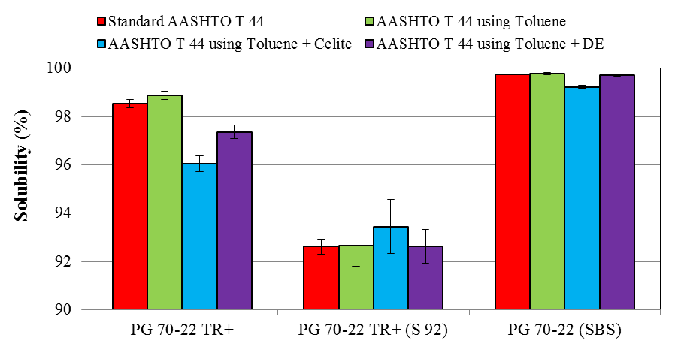
Solubility Results
Use of toluene as the solvent
The addition of an analytical filter
Some differences in solubility
Notes:
Three amounts of Celite 505 were used: 0.5 g, 1.0 g, and 1.5 g. Based on visual observations, 1.5 g of Celite 505 provided quicker filtration compared to 0.5 and 1.0 g respectively.

Slide 33
Solubility Results: Analysis of Variance
Compared to Standard Method, AASHTO T 44.
Not a statistically significant difference using toluene compared to trichloroethylene.
The differences in solubility when using an analytical filter aid were 0.5 to 2.5 percent: significant considering solubility is normally specified to the nearest 0.1 percent !
Notes:
The lower measured solubility with the analytical filter aid may be due interaction between the filter aid and the modifier that produces agglomerations of modifier that will not pass through the filter.

Slide 34
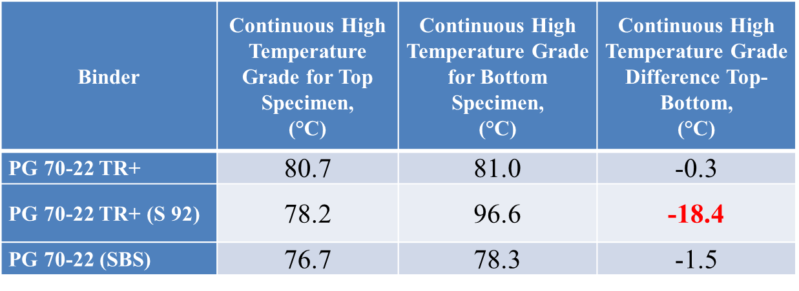
Separation Results
Separation tests conducted following ASTM D7173: samples are stored in vertical tubes in an oven at 163 °C for 48 hours
Test specimens taken from the top and bottom of the vertical storage tube are measured using AASHTO T 315
GTR is separating and sinking to the bottom of the separation tube.

Slide 35
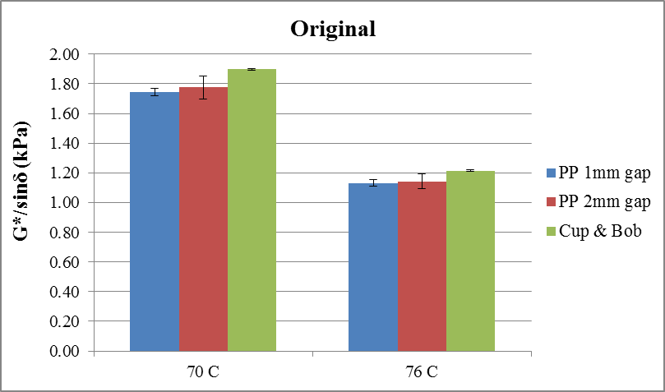
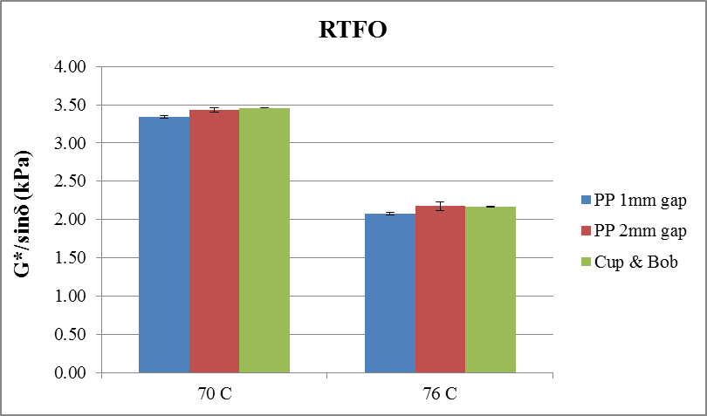
PG Results: PG 70-22 TR+ (S97) 1 & 2 mm gap vs. Cup and Bob
Same PG grade
Cup & Bob (CC 17) slightly higher G*/sinδ value: perhaps due to trimming or shelf-aging of material
Cup & Bob: smallest values of standard deviation
Notes:
The true PG grade of PG 70-22 TR+ is PG 75.5 (20.7) -28.8

Slide 36
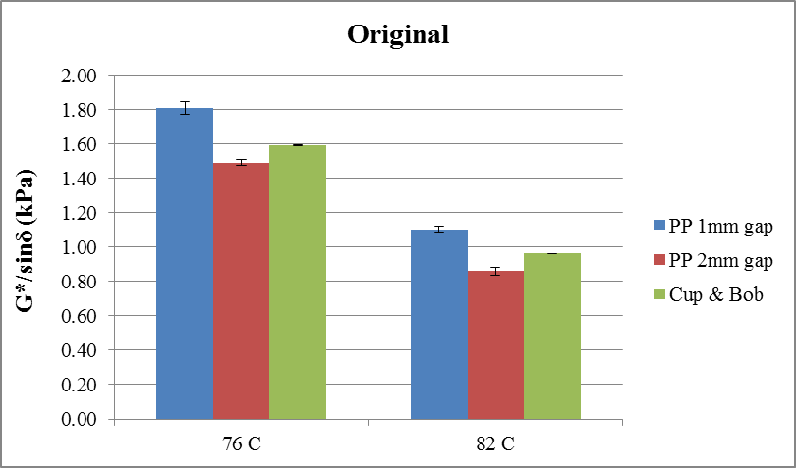
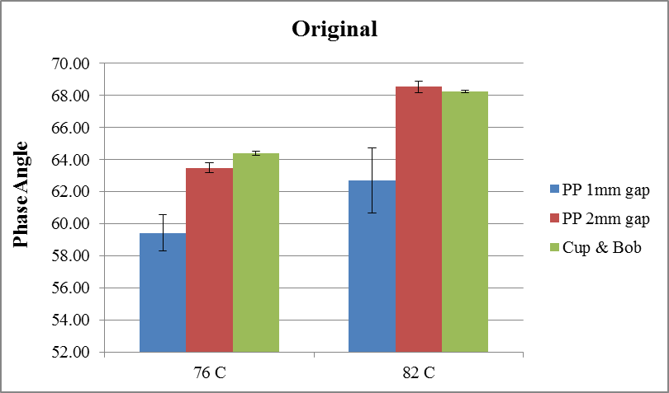
PG Results: PG 70-22 TR+ (S92) 1 & 2 mm gap vs. Cup and Bob - Unaged
PP 1mm shows different material behavior
PP 1mm: possible particle interactions with plates -> higher stiffness & more elastic type behavior
Similar results for PP 2mm and Cup & Bob
Notes:
The true PG grade of PG 70-22 TR+ (S92) is PG 70-22 TR+ (S 92) -> PG 80.7 (13.1) -32.0

Slide 37
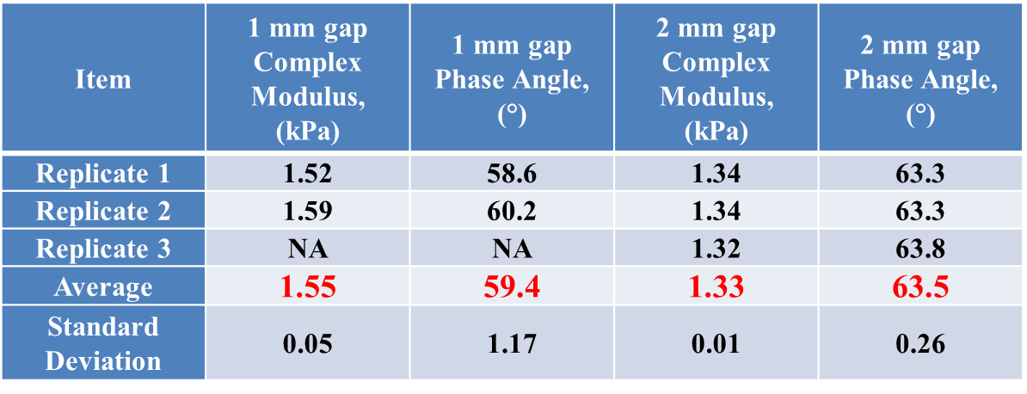
DSR PG Results: 1 vs. 2 mm gap PG 70-22 TR+ (S 92) – Original binder at 76 °C
For gap sizes of 1 to 2 mm: when there is an interaction of the rubber particles with the testing plates -> ↑ gap : ↓ variability, ↓ the complex modulus, ↑ the phase angle.
Lower G*/sinδ and phase angle for 1mm
Notes:
The true PG grade of PG 70-22 TR+ (S92) is PG 70-22 TR+ (S 92) -> PG 80.7 (13.1) -32.0

Slide 38
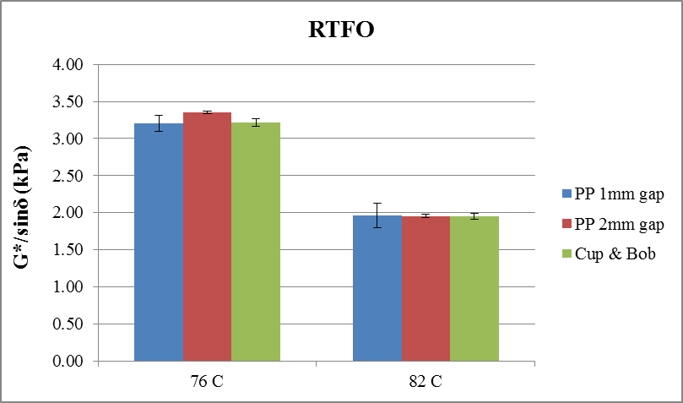
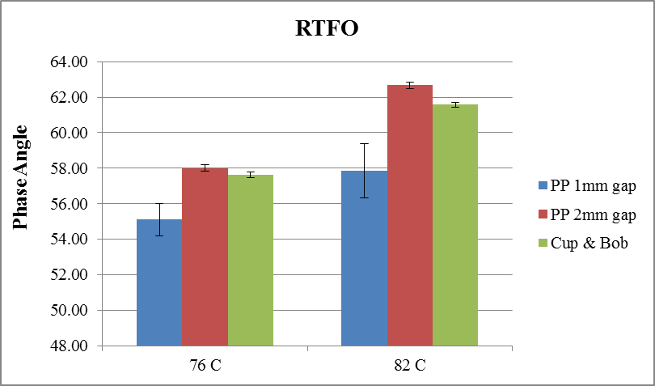
PG Results: PG 70-22 TR+ (S92) 1 & 2 mm gap vs. Cup and Bob - RTFO
Same PG grade
PP 1mm: possible particle interactions with plates -> lower phase angle (more elastic type behavior)
Differences decreased after RTFO conditioning
Notes:
The true PG grade of PG 70-22 TR+ (S92) is PG 70-22 TR+ (S 92) -> PG 80.7 (13.1) -32.0

Slide 39
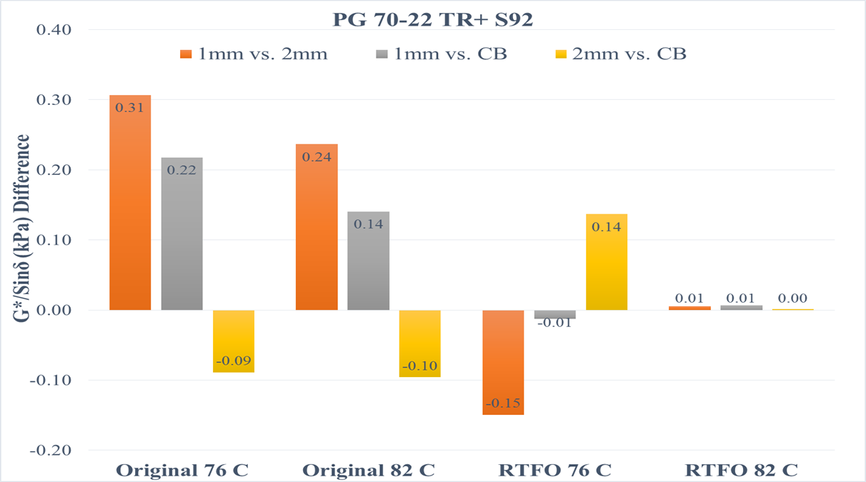
PG Results: PG 70-22 TR+ (S92)
2mm vs. Cup & Bob: most similar results
Differences decreased after RTFO aging …
Notes:
The high temperature PG grade of RTFO binder is PG 80.7 (13.1) -32.0 for both 1 mm and 2 mm gap setting.
However, the G*/sinδ and phase angle were higher for 2 mm gap when compared to 1 mm gap.

Slide 40
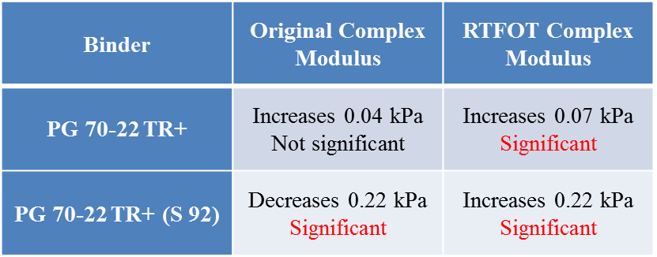
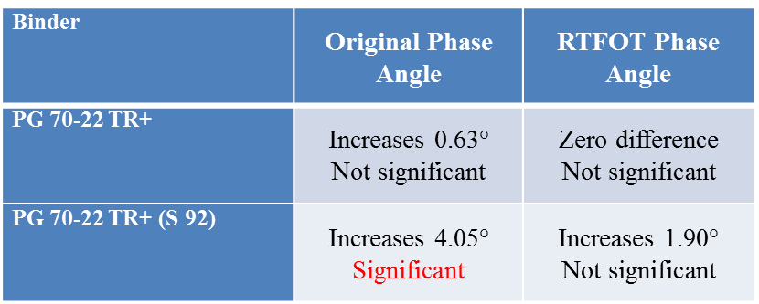
DSR PG Results: 1 vs. 2 mm gap Statistical Analysis – Effect of 1mm increase in gap
Only PG 70-22 TR+ (S 92) original binder show effects consistent with particle interaction.
When used to test binders modified with GTR, this gap may be too small to accommodate the rubber particles.
Concentric Cylinder (Cup & Bob) needed as testing geometry for these materials.
Notes:
The true PG grade of PG 70-22 TR+ (S92) is PG 70-22 TR+ (S 92) -> PG 80.7 (13.1) -32.0

Slide 41
Summary of Findings
Solubility: Toluene was found to be an acceptable alternative to Trichloroethylene as a solvent for solubility testing.
Separation: GTR, due to its higher specific gravity than neat asphalt binder, is separating and sinking to the bottom of the separation tube. Separation of TR+ (S 92) binder during non-agitated long-term storage should be expected.
DSR testing: Results indicate that particle interaction with the plates likely occurs when testing the PG 70-22 TR+ (S 92) using the parallel plate geometry.

Slide 42
Takeaway
Separation: Needs to be considered for Asphalt Rubber Material. (ASTM D7173)
DSR testing: All Asphalt Rubber Binders are not the same ! Some may work with PP and some not. Cup & Bob is a scientific & practical solution.
DSR testing:
PP issues: trimming, edge effect, particle interactions, rubber swelling, rubber mesh size and percentage, etc.
Cup & Bob: no trimming, exact volume filling, no edge effect

Slide 43
Technical Assistance
If you have upcoming projects for which you would like MATT technical assistance, contact:
Amir Golalipour, amir.golalipour.ctr@dot.gov, 202.366.3982
Dave Mensching, david.mensching@dot.gov, 202.493.3232
https://www.fhwa.dot.gov/pavement/asphalt/trailer/
Notes:
UPDATED WEBPAGE LINK

Slide 44
Thank You – Questions?
Trailer is parked outside! Come in for a tour!
We’re here to assist! Please stop by anytime for more discussion.

