Slide 1

Arizona’s Concrete Pavement Research Project (SPS-2)

Slide 2
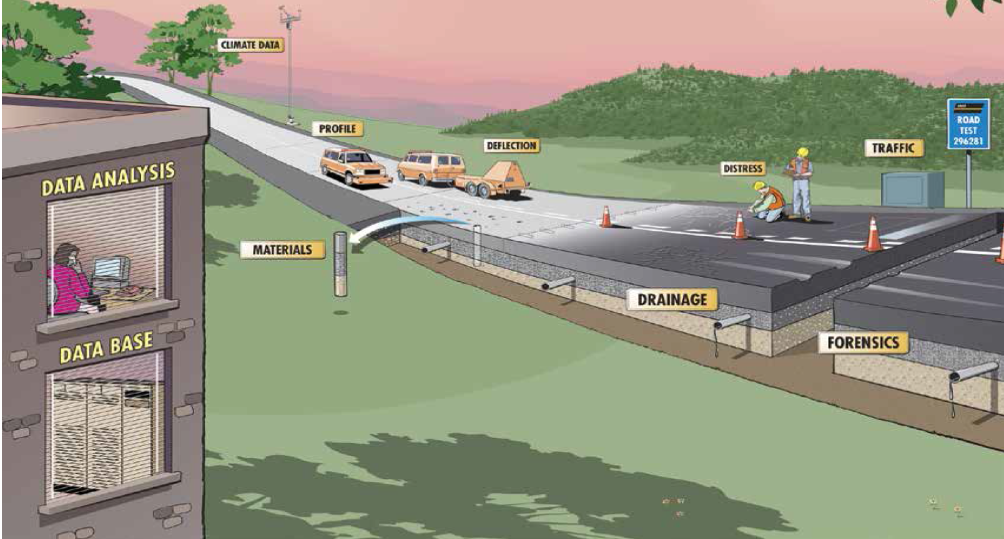
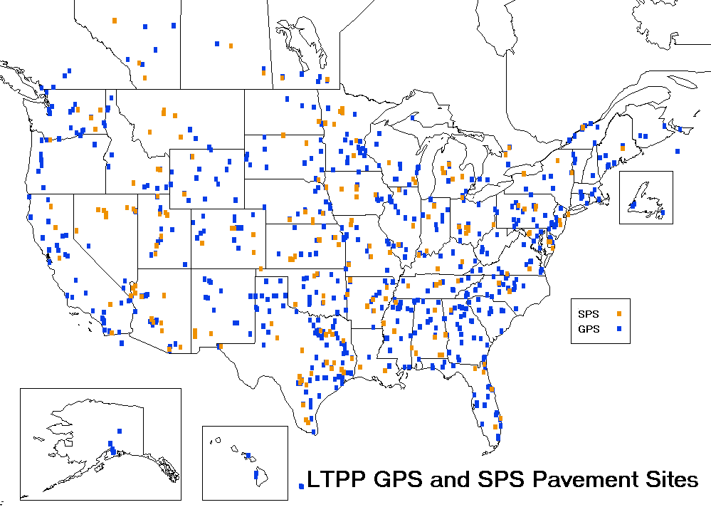
But First, What Is LTPP?
Long Term Pavement Performance (LTPP)

Slide 3


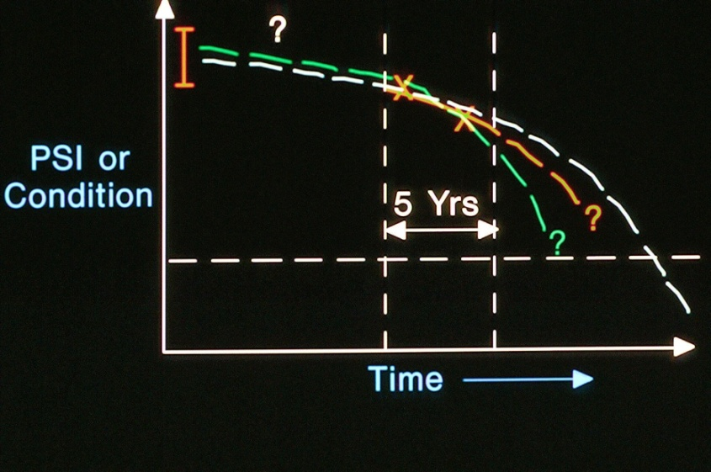
LTPP’s GOAL is…
to provide answers to
HOW and WHY
pavements perform as they do!

Slide 4
But First, What Is SPS-2?
Largest on Going Concrete Pavement Research Project in the World
Strategic Study of Structural Factors for Rigid Pavements
Thickness
Base Type
Concrete Strength
Lane Width
Drainage

Slide 5
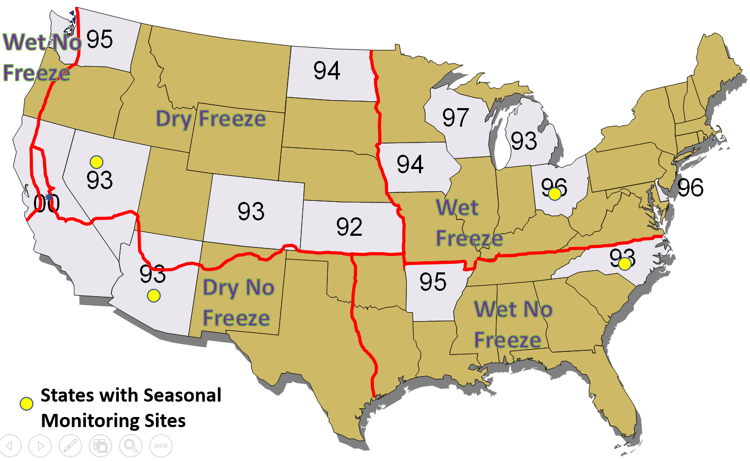
How Was SPS-2 Deployed
Statistical Design Called for 12 test sections to be constructed in each of 16 states (14 States)
Statistical Design Called for 192 test sections to be built (168 Constructed)
Statistical Design called for SPS-2 Core Experiment (12 TS) to have Four States in Each of Four Climate Zones (?)

Slide 6
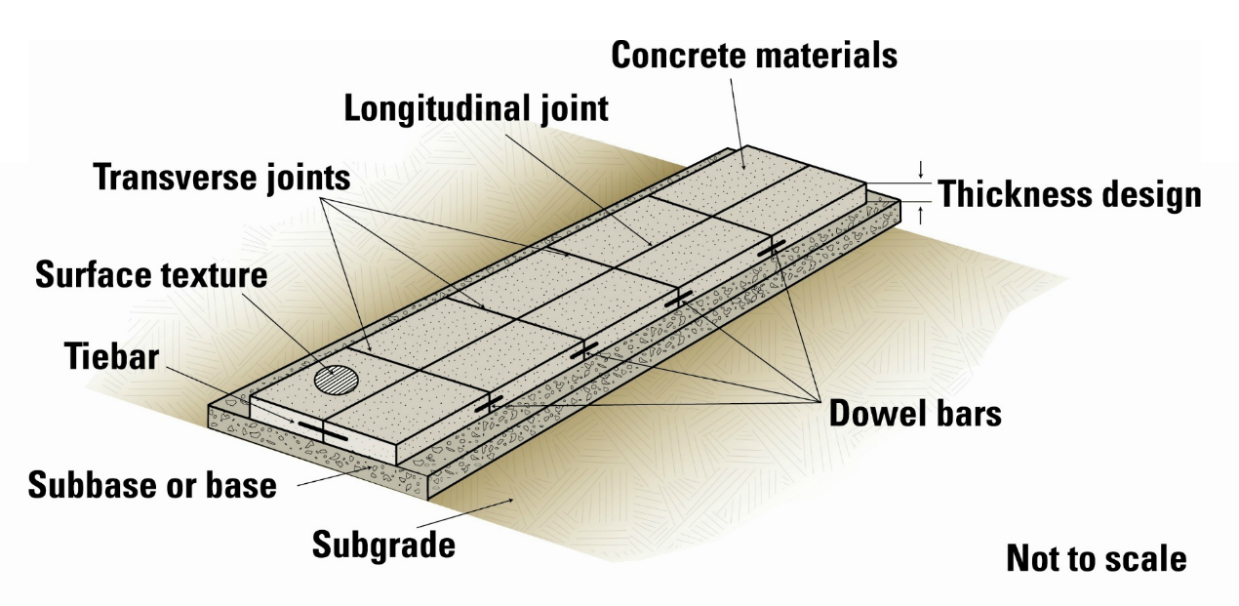
PCCP Design Elements
Shoulder Type
Thickness
Base Type
Concrete Strength
Lane Width
Drainage

Slide 7
Time Line of SPS-2 Experiment
It is anticipated that only a few SPS-2 projects will be built during the 1990 construction season. The remaining test sites will be selected from the identified candidates scheduled for construction in 1991, or even 1992 if necessary
KS
5
2
2
2
1
CA
AZ

Slide 8
Time Line of SPS-2 Experiment
26 Years
Influence of Design Features
Effects of Subsurface Drainage
Curl & Warp Analysis
Analysis of Fault Data
Initial Evaluation & Analysis
SPS-2 Construction
Outlet Inspection

Slide 9
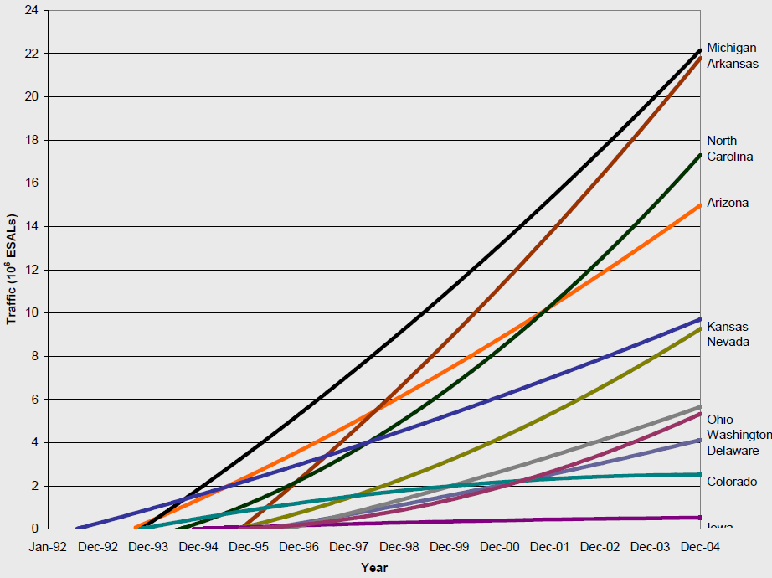
Traffic Levels on SPS-2 Experiments

Slide 10
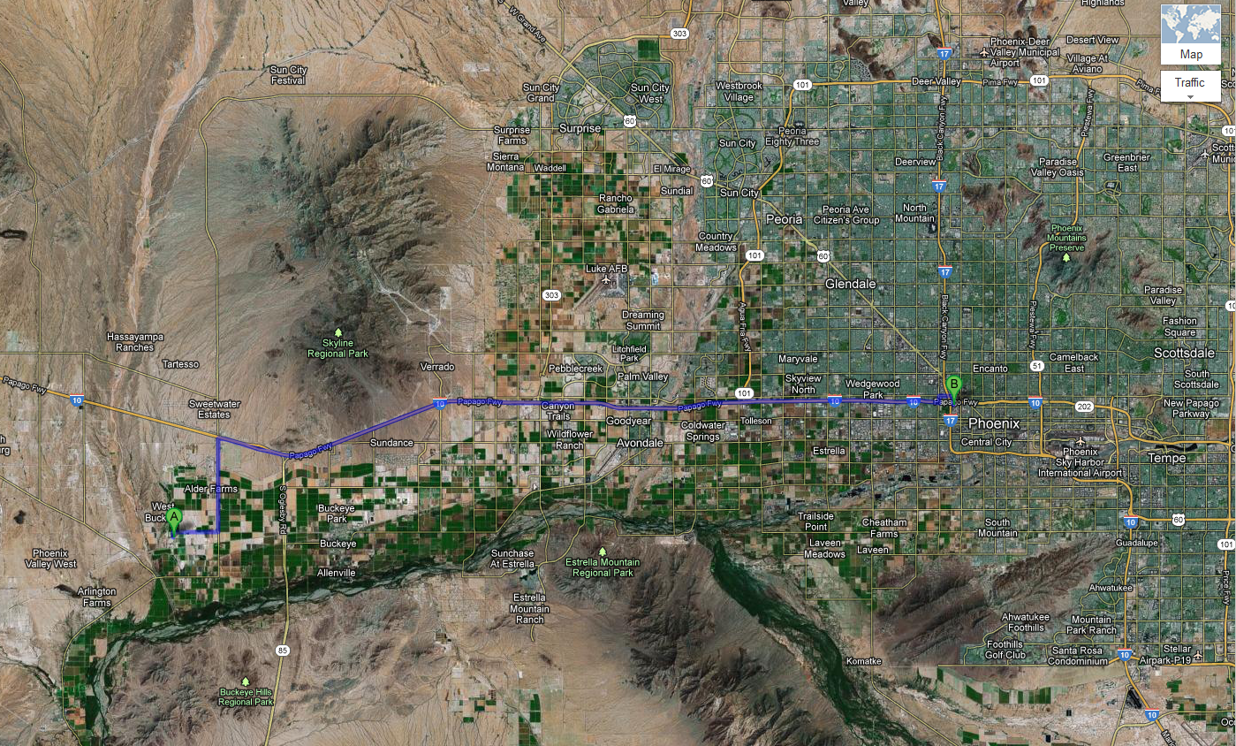
The Arizona Concrete Pavement Experiment (SPS-2)
MP 106 EB
Project

Slide 11
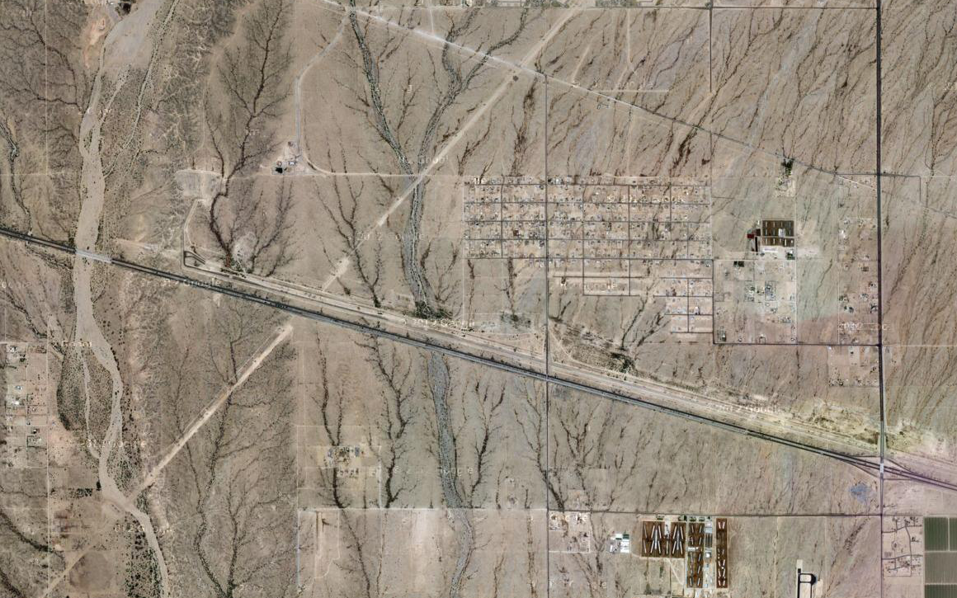
Google Earth Image of Test Sections
Hassyampa River
Palo Verde Rd
Johnson
Rd

Slide 12
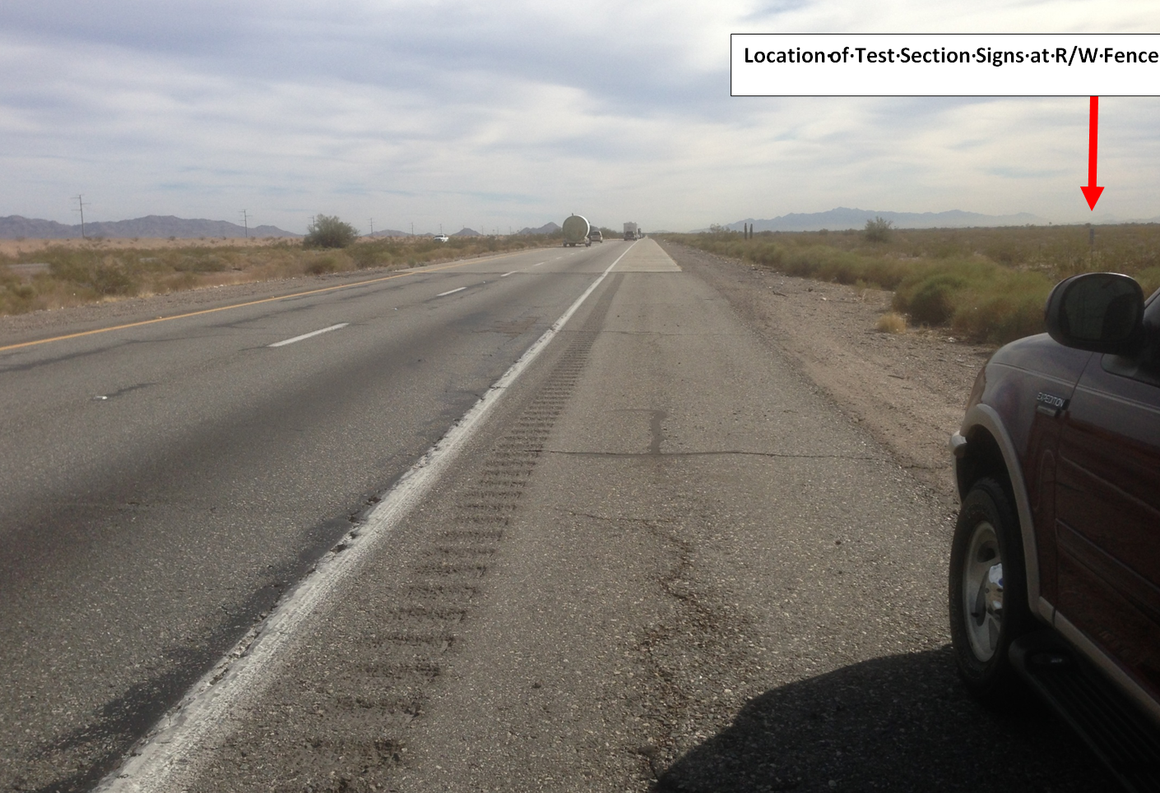
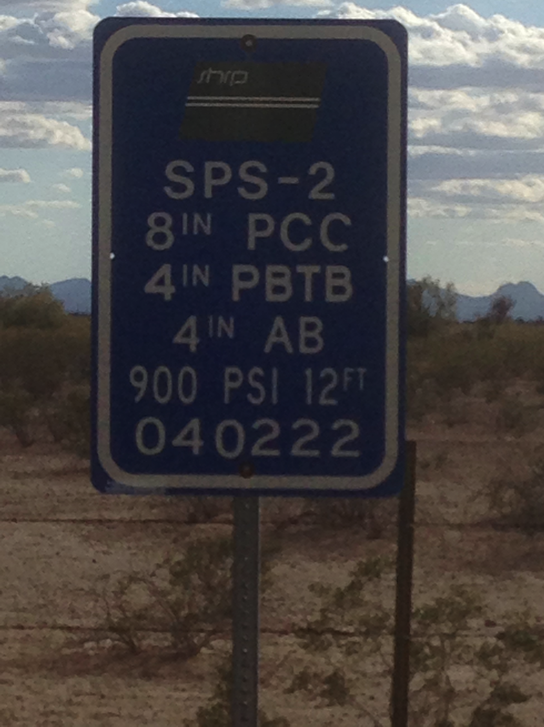
Approaching from the West End
MP 106 EB 611 ft

Slide 13
Test Section Layout
19 PCCP Test Sections
Design Features:
PCCP Thickness- (2)
Base Type- (3)
Concrete Strength- (2)
Lane Width- (2)
Drained or Undrained

Slide 14
Arizona Project Construction Timeline
(6 - 9 months)
Removing Existing EB AC and Constructing Detour onto WB
Over Excavating Existing Subgrade 1 ft and Recompacting
Constructing Edge Drains
Constructing Aggregate Base, Lean Concrete Base, and Permeable Base
Constructing 8”, 11” and 12.5” Thick PCCP
Constructing 550 and 900 psi Flexural Strength PCCP
Constructed Doweled and Undoweled PCCP

Slide 15
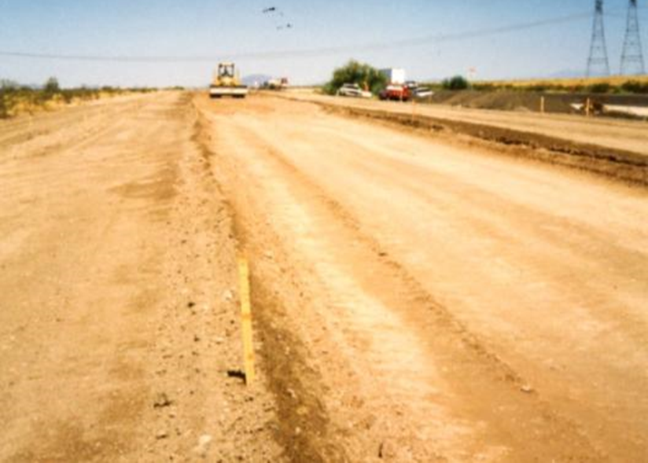
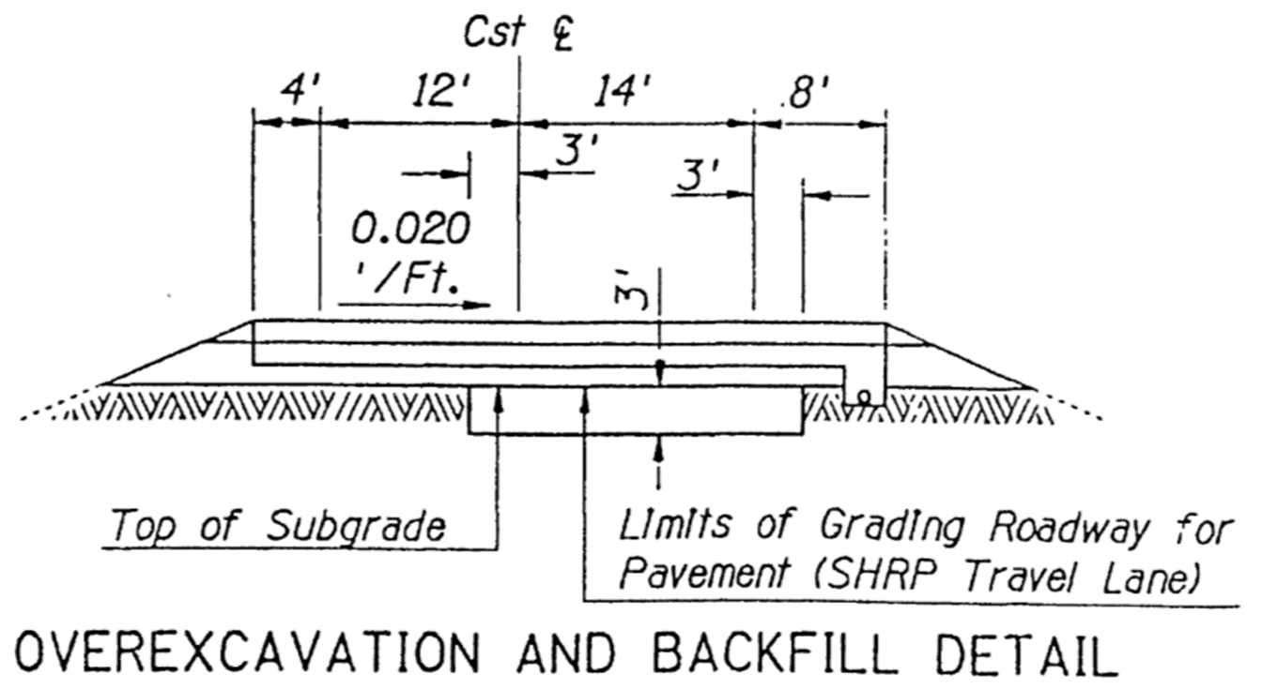
Subgrade Construction
Subgrade Preparation

Slide 16
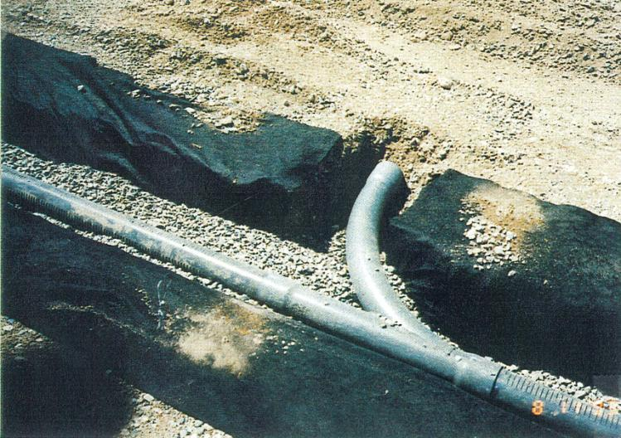
Drained and Undrained
Slots

Slide 17
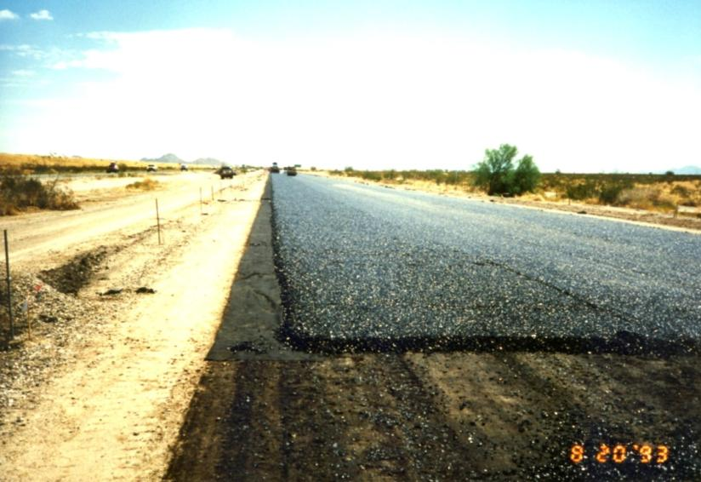
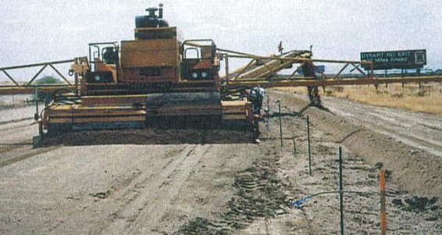
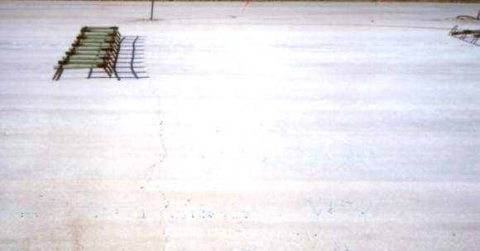
Base
Construction
PATB
DGAB
LCB

Slide 18
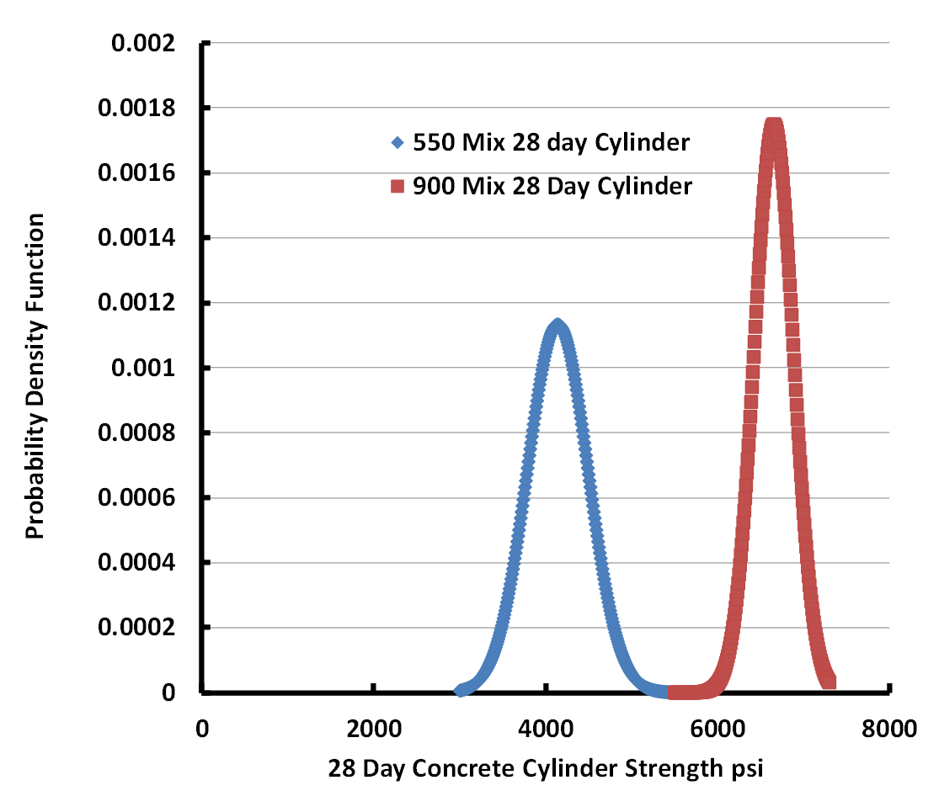
Concrete Strength

Slide 19
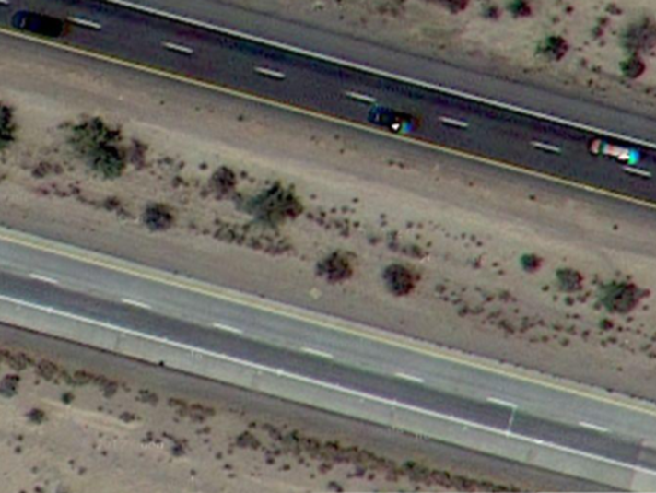
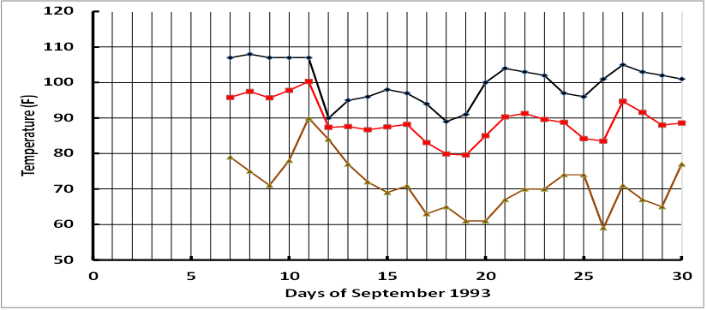
PCCP Thickness
8” & 11”
Night Paving September 1993
Three Mixes Used (1” & 1.5”)
All LTPP Sections Doweled
16 ft
22 ft

Slide 20
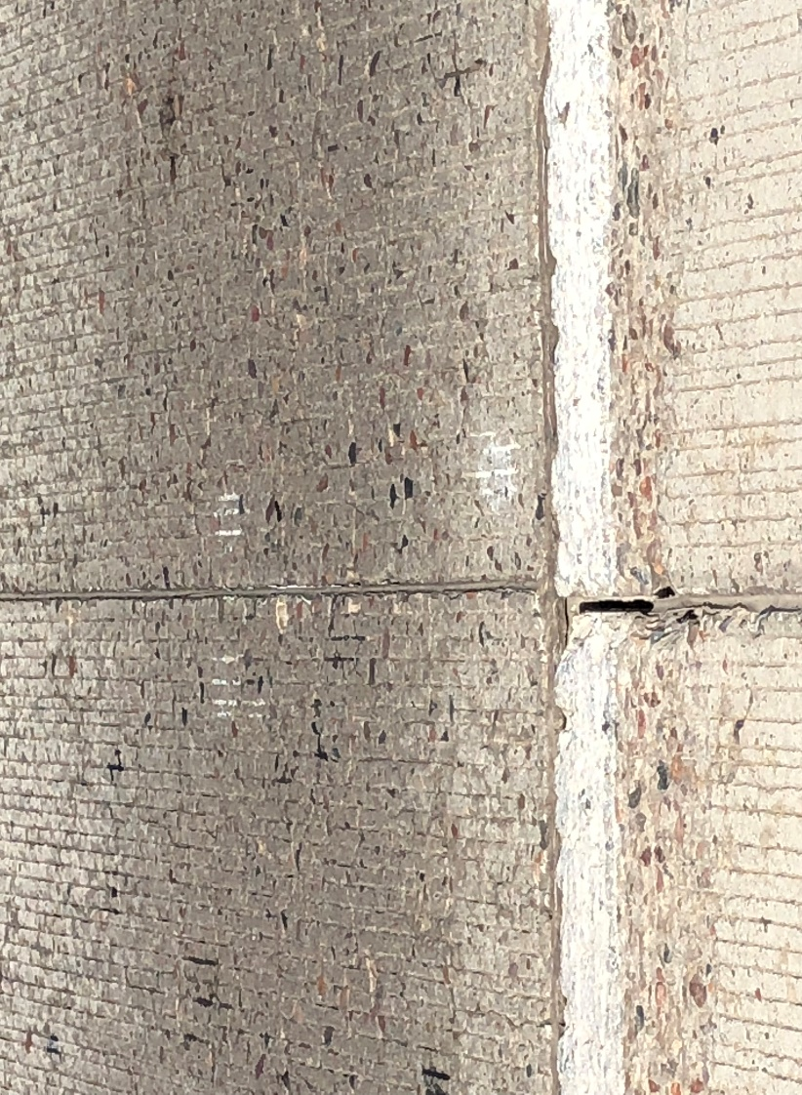
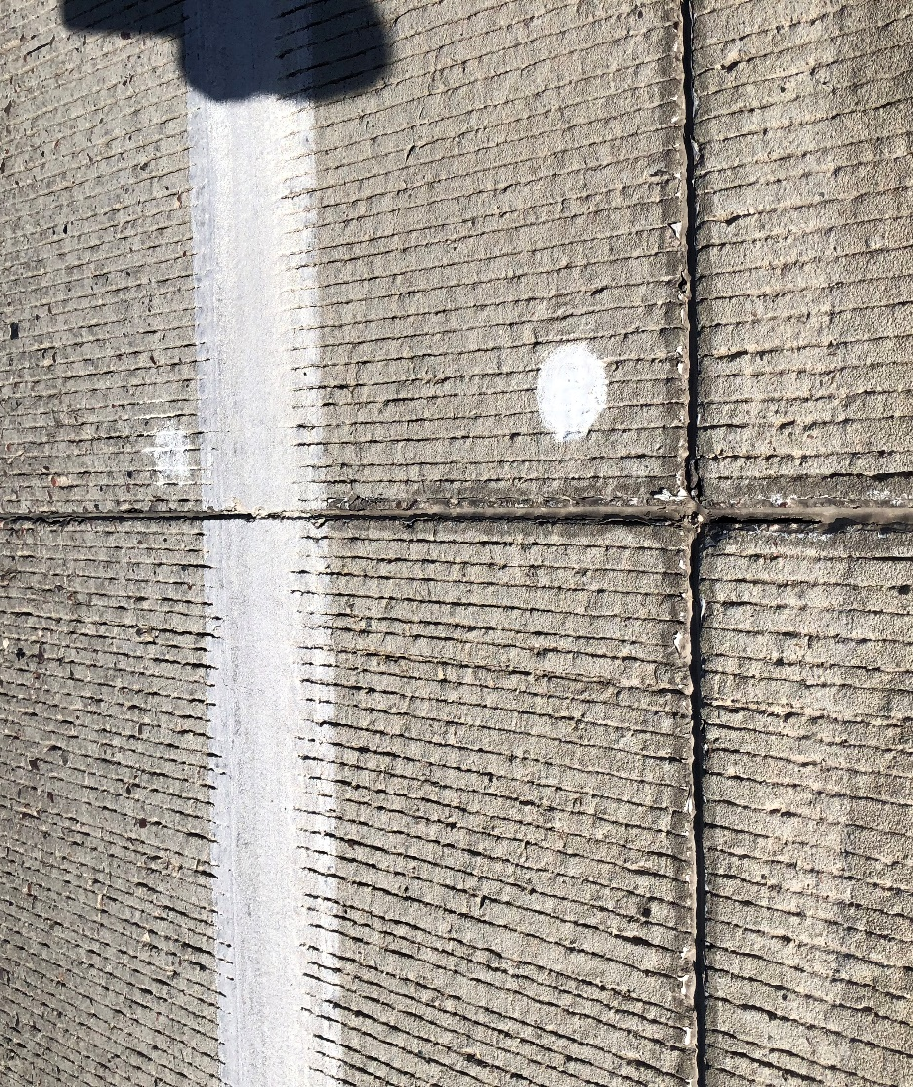
Lane
Width
12 Ft
14 Ft

Slide 21
What Did We Learn After 25 Years
So What Have We Learned After 25 Years

Slide 22
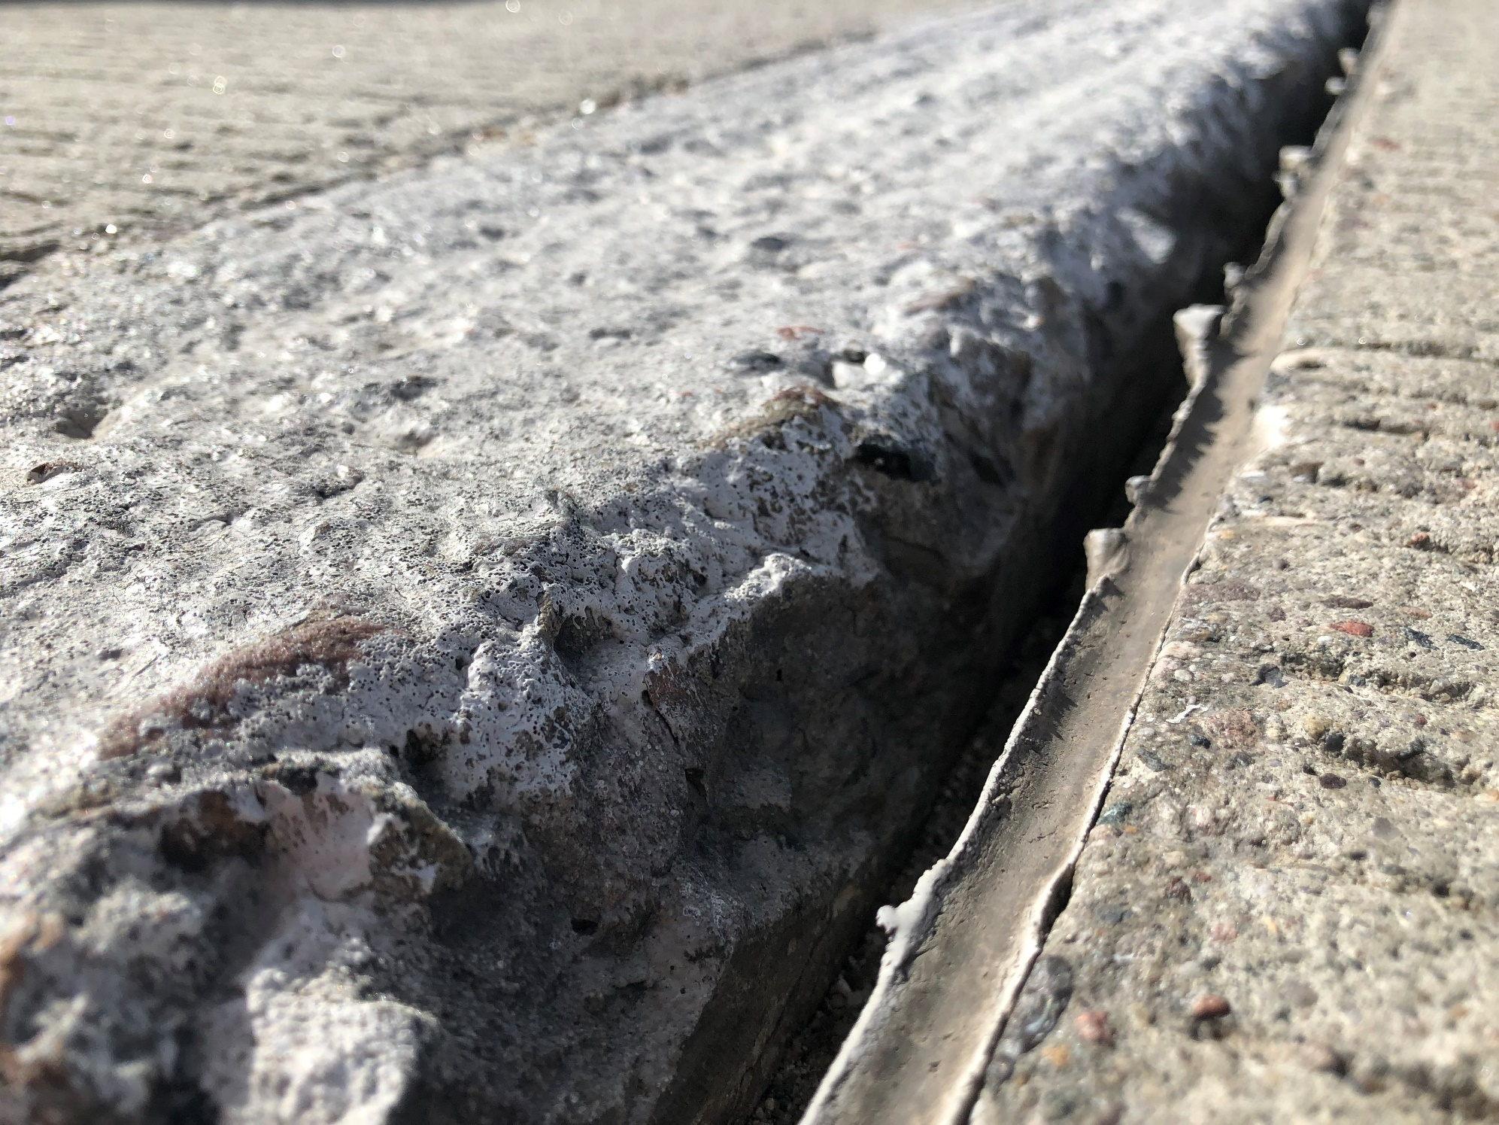
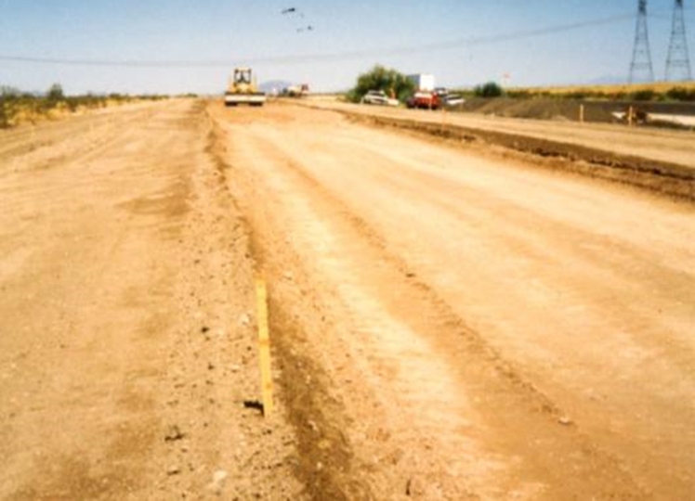
Subgrade Construction
Shoulder
Travel Lane

Slide 23
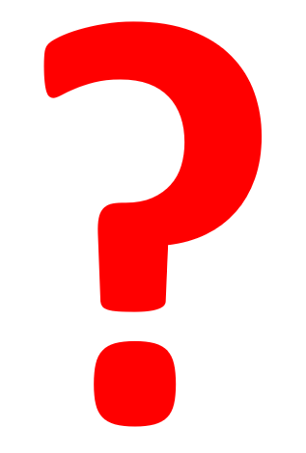
Drained and Undrained

Slide 24
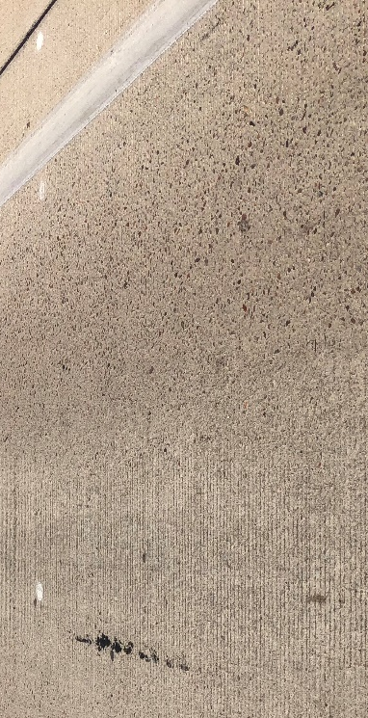
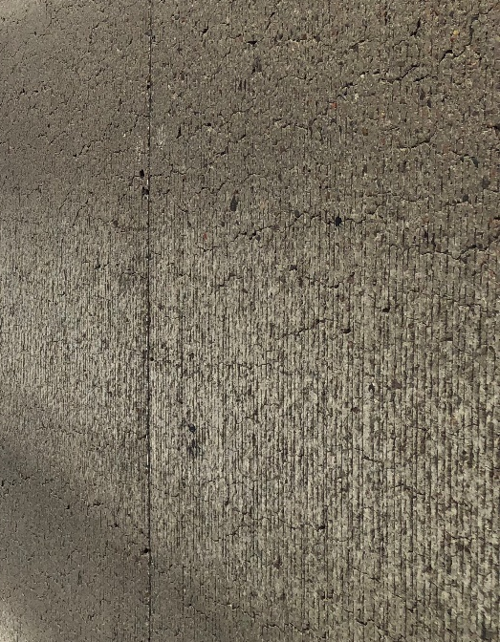
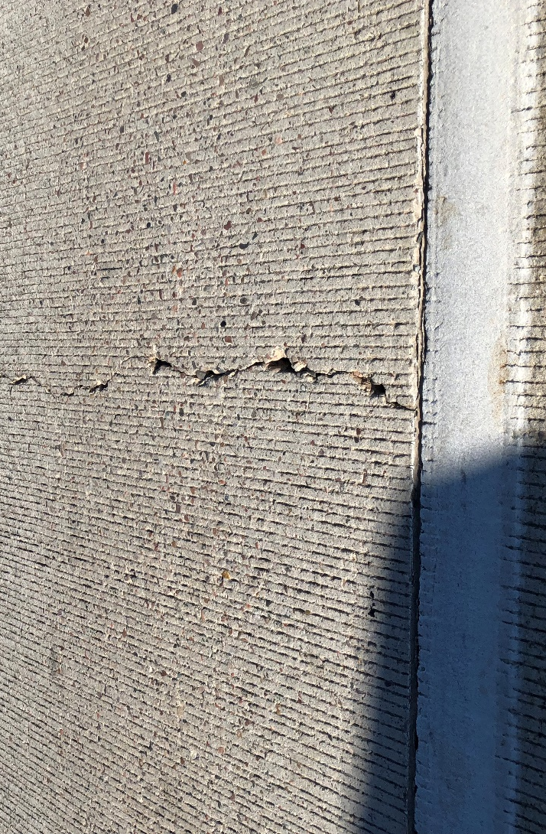
Base
Type
BEST
PATB
GOOD
DGAB
WORST
LCB

Slide 25

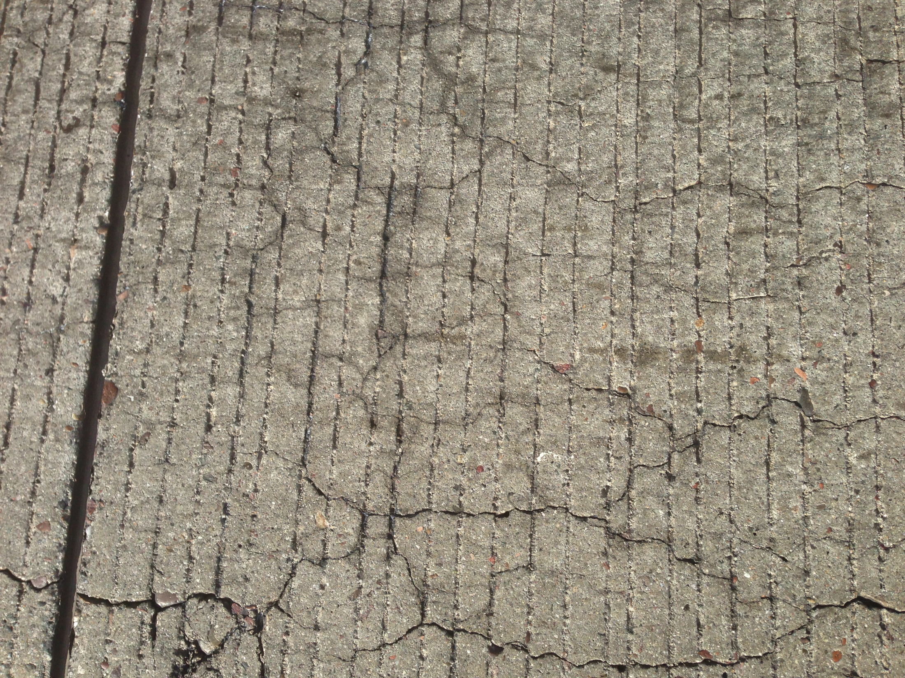
Concrete Strength
550 PSI
900 PSI

Slide 26
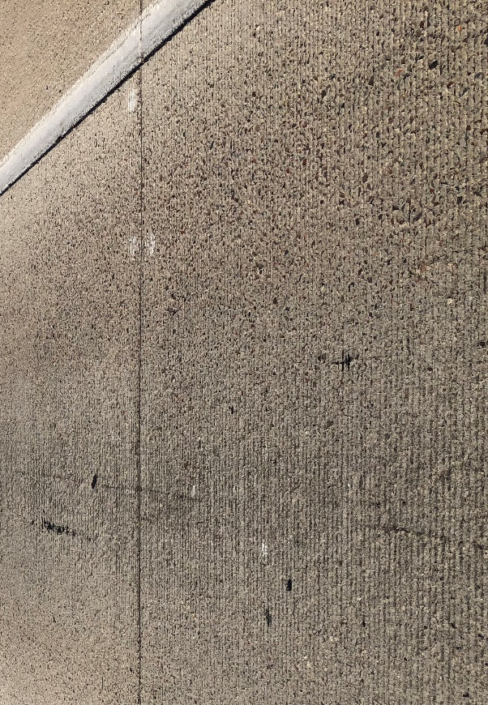
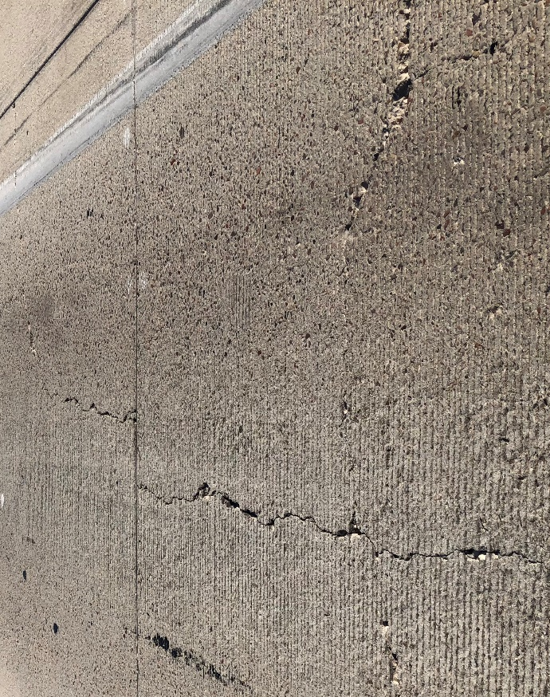
Lane
Width
12 Ft
14 Ft

Slide 27
PCCP Thickness
8” & 11”
Thicker is Better

Slide 28
Comparison of Doweled to Undoweled
SPS-2 Core Experiment 12 TS
SPS-2A JPCP 6 TS
SPS-2B JRCP 12 TS
State Supplemental Sections

Slide 29
What About the Other SPS-2?

Slide 30
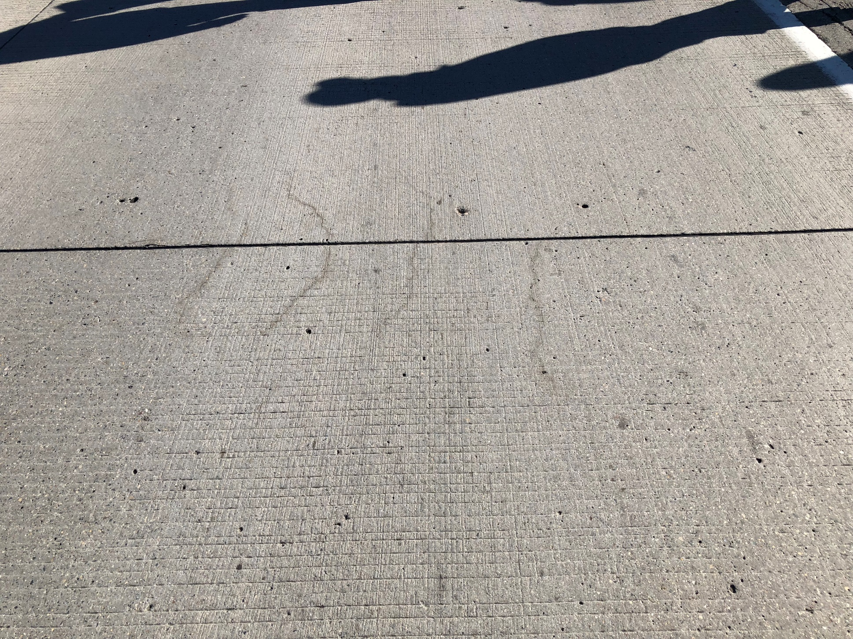
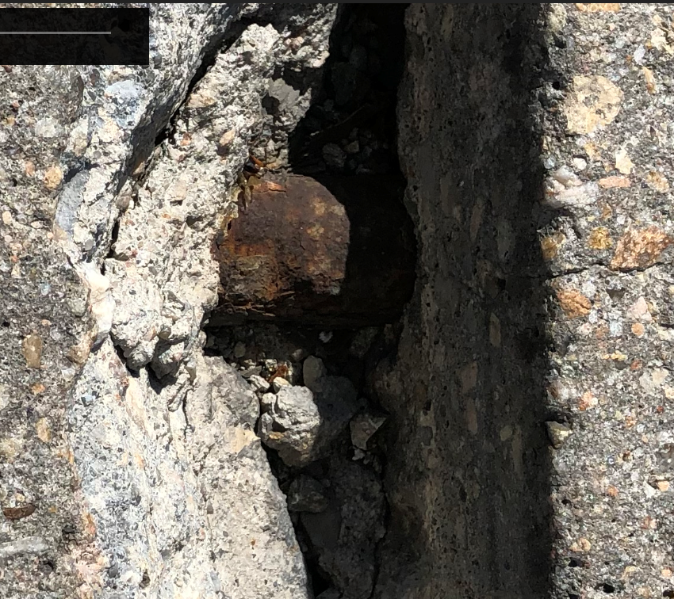
Cracking Over Dowels
North Dakota
8” PCCP
Kansas

Slide 31
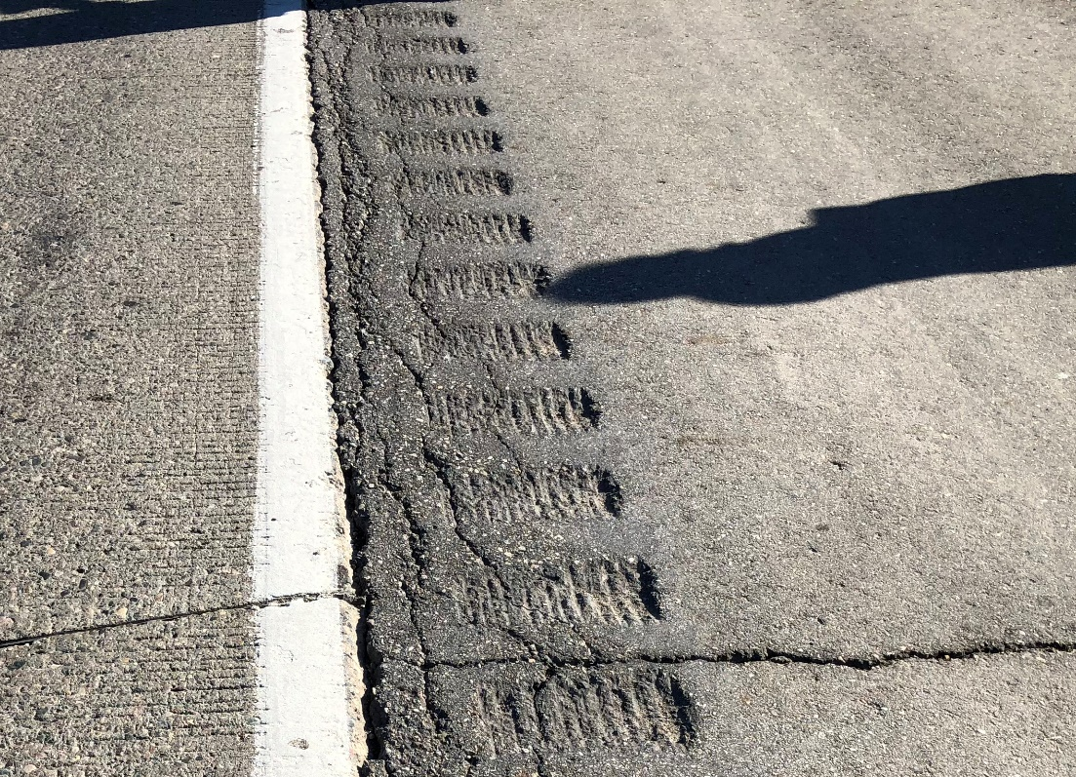
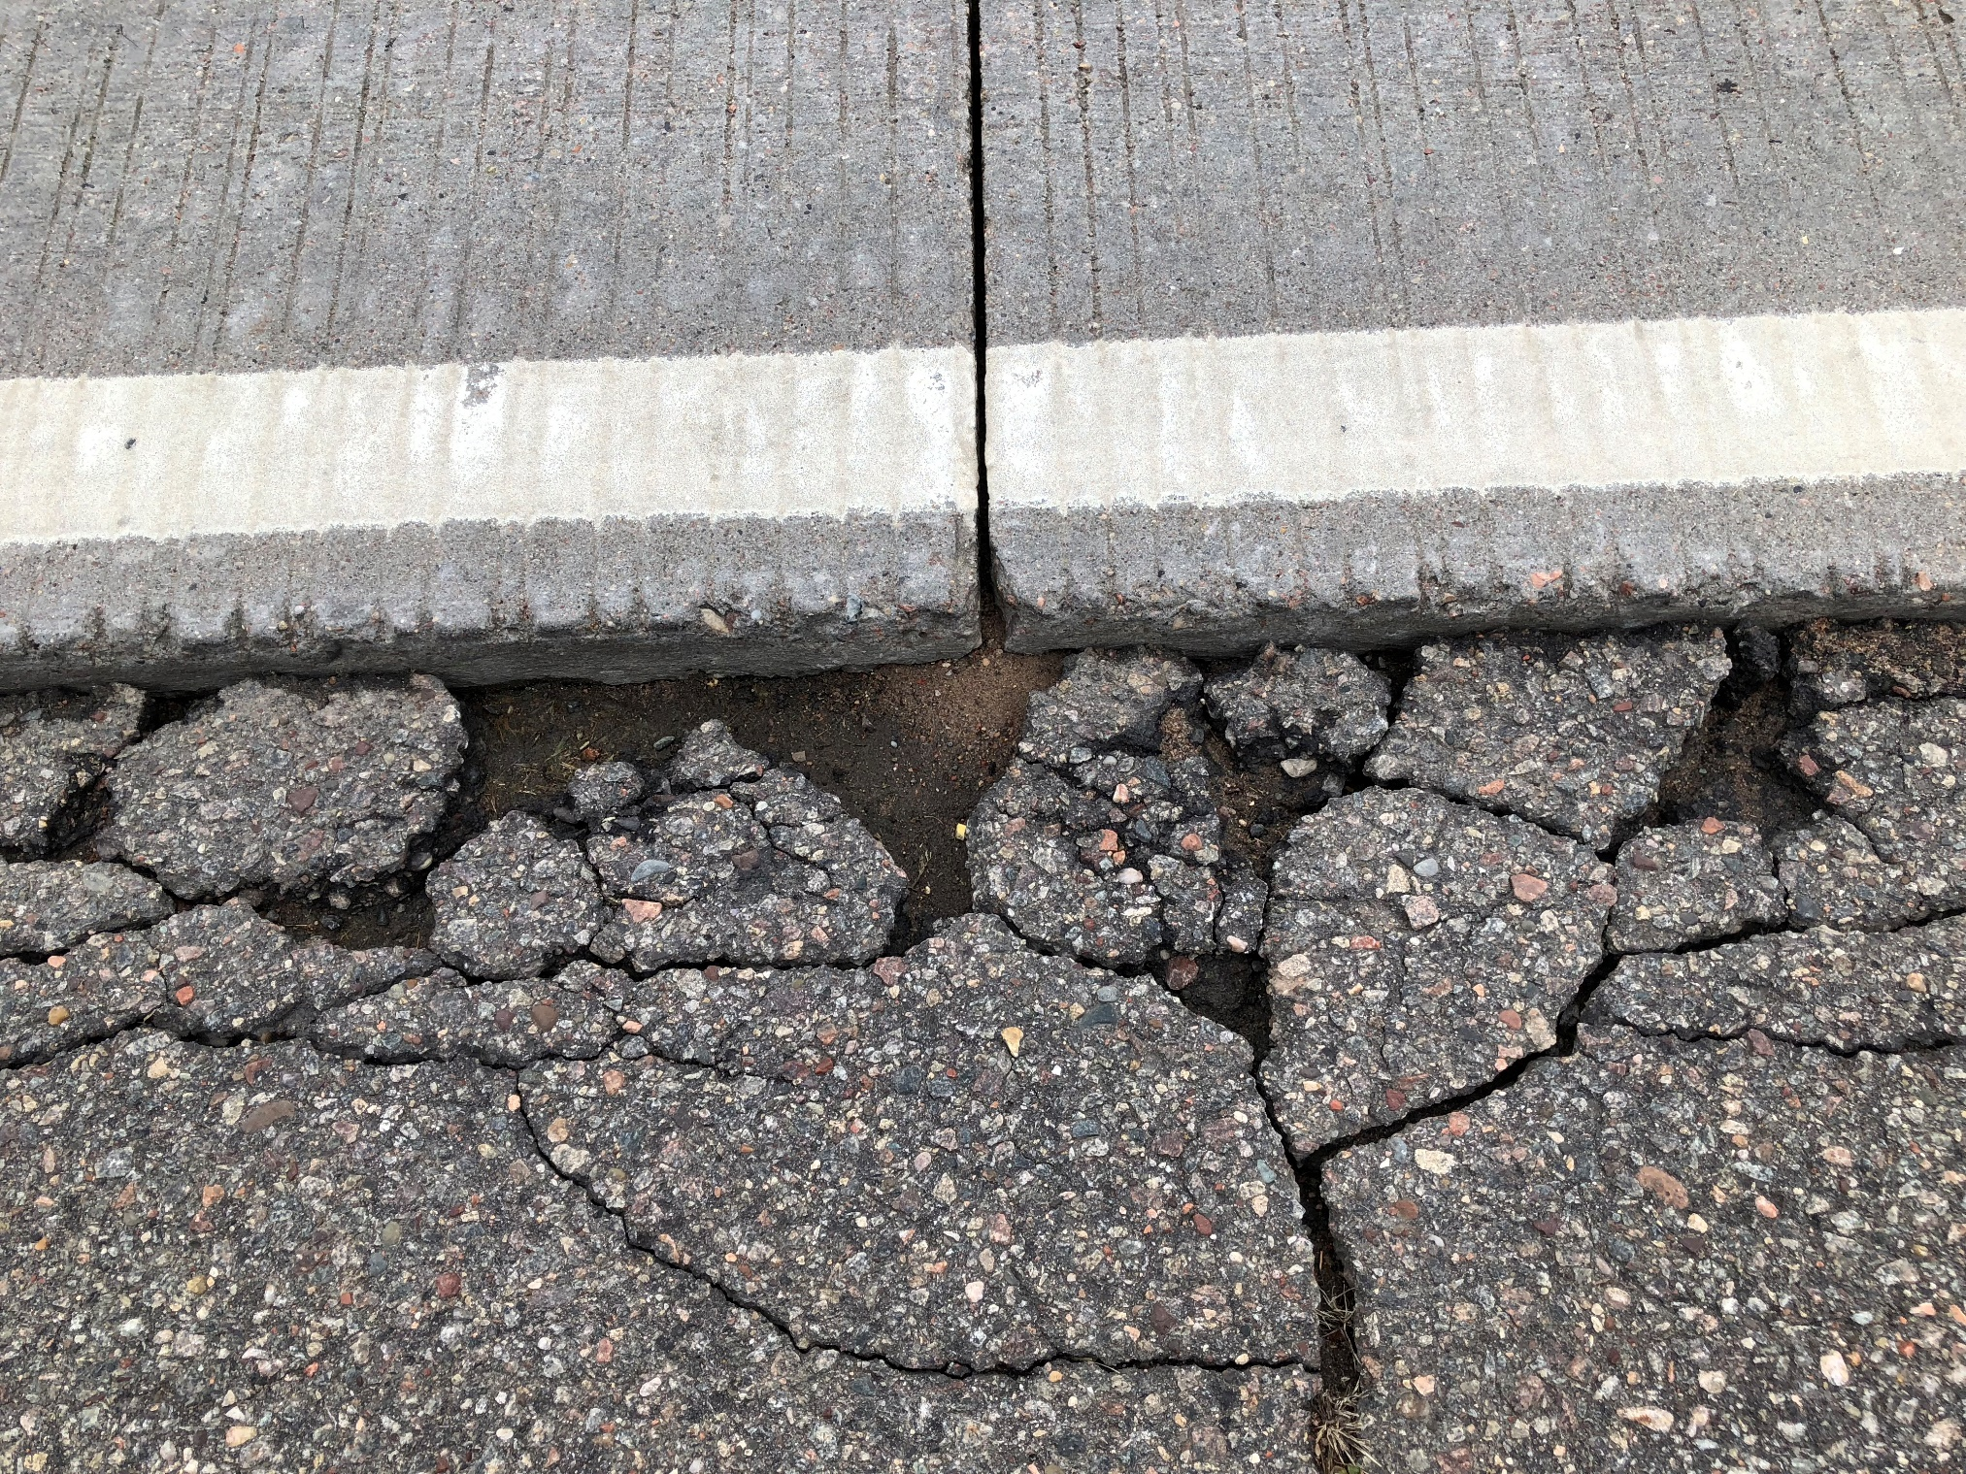
Shoulder Type
North Dakota
Wisconsin

Slide 32
Issues with LTE as Performance Measure

Slide 33
Transverse Crack Count as Performance Measure

Slide 34
Conclusions (My Opinions)
PATB Performed Best for Initial Smoothness and Rate of Progression of Roughness
LCB performed worst with transverse cracking and most influence of Widened Shoulder
550 psi Mix Out Performed 900 psi
Widened Traffic Lanes Create a Higher Potential for Longitudinal Cracking

Slide 35

SPS-2 Pooled Fund Reports
NCE Report:
  SPS-2 PAVEMENT PRESERVATION EXPERIMENT COMPARISON OF PAVEMENTME AND ACTUAL PERFORMANCE

Slide 36
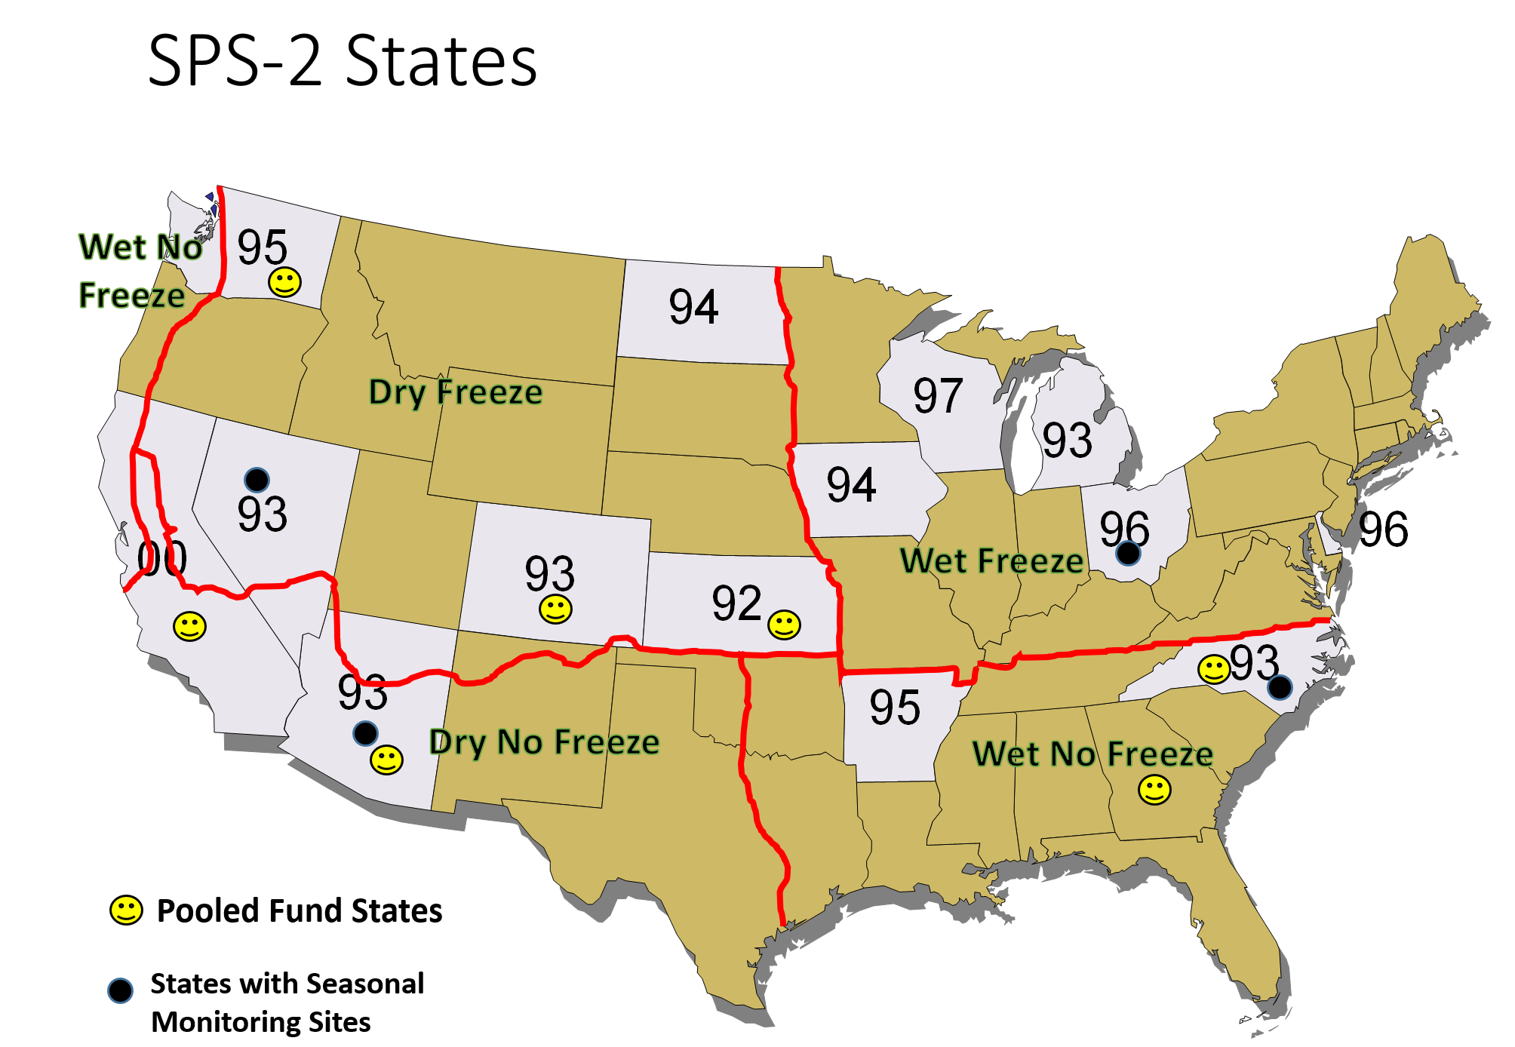
SPS-2 Pooled Fund Reports

Slide 37
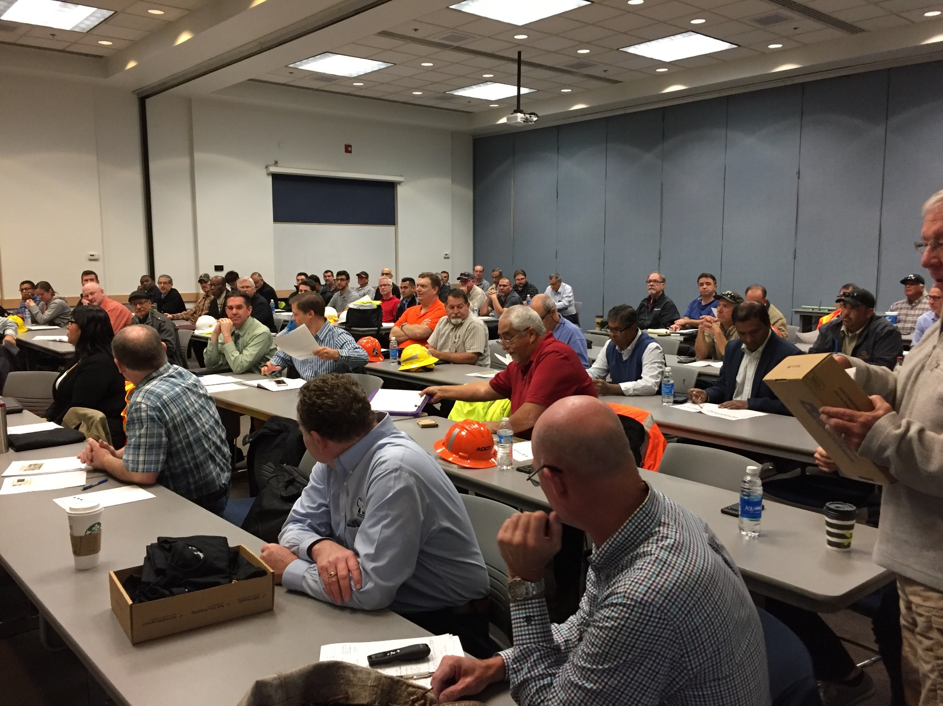
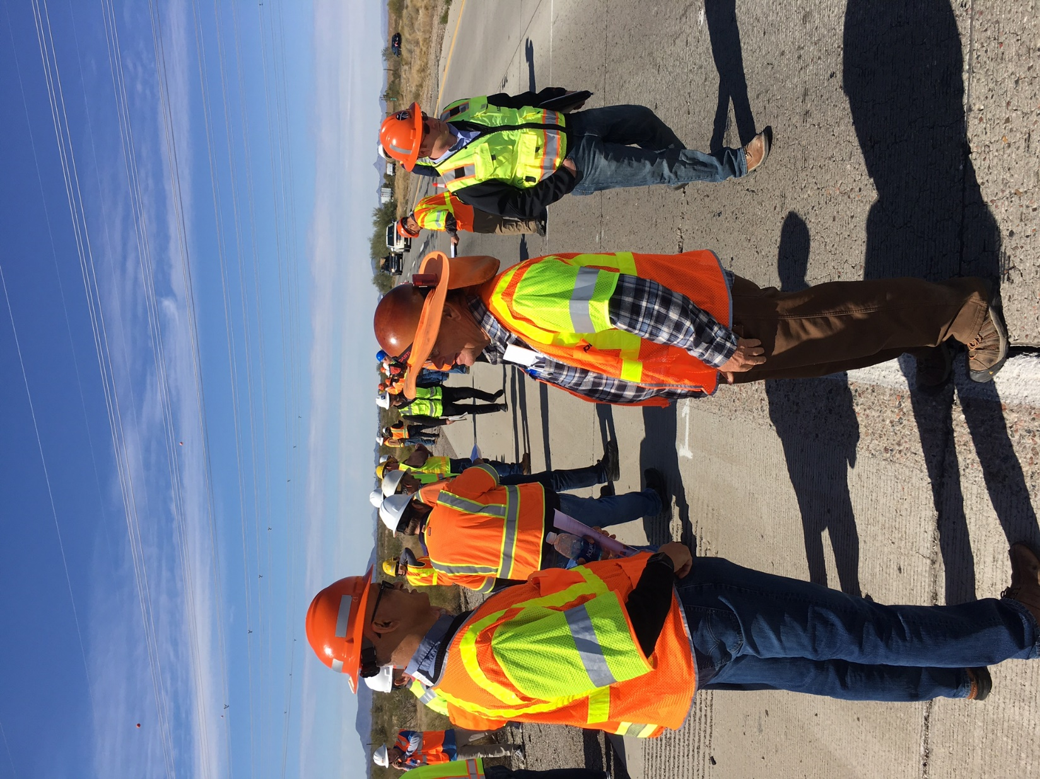
Arizona SPS-2 Tech Day

Slide 38

Questions?
Thank You!

Slide 39
The End!

