Slide 1
PAVEMENT RECONSTRUCTION CHALLENGES AND INNOVATIONS ON I-40 WEST OF FLAGSTAFF
ADOT Geotechnical Services Section
Brent Conner, P.E. and Tad Niemyjski, P.E.
November 15, 2018

Slide 2
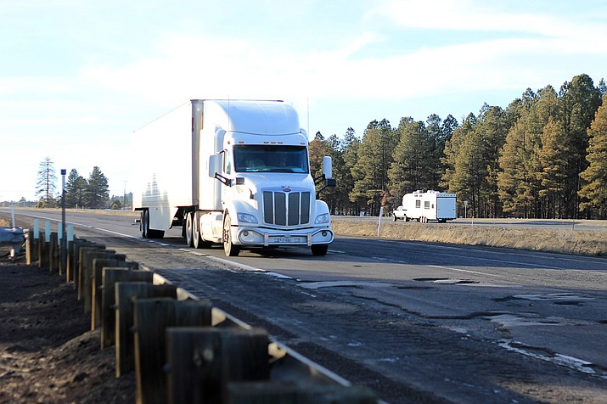
WINTER OF 2016/2017

Slide 4
Asphaltic Concrete Overlay on 8 to 9 inch PCCP

Slide 5
Spalling PCCP beneath AC Overlay
Maintenance worked diligently to attempt to keep road operational.
$$$ High Maintenance Expense

Slide 6
Media outlets in Williams and Flagstaff reported more than 150 blown tires in 60 day span. Many vehicles bent rims and damaged suspension and undercarriages.

Slide 7
ADOT’s Response
Devil Dog project was initiated in April 2017
Cataract Lake project, previously scheduled for December 2017 bid advertisement, increased scope to include 6 miles of complete reconstruction

Slide 8
Devil Dog to Williams I-40 MP 156.5 to MP 161
Cataract Lake Road to Parks TI I-40 MP 162 to MP 179 (Presentation by Tad Niemyjski)

Slide 9
Devil Dog Project
Initiated in Late March 2017
Design Complete by June 2017
Design Team – Gannett Fleming (Roadway), EcoPlan (Environmental), ADOT Pavement Design Section, ADOT Geotechnical Services, ADOT Contracts and Specs
Project Manager – Suzanne Deitering
Project Sponsors – SEO (Todd Emery and Barry Crockett)

Slide 10
Why Reconstruct Devil Dog?
Cost to maintain existing roadway prohibitive
2014 project from MP 152 to MP 161 cost $16 million
Yearly maintenance cost rising rapidly
PCCP section spalling due to thin section (8 to 9 inches)
Subgrade drainage ineffective
Future truck traffic

Slide 11
Devil Dog Project
Geotechnical investigation and recommendations completed April 20, 2017
Large sections of subgrade were deeply saturated
Some moisture contents near 30%

Slide 12
Devil Dog Pavement Design
14 inch doweled PCCP
EB lanes – New construction from subgrade up (long season summer 2018)
WB lanes – Place new PCCP on top of existing roadway. Adjust existing grade with AC to correct super-elevation. (short season July 15, 2017 to November 1, 2017)

Slide 13
Sustainability Design
Specification for Class 6 aggregate layer written to encourage recycling of existing PCCP
Specification for paving products allows Recycling of Asphaltic Concrete (RAP)

Slide 14
Devil Dog Construction
Prime Contractor – Fann Contracting
Contractor requested to change sequencing to perform complete reconstruction of EB lanes in short season
Extensive recycling program developed by contractor

Slide 27
PCCP Dowel Placement

Slide 28
Devil Dog Material Haul
Cement – Drake Plant 35 miles
Fly Ash – Cholla Power Plant Joseph City 115 miles
PCCP Fine Agg – Hanson in Prescott 60 miles
PCCP Coarse Agg – Fann’s Red Lake Source 17 miles
AC Paving – Produced at Fann’s Red Lake Source 17 miles
Recycling PCCP reduced approximately 3,000 aggregate truckload hauls to project

Slide 29
Project Costs
Bid Award - $33,980,986
Design - $641k or 1.8% of construction
Closeout - $36,591,790
7.7% overrun - $2.6 million
Pumping subgrade $520k
Bid item overruns $2.1 million

Slide 30
How to Improve?
Adjusting super-elevation grades on WB over-topping design with AC proved difficult. Up to 30 inch wedge in some places. Major source of cost over run.
Pumping subgrade. Focus on mainline PCCP. What about shoulders?
Gradation for PCCP recycling produced waste product from bottom end. Could have designed to utilize this product.

Slide 31
Project Successes
Completed EB reconstruction in short season before winter – 105 days
On-site concrete batch plant
On-site crusher
Partnering – Listened to contractor to allow EB full reconstruction vs WB over-topping in short season
Traffic crossovers to keep work separated from traffic

Slide 32
I-40 Pavement Reconstruction Cataract Lake to Parks TI Cement Treated Cinder Base

Slide 33
Cataract Lake to Parks Traffic Interchange
Section of I-40 was constructed in about 1967
Scoped as a pavement rehabilitation project
17 miles of milling and replacing surface asphalt
East of Williams and extended to Parks, Arizona
Several areas of pavement showed signs of full depth failure during the winter of 2016/2017

Slide 34
Pavement Failures

Slide 35
Pavement Failures

Slide 36
Reconstruction Areas
Scope increased to include investigating failing pavement late in the design process
Several areas of repeated patching of pavement
Five mile section and a one mile section
Both lanes in each direction

Slide 37
Subsurface Investigation
Subsurface Investigation began with 21 borings in April of 2017
Supplemental Investigation included 37 additional borings in August of 2017

Slide 38
Subsurface Investigation

Slide 39
Subsurface Investigation

Slide 40
Subsurface Investigation

Slide 41
Subsurface Investigation
Processed cinder pavement foundation material
Primarily silty to clayey sands
Averaged:
98% passing the 3/4” sieve
71% passing the #4 sieve
15% passing the #200 sieve

Slide 42
Subsurface Investigation

Slide 43
Subsurface Investigation
Encountered wet cinder conditions
Particularly in early part of the construction season
Moisture contents ranged from 8 to 27% moisture
Averaged 17% moisture by weight

Slide 44
Subsurface Investigation

Slide 45
Evaluation of Reconstruction Options
Mill and overlay as planned
Full depth reconstruction
Use of geogrid and geotextile below the pavement
Overexcavation of cinders and replace with aggregate base
Choice based on construction cost and schedule:
Treatment of existing cinder foundation materials

Slide 46
Cement Treatment of Cinders
Required no overexcavation and replacement
which reduced haul costs and construction time
No costly aggregate base required
Minimal waste material generated
In place mixing and curing

Slide 47
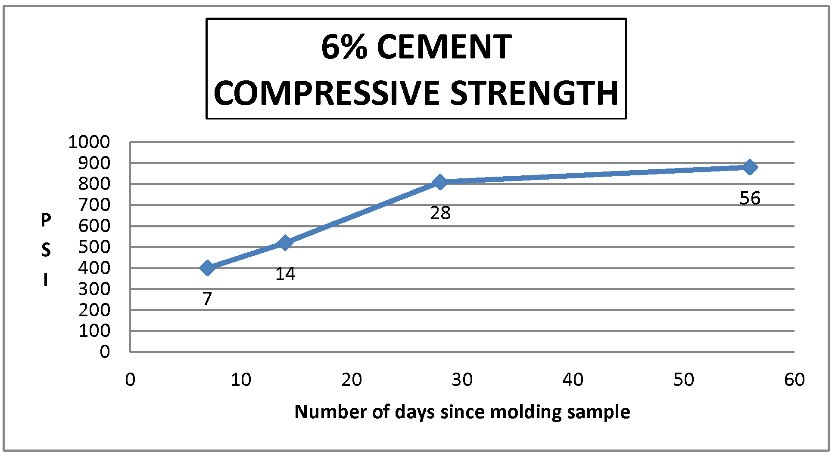
Cement Treated Cinder Mix Design
Varied cement content
28 day strength design
6% portland cement by weight

Slide 48
Base Shrinkage Cracking Concern
Pavement base stiffer than AC pavement section
Concerns of shrinkage cracks reflecting to the surface
Pavement cracks introduce water into the subgrade
Texas Transportation Institute study on the use of microcracking of cement treated bases

Slide 49
Microcracking
“Effectiveness of Minimizing Reflective Cracking in Cement-treated Bases by Microcracking” (FHWA Report No. FHWA/TX-05/0-4502-1, Oct. 2004)
Frequent cracking mitigates large shrinkage crack widths
Reduction of risk for surficial reflective cracking
Stiffness reduction

Slide 50
Construction
In-situ mixing and curing bid price was $7 per sq. yd.
Intelligent compaction used to monitor microcracking strength reduction
Microcracking was performed about 3 days after mixing and compaction

Slide 51
Construction

Slide 52
Construction

Slide 53
Construction
Notice rutting of untreated cinders on right side

Slide 54
Construction
Finished cement treated cinders in the middle of image

Slide 55
Construction

Slide 56
Lessons Learned and Project Successes
Cement stabilized cinders was effective
Microcracking was important
Intelligent compaction was effective for monitoring strength reduction
Accelerated reconstruction efforts
Saved between 8,000 and 9,000 haul truck trips
No construction change orders
About $5 million saved

Slide 57
Questions

