Slide 1
Prime Factors for Successful
Preservation Treatments
Arizona Pavements / Materials Conference
Larry Galehouse, P.E., P.S.
National Center for Pavement Preservation

Slide 2
Preservation Treatments
Asphalt Treatments |  | Concrete Treatments
Fog Seal | Crack Treatment | Joint & Crack Sealing
Chip Seal | Scrub Seal | Diamond Grinding
Slurry Seal | Micro Surfacing | Diamond Grooving
Cape Seal | Patching | Dowel-Bar Retrofit
Ultrathin HMA Overlay | Hot In-place Recycling | Partial Depth Repair
Thin HMA Overlay (1½”) | Cold In-place Recycling | Full Depth Repair
Ultrathin Bonded Wearing Course | High Friction Surface Treatments | Cross-Stitching Slab Stabilization

Slide 3
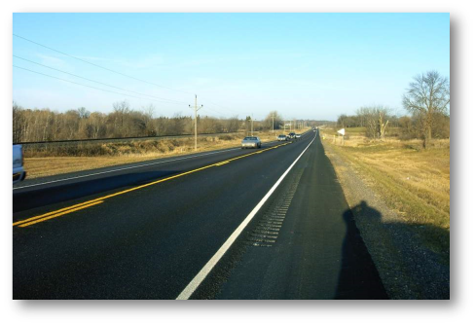
Successful Preservation
Treatment Examples
Chip Seal
Dowel Bar
Retrofit
Micro Surfacing

Slide 4
So what are the prime factors for
successful preservation
treatments?

Slide 5
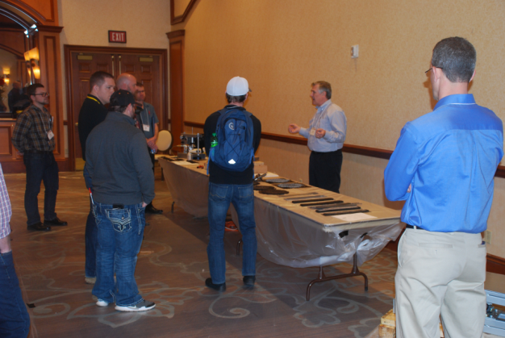
Factor 1 – Qualified Personnel
Training is essential for successful pavement preservation projects.

Slide 6
Qualified Personnel
Contractor and agency employees need to acquire knowledge about how to build a pavement preservation treatment.

Slide 7
Qualified Personnel
Technicians conducting material sampling and testing for quality acceptance or quality control activities need to be certified by a nationally recognized organization.

Slide 8
Qualified Personnel
Certain contractor employees need to be certified for the treatment(s) they construct.
These employees should include:
Superintendents
Foreman
Operators of major equipment

Slide 9
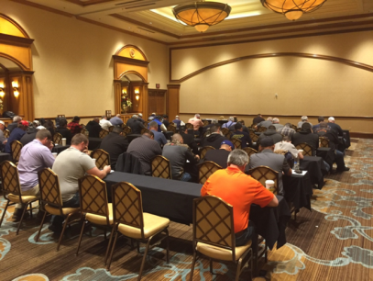
Qualified Personnel
Certification is confirmation that a person has the necessary knowledge of a specific pavement preservation treatment by examination from a recognized independent third party specializing in the field.

Slide 10
Factor 2 – Laboratory Accreditation
Accredited laboratories conducting tests used in mix design or acceptance have trained personnel knowledgeable on specific test methods.

Slide 11
Laboratory Accreditation
Accredited laboratories must undergo an on-site third party assessment.
This includes a scheduled review of:
Technician training and competency records
Equipment calibration and check records
Each test method demonstrated by lab staff
The proficiency sample program

Slide 12
Laboratory Accreditation
Many laboratory accreditation programs are available:

Slide 13
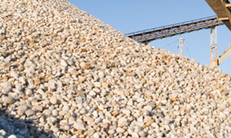
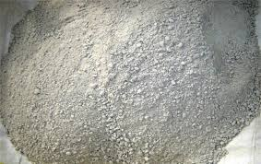
Factor 3 – Quality Materials
Quality materials are essential for quality results.

Slide 14
Quality Materials
Specifications address quality materials through:
Certificate of Compliance or Certificate of Analysis
Prequalified Aggregate Suppliers
Qualified Products List (QPL)
Approved Products List (APL)
Tested Stock Suppliers

Slide 15
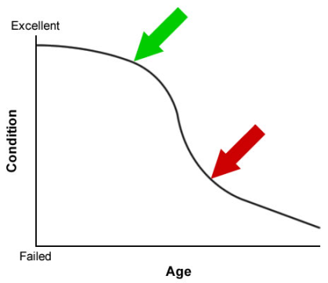
Factor 4 – Project Selection
Fiscal constraints and pressure from legislators and administrators force agencies to work on pavements too far down the deterioration curve.

Slide 16
Project Selection
Pavement Management Systems
Pavement Inventories
Type, Age, Location, etc.
Ride Quality Measurements
Distress
Functional and Structural
Rutting
Faulting

Slide 17
Project Selection
Field Review (Windshield Survey)
Asphalt Pavements
Oxidation
Early Raveling
Bleeding
Drainage Issues
Concrete Pavements
Joint Seals
Pop-outs

Slide 18
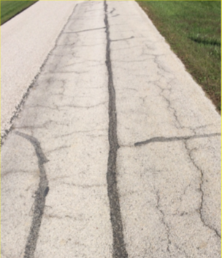
Project Selection
Poor choices for pavement preservation.

Slide 19
Causes of Poor Pavement Performance
in USA

Slide 20
Factor 5 - Quality Control
The system used by a Contractor party to monitor, assess and adjust their production or placement processes to ensure that the final product will meet the specified level of quality.

Slide 21
Acceptable Quality Control Plan
Scope and Reference Documents
Definitions
Quality Control Personnel
Quality Control Testing Facilities and Equipment
Materials Control
Quality Control Sampling and Testing
Production Equipment
Treatment Placement and Workmanship
Documentation
Non-Conformance and Corrective Action

Slide 22
Quality Control Plan Parts
SCOPE and REFERENCE DOCUMENTS
ASTM Standards
AASHTO Standards
Guidelines and Technical Bulletins
Standard Specifications and Project Special Provisions

Slide 23
Quality Control Plan Parts
DEFINITIONS
Making Terms Used in QC Plan Clear and Distinct

Slide 24
Quality Control Plan Parts
QUALITY CONTROL PERSONNEL
Company Personnel Responsible for QC
Subcontractors Responsible for QC
Material Suppliers Meeting Testing Requirements

Slide 25
Quality Control Plan Parts
4. QUALITY CONTROL TESTING FACILITIES and EQUIPMENT
Laboratory Used for Material Sampling and Testing
Laboratory Used for Mix Designs
Must be Accredited Laboratories

Slide 26
Quality Control Plan Parts
5. MATERIALS CONTROL
All Materials Used in Treatment are Identified
List of Approved Material Sources
Storage Requirements and Stockpiling Provisions

Slide 27
Quality Control Plan Parts
6. QUALITY CONTROL SAMPLING and TESTING
Lot Size Defined for Sampling
Sampling Identification System
Storage and Retention Procedures for Samples
Sampling Methods, Test Procedures and Frequency

Slide 28
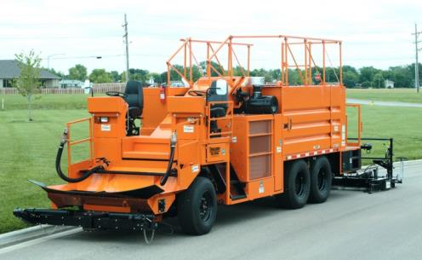
Quality Control Plan Parts
7. PRODUCTION EQUIPMENT
Identify All Equipment Used During Construction
Provide Spec Sheets for Major Equipment

Slide 29
Quality Control Plan Parts
8. PLACEMENT and WORKMANSHIP
Calibration Procedure for Equipment
Equipment Checks, Inspection Methods and Frequency
Pavement Surface Preparation Procedures
Pre-Production Quality Control Checks
Related Production Activities
Traffic Control
Tack Coat, etc.

Slide 30
Quality Control Plan Parts
8. PLACEMENT and WORKMANSHIP - continued
Critical Factors That Can Affect Production Results
Identify Protocols for Proper Workmanship
Production QC Activities, Test Frequencies, and Inspection Methods
Cleanup
Daily
End of Project

Slide 31
Quality Control Plan Parts
9. DOCUMENTATION
Examples of Reporting Forms
Production Quality Control Reporting
Sampling and Testing Results
Daily Production Records
Non-Conformance Report
Document Retention Details

Slide 32
Quality Control Plan Parts
10. NON-CONFORMANCE and CORRECTIVE ACTION
Corrective Actions Described for:
Materials Not Meeting Specifications
All Potential Defects in Workmanship

Slide 33
Quality Control Plan Parts
APPENDICES – Supporting Documents
Company Organization Chart
Resumes of QC Personnel
Employee Certifications
Equipment Specifications
Examples of Report Forms

Slide 34
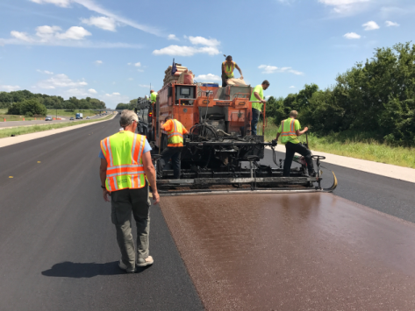
Factor 6 - Agency / Owner - Acceptance
Acceptance is the process which the Agency, Owner, or Designated Agent determines whether the quality of the product meets the contract requirements.

Slide 35
Agency / Owner - Acceptance
The Agency, Owner, or Designated Agent will verify the degree of compliance by independently performing:
Random Material Sampling and Testing
Inspection of Workmanship

Slide 36
Agency / Owner - Acceptance
The objectives of acceptance are to:
Perform sampling and testing for key quality characteristics.
Inspect to identify visually deficient work.
Measure the quality of all materials produced and placed by the contractor.
Determine the corresponding payment the contractor should receive.

Slide 37
Quality Assurance
Quality is critical for the contractor to achieve customer satisfaction and retain future pavement preservation work.

Slide 38
Quality Assurance
Quality pavement preservation treatments make an important contribution to long-term revenue and profitability.

Slide 39
Questions

